Slide 1
HOW TO PUBLISH CMC TO JOIN UTC(k)
Liz Catherine Hernández Forero
2022-05-24

Slide 2
INTRODUCTION

Slide 3
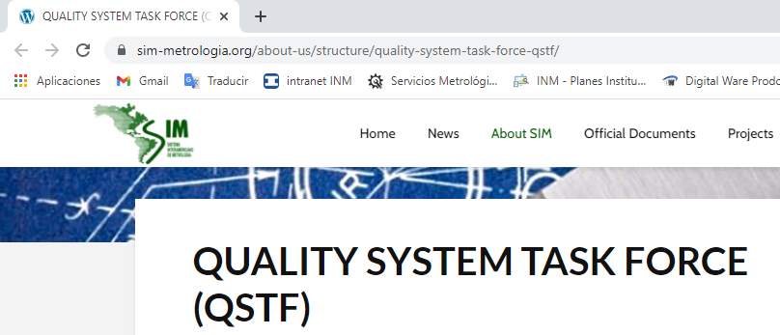
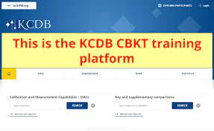
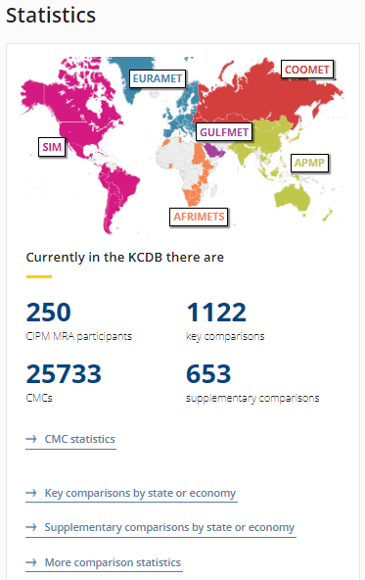
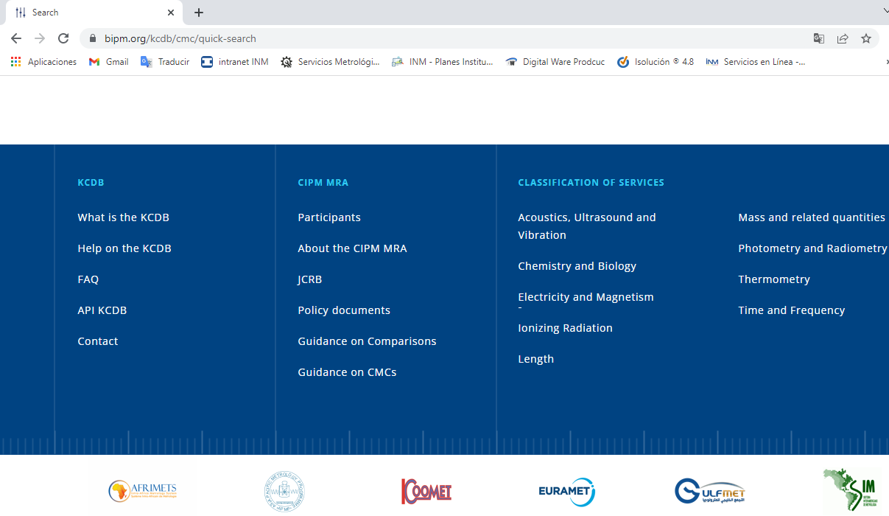
Key Elements
Classification of services in Time and Frequency
version 1.1
(September 2013)
QSTF
Quality System
Task Force
Key Comparison DataBase
Dream?
Assessments
(Peer Reviews).
Guidance documents.
https://www.bipm.org/documents/20126/2071143/TF_services.pdf/a2ce53fc-80f0-b8fe-0271-3385c1be121b
https://sim-metrologia.org/about-us/structure/quality-system-task-force-qstf/
https://www.bipm.org/kcdb/
Fuente: https://whytheldschurchistrue.com/tag/brett-mcdonald/
https://www.nist.gov/pml/sim-quality-system-documentation

Slide 4
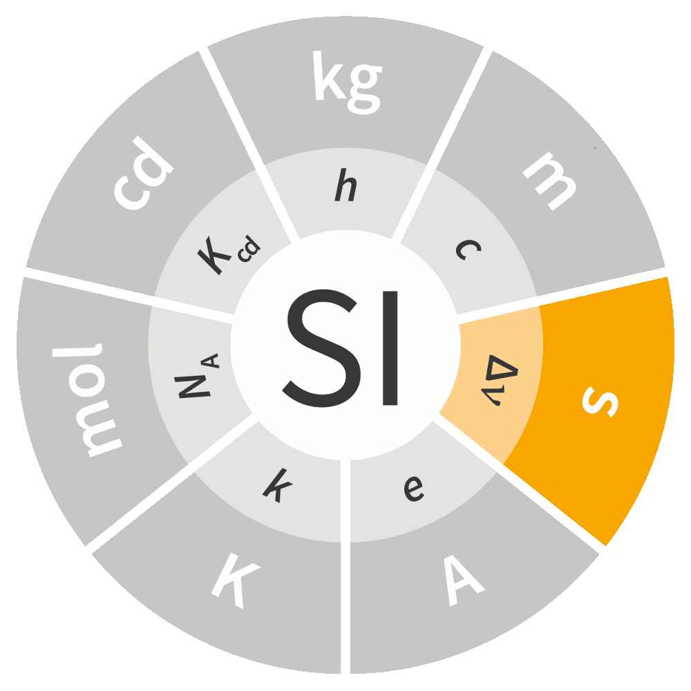
Key Elements
- Technical
Metrologists
- Technical
Metrologists
- Administrative
Quality manager
Support professionals for quality system

Slide 5
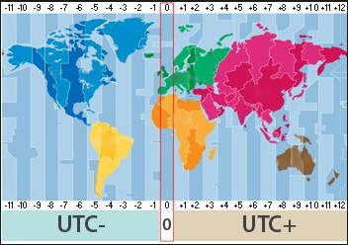
Key Elements
IoT
2017

Slide 6
GENERAL SEQUENCE
INM Colombia
Administrative
Technical
issues

Slide 7
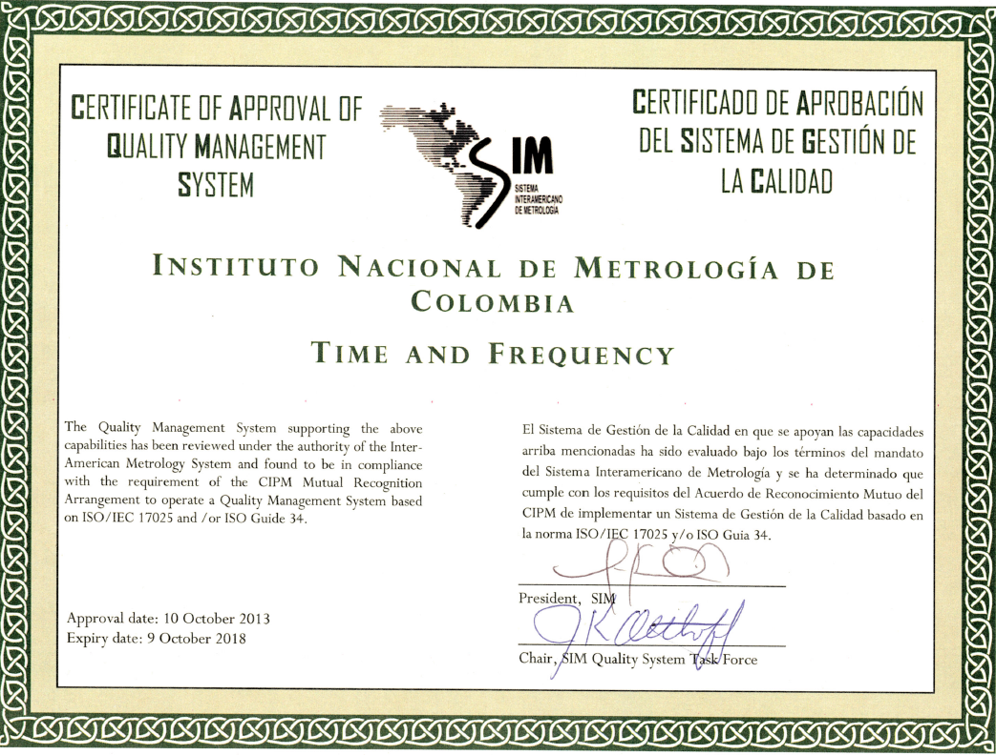
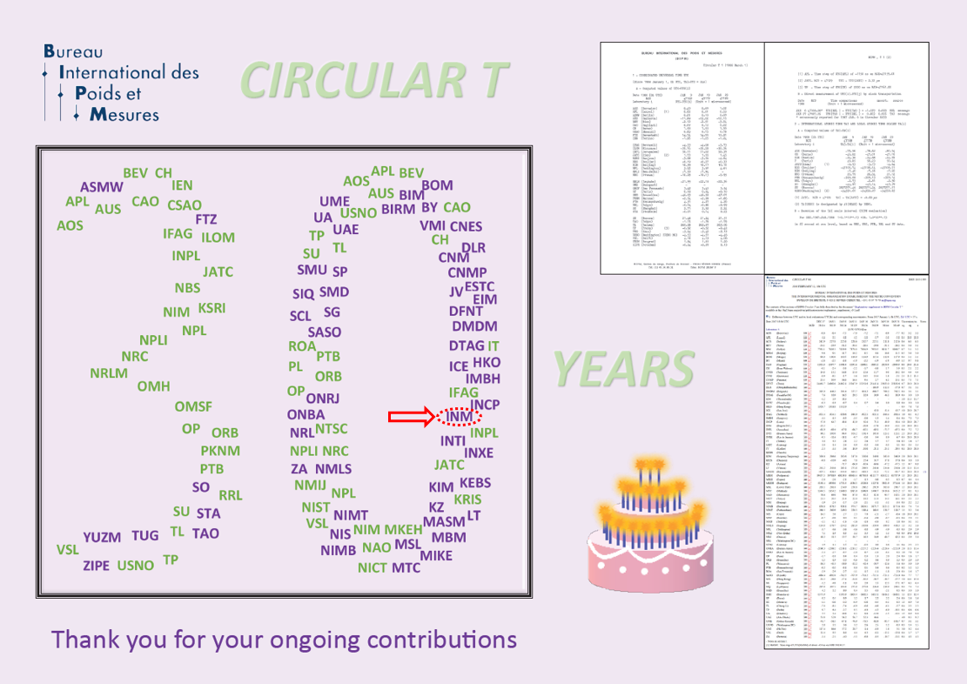
1. Quality Topics
2015-02-10
SIM.TF.10.2014
Colombia
signed the
arrangement
Peer Review
CCTF-K001.UTC
➔ UTC(k), k=NIST
SIMTN ➔ SIMT(INM)
UTC(INM)
2012
List of comparions
supporting
SIM QSTF
approval
TF - QMS
2013
2015
2017
2018
2023
2011
2014
Accreditation monitoring audits
NVLAP LAB CODE 200947 -0

Slide 8
1. Quality Topics
2015-02-10
SIM.TF.10.2014
Colombia
signed the
arrangement
Peer Review
CCTF-K001.UTC
➔ UTC(k), k=NIST
SIMTN ➔ SIMT(INM)
UTC(INM)
2012
List of comparions
supporting
SIM QSTF
approval
TF - QMS
2013
2015
2017
2018
2023
2011
2014
¿2016?
Accreditation monitoring audits
NVLAP LAB CODE 200947 -0

Slide 9
Traceability Scheme
Modular Example

Slide 10
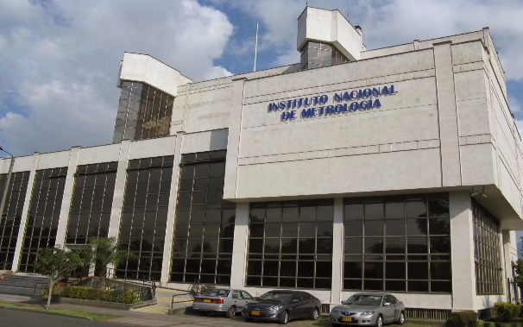
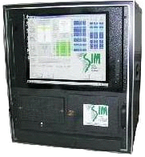
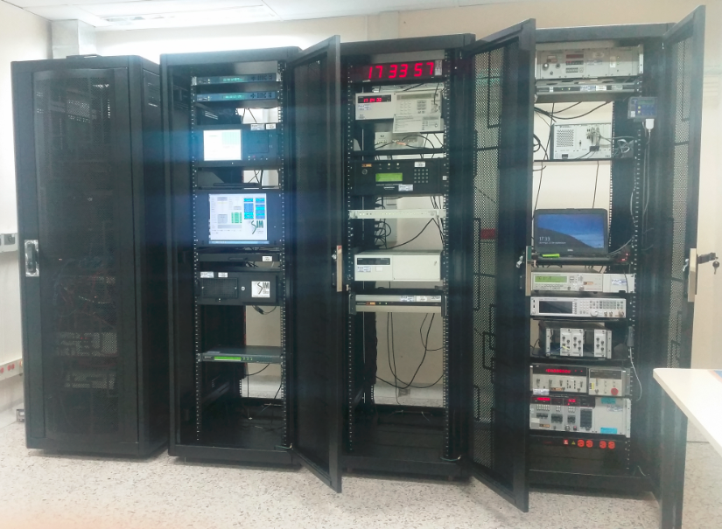
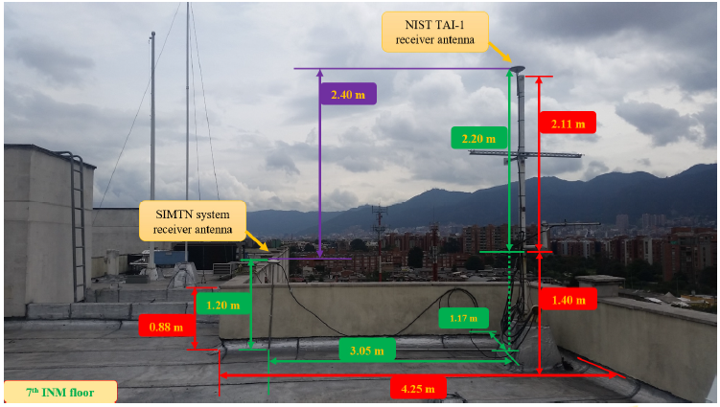
2. Update System
SIM
Common View
2007
May
SIMT Common View
Improvement
opportunities
Last Reading
Infrastructure
- New Racks
- Auxiliary devices
(better distribution and storage of devices)
2015
April-July
NIST TAI-1
NIST TAI-1
REF - GPS
2017
September
Consistent “Time Scales”
SIMT(INM)
UTC(INM)
- Relocation of antennas
- Install new wiring
(measure distances)

Slide 11
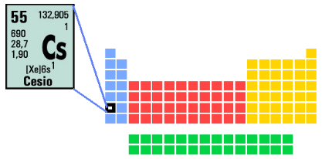
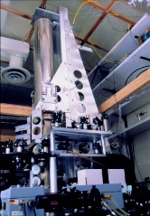
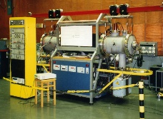
Modular example
Link uncertainty

Slide 12
2. Update System
2015-02-10
SIM.TF.10.2014
Peer Review
UTC(INM)
2012
2013
2015
2017
2018
2023
2011
2014
Admin + Tech
¿2016?
Update System: 2017-08
Metrological assurance activity
TAI-1
tai@bipm.org
CGGTTS: 2015-04-15
SIMT
2007
Internal monitoring audits

Slide 13
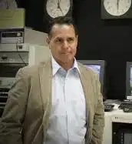
3. Cooperation
Francisco Jiménez
Oscar Fallas
Mike Lombardi
Stefania Romisch
Raúl Solis
Mauricio López
Diego Luna
Marina Gerstvolf
2009
2010
2017 SIM TFMWG
2015-02-10
SIM.TF.10.2014
Peer Review
UTC(INM)
2012
2013
2015
2017
2018
2023
2011
2014
Admin + Tech
2016
Update System: 2017-08
Metrological assurance activity
TAI-1
tai@bipm.org
CGGTTS: 2015-04-15
SIMT
2007
Internal monitoring audits

Slide 14
4. Submission of the SIM.TF.10.2014 CMC
2015-02-10
SIM.TF.10.2014
Colombia
signed the
arrangement
Peer Review
CCTF-K001.UTC
➔ UTC(k), k=NIST
SIMTN ➔ SIMT(INM)
UTC(INM)
2012
List of comparions
supporting
SIM QSTF
approval
TF - QMS
2013
2015
2017
2018
2023
2011
2014
2016
Update System: 2017-08
Metrological assurance activity
TAI-1
tai@bipm.org
CGGTTS: 2015-04-15
SIMT
Accreditation monitoring audits
Internal monitoring audits
NVLAP LAB CODE 200947 -0

Slide 15
Paperwork
Modular Example

Slide 16
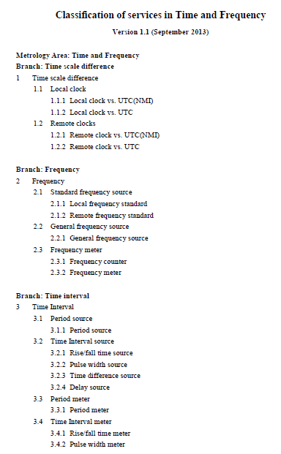
Key Elements
Classification of services in Time and Frequency
version 1.1
(September 2013)
1) preparation of the CMCs
by the NMI/DI
for submission to their RMO;
2) intra-regional review by the RMO;
3) inter-RMO review;
https://www.bipm.org/documents/20126/2071143/TF_services.pdf/a2ce53fc-80f0-b8fe-0271-3385c1be121b
Fuente: https://whytheldschurchistrue.com/tag/brett-mcdonald/

Slide 17
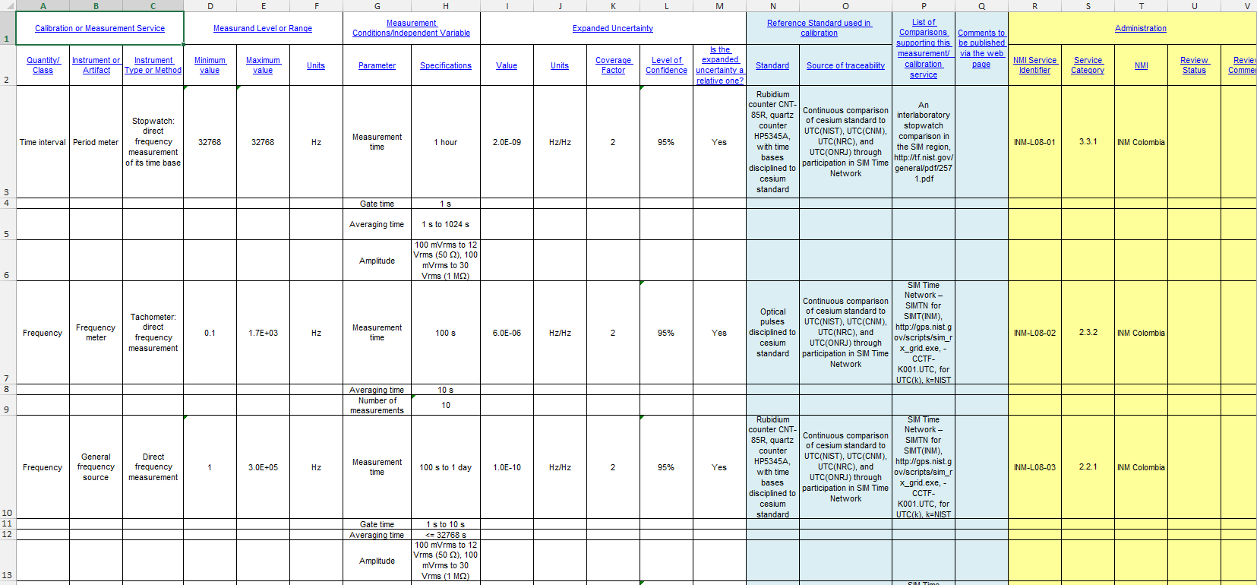
Submission of the SIM.TF.10.2014 CMC
Classification of services in Time and Frequency
Version 1.1 (September 2013)

Slide 18
Key Elements
QSTF
Quality System
Task Force
Assessments
(Peer Reviews).
Guidance documents.
1) preparation of the CMCs
by the NMI/DI
for submission to their RMO;
2) intra-regional review by the RMO;
3) inter-RMO review;
https://sim-metrologia.org/about-us/structure/quality-system-task-force-qstf/
Fuente: https://whytheldschurchistrue.com/tag/brett-mcdonald/
https://www.nist.gov/pml/sim-quality-system-documentation

Slide 19
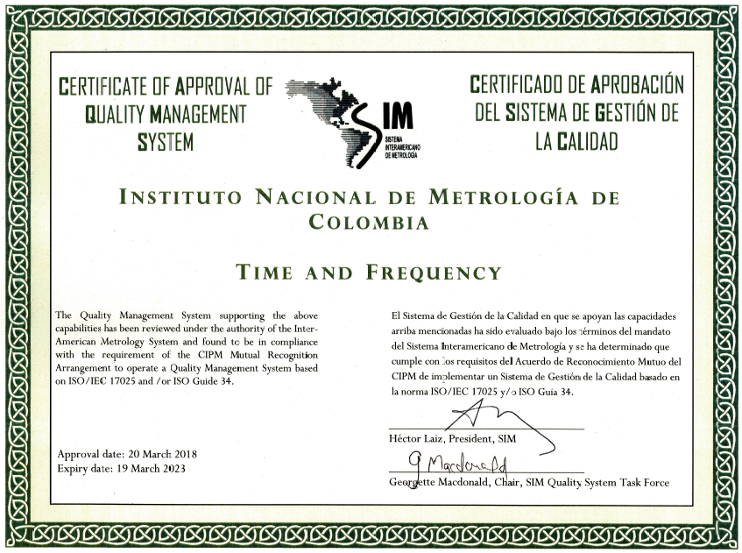
Submission of the SIM.TF.10.2014 CMC
2013
October
5
years
(expiry date)
- Local RMO reports approval of
scope and uncertainties
of NMI’s CMC.
- Declaration from an RMO
that CMC are supported
by a fully implemented Quality System.
2018
March
2023
March
References:
- CIPM MRA-G-12 version 1.0, - Quality management systems in the CIPM MRA.
- QSTF-00 (Procedure for Review and Approval Quality Management Systems); Version 1.1; Approved on 9 March 2018.
https://sim-metrologia.org/about-us/structure/quality-system-task-force-qstf/
- SIM 09 version 11, Procedure for Review of the Quality Management System of National Metrology Institutes and
Designated Institutes and SIM.
https://sim-metrologia.org/wp-content/uploads/2020/06/sim-09.pdf

Slide 20
Submission of the SIM.TF.10.2014 CMC
First
Colombian
Example
Date | RMO | Version number of the CMC file | Quantity of comments
2014-05-30 to 2014-08-08 |  | 01 and 02 | 6
2014-08-08 to 2015-01-21 |  | 03 | 24
2015-01-21 to 2015-02-12 |  | 04 | 2
Final version

Slide 21
Submission of the SIM.TF.10.2014 CMC
First
Colombian
Example
Date | RMO | Version number of the CMC file | Quantity of comments
2014-05-30 to 2014-08-08 |  | 01 and 02 | 6
2014-08-08 to 2015-01-21 |  | 03 | 24
2015-01-21 to 2015-02-12 |  | 04 | 2
2014 – 1 week
Andreas Bauch
Final version

Slide 22
Submission of the SIM.TF.10.2014 CMC
Updated mechanism
Date | RMO | Version number of the CMC file | Quantity of comments
2014-05-30 to 2014-08-08 |  | 01 and 02 | 6
2014-08-08 to 2015-01-21 |  | 03 | 24
2015-01-21 to 2015-02-12 |  | 04 | 2
old by Excel
CIPM MRA-D-04
CIPM MRA-G-03
new
by KCDB 2.0
Final version

Slide 23
Key Elements
Are you ready to submit your CMC?
CMC preparation and review
Key Comparison DataBase
1) preparation of the CMCs
by the NMI/DI
for submission to their RMO;
2) intra-regional review by the RMO;
3) inter-RMO review;
https://www.bipm.org/documents/20126/43742162/CIPM-MRA-G-13.pdf/f8b8c429-42e0-4cf1-dc6c-bc60ab7f371a
Policy documents
Guidance documents
https://www.bipm.org/kcdb/
References:
- CIPM MRA-G-13 version 1.1, Calibration and measurement capabilities in the context of the CIPM MRA, Guidelines for their review, acceptance and maintenance. Appendix B, C of the CIPM MRA.
https://www.bipm.org/documents/20126/43742162/CIPM-MRA-G-13.pdf/f8b8c429-42e0-4cf1-dc6c-bc60ab7f371a
- CIPM MRA-G-12 version 1.0, - Quality management systems in the CIPM MRA.
https://www.bipm.org/en/cipm-mra/cipm-mra-documents
Fuente: https://whytheldschurchistrue.com/tag/brett-mcdonald/

Slide 24
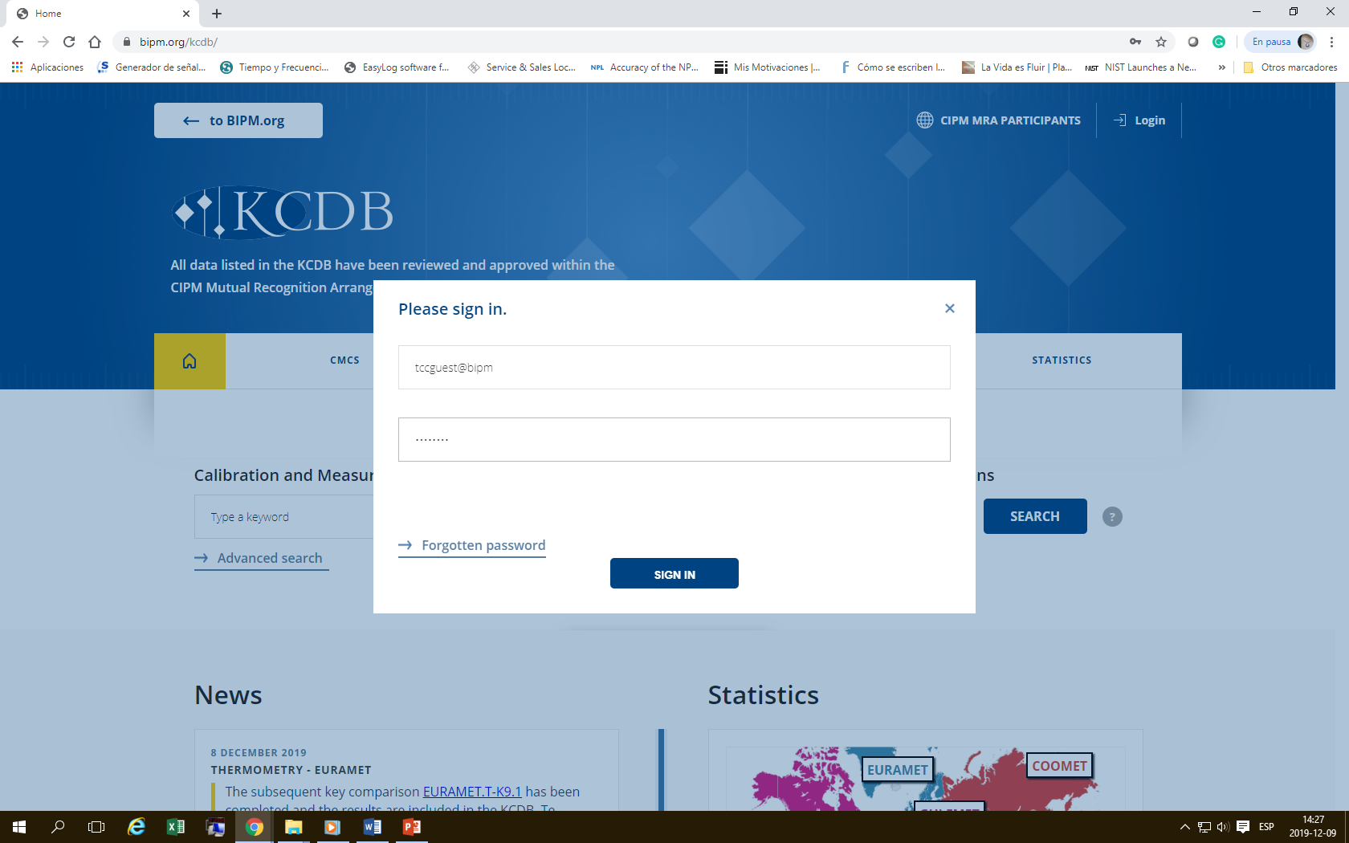
KCDB 2.0
tcguest@bipm
tcontact
* CBKT: Capacity Building and Knowledge Transfer Programme

Slide 25
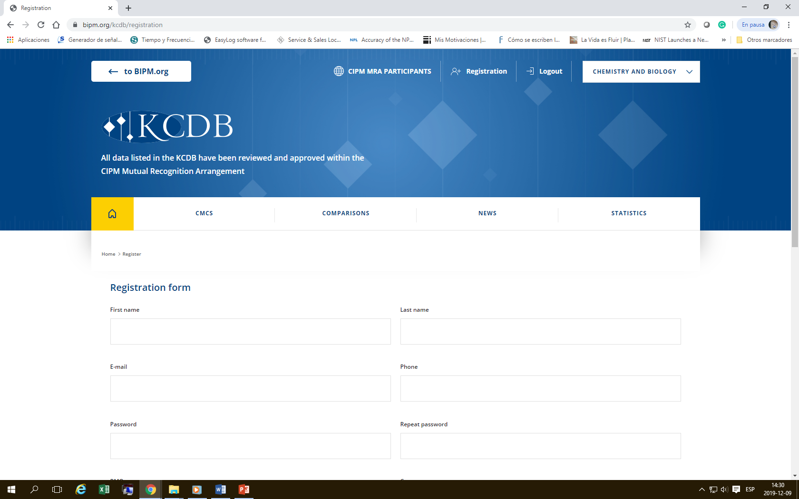
KCDB 2.0
* CBKT: Capacity Building and Knowledge Transfer Programme

Slide 26
Conclusions

Slide 27
Conclusions
Primary Standard:
- It is not necessary to wait until your
NMI/DI has built a Cesium atomic clock to contribute to UTC.
Key comparison:
- CMC can be published via SIMT or directly via UTC.
(list of comparisons supporting).
Technical competence:
- Contributing to UTC means that the NMI/DI has implemented
metrological assurance activities to analyze clock data 24/7.
CMC – Quality system:
- The scope of calibration services provide metrological traceability.
Dream?
Fuente: https://whytheldschurchistrue.com/tag/brett-mcdonald/

Slide 28
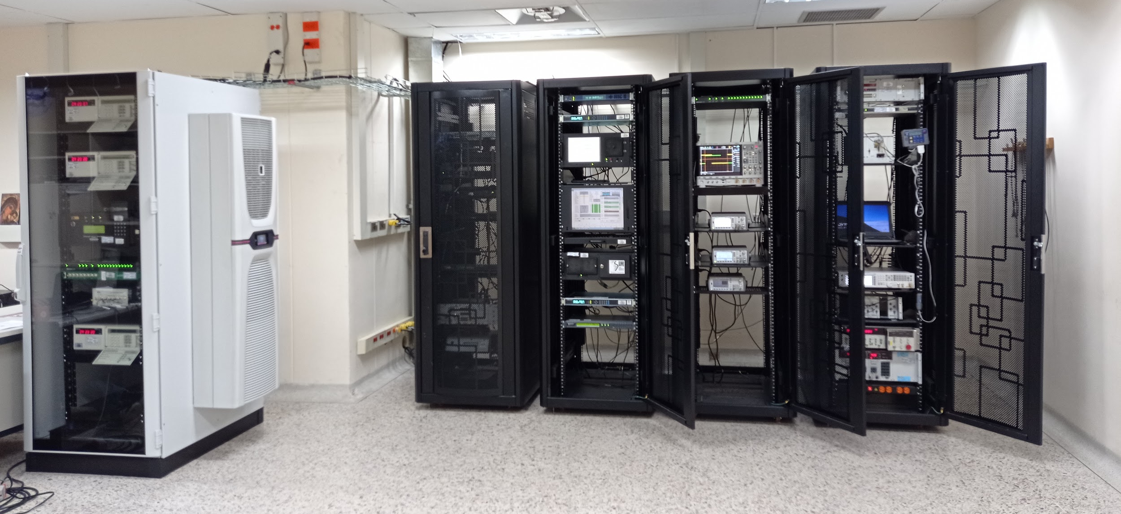
THANK YOU !
¡Gracias!

