Slide 1
Frequency and Time Group
Measurement Science and Standards
National Research Council Canada
F&T-MSS-NRC
M. Gertsvolf
SIM TFWG 2017

Slide 2
NRC – MSS
NRC
MSS
3700 employees
1B$ budget
88 research facilities
22 locations
  Transportation and Manufacturing
  Engineering
  Life Sciences
  Emerging Technologies
  Industrial Research Assistance Program
180 employees
30M$ budget
3 locations
  Black carbon
  Nanomaterials
  Photometry and spectra-photometry
  Thermometry and radiometry
  Mechanical metrology
  Electrical
  Electrical power
  Mass and related quantities
  Ionizing radiation
  Medical devices
  Biotoxins
  Organic chemistry
  Inorganic chemistry
  Frequency and Time

Slide 3
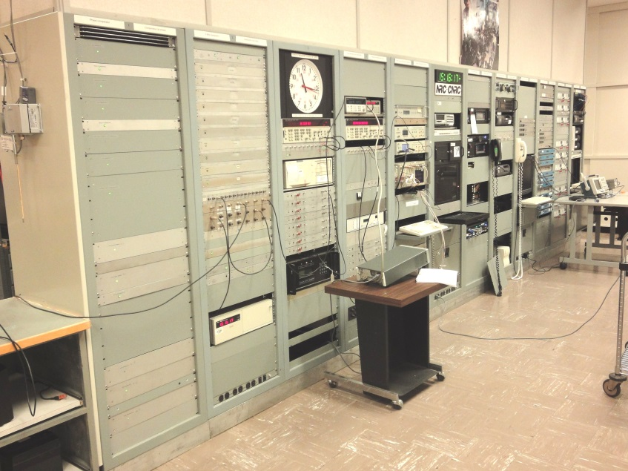
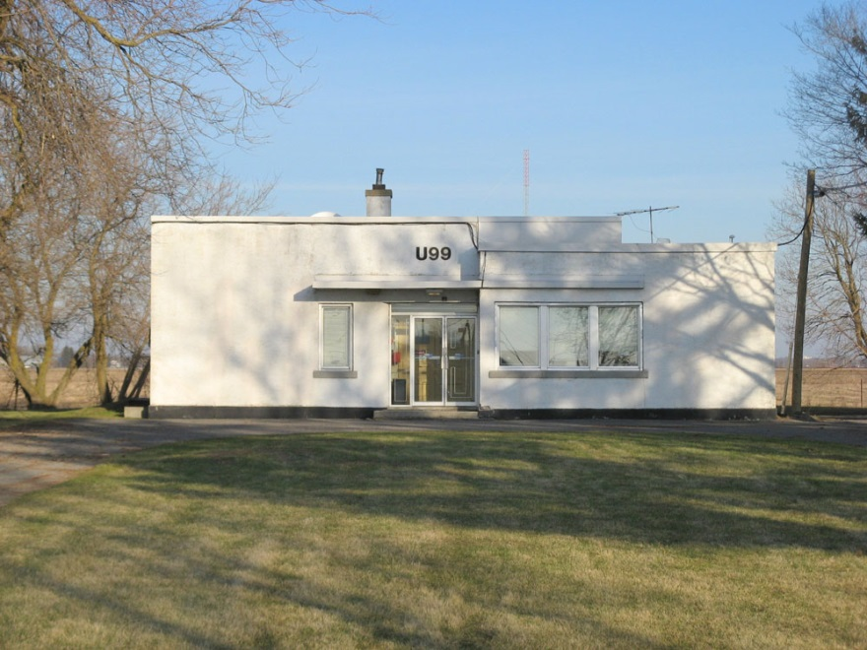
NRC F&T Facilities
M-36
CHU

Slide 4
NRC Timescale
Clocks
Systems
running
  3 Cs 5071-B High Performance
  4 Cs 5071-B Regular Performance
  2 HM (MHM 2010, VCH-1003M)
Phase comparators
  21 channel 5 MHz NRC
  8 channel 80MHz TimeTech
  6 channel 100MHz TimeTech
Auxiliary offset generators
  AOG-110 SigmaTau
  HROG-5 SDI (2)
  Amro
Time Interval Counters for CCTF-K001.UTC
  CNT-91 Pendulum (2)
GNSS
receivers
  PolaRx4TR PRO Septentrio
  Z12-T Ashtech (2)
  NET-G3A Topcon
  TRE-G3T Delta Javad (NRCan)
  OEMV Novatel (2)
  OEM4 Novatel (2)
antennas
  Ashtech 701945
  Novatel GPS-702
  AOAD/M_T AOA Dorne Margolin

Slide 5
F&T lab

Slide 6
F&T Dissemination
Services
Comparisons
Calibration Services
NTP
Talking clock
Web clock
Telephone clock
CHU broadcast
TimeLink – Monitored NTP
TimeLink – Remote Clock
UTC(NRC)
UTCr(NRC)
SIM(NRC)

Slide 7
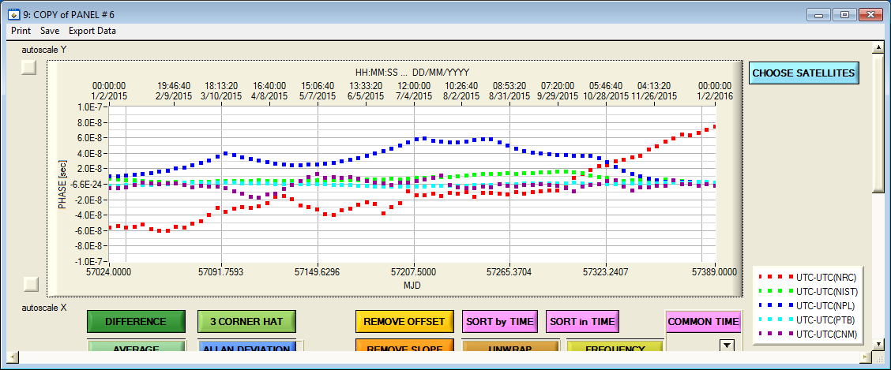
UTC(NRC)

Slide 8
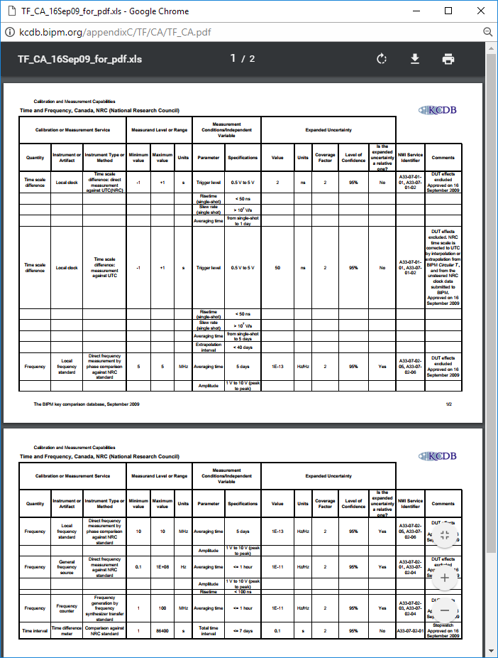
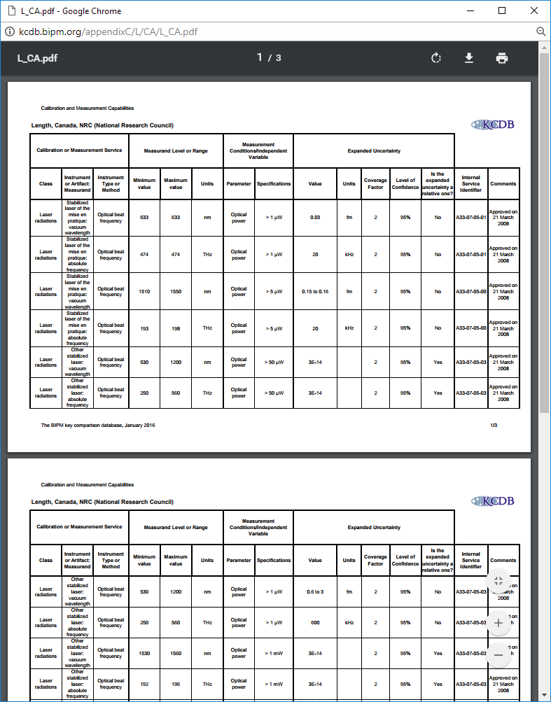
Calibration Services - CMC
TF
Length

Slide 9
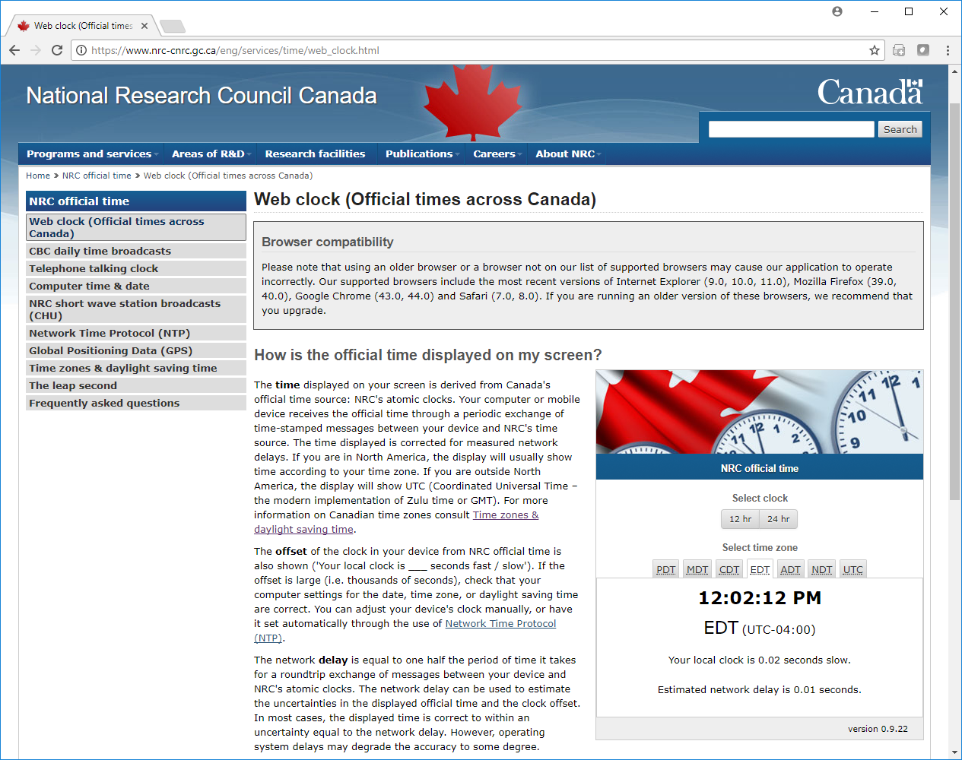
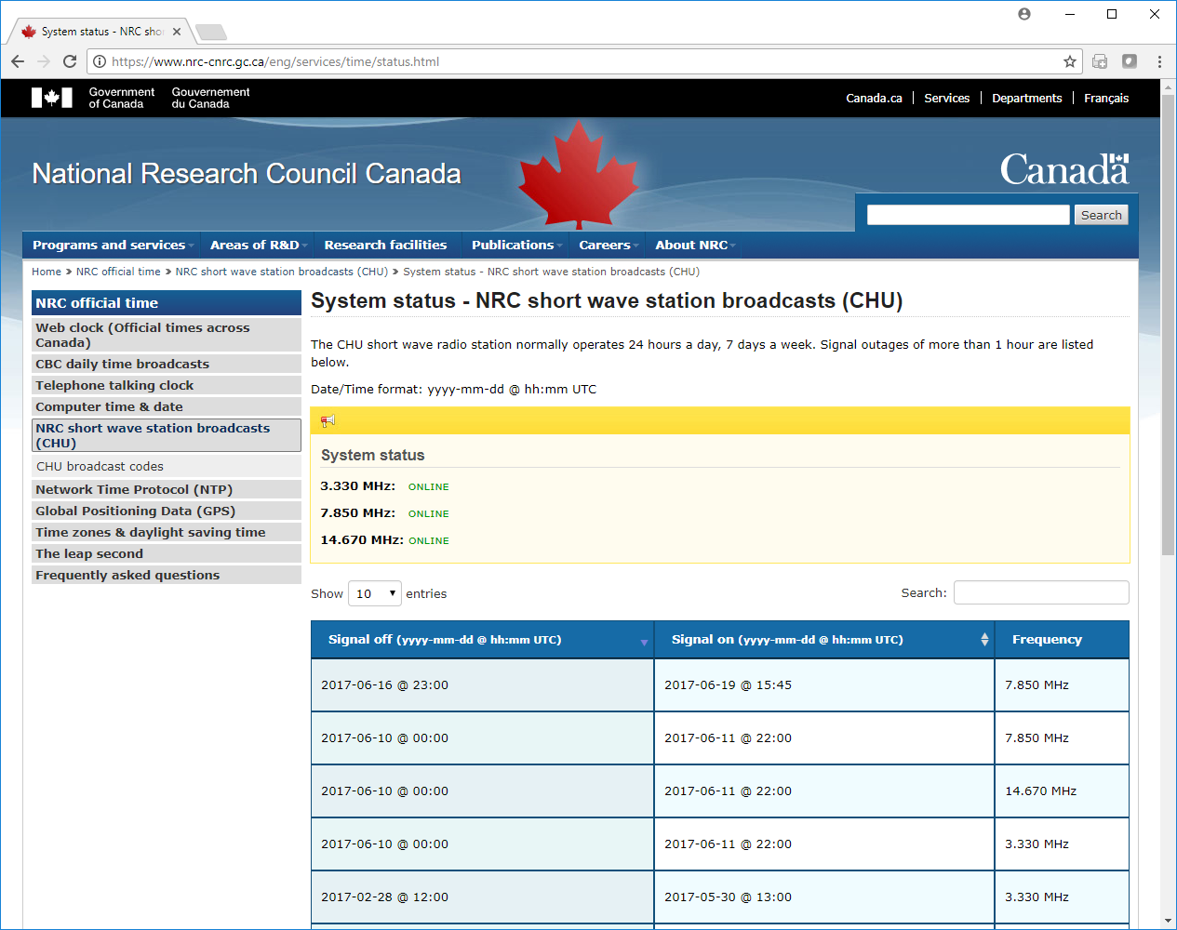
Web services
Web Clock
CHU Status

Slide 10
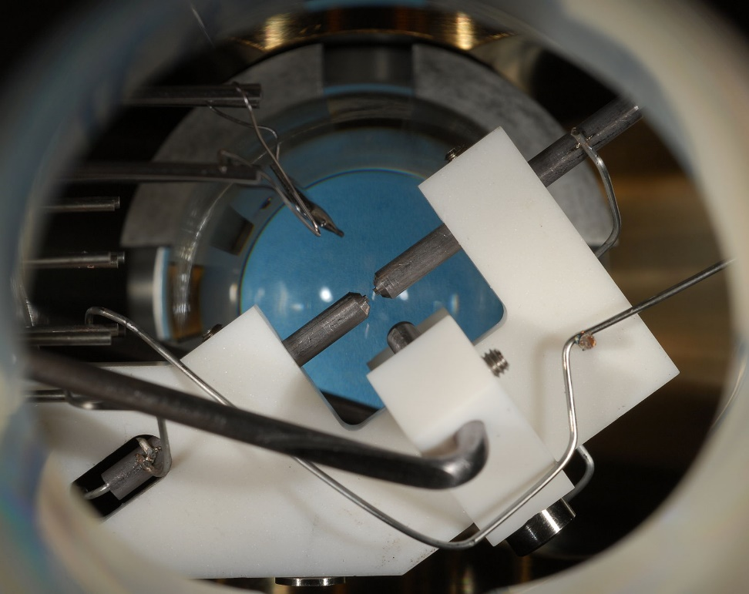
F&T Optical Frequencies
Frequency Combs
Strontium Ion
800 nm Ti:Sapphire GigaOptics + NRC
1550 nm Er UBC + NRC
1550 nm Er NRC
Optical standards
633 nm I₂/HeNe (3)
1540 nm C₂H₂ stabilized diode
674 nm 88Sr⁺ ultra-stable diode
Uncertainty evaluation of ⁸⁸Sr⁺
Current: 1.1 × 10⁻¹⁷
Expected: 3÷4 × 10⁻¹⁸
Measured: 1.7 × 10⁻¹⁵

Slide 11
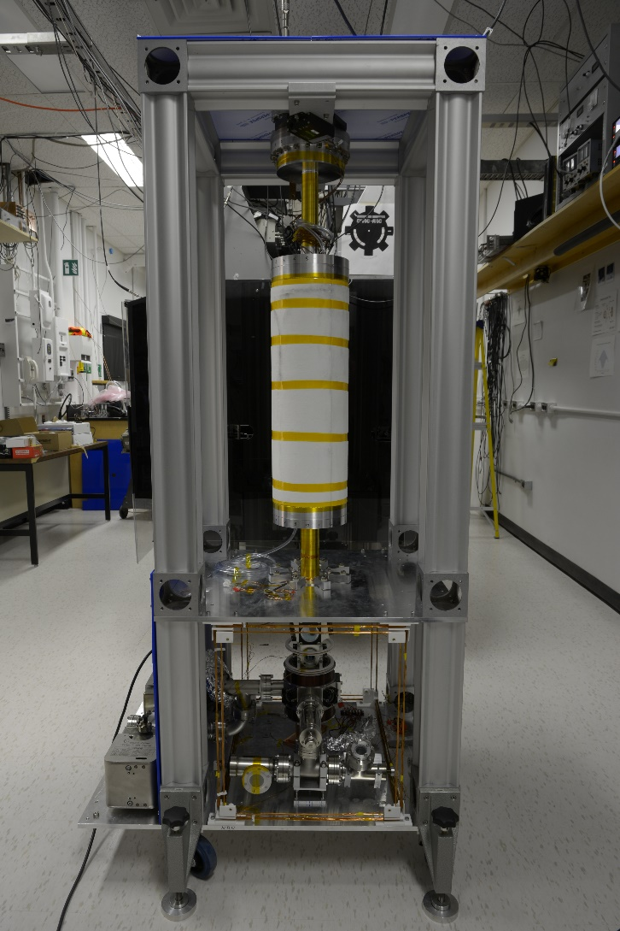
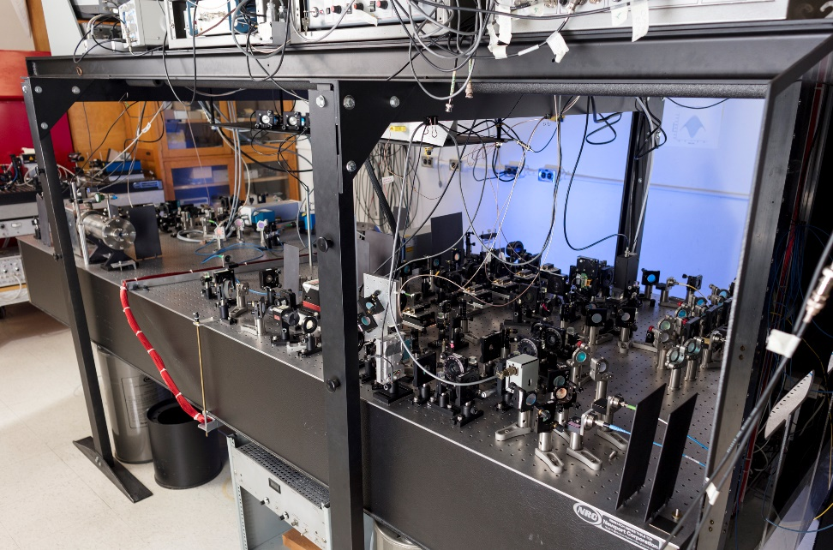
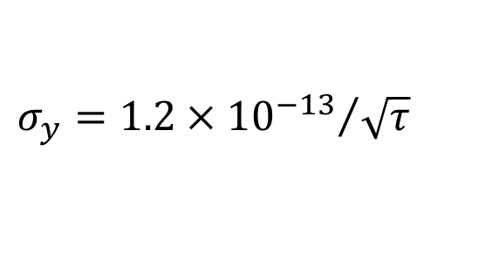
Caesium Fountain NRC-FCs2
$$σ_{y}={1.2×{10}^{−13}}/{\sqrt{τ}}$$

Slide 12
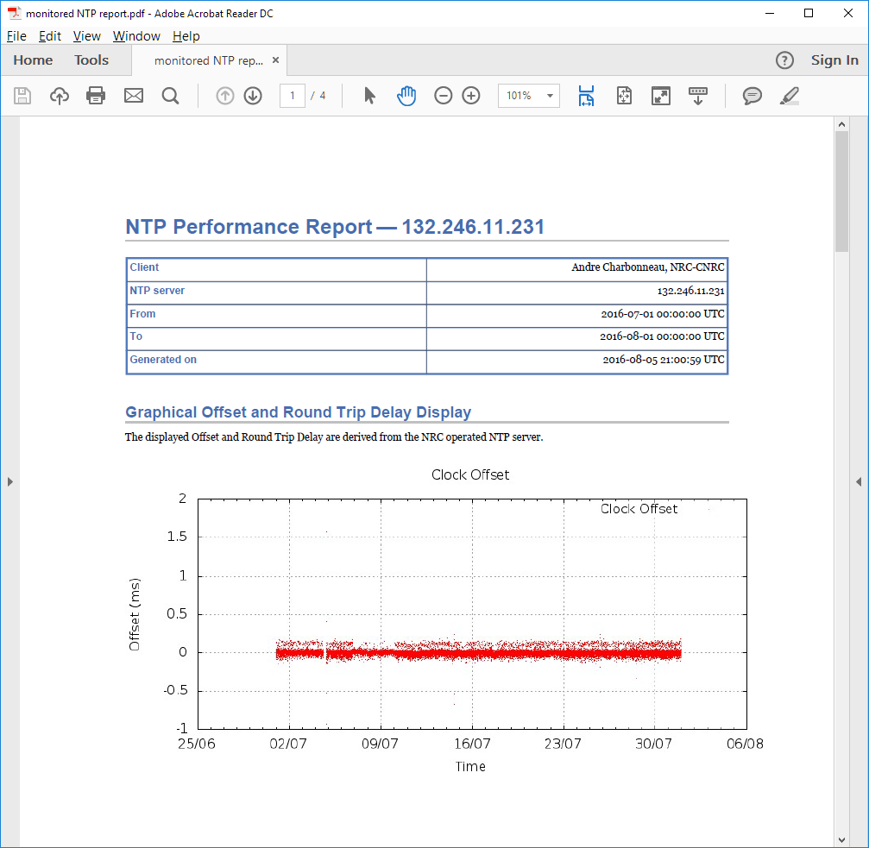
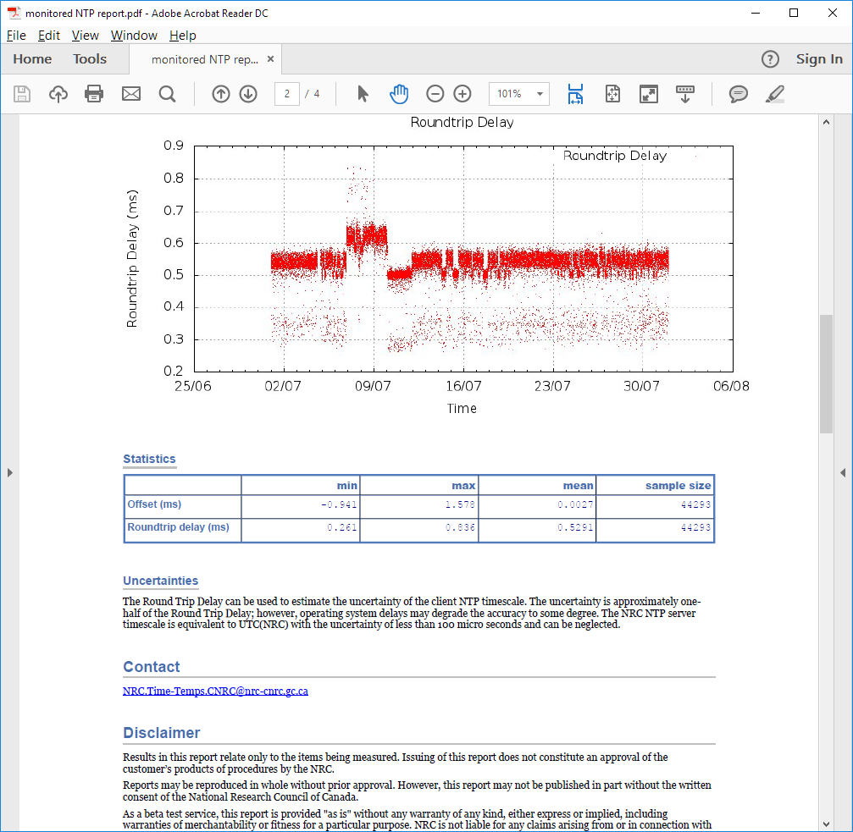
NRC TimeLink – Monitored NTP

Slide 13
NRC TimeLink – Remote Clock
Rb standard
GPS Rx
Remote control
Secure connection
multiple backups
continuous monitoring

Slide 14
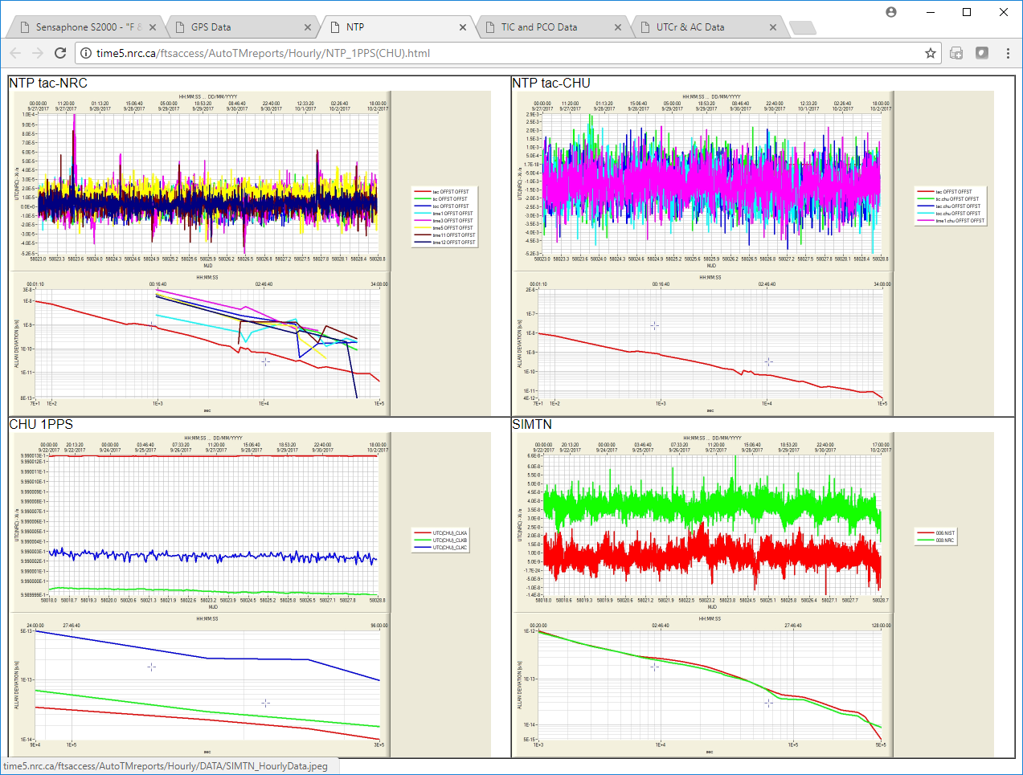
Performance Monitoring

Slide 15
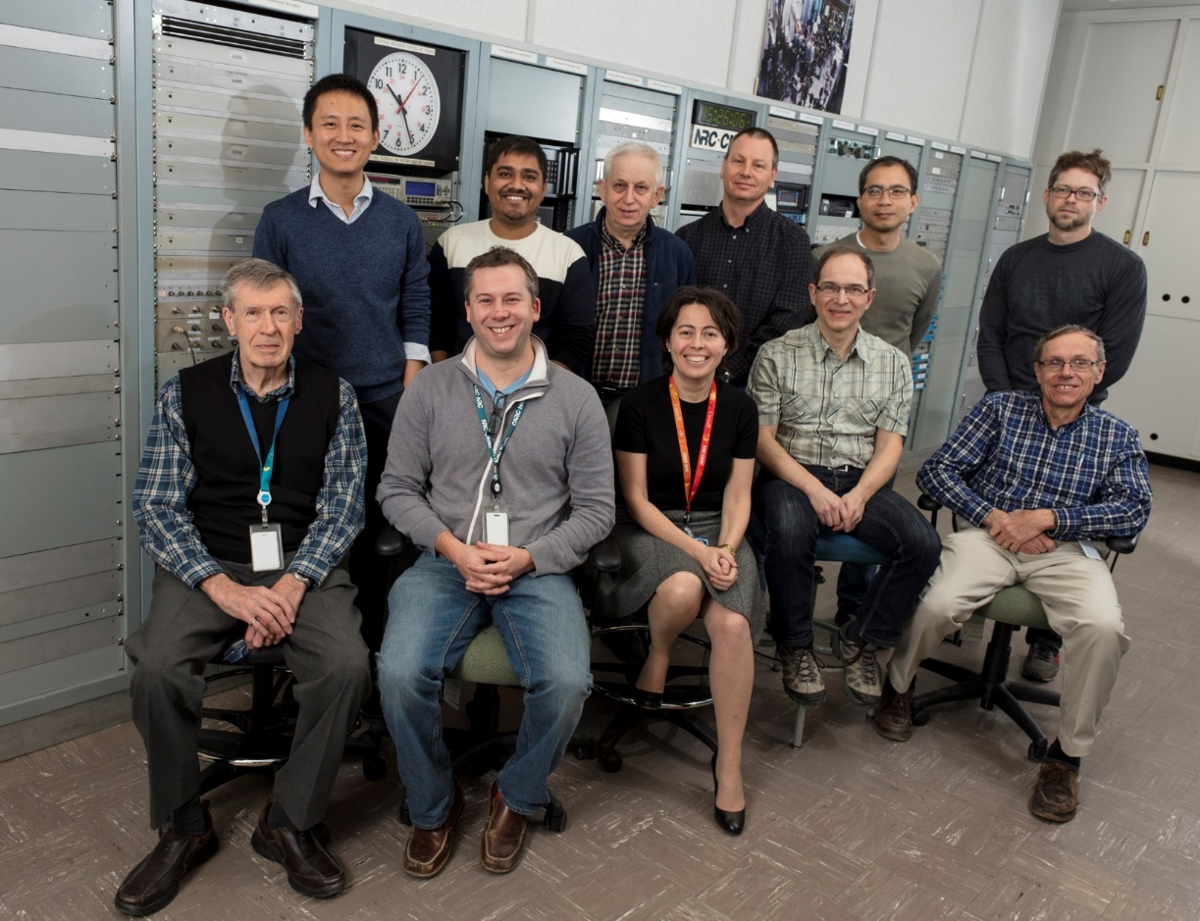
NRC MSS F&T
+ Ladan Arissian, Rob Douglas

Slide 16


Thank you
Marina Gertsvolf
Team Leader, Frequency & Time
marina.gertsvolf@nrc-cnrc.gc.ca
www.nrc-cnrc.gc.ca
16

