Slide 1
SKNBS
SIM T & F Working Group Meeting
27-29 January 2015, Panama
Presenter: Hiram Williams,
St. Kitts and Nevis Bureau of Standards

Slide 2
Outline
About St. Kitts and Nevis
SKNBS Overview
Services
Time and Frequency

Slide 3
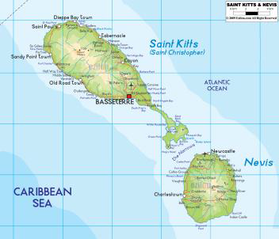
About St. Kitts and Nevis
The twin island Federation of St. Kitts and Nevis (SKN) consists of two islands located in the northern part of the Lesser Antilles chain of islands in the Eastern Caribbean. St. Kitts is located at latitude 17.3º north and longitude 62.7º west and Nevis is located two miles (3 km) to the south-east, at 17.2º north and longitude 62.6º west

Slide 4
About St. Kitts and Nevis
The Federation of SKN has a land area of 269 sq. km. (104 sq. miles). The larger of the two islands, St. Kitts is 176 sq. km. (68 sq. mi.) in area. It is approximately 36.8 km (23 mi) long and is roughly oval in shape with a narrow neck of land extending like a handle from the south-eastern end. Nevis has an area of 93 sq. km. (36 sq. mi), with a length of 12.3 km (7.64 mi) and a width of 9.6 km (5.96 mi) at its widest point.

Slide 5
About St. Kitts and Nevis
Both islands are volcanic in origin, with central mountain ranges that dominate the landscape and radiate downward to the coasts. A large proportion of the flat lands are located near the coast therefore most urban and agricultural developments are established in that geographical area .
The Federation of SKN has a population of approximately 46,000, with 35,000 persons (76%) residing on St. Kitts and the remaining 11,000 persons (24%) on Nevis

Slide 6
St. Kitts and Nevis Bureau of Standards
Formally established with the passage of National Bureau of Standards Act, 1999
Major responsibility of protecting the environment, health and safety of consumers
To facilitate the implementation of standards in the Federation
To act as the custodian of the national standards of mass, length, capacity, time, temperature and electrical measurements

Slide 7
Chemistry and Microbiology Units
Responsible for providing analytical and technical services necessary for providing the basis for standards development and compliance monitoring
-training workshops in the control of food safety and quality as it relates to improve monitoring of the industry including processing, imported foods, food service and street food sectors.

Slide 8
Chemistry and Microbiology Units
Provide services to Farmers in the areas of soil, fertilizer and plant tissue analyses.
Assist agro-processors of fruit juices, confectioneries and sauces in developing products of a consistent standard

Slide 9
Chemistry/Soil lab
Ph
Lime requirements
Total nitrogen
Chloride content
Phosphorus
Manganese
Copper
Potassium
Lead
Calcium
Organic carbon

Slide 10
Microbiology
Total aerobic plate count (TAPC)
Total coliform
Faecal coliform
E. Coli
Staphylococcus
Yeast and moulds
Salmonella
Listeria and Vibrio detection
Detection of Giardia, Cryptosporidium,Clostridia and Scrombotoxin (histamine)

Slide 11
Metrology
Management of the national system of metrology; verification and calibration of scales, balances and other measuring devices within the Federation.

Slide 12
Metrology Services
-Mass ; calibration and verification of balances/scales
-Volume ; capacity to verify fuel dispensers
-Time and frequency measurements
Other areas of interests- temperature, ph, pressure, electrical and water metering,

Slide 13
Where we are now
Strengths:
- Capacity in the areas of mass and volume
-Verification and calibration of weighing instruments and fuel dispensers
-Weights traceable to International standards

Slide 14
Where we are now
WEAKNESSES:
-Lack capacity in the areas of temperature, pH, pressure and flow
-Limited financial resources
-Lack adequate space at the bureau for other metrology activities

Slide 15
WHERE DO WE WANT TO GO
Improve competencies and enhance competitiveness of the people we train
Build capacity in the areas of time and frequency, temperature, pH, pressure, flow, electrical and water meters.
A well established national authority for metrology

Slide 16
Time and Frequency
SIM Time & Frequency Measurement System received in August 2014 through SIM Time & Frequency Working Group
SIM Time & Frequency Measurement System installed and commissioned in December 2014
Participates in SIM Time Network

Slide 17
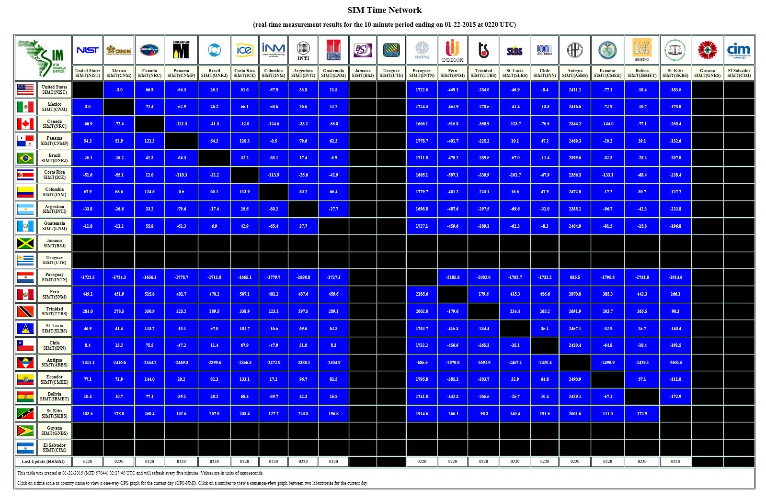

Slide 18
Time and Frequency equipment

Slide 19
Challenges
Occasional Power Failure- will require UPS
Difficult to maintain measurements within the desired range by manual frequency adjustments.
Relevance of time and frequency measurements: how does it impact people lives and facilitate growth in the economy.
Financial resources; external and Government to further build capacity

Slide 20
National Telecommunications Regulatory Commission (NTRC)
Regulate and coordinate telecommunications in the twin island federation and acts as a regulatory body that enhances the operation of telecommunications in the interest of the Government and people of Saint. Kitts and Nevis
Plan, supervise, regulate and manage the use of the radio frequency spectrum in conjunction with ECTEL
To help manage the spectrum, the NTRC uses sensitive equipment, and powerful spectrum analyzing / monitoring and management software

Slide 21
Electrical Power Suppliers Time and Frequency GPS clock
Time and frequency monitoring and control clock designed to provide a clearly visible display of time and frequency in power generation and distribution control rooms
It has an accurate mains frequency meter, it also show the standard time derived from the an external precision time reference, the frequency time derived from the 60Hz supply frequency and the time difference between the standard time and the frequency time

Slide 22
Airport GPS master clock
GPS master clock receives time and date information from Global Positioning System satellites and supplies this data to the user in the form of four (4) different types of time code

Slide 23
The Way forward
To raise awareness on the importance of Time and Frequency measurements
Development and establishment of a St. Kitts and Nevis National Standard for Time and frequency.
Engage in international comparison of time and frequency measurements to ensure traceability.
SKNBS recognized as the official timekeeper for St. Kitts and Nevis
Build capacity for the dissemination of time measurements to clients within St. Kitts and Nevis

Slide 24
THANK YOU
St. Kitts and Nevis Bureau of Standards
P.O.Box 186
La Guerite
Basseterre
St. Kitts
Phone: 869-465-5279
Email: mplbos@gmail.com
Website: miticca.gov.kn
facebook.com/sknbs

