Slide 1
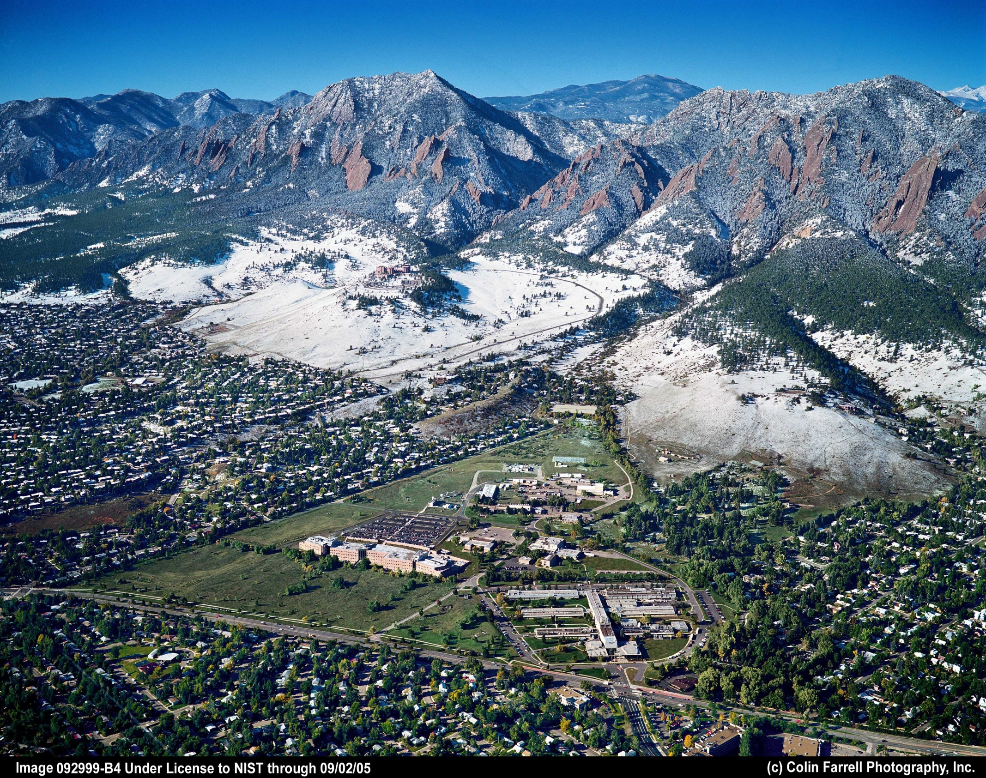
Time, Timekeeping and
Time Distribution at NIST
Tom O’Brian
Chief, NIST Time and Frequency Division

Slide 2
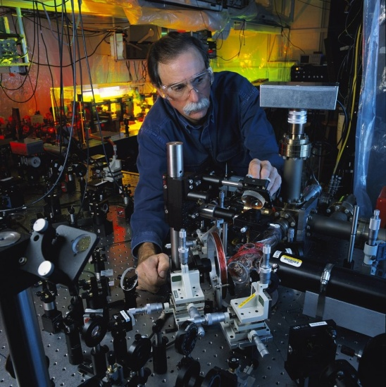
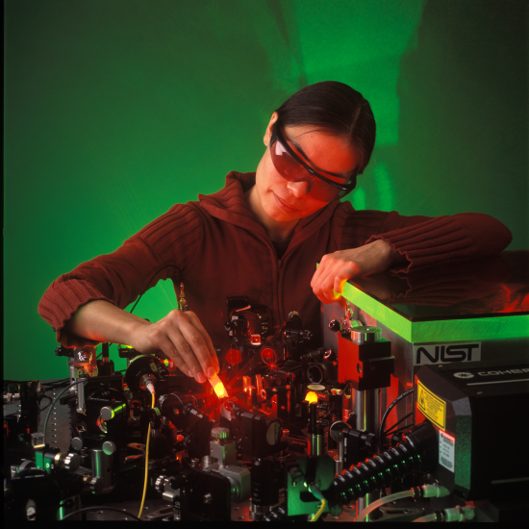
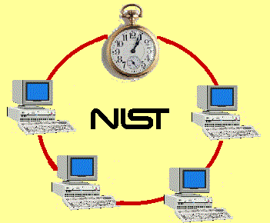
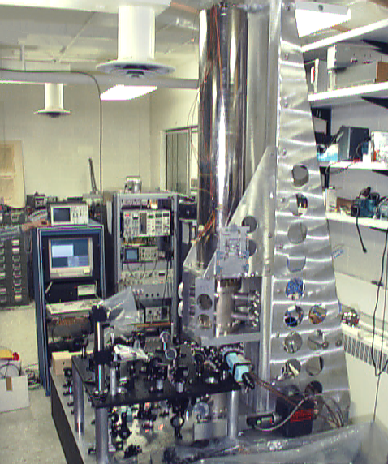
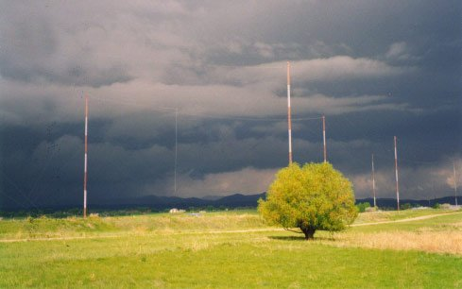
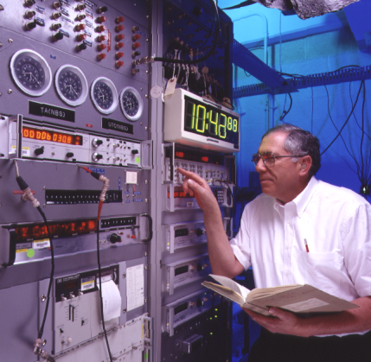
Time, Timekeeping and Time Distribution
An overview of some activities of the NIST Time and Frequency Division.

Slide 3
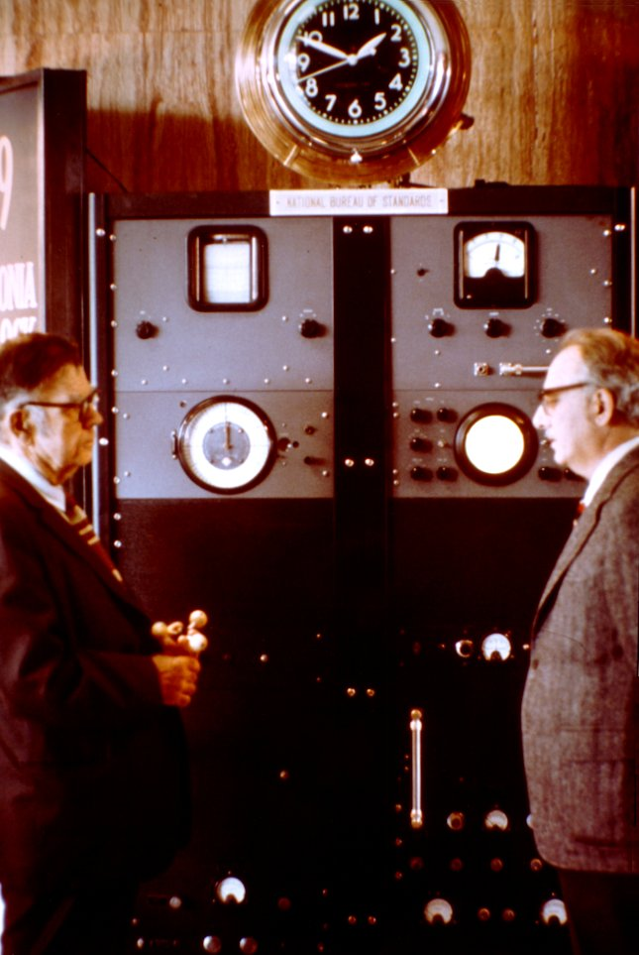
Brief history of timekeeping
World’s first atomic clock (sort of…)
NIST (NBS) 1949.
Washington, DC.
Ammonia molecule inversion.
  23.79 GHz.
Not used as a frequency standard or a clock.
World’s first atomic clock – sort of…

Slide 4
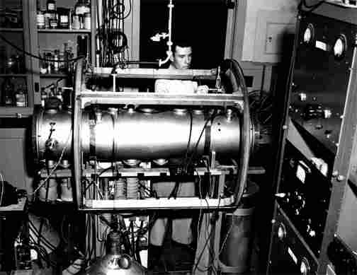
Brief history of timekeeping
Cesium beam standards
NPL (UK) had first working cesium beam standard 1955.
First NBS cesium beam standard: NBS-1.
Construction began at NBS in Washington, DC, 1952.
Moved to new NBS Central Radio Propagation Labs in Boulder in 1954.
Δf/f ~ 1 x 10⁻¹⁰
Equivalent to 1 second in 300 years.

Slide 5
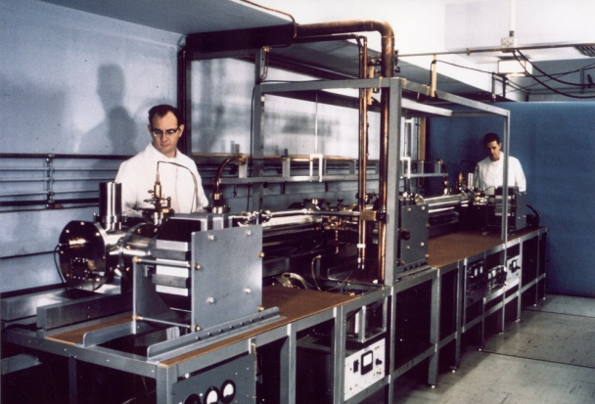
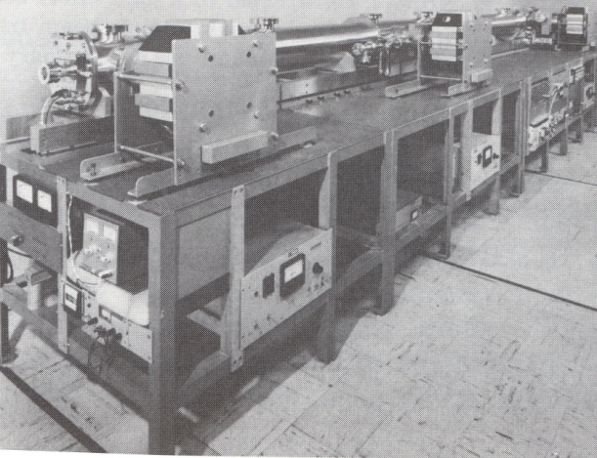
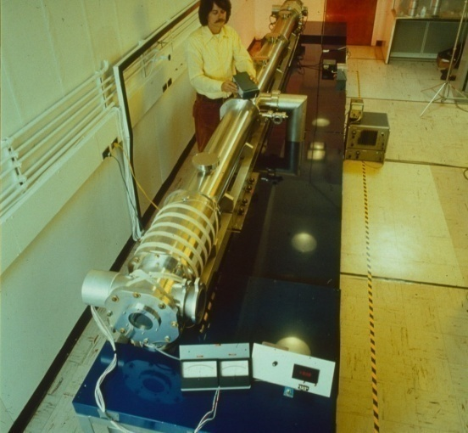
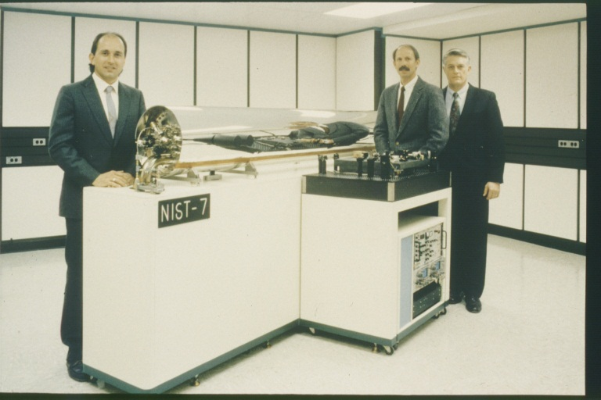
NBS/NIST Atomic clocks
Continuing improvements (1960 to 1999)…
NBS-3
NBS-5
NBS-6
NIST-7
All used hot cesium atoms: Fast movement limits precision….

Slide 6
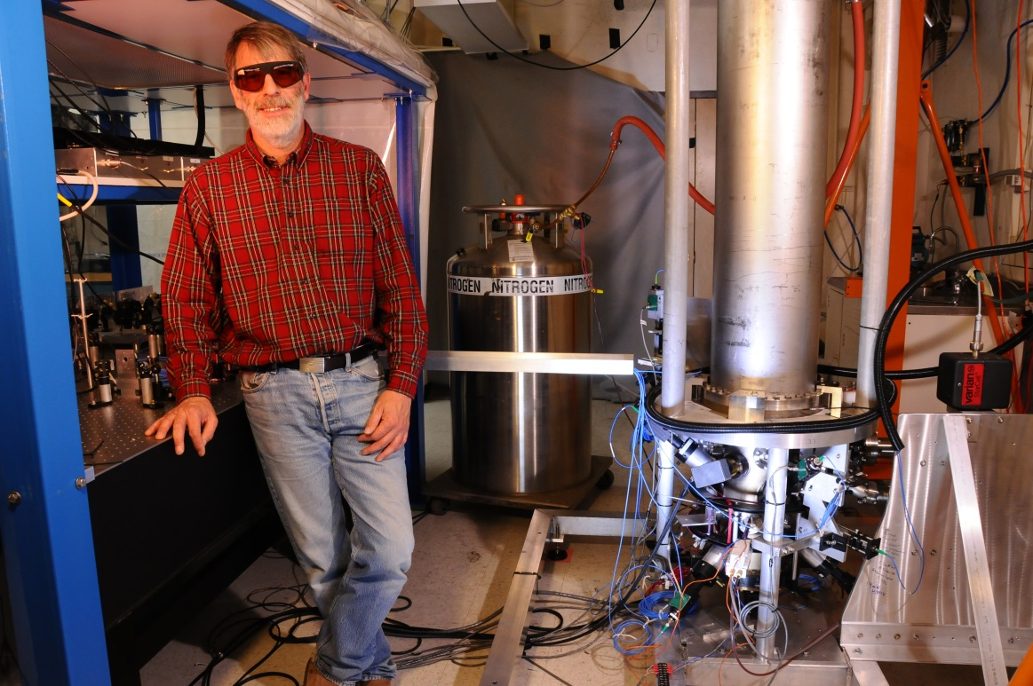
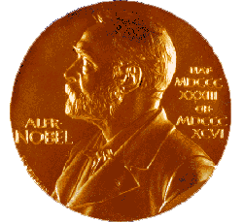
NIST-F2 Atomic Fountain Clock
An Official Time Standard for the United States
1 second is defined as the duration of 9,192,631,770 cycles of the cesium hyperfine transition.
Frequency uncertainty
Δf/f = 1 x 10⁻¹⁶.
1 second in 300 million years.
Enabled by NIST pioneering laser cooling and trapping.
NIST-F2 laser-cooled fountain standard
atomic clock
Equivalent to measuring distance from earth to sun (150 million km) to uncertainty of about 15 microns (1/10 the thickness of a human hair).

Slide 7
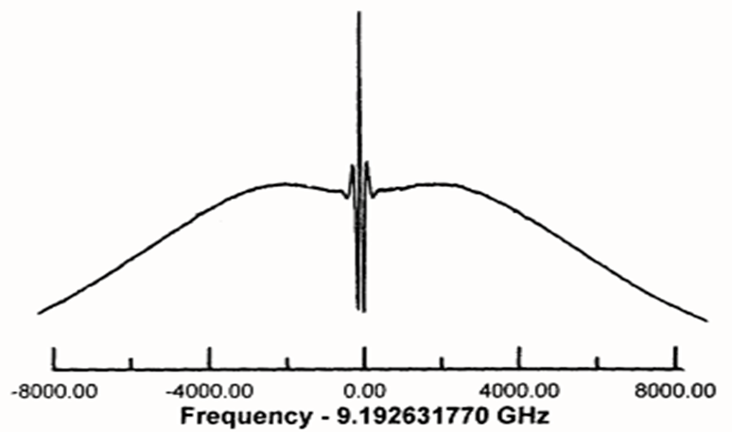
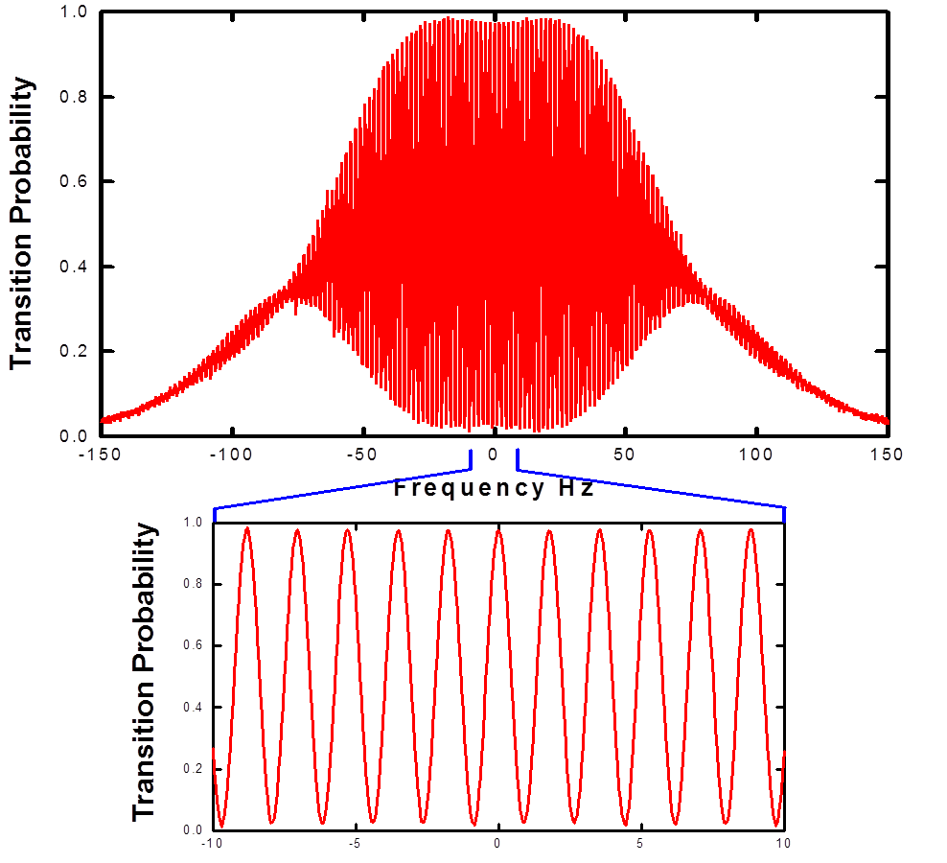
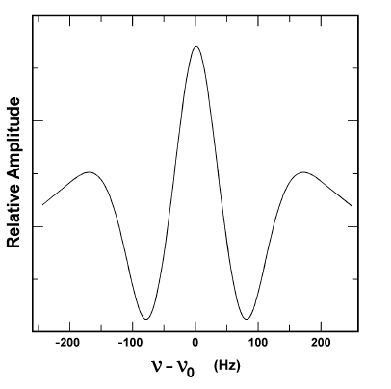
Cesium Atomic Clocks: From Thermal Beam to Laser Cooling
Typical thermal beam spectrum
T ~ 500 K (~200 C)
Δf ~ 65 Hz
NIST-F1 laser-cooled spectrum
T ~ 0.5 μK
Δf ~ 0.5 Hz

Slide 8
Improvements in Atomic Clocks (Frequency Standards)
NBS-1
10⁻¹⁰
60 Years of Progress in Atomic Clocks
10⁻¹¹
10⁻¹²
10⁻¹³
Cesium Microwave
Primary Frequency
Standards
NBS-6
Frequency Uncertainty Δf/f
10⁻¹⁴
NIST-7
10⁻¹⁵
NIST-F1
NIST-F2
10⁻¹⁶
10⁻¹⁷
Year

Slide 9
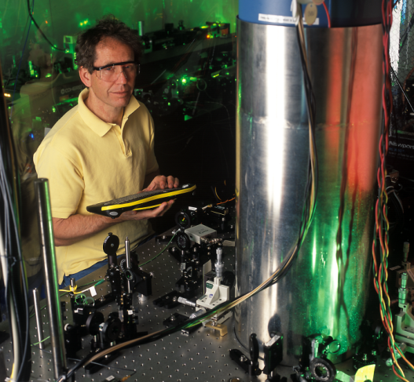
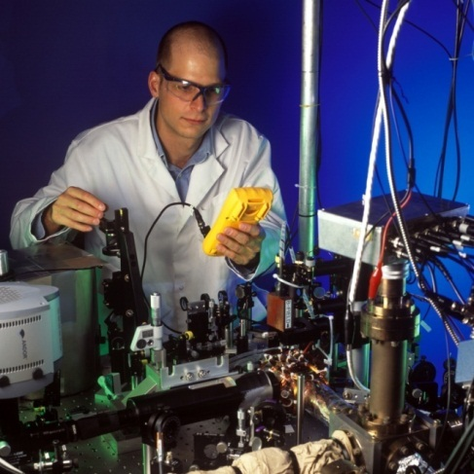
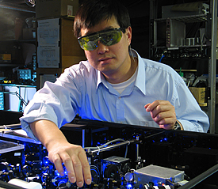
NIST Research Optical Frequency Standards
Mercury Ion Atomic Clock
NIST
Aluminum Ion Logic Clock
NIST
Strontium Lattice Clock
NIST/JILA
Research atomic clocks at NIST already at Δf/f = 6 x 10⁻¹⁸.
  1 second in about 5 billion years.
Rapidly improving.
NIST and JILA have five of the best types of atomic clocks in the world.
  Applying NIST and JILA Nobel Prize breakthroughs (1997, 2005, 2012).
Equivalent to measuring distance from earth to sun (150 million km) to uncertainty of about 0.9 micron (size of a bacterium).

Slide 10
Improvements in Frequency Standards
Frequency uncertainty ~
Δf
Atomic Resonance
= observation time
= number of atoms
NIST research atomic clocks
Al⁺ 1124 THz (1124 x 10¹² Hz)
Hg⁺ 1064 THz
Yb 520 THz
Ca 456 THz
Sr 429 THz
Cs 0.0092 THz
Optical
Microwave

Slide 11
Femtosecond Laser Frequency Combs: Key to Optical Clocks
Optical ref 1
ν₁
fs laser
Optical ref 2
ν₂
Compare ν₁ vs ν₂
set ν_{n} = ν_{opt}
ν_{m} - ν_{opt2}
Optical
reference 1
Optical
reference 2
0
ν
Optical standards at NIST
Al⁺ (1124 THz), Hg⁺ (1064 THz), neutral Yb (520 THz), Ca (456 THz) and Sr (429 THz)
x 2
set f_{o}= 0
Direct comparison to Cs
(0.0092 THz)

Slide 12
Improvements in Atomic Clocks (Frequency Standards)
NBS-1
10⁻¹⁰
Optical Frequency
References
(Research)
10⁻¹¹
10⁻¹²
10⁻¹³
Cesium Microwave
Primary Frequency
Standards
NBS-6
Frequency Uncertainty Δf/f
10⁻¹⁴
NIST-7
10⁻¹⁵
NIST-F1
NIST-F2
10⁻¹⁶
NIST optical
frequency references
10⁻¹⁷
Year

Slide 13
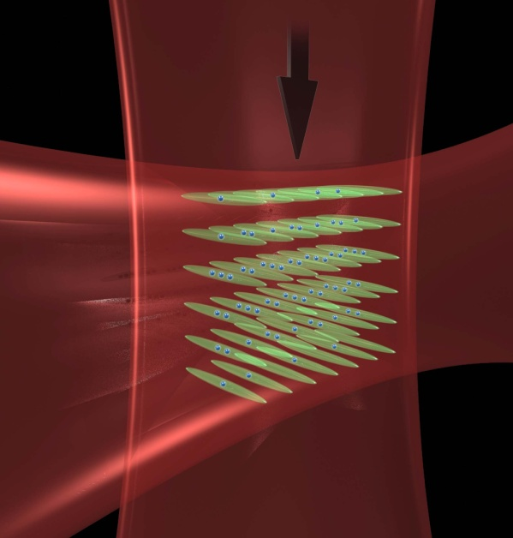
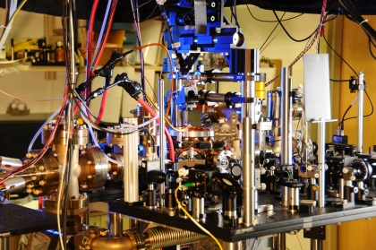
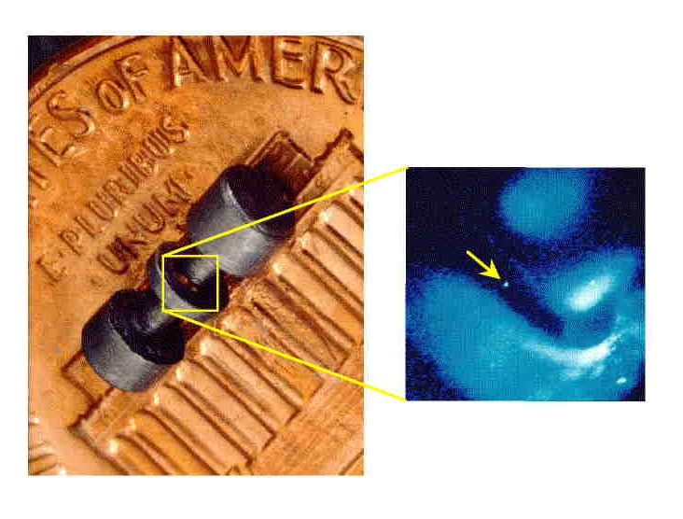
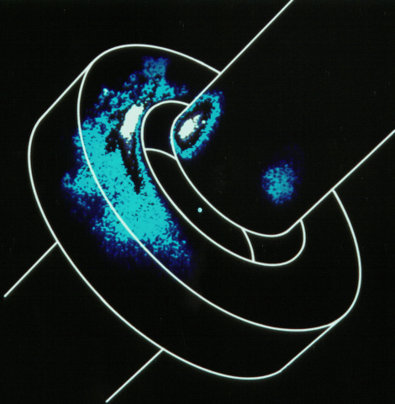
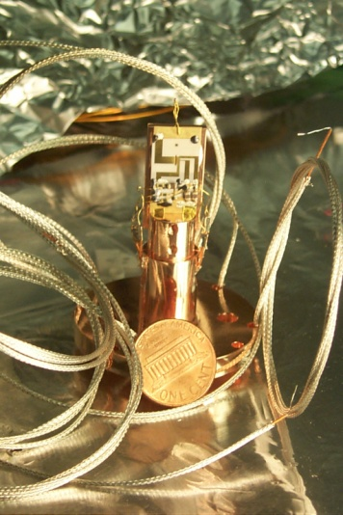
Optical Atomic Clocks at NIST
High-frequency optical clocks outperform microwave (cesium) clocks.
Potential to perform ~100 times better than best cesium clocks.
Many years before SI second redefined to optical standard(s).
Δf/f ~ 6 x 10⁻¹⁸
Strontium or Ytterbium optical lattice clocks
Δf/f ~ 10 x 10⁻¹⁸
Δf/f ~ 8 x 10⁻¹⁸
Single ion
Single mercury ion trap
Aluminum ion logic clock

Slide 14
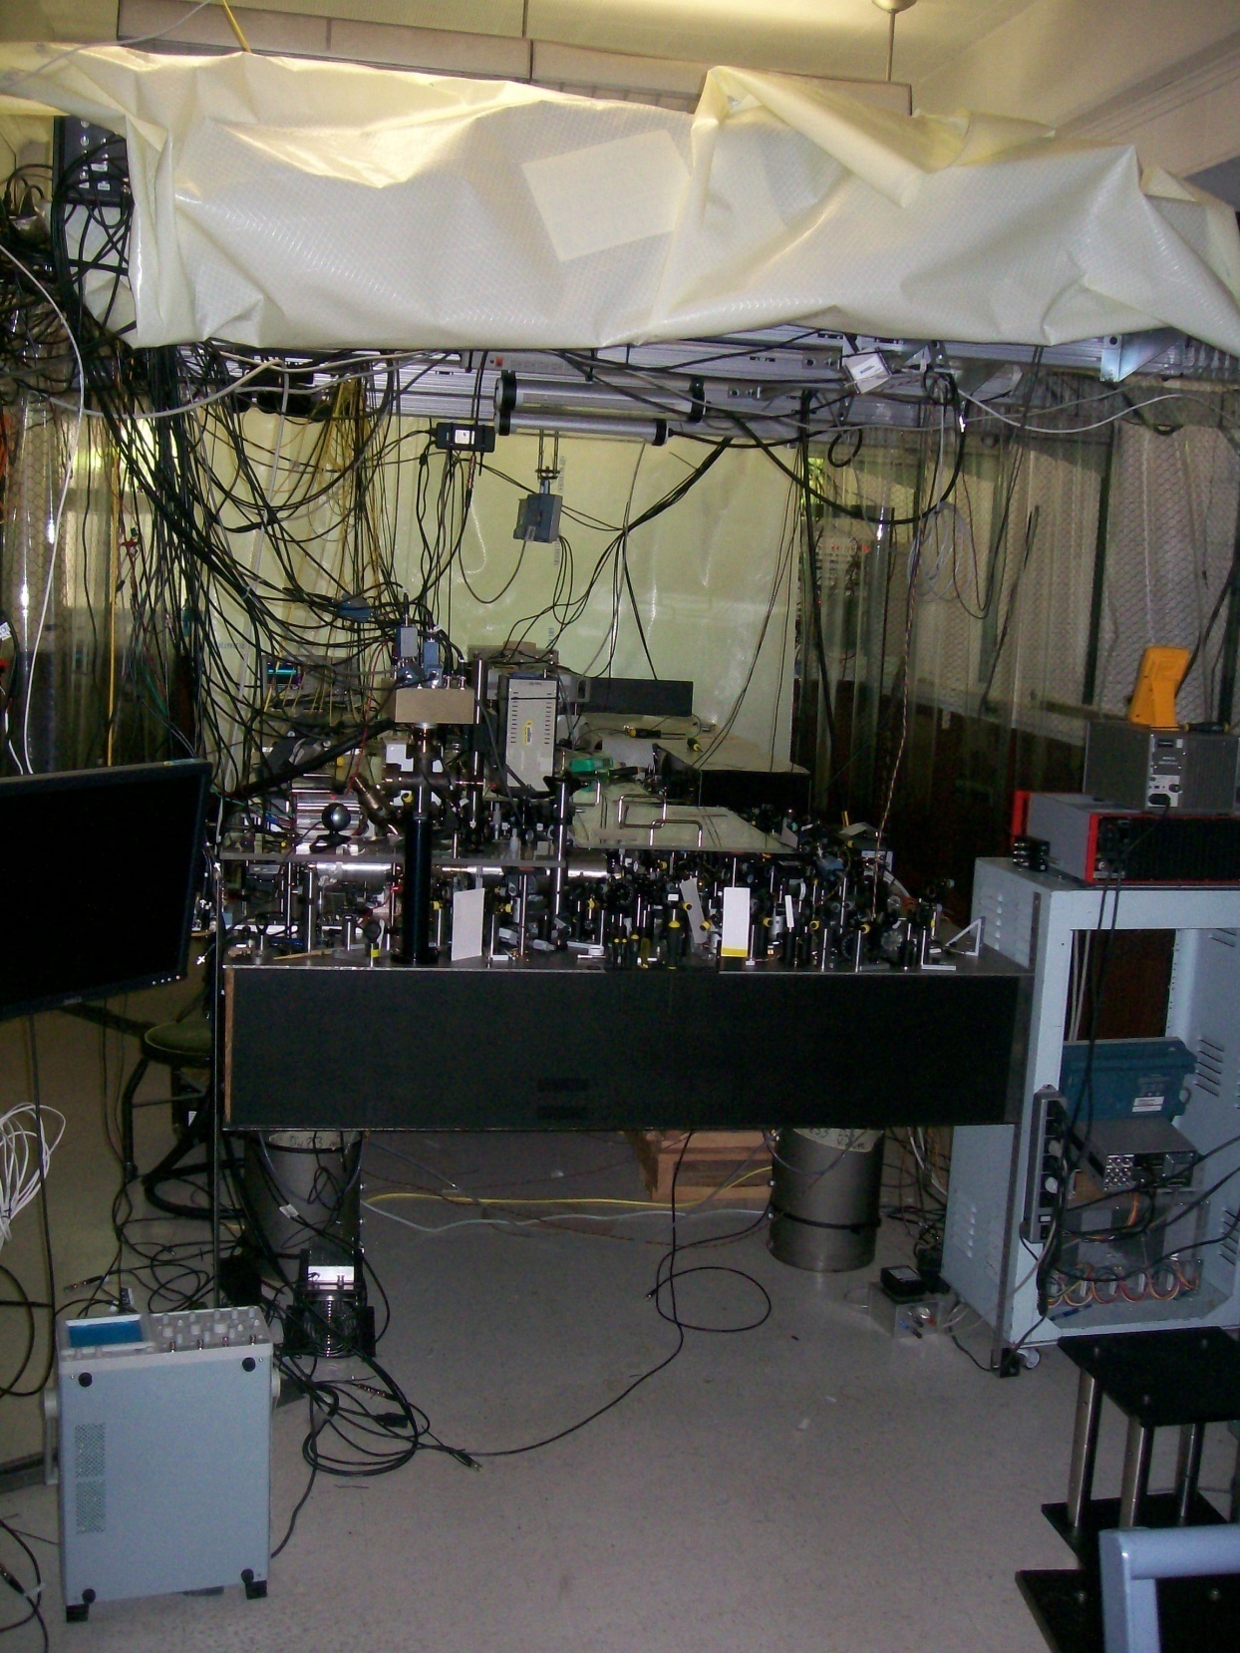
Aluminum ion “logic clock.”
Δf/f ~ 8 x 10⁻¹⁸
1 second in 4 billion years.
Currently slightly less precise than NIST optical lattice clocks.

Slide 15
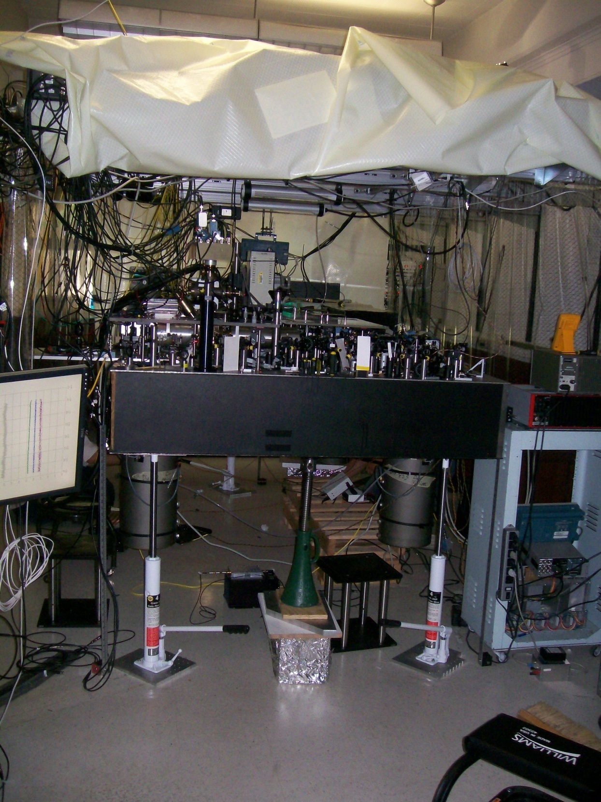
General and Special Relativity:
Measure changes in clock frequency by:
Raising clock as little as 10 cm.
  1 cm Δh ~ 1 x 10⁻¹⁸ Δf near earth’s surface).
Moving ions as slowly as jogging speed.
Extremely precise optical atomic clocks may be most useful for measuring:
Gravity.
Magnetic fields.
Force and mass.
Electrical quantities.
Temperature.
Motion and acceleration.
Many other quantities…

Slide 16
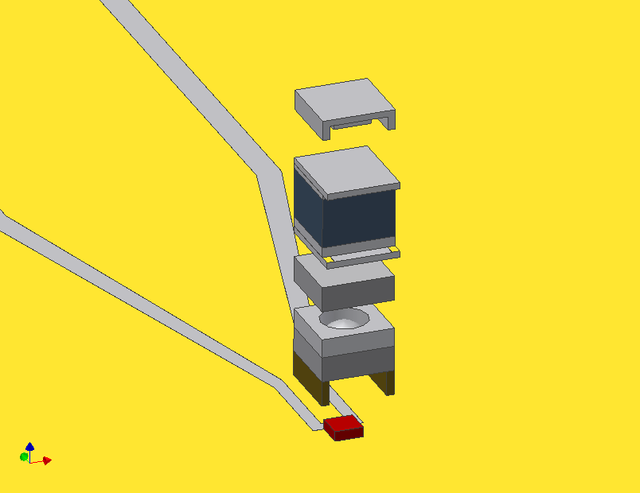
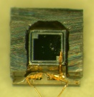
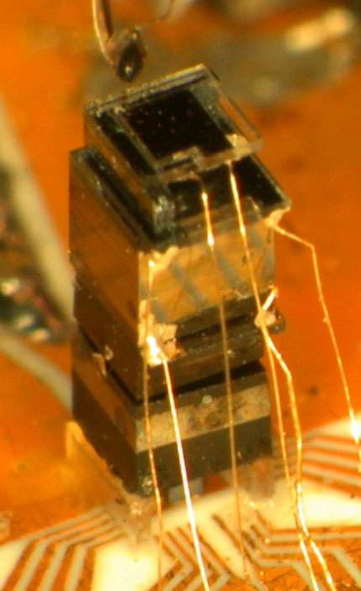
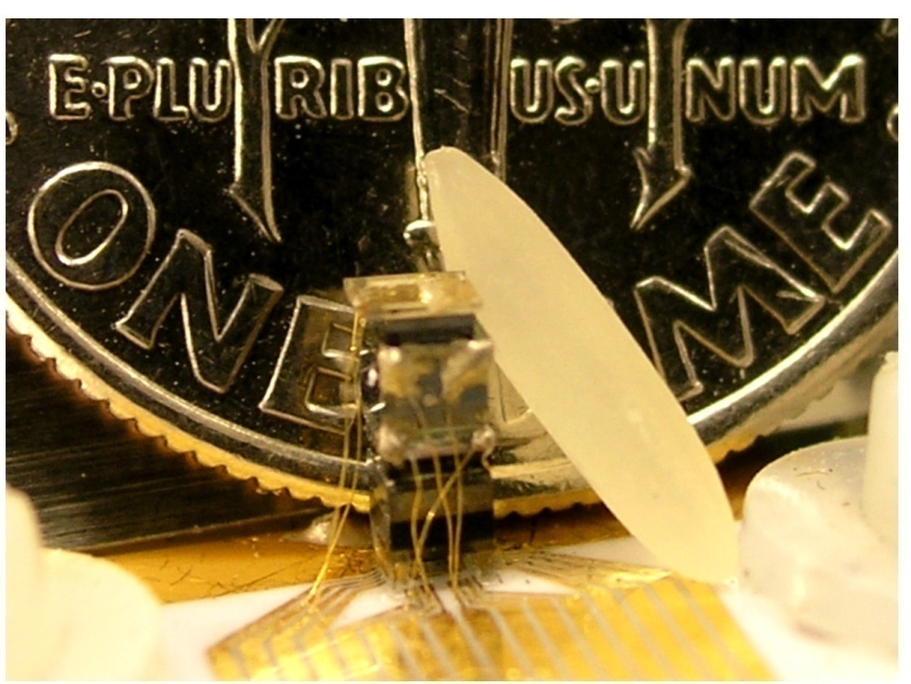
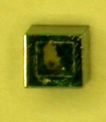
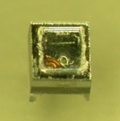
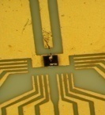
NIST Chip-Scale Atomic Devices
“Post-Timing” Applications
1 mm
Chip-scale atomic clock (NIST 2004)
Chip-scale atomic magnetometer (NIST 2005)
Ultraminiature gyroscope (NIST 2008)
Future atom-based sensors (under development)

Slide 17
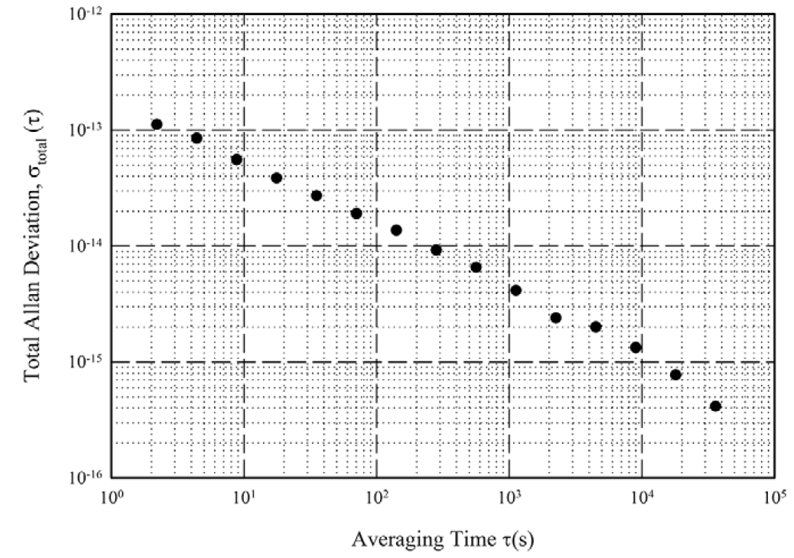
Stability of Atomic Clocks
NIST-F2 stability
1.7 x 10⁻¹³ τ^{-1/2}
1 day

Slide 18
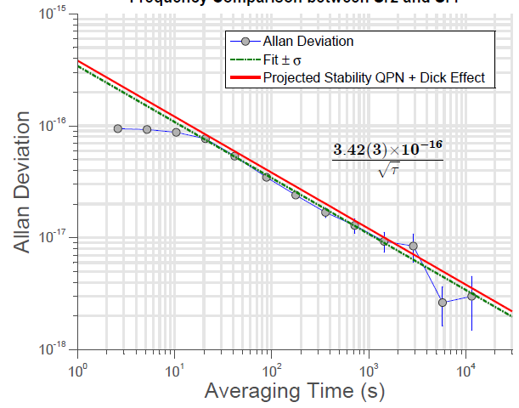
Stability of Atomic Clocks
NIST/JILA Sr optical lattice clock instability

Slide 19
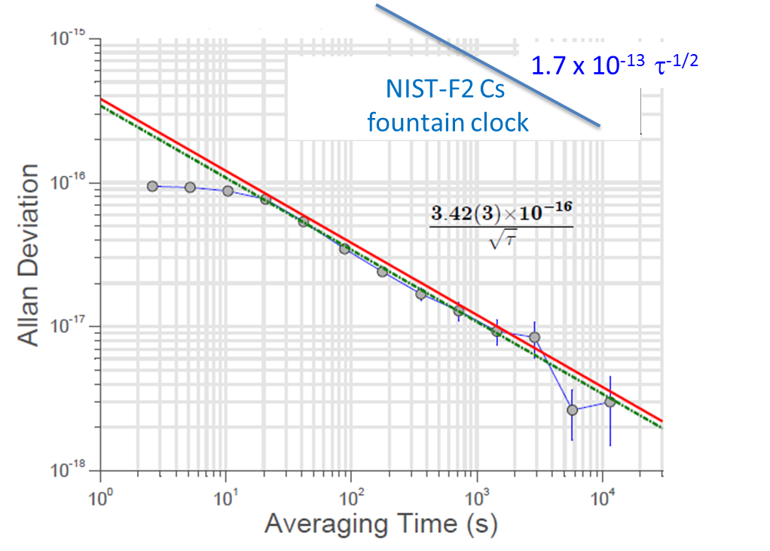
Atomic clocks
Optical and microwave clock stabilities
~1 x 10⁻¹⁶ at 3 x 10⁶ s
~1 x 10⁻¹⁶ at 10 s

Slide 20
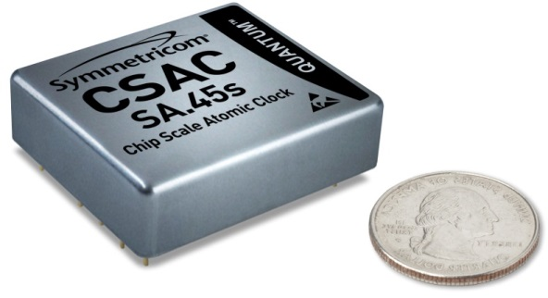
NIST Chip-Scale Atomic Devices
Sensors Based on Frequency Metrology (“Atomic Clocks”)
1 mm
Chip-scale atomic clock
Chip-scale atomic magnetometer
Ultraminiature gyroscope
Future atom-based sensors
Symmetricom (now Microsemi):
First commercial CSAC.
January 2011.
Δf/f ~10⁻¹¹ .

Slide 21
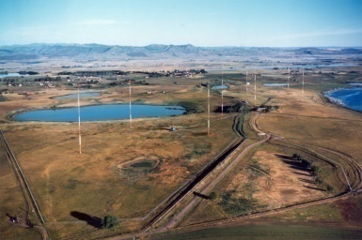
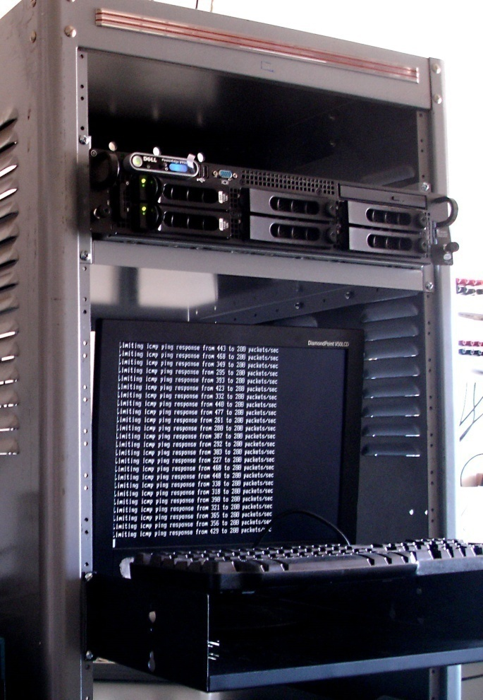
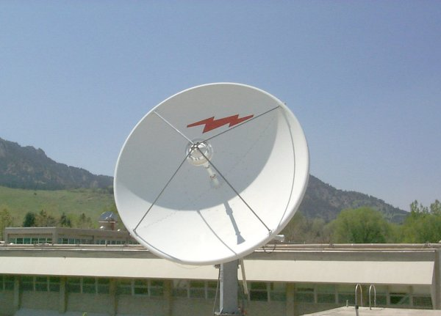
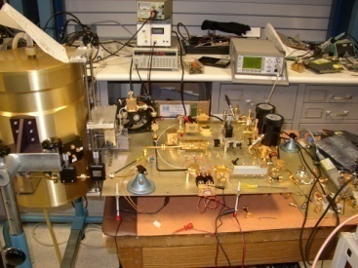
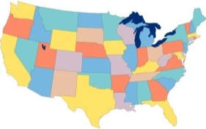
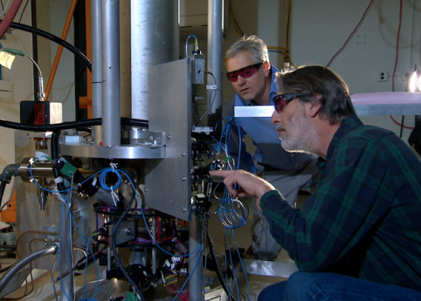
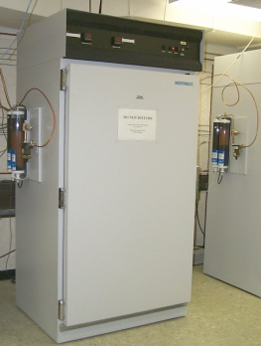
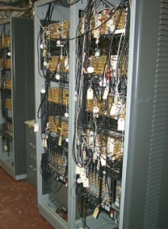

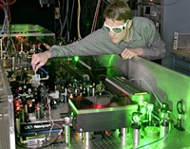

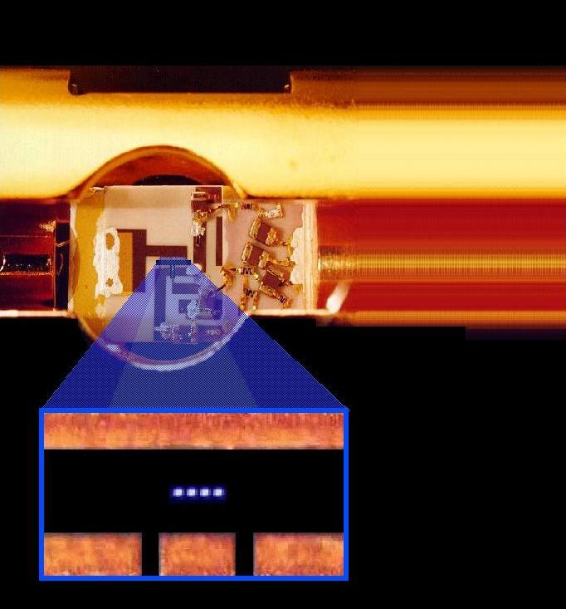
NIST Time and Frequency Standards and Distribution
Time and Frequency Distribution Services
Radio broadcasts
Networks
Satellites
Noise metrology
Primary Frequency Standards and
NIST Time Scale
Realization of SI second
Hydrogen Maser &
Measurement system
NIST-F2
Research on Future Standards and Distribution
Optical clocks
Optical frequency
synthesis
Chip-scale atomic devices
Quantum computing

Slide 22
NIST Time and Frequency Standards and Distribution
Time and Frequency Distribution Services
Radio broadcasts
Networks
Satellites
Noise metrology
Primary Frequency Standards and
NIST Time Scale
Realization of SI second
Hydrogen Maser &
Measurement system
NIST-F2
Research on Future Standards and Distribution
Optical clocks
Optical frequency
synthesis
Chip-scale atomic devices
Quantum computing

Slide 23
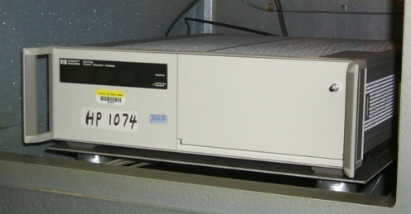



NIST Time Scale and Distribution
Two-way satellite time & frequency transfer
Cesium Beam standards
UTC(NIST)
Hydrogen Masers
GPS
Measurement System
Calibrated by NIST-F1/F2 primary frequency standards
International coordination of time and frequency: UTC, TAI, etc.

Slide 24
NIST Time and Frequency Standards and Distribution
Time and Frequency Distribution Services
Radio broadcasts
Networks
Satellites
Noise metrology
Primary Frequency Standards and
NIST Time Scale
Realization of SI second
Hydrogen Maser &
Measurement system
NIST-F2
Research on Future Standards and Distribution
Optical clocks
Optical frequency
synthesis
Chip-scale atomic devices
Quantum computing

Slide 25



NIST Time and Frequency Distribution
NIST Internet Time Service – time codes delivered over the Internet.
8 billion requests per day.
Built into common operating systems: Windows, Mac, Linux, etc.
Servers at about 25 locations across the United States.
Need for auditable time-stamping at ever greater timing precision.
NY Stock Exchange
“Flash crash”
Automated Trading Anomaly
May 6, 2010

Slide 26





Time By Radio: WWV/WWVH

Slide 27


Time by Radio: WWV/WWVH
HF time signal stations operate in the radio spectrum from 3 to 30 MHz (often known as shortwave). WWV is the shortwave station operated by NIST from Fort Collins, Colorado. Its sister station, WWVH, is located on the island of Kauai in Hawaii.
Both stations broadcast on 2.5, 5, 10, and 15 MHz, and WWV is also available on 20 MHz.
WWV and WWVH are best known for their audio time announcements. The exact size of the radio audience is unknown. About 2000 users per day listen to the signals by telephone through the Telephone Time-of-Day Service (TTDS).

Slide 28

Time By Radio: WWVB
WWVB low frequency broadcast of time code signals (60 kHz). Began broadcasting from Fort Collins, Colorado in 1963.

Slide 29





WWVB Radio Controlled Clocks
Low frequency time signal stations operate at frequencies ranging from about 40 to 80 kHz.
WWVB broadcasts on 60 kHz with 70 kW of power from Fort Collins, Colorado.
At least 50 million WWVB radio controlled clocks are believed to be in operation.

Slide 30
NIST Time and Frequency Standards and Distribution
Time and Frequency Distribution Services
Radio broadcasts
Networks
Satellites
Noise metrology
Primary Frequency Standards and
NIST Time Scale
Realization of SI second
Hydrogen Maser &
Measurement system
NIST-F2
Research on Future Standards and Distribution
Optical clocks
Optical frequency
synthesis
Chip-scale atomic devices
Quantum computing

Slide 31




Some Nobel Prizes Related to Atomic Time and Frequency Metrology
1943 | Otto Stern | Molecular/atomic beam spectroscopy.
1944 | Isidor Rabi | Atomic beam resonance technique.
1955 | Polykarp Kusch | Magnetic moment of electron; early atomic clocks.
1964 | Charles Townes, Nicolai Basov, Alexandr Prokhorov | Quantum electronics, including maser/laser principles.
1966 | Alfred Kastler | Optical pumping methods.
1989 | Norman Ramsey, Hans Dehmelt, Wolfgang Paul | Atomic clock techniques; trapped ion spectroscopy.
1997 | Bill Phillips, Steven Chu, Claude Cohen-Tannoudji | Laser cooling of neutral atoms.
2001 | Eric Cornell, Carl Wieman, Wolfgang Ketterle | Bose-Einstein condensate.
2005 | Jan Hall, Ted Hansch, Roy Glauber | Femtosecond laser frequency combs.
2012 | Dave Wineland, Serge Haroche | Quantum state measurement and manipulation.
Bill Phillips
NIST
Carl Wieman
Eric Cornell
NIST/JILA
Jan Hall
NIST/JILA
Dave Wineland
NIST
More to come…

Slide 32

tf.nist.gov

Slide 33


Public, searchable database of Time & Frequency Division publications.
>2,700 PDFs posted.
tf.nist.gov

