Slide 1
INSTITUTO DOMINICANO PARA LA CALIDAD
Dominican Institute For Quality

Slide 2
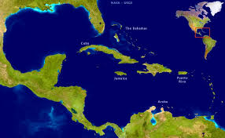

Slide 3
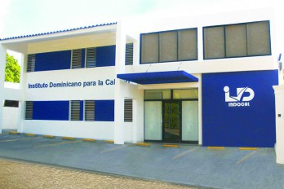

Slide 4
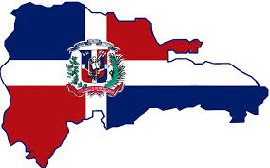
As a National Metrology Institute In INDOCAL we seek to be the National Reference in time and frequency.
We know time is the most measured magnitude.
Know how important is for the countries to counteract the difficulties and setbacks in the economical and technological development.
And also know time is important to develop other magnitudes .

Slide 5
That’s why having a reliable time base legally harmonized with embodiments of time of other countries, provides the Dominican Republic a great tool to achieve it´s goals in metrological area in short and long term.

Slide 6
With this advance we can become diffusers of Legal time via: Telephone , Internet, Radio Station to be used in more demanding applications such as Telecommunications, Synchronization of Energy Networks, Military operations, Commercial and Financial Transactions, Digital Signature.

Slide 7
We will also be able to offer services to the industry such as: Homologation and Calibration of Digital Timers, Frequency Counters, Time Intervals, Signal Generators, Oscilloscopes etc.

Slide 8
The metrological objectives of the Dominican Republic in time and frequency have increased , today as well as providing services is also our goal to contribute to this great family of metrologists, who are not only thinking in their own countries if not for all countries in America and the world.

Slide 9
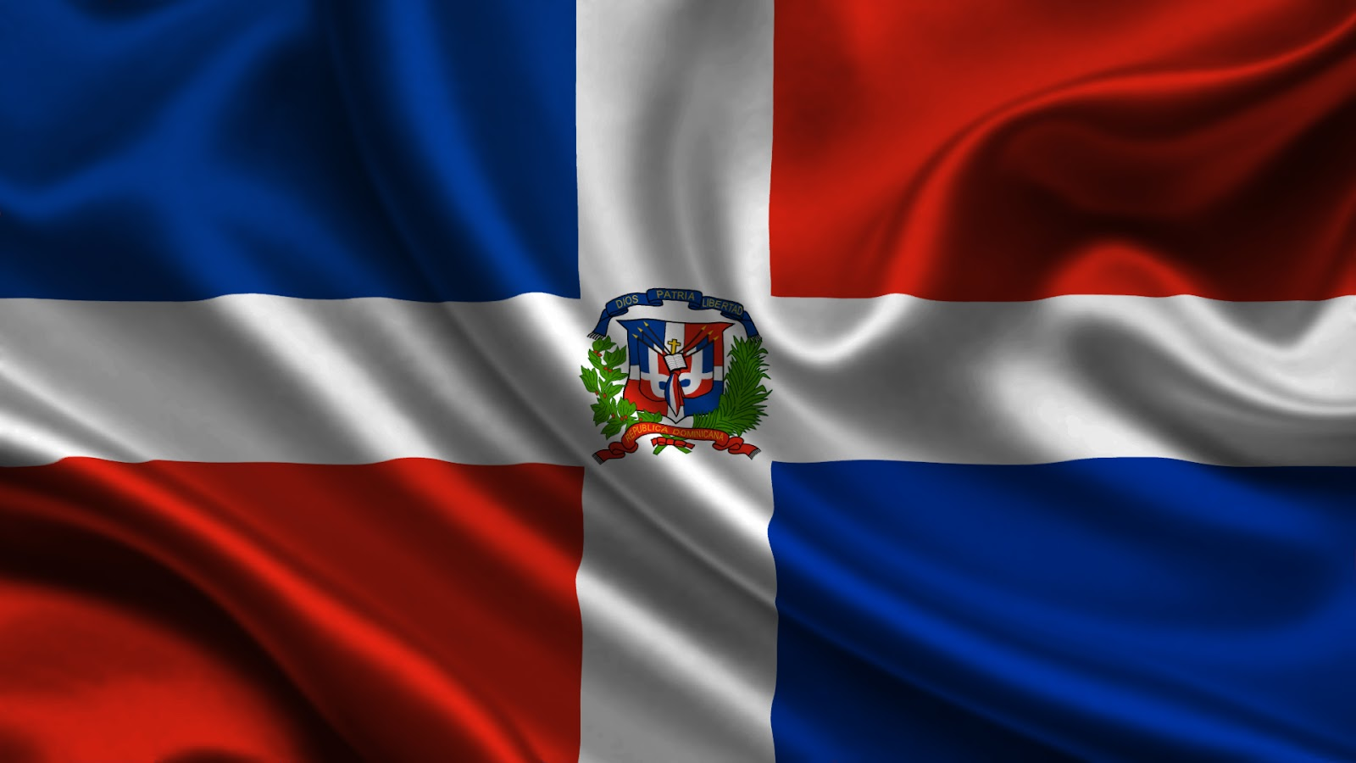
Thank you
Ing. Omar Reyes Herrera
omarrey17@hotmail.com

