Slide 1
Basic Laboratory Calibrations
(Stopwatches and Tachometers)
2015 SIM TFWG Workshop
Luis Mojica Ovalle
lmojica@cenamep.org.pa
mojica25@hotmail.com
Electromagnetic Magnitudes Area
CENAMEP AIP

Slide 2
Stopwatch and Tachometer Calibrations
  OUTLINE:
  About the presentation
  Stopwatch Calibrations
  Device Under Test (DUT)
  Traceable Reference
  Calibration Method
  Calibration Result
  Tachometer Calibrations
  Device Under Test (DUT)
  Traceable Reference
  Calibration Method
  Calibration Result

Slide 3
Stopwatches and Tachometers Calibrations
REFERENCES:
NIST - Practice Guide Timer Calibrations - 2009 Edition
L. M. Mojica and R. F. Solis, "Error de Tiempo en Cronometros Digitales en Base a Mediciones de Intervalo de Tiempo y Frecuencia," Proceedings of 2011 SEMETRO Conference, Natal, Brazil, 8 p., September 2011.
J. Jiménez and H. Sánchez, "Calibracion de Cronometros Mediante la Medicion de la Frequencia del Oscilador de Cuarzo," Proceedings of 2009 SEMETRO Conference, João Pessoa, Paraíba, Brazil, 3 p., June 2009.
L. Trigo and D. Slomovitz, "Calibración de cronómetros digitales por método de inducción," IEEE Encuentro de Energía, Potencia, Instrumentación y Medidas, Montevideo, Uruguay, pp. 21-23, October 2008.
MSL - Technical Guide 8 - Calibration Stopwatch

Slide 4
  Why measurement instruments need calibration? ??
  Do We make measurements without errors? ??

Slide 5
I PART
Stopwatch Calibrations

Slide 6
Stopwatch/Timer Calibrations
  Device Under Test (DUT)
  Traceable Reference
  Calibration Method
  Calibration Result

Slide 7
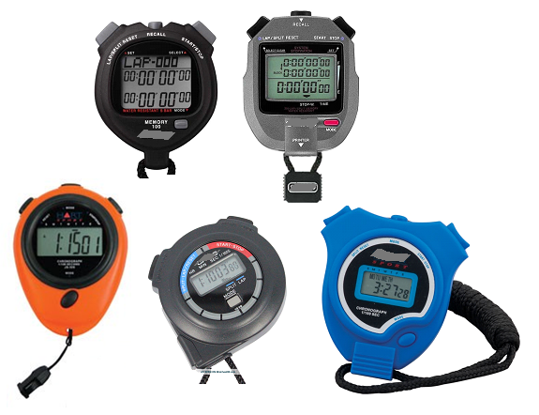
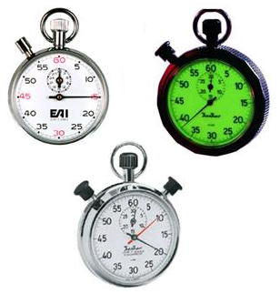
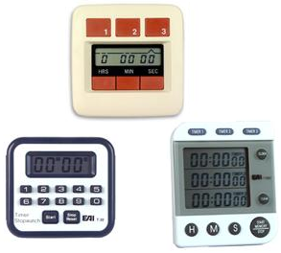
Stopwatches/Timers
Timers
Mechanical Stopwatches
Used extensively in industry is the process control timer.
Digital Stopwatches
Digital stopwatch have a digital design employing quartz oscillators and electronic circuitry.
Mechanical stopwatches have an analog design and use mechanical mechanisms.
Timers, unlike stopwatches, count down from a preset time period instead of
counting up from zero.
  “Time Interval Meters”

Slide 8
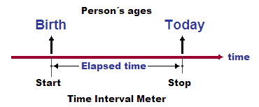
  WHAT ABOUT STOPWATCHES AND TIMERS?
Instruments used to measure time interval.
Time interval is defined as the elapsed time between two events.
The standard unit of time interval is the second (s)
from NIST - Practice Guide Timer Calibrations - 2009 Edition .

Slide 9
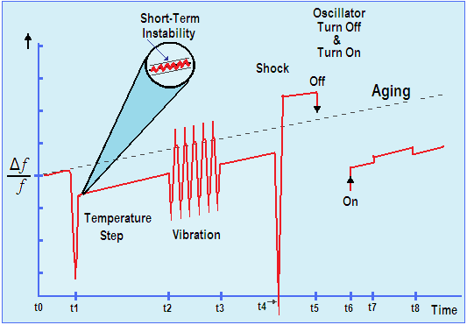
  WHY WE NEED TO CALIBRATE A STOPWATCH OR LABORATORY TIMER?
Many factors can cause a quartz crystal oscillator to change frequency.
from NIST - Practice Guide Timer Calibrations - 2009 Edition.

Slide 10
  WHY WE NEED TO CALIBRATE A STOPWATCH OR LABORATORY TIMER?
The measurement of time interval is an important parameter in many laboratory or industrial measurements.
For example:
  Flow measurement
  process timing
  chemical measurement
  and radiological exposure control
from MSL Technical Guide 8 - Calibration Stopwatches.

Slide 11
  Uses of Stopwatches and Timers in Panamá
Inspection and certification of quality oil with emphasis on marine fuels.
To test viscosity oil products: measuring the time it takes to move into a glass capillary.
In creating tablets (medical pills): to control the timing of the various steps in a process called Wet Granulation.
In real-time PCR methodologies: for rapid detection of the presence of pathogenic microorganisms in food (Genetic Detection System Assurance GDS).

Slide 12
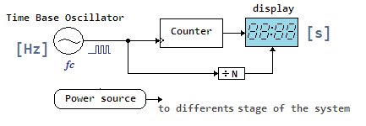
  Some Stopwatch/Timer physical features
Every stopwatch is composed of four elements:
  Power source
  Time base
  Counter
  Indicator (display).

Slide 13
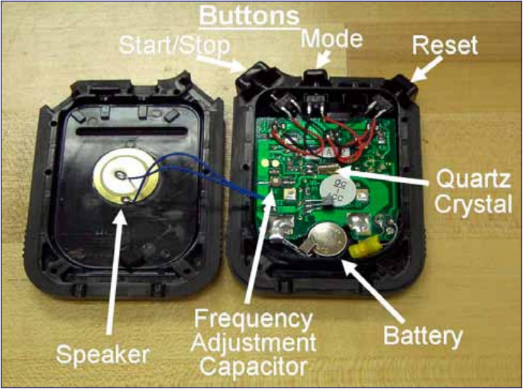
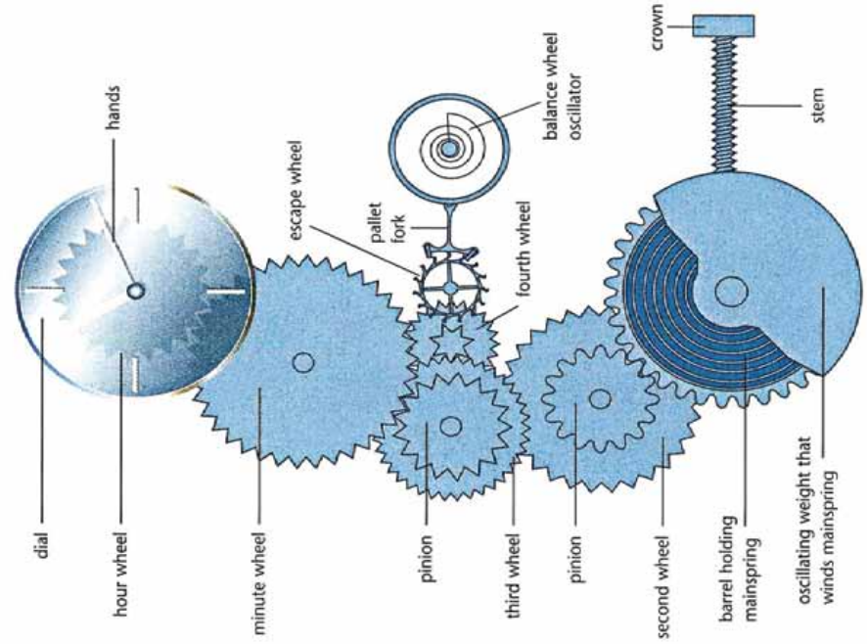
  Some Stopwatch/Timer physical Features
Interior of digital stopwatch.
Interior of mechanical stopwatch.
The design and construction of each component depends upon the type of stopwatch.
from NIST - Practice Guide Timer Calibrations - 2009 Edition .

Slide 14
  About of Stopwatch/Timer Especification
Stopwatch
Resolution:
  1/100 second
  1/1000 second
Total elapsed time display:
  Times up to 10 hours
  9:59’59.999’’
  0 to 99 hours, 59 minute, 59 second
Accuracy
  ±30 seconds/month
  99.9988 %
  ± 5 s/day
Timer
Countdown timer:
  100 hours. Count Down/ Up Timer
  99 hours, 59 minute, 59 second to 0

Slide 15
Stopwatch/Timer Calibrations
  Device Under Test (DUT)
  Traceable Reference
  Calibration Method
  Calibration Result

Slide 16
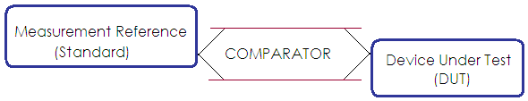
  Like all calibrations, stopwatch and timer calibrations are simply comparisons
  Measurement reference are:
      a time interval standard or
      a frequency standard
  If a time interval standard is used, it is compared to the DUT’s display.
  If a frequency standards is used, it is compare to the DUT’s time base oscillator.

Slide 17
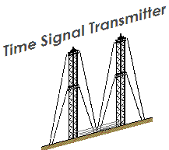

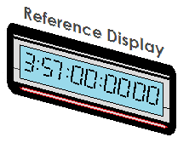

  Examples of Traceable Reference
  Time Interval References:
  Traceable time display.
  Time base oscillator.
  An traceable audio time signal (usually obtained with a shortwave radio or a telephone).
  Since time interval (and not absolute time) is being measured, the fixed signal delay from the source to the user is not important as long as it remains relatively constant during the calibration process.

Slide 18
Stopwatch/Timer Calibrations
  Device Under Test (DUT)
  Traceable Reference
  Calibration Method
  Calibration Result

Slide 19
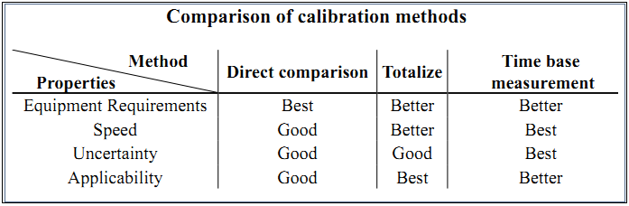
  Generally accepted methods for calibrating a stopwatch or timer
  Direct comparison method
  Totalize method
  Time base method
Start
Stop
Time Interval Reference
Measured Time Interval
Measurement Error!!

Slide 20
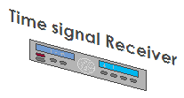


  Direct comparison method
Consists of time interval measurements that compare the time
interval display of the DUT to a traceable time interval reference.
  The time interval reference is normally a signal broadcast by an NMI, usually in the form of audio tones.
DUT
Telephone Network

Slide 21
  Direct comparison method
Advantages:
  relatively easy to perform: if a telephone is used, does not require any test equipment or standard.
  It can be used to calibrate all types of stopwatches and many types of timers, both electronic and mechanical.
Disadvantages:
  The operator’s start/stop reaction time is a significant part of the total uncertainty.
  It requires long measurement periods.

Slide 22
  Direct comparison method
  Three potentially significant sources of uncertainty:
    The reaction time of the calibration technician.
    The resolution of the DUT.
    The uncertainty of the reference.

Slide 23
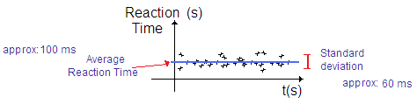
  Direct comparison method
Sources of uncertainty:
The reaction time of the calibration technician:
  The average reaction time of the operator can be either negative (anticipating) or positive (reacting after).
  It is recommended that each calibration laboratory perform tests to determine the uncertainty of their operator’s reaction
  time.

Slide 24
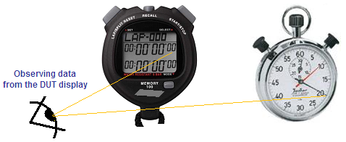
  Direct comparison method
Sources of uncertainty:
The resolution of the DUT:
Typical Resolution
1/100 second
1/1000 second
This method requires observing data from the DUT display.
For digital indicating devices:
Resolution uncertainty is one half of the least significant digit
(assumed rectangular probability distribution).
For an analog watch:
The same method of determining resolution uncertainty may be
used because the watch moves in discrete steps from one fraction
of a second to the next.

Slide 25
  Direct comparison method
  The uncertainty of the reference:
Using ordinary land line:
It is recommended that an
uncertainty of 30 ms be assigned if
the reference signal is one of the
telephone services, two phone
calls.
Using a not ordinary land line:
It is recommended that an uncertainty of 150 ms be assigned if wireless or VOIP networks are used.
(ITU recommends that delays be kept below this level to avoid the distortion of voice transmissions )
or 250 ms if calls are routed through a satellite. (Although the use of satellites is now rare)
Telephone Network
Ordinary or not ordinary land
DUT
Embedded System or PC System

Slide 26
  Direct comparison method
  The uncertainty of the reference (Continuation):
Using radio signals:
it is recommended that an
Uncertainty often less than 0.01
ms be assigned .
if a one hop path becomes a two hop path, the
received uncertainty of the radio signal will still
not exceed 1 ms.
Using time display:
It can generally be assumed that
the uncertainty of the display is less than1 ms be assigned.
This is because instruments that continuously
synchronize their displays to traceable signals
will normally have repeatable and stable delays.
DUT

Slide 27
  Uncertainty analysis for direct comparison method
  A example using ordinary land Line
Source of uncertainty | Magnitude, ms | Method of evaluation | Distribution | Standard uncertainty, ms
Reaction time average | 100 | Type B | Rectangular | 58
Reaction time standard deviation | 60 | Type B | Normal (k=1) | 60
Telephone delay deviation | 30 | Type B | Rectangular | 17
½ DUT resolution | 5 | Type B | Rectangular | 3
Combined uncertainty |  |  |  | 85
Expanded uncertainty (k = 2, approximately a 95 % level of confidence) |  |  |  | 170
* Assuming: Resolution 0.01 s and operators had previous experience calibrating stopwatches.

Slide 28
  Generally accepted methods for calibrating a stopwatch or timer
  Direct comparison method
  Totalize method
  Time base method
Start
Stop
Time Interval Reference
Measured Time Interval
Measurement Error!!

Slide 29
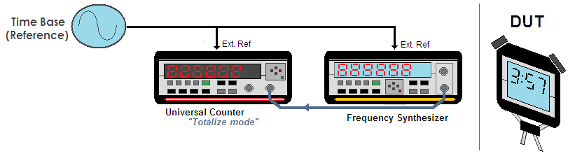
  Totalize method
Partially eliminates the measurement uncertainty from human reaction time.
The time interval reference is generated in the laboratory using a synthesized signal generator, a universal counter, and a traceable frequency standard.
To begin the measurement, start the stopwatch and manually open the gate of the counter at the same time.
The frequency should have a period at least one order of magnitude smaller than the resolution of the stopwatch.
Stopwatch Resolution | Period synthesized signal | Frequency synthesized signal
0.01 s | T < 0.001 s | f > 1 kHz
0.001 s | T < 0.0001 s | f > 10 kHz

Slide 30
  Totalize method
Advantages:
  Partially eliminates the measurement uncertainty from human reaction time.
  Therefore has a lower measurement uncertainty than the direct comparison method.
Disadvantages:
  Requires more equipment than the direct comparison method.

Slide 31
  Totalize method
Source of Measurement Uncertainty:
Ranging from 1×10⁻⁶ to 1×10⁻⁹;
cesium oscillator or a GPS disciplined
Oscillator 1×10⁻¹² or less.
Half of the least significant digit.
*Rectangular distribution
  Device Under Test Resolution Uncertainty
  Uncertainty of the Frequency Reference
±1 least significant digit on the display.
* The counter is simply used as an event counting device
  Uncertainty Due to the Counter
  Uncertainty Due to Human Reaction Time
Example:
Mean reaction time 27 ms,
Standard deviation 10 ms

Slide 32
  Uncertainty analysis for totalize method
A example:
Source of uncertainty | Magnitude, ms | Method of evaluation | Distribution | Standard uncertainty, ms
Reaction time average | 35 | Type B | Rectangular | 20
Reaction time standard deviation | 12 | Type B | Normal (k=1) | 12
Synthesizer accuracy | 0 | Type B | Rectangular | 0
Totalize counter resolution | 1 | Type B | Rectangular | 1
½ DUT resolution | 5 | Type B | Rectangular | 3
Combined uncertainty |  |  |  | 24
Expanded uncertainty (k = 2, approximately a 95 % level of confidence) |  |  |  | 47
* Assuming: Resolution 0.01 s and operators had previous experience calibrating stopwatches.

Slide 33
  Generally accepted methods for calibrating a stopwatch or timer
  Direct comparison method
  Totalize method
  Time base method
Start
Stop
Time Interval Reference
Measured Time Interval
Measurement Error!!

Slide 34

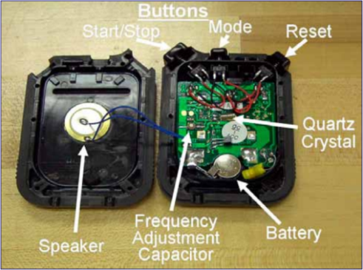
  Time base method
You should never disassemble a stopwatch or timer and attempt to measure the time base frequency by making a direct electrical connection.
“The crystal oscillators in these units are very small, low-power devices.
Their frequency can dramatically change if they are disturbed or loaded down by the impedance of a frequency counter, and in some cases they can even be destroyed by incorrect electrical connections”
from NIST - Practice Guide Timer Calibrations - 2009 Edition .

Slide 35
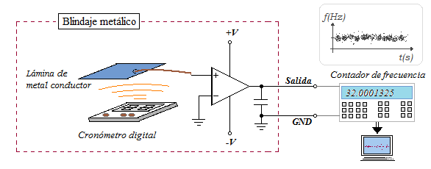
  Time Base Method
This method is a frequency measurement.
It compares the frequency of the DUT’s time base oscillator to a
traceable frequency standard.
Use “Inductive or Acoustic pickup to measure the time base
frequency.
The exact method of measuring the stopwatch’s time base depends
upon the type of stopwatch or timer being calibrated.
Time base Calibrated or
Traceable external Ref.

Slide 36
  Time base method
About measurement system
Time base Calibrated
or
Traceable external Signal.
The frequency counter time base must have been recently calibrated and certified.
“A better solution is to have a traceable 5 MHz or 10 MHz signal that can be used as an external time base for the frequency counter and all other test equipment”

Slide 37
  Time base method
About measurement system
“Inductive or Acoustic pickup to measure the time base frequency”
An acoustic pickup can be used to measure the “tick” of a mechanical stopwatch.
An inductive pickup can even be used to sense the stepping motor frequency of analog mechanical stopwatches, or the “blink rate” of a digital stopwatch display.
An inductive or acoustic pickup can be used to monitor the stopwatch’s time base frequency. (Digital and LED-type stopwatch).
Time base Calibrated or
Traceable external Ref.
Read: L. Trigo and D. Slomovitz, "Calibración de cronómetros digitales por método de inducción,"

Slide 38
  Time base method
Advantages:
This method is also much faster.
Eliminates the uncertainty introduced by human reaction time.
Uncertainty can be reduced by at least two orders of magnitude when
compared to the direct comparison method, often to 1×10⁻⁶ or less.
Disadvantages:
Requires more equipment.
Does not easily work on some electrical, mechanical, or
electro-mechanical units.
It also does not test the functionality of the stopwatch or timer, only
the time base.

Slide 39
  Time base method
Uncertainties Source:
For example, If we use a time base stopwatch calibrator and take into account its:
  Specified accuracy of ±0.005 s/day
  Resolution of 0.001 s
Important:
  There is no uncertainty contributed by human reaction time.
  The resolution uncertainty of the stopwatch calibrator is
  insignificant compared to its accuracy specification.
  Resolution uncertainty does not need to be considered, since
  data are not observed from the DUT’s display.

Slide 40
  Time base method
An example:
Source of uncertainty | Magnitude, ms | Method of evaluation | Distribution | Standard uncertainty, ms
Reaction time average | 0 | Type B | Rectangular | 0
Reaction time standard deviation | 0 | Type B | Normal (k=1) | 0
Measurement system accuracy | 5 | Type B | Rectangular | 3
Measurement system resolution | 1 | Type B | Rectangular | 1
½ DUT resolution | 0 | Type B | Rectangular | 0
Combined uncertainty |  |  |  | 3
Expanded uncertainty (k = 2, approximately a 95 % level of confidence) |  |  |  | 6

Slide 41
Stopwatch/Timer Calibrations
  Device Under Test (DUT)
  Traceable Reference
  Calibration Method
  Calibration Result

Slide 42
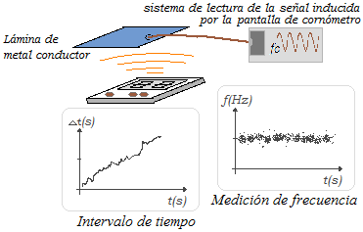
  Calibration Result
Time interval measurement
Frequency measurement
Δt
━
Τ
Δf
━
f
Start
Stop
Time Interval Reference
Measured Time Interval
Measurement Error!!

Slide 43
  Calibration Result
Start
Stop
Time Interval Reference
Measured Time Interval
Measurement Error!!
Time interval measurement
Frequency measurement
Δt
━
Τ
Δf
━
f
What is the ecuation?
Δt
━
Τ
Δf
- ━
f
Δt
━
Τ
Δf
━
f
=
or
=

Slide 44
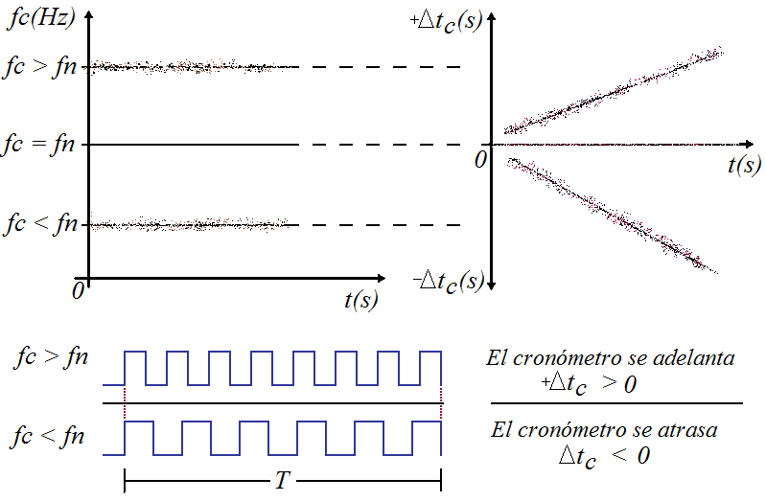
  Calibration Result
Answer the question:
Δt
━
Τ
Δf
━
f
=
* Do not use negative sign!

Slide 45
  Calibration Result
Example: If a time base measurement calibration result is:
Δf
━
f
7E-6 Hz/Hz
=
Δt
━
Τ
Δf
━
f
Using:
=
The Error at T=24 hours is:
Δt
7E-6 * 86400 s
=
Δt
0.604 s @ 1 day
=

Slide 46
Conclusion
Calibration methods should be used carefully.
All calibration methods are complement of each other.
Before any calibration check uncertainty ratio
(TUR 4:1 can be acceptable)
Never disassemble a stopwatch or timer and attempt to
measure the time base frequency by making a direct
electrical connection.

Slide 47
¡Muchas Gracias!
“Muito obrigado”
Thank you very much!
SIM TFWG

Slide 48
Video

Slide 49
II PART
Tachometer Calibrations

Slide 50
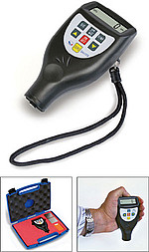
OBJETIVO
Calibración de Tacómetros
Presentar un procedimiento y método para la calibración de Medidores de Frecuencia de Acople Óptico (MFAO)
Ejemplo: Tacómetros.
ALCANCE
Abarca Medidores de Frecuencia de Acople Óptico (MFAO) desde 0,5 Hz hasta 250 kHz.

Slide 51
Tachometer Calibrations
  Device Under Test (DUT)
  Traceable Reference
  Calibration Method
  Calibration Result

Slide 52
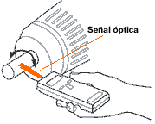
Tacómetros
Es un instrumento utilizado para medir frecuencia de rotación por ejemplo, contar el número de revoluciones de un eje por unidad de tiempo.
El tacómetro óptico mide la frecuencia de rotación (RPM) en un elemento rotatorio, usando un has de luz visible.
Según el tipo de acople, hay tacómetros de acople óptico y de acople mecánico.
Esta presentación está enfocada a los tacómetros de acople óptico.

Slide 53
Tacómetros
Magnitud y unidad de medida
60 RPM
1 Hz
Frecuencia de rotación
[RPM]
=
Frecuencia
[Hz]
Para fenómenos mecánicos repetitivos como la rotación de ejes de motores, por ejemplo, la frecuencia usualmente se mide en revoluciones por minuto y su símbolo se expresa como r/min o también RPM.
En señales eléctricas, la unidad estandar para frecuencia es el hertz (Hz), definido como el número de eventos o ciclos por segundo.

Slide 54
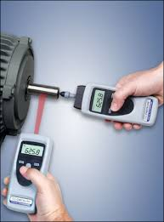
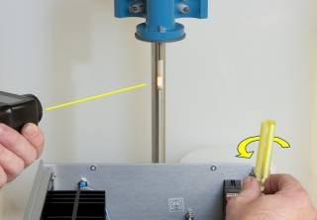
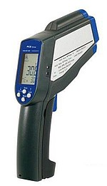
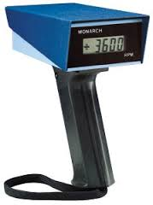
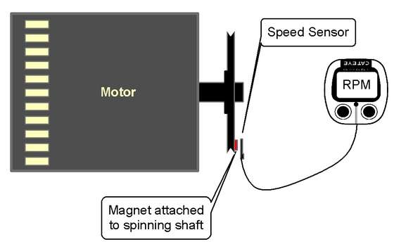
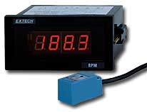
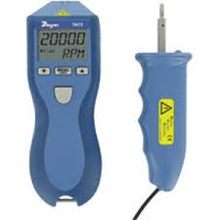
Tacómetros
La construcción robusta, portabilidad y características notables del tacómetro óptico, lo hacen ideal para el departamento de mantenimientos, operadores de máquinas y varias otras aplicaciones en máquinas.
Use an Optical Tachometer
with Reflective Target

Slide 55
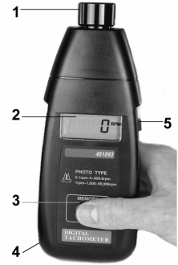
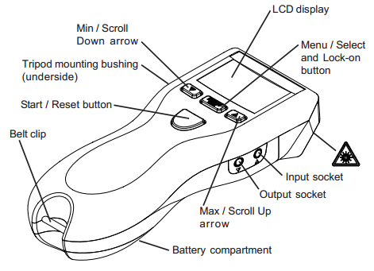
Localización de Características
Fuente de iluminación
Pantalla LCD
Botón para registro en memoria
Compartimento de la batería atrás
Botón de medición

Slide 56
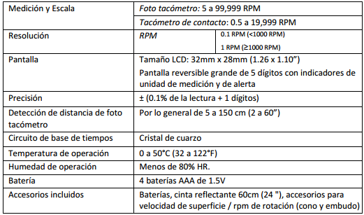

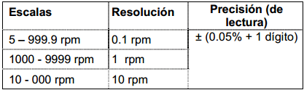
Acerca de las especificaciones técnicas

Slide 57
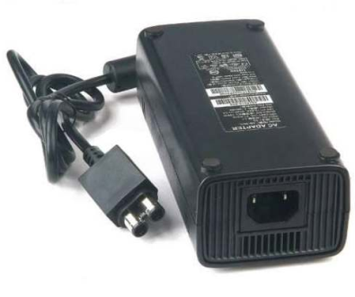
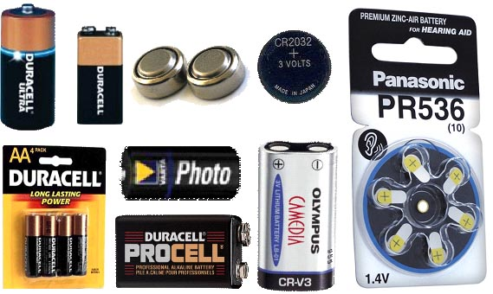
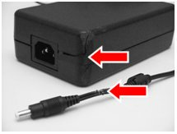
Recepción del equipo
Entrega del MFAO por parte del cliente.
Debe verificarse el funcionamiento del MFAO.
Puede ser aceptado ó rechazado el MFAO.
Para un MFAO es motivo de rechazo técnico problemas en lo siguiente:
Botones en mal estado.
Baterías agotadas.
Display quebrado.
Sensor óptico dañado.
Notes:
Para un MFAO es motivo de rechazo técnico problemas en lo siguiente:
-Alimentación del objeto (baterías o fuentes de alimentación).
-Problemas en lo botones.
-Problemas con la pantalla de visualización de los datos de medida.
-Problemas al momento de capturar la señal (fallas del sensor).
-Limpieza general del equipo.

Slide 58
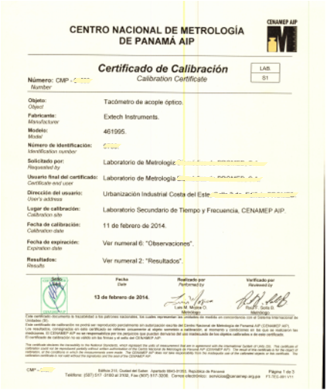
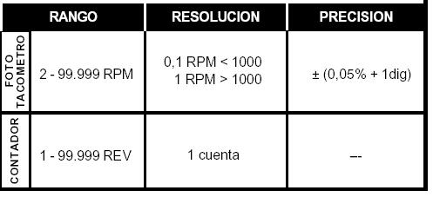
Documentos necesarios para la calibración
Manual del objeto bajo calibración.
Las especificaciones técnicas que otorga el fabricante.
Certificados de calibración anteriores, si aplica.
Notes:
Protocolo de calibración codificada PT-S1-001.
Hoja de cálculo codificada CL-S1-00.1

Slide 59
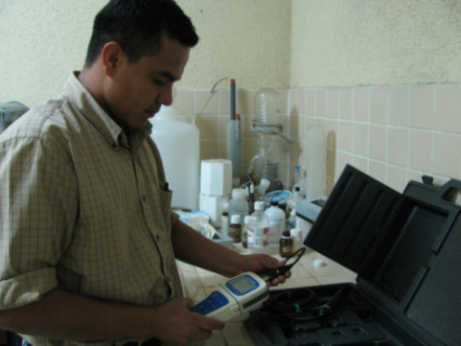
Manejo del equipo bajo calibración
El manejo, transporte y manipulación de equipos empleados para realizar el proceso de calibración debe darse con mucho cuidado.
Golpes, impactos fuertes ó someterlo a condiciones ambientales extremas pueden ocasionar daños irreversibles en el MFAO.
Muchos factores pueden causar cambios en la frecuencia de un oscilador de cuarzo.

Slide 60
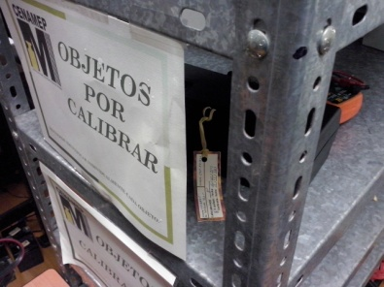
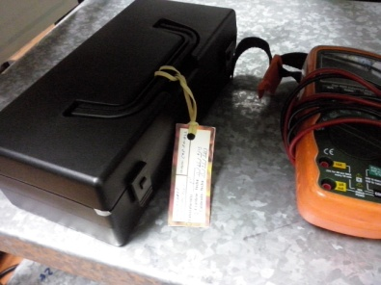
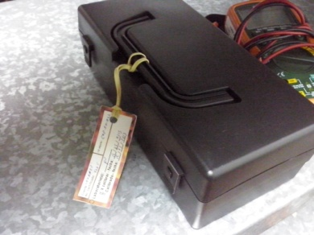
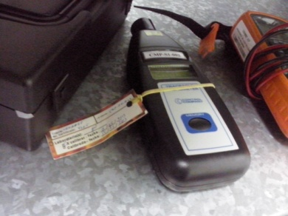
Manejo del equipo bajo calibración
Marcado y almacenaje del MFAO
El equipo bajo calibración debe ser almacenado en un lugar seguro que evite que sus propiedades de trabajo sean afectadas y que no se confundan con otros equipos bajo calibración dentro del laboratorio.

Slide 61
Tachometer Calibrations
  Device Under Test (DUT)
  Traceable Reference
  Calibration Method
  Calibration Result

Slide 62
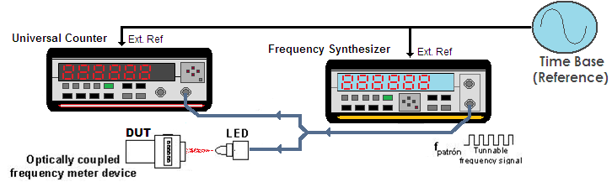
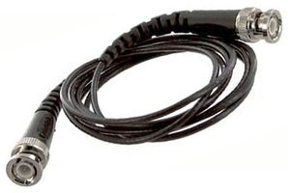
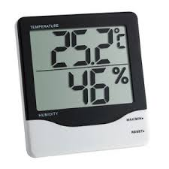
Sistema de calibración
Equipos de medición
Sistema de generación de señales
  Disciplinado a una señal patrón
  trazable al SI.
  Adaptador para generar pulsos ópticos.
Contador de señales
  Disciplinado a una señal patrón
  trazable al SI.
  Utilizado para medir la frecuencia de la
  señal generada .
Equipos auxiliares
Medidor de condiciones ambientales:
  Resolución en temperatura
  < 0,1 ºC
  Resolución en humedad relativa
  < 1 % RH.
Cables en buenas condiciones:
  Coaxiales con conectores BNC.
Notes:
Patrón de Referencia: Por ser este un servicio el cual posee su Capacidad de Medición y Calibración inscrita en el BIPM, la referencia deberá ser mantenida mediante un PPTF o escala de tiempo que realice UTC(CNMP), posea trazabilidad y mantenga un sistema de aseguramiento de la calidad de los datos generados. La señal de referencia es de 10 MHz.
El contador de señales: deberá estar disciplinado con la señal de 10 MHz que también disciplina al sistema de generación y que sean trazables a UTC(CNMP). Además deberá mantener las características determinadas para brindar el servicio de calibración.
Sistema de generación de señales: Se encarga de generar las señales con las que mediante el convertidor a pulsos lumínicos, genera el estimulo en los sensores de los equipos. - -Generar señales con amplitudes de 0,5 V a 5 V.
-Tarjeta procesadora y programa TYFCONTROL.

Slide 63
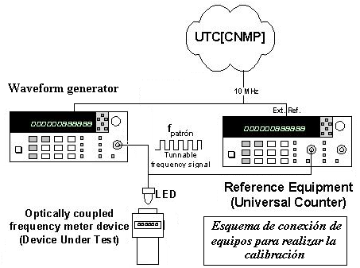
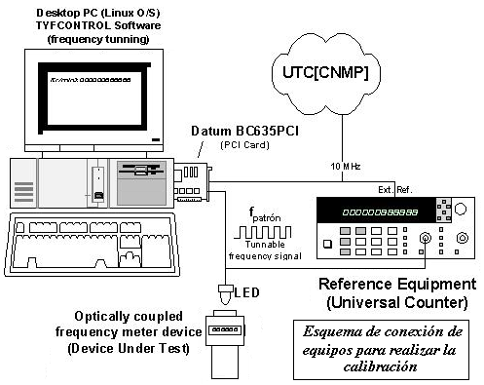
Configuración del sistema de calibración
Sistema de calibración de MFAO utilizando la tarjeta procesadora de tiempo y frecuencia.
Sistema de calibración de MFAO utilizando un generador de señales
Notes:
Diodo emisor de luz (generador de pulsos ópticos).
Divisor de potencia (una T se puede emplear pero se busca que tengan los mismos voltajes tanto en el generador de pulsos como en el contador de frecuencia).

Slide 64
Configuración del sistema de calibración
Configuración para el generador de señales:
- Generar señales cuadradas con amplitudes de 0,5 V a 5 V.
- Frecuencia de la señal según cada punto de calibración.
Configuración para el contador de señales:
- Medición de frecuencia.
- Impedancia de entrada de 1 MΩ.
- Acople de entrada en DC.
- Nivel de disparo manual (dependiendo del nivel
de salida del generador de frecuencia).
- Ventana de observación de 10 s.
- Si el MFAO es un tacómetro, cambiar el factor de
multiplicación de 1 a 60 (1 Hz = 60 RPM).

Slide 65
Trazabilidad del sistema de calibración
Antes de iniciar la calibración debemos primero
validar la trazabilidad documentada de los equipos
involucrados.
La evidencia de trazabilidad puede ser localizada
por ejemplo en:
  Base de datos del SIM (SIMT) o del BIPM (Circular T),
  ingresando en sus respectivas páginas web.
  Certificados de calibración de los equipos del sistema de referencia.

Slide 66
Tachometer Calibrations
  Device Under Test (DUT)
  Traceable Reference
  Calibration Method
  Calibration Result

Slide 67
Método de calibración
Calibración por Comparación Directa contra la medida de frecuencia
de un contador de frecuencias trazable al SI.
Un sintetizador de señales hace encender y apagar un diodo emisor
de luz (LED) para generar pulsos ópticos de una frecuencia conocida y
trazable al SI.
El intervalo de tiempo entre cada pulso óptico corresponde a un
periodo de la frecuencia de señal.
“La frecuencia de los pulso ópticos se miden tanto con el MFAO como el contador de frecuencia”

Slide 68
Condiciones ambientales para la calibración
Las condiciones ambientales deben estar dentro del siguientes valores:
  Temperatura: 23 ºC ± 3 ºC.
  Humedad relativa: 55 %RH ± 20 %RH.
El objeto deberá permanecer en el laboratorio por lo menos 24 horas antes de realizar la calibración para asegurar una completa estabilidad térmica.
Notes:
Si va a ser restablecido el proceso de calibración, las condiciones ambientales deberán pasar por lo menos 4 horas de estabilización antes de iniciar la toma de datos para asegurar las características del área de trabajo.

Slide 69
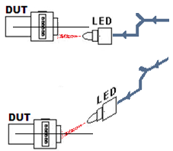

Precauciones para la calibración
Alineación: es recomendable fijar adecuadamente tanto el sensor óptico del MFAO como el generador de pulsos ópticos.
Realizar una medición de prueba para verificar que no hay interferencias lumínicas alrededor.
Notes:
De esta forma, el sistema generador de pulsos ópticos se debe colocar perpendicular a la superficie del MFAO a una distancia entre 1 cm y 5 cm.
Antes de activar la señal de pulsos de luz, y una vez montado el MFAO en el lugar de calibración, se deberá realizar una medición con éste, para verificar que no existen otras señales lumínicas que puedan causar errores en la medición.

Slide 70
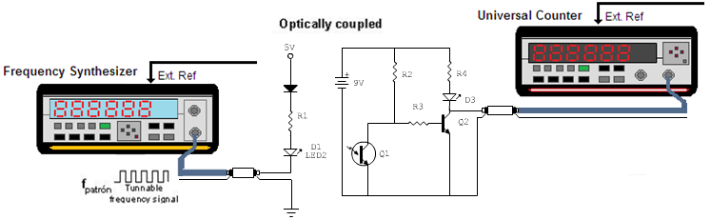
Precauciones para la calibración
Se debe verificar que la frecuencia luminosa generada por el LED corresponda a la frecuencia generada por la fuente utilizada (tarjeta procesadora o generador de ondas).
Circuito de verificación de la conversión de la señal eléctrica a luz.
Notes:
Se debe verificar que la frecuencia luminosa generada por el LED corresponda a la frecuencia generada por la fuente utilizada (tarjeta procesadora o generador de ondas). Por ello se utilizará un circuito de verificación como el indicado en la figura.

Slide 71
Escogencia de los puntos de calibración
El objeto deberá ser calibrado en diez puntos.
Se deben medir al menos dos puntos por escala de medición del MFAO.
Típicos puntos de Calibración (RPM)
50
100
500
750
1 000
2 500
5 000
7 500
10 000
15 000
50 000
93 750
*El cliente puede solicitar puntos de calibración diferentes a los presentados en la tabla.
Valores típicos de cambio de escala en los tacómetros
100 RPM
1 000 RPM
10 000 RPM
Notes:
Los puntos deberán (no obligatorio) ser escogidos con respecto al máximo y mínimo medible de la escala y cubriendo varios puntos en medio.
Se recomiendan puntos alrededor del inicio y del final de cada escala.

Slide 72
Toma de datos durante la calibración
Se ajusta la salida del generador de señales a la
frecuencia de los puntos escogidos.
Para los tacómetro, se activará la medición por un
intervalo de tiempo mayor o igual a 10 segundos.
Se realizan cinco mediciones por cada punto de
calibración.
Los valores medidos se registran en el protocolo de
calibración tan pronto se estabilicen las lecturas en
el tacómetro.
Notes:
Para el tacómetro: y se anotará la lectura tanto del contador de frecuencia de referencia como del tacómetro en el protocolo de calibración.

Slide 73
Ejemplo de datos registrados en la calibración
Referencia (RPM) | Objeto (RPM)
50.00 | 50.0
 | 50.0
 | 50.0
 | 50.0
 | 49.9
100.00 * | 100.0
 | 100.9
 | 100.0
 | 999.9
 | 100.0
500.00 | 500.0
 | 500.0
 | 500.0
 | 500.0
Protocolo de calibración:
Información del MFAO.
Información de los instrumentos. del sistema de calibración.
Información de las condiciones ambientales del laboratorio.
Fechas de inicio y fin de la calibración.
Número de certificado de calibración
* No hubo cambio en la resolución del tacómetro

Slide 74
Tratamiento de los datos
La estimación de la incertidumbre y la expresión de los resultados de la calibración, se hacen conforme a lo expresado en la Guía de Estimación de Incertidumbre de Medición (GUM).
El procesamiento de los datos se realiza mediante la hoja d e cálculo, creada en Excel.

Slide 75
Estimación de incertidumbre
Para cada punto de medición, debe establecerse el error mediante la siguiente ecuación:
En donde:
: Error de medición de frecuencia.
: frecuencia medida por el MFAO.
: frecuencia medida por el contador de frecuencia de referencia.

Slide 76
Fuentes de Incertidumbre
Repetibilidad de la medición (U_{rep})
Resolución del MFAO (U_{ores})
Incertidumbre del conjunto patrón
(U_{Pat} )
Se considera como única fuente de incertidumbre la resolución de éste (u_{Ores}).
La incertidumbre del conjunto patrón (u_{Pat}) incluye la estabilidad de la base de tiempo de referencia.
La componente de repetitividad de las mediciones para los intervalos calibrados (u_{Rep}).

Slide 77
Fuentes de Incertidumbre
MFAO digital
(distribución rectangular)
MFAO analógico
(distribución triangular)
(u_{Ores}).
I: es el intervalo de la mínima división de la escala en el objeto
Un valor de 1.4×10⁻⁸ Hz/Hz, basado en la validación del método de calibración de este procedimiento.
(u_{Pat}).
f : frecuencia medida por el contador de frecuencia de referencia
(u_{Rep}).
Repetitividad de la medición se obtiene para cada punto.

Slide 78
Datos transferidos a la hoja de cálculo de Excel
Número de Certificado | 00357 | Identificación | CMP-S1-001
Objeto | Tacómetro de acople óptico | Modelo | Photo/Contact Tachometer
Fabricante | Traceable | Unidades | RPM | Tipo de visualización | Digital
 | Referencia (RPM) | Objeto (RPM) | Promedio del Objeto (RPM) | Error (RPM) | Desvío Estándar
1 | 50.00 | 50.0 | 49.98 | -0.02 | 0.04
 |  | 50.0
 |  | 50.0
 |  | 50.0
 |  | 49.9
2 | 100.00 | 100.0 | 100.00 | 0.00 | 0.00
 |  | 100.0
 |  | 100.0
 |  | 100.0
 |  | 100.0
3 | 500.00 | 500.0 | 500.00 | 0.000 | 0.000
 |  | 500.0
 |  | 500.0
 |  | 500.0
 |  | 500.0
4 | 750.00 | 750.1 | 750.10 | 0.100 | 0.000
 |  | 750.1
 |  | 750.1
 |  | 750.1
 |  | 750.1

Slide 79
Estimación de incertidumbre y hoja de cálculo
Fuente | Incertidumbre (RPM) | Distribución | ui*ci (RPM) | Peso (%) | Incertidumbre combinada (RPM) | [Ui/Uc]⁴/v_{i} | Veff | Factor de cobertura k (95,45) | Incertidumbre Expandida (RPM) | Incertidumbre Expandida (RPM) | Incertidumbre Relativa (RPM/RPM)
u_{ORES} | 0.1 | Rectangular | 2.89E-02 | 39.22 | 0.053 | 1.73E-05 | 8.03 | 2.37 | 0.1260 | 0.20 | 4.0E-03
u_{PAT} | 4.20E-05 | Normal | 2.10E-05 | 0.03 |  | 4.85E-17
u_{REP} | 0.0447 | Normal | 4.47E-02 | 60.75 |  | 1.25E-01
u_{ORES} | 0.1 | Rectangular | 2.89E-02 | 99.85 | 0.029 | 2.00E-04 | 5000.02 | 2.00 | 0.06 | 0.10 | 1.0E-03
u_{PAT} | 8.40E-05 | Normal | 4.20E-05 | 0.15 |  | 8.96E-15
u_{REP} | 0.00E+00 | Normal | 0.00E+00 | 0.00 |  | 0.00E+00
u_{ORES} | 0.1 | Rectangular | 2.89E-02 | 99.28 | 0.029 | 1.73E-05 | 57800.02 | 2.00 | 0.06 | 0.10 | 2.0E-04
u_{PAT} | 4.20E-04 | Normal | 2.10E-04 | 0.72 |  | 4.85E-13
u_{REP} | 0.00E+00 | Normal | 0.00E+00 | 0.00 |  | 0.00E+00
u_{ORES} | 0.1 | Rectangular | 2.89E-02 | 98.92 | 0.029 | 2.00E-04 | 5001.19 | 2.00 | 0.06 | 0.10 | 1.3E-04
u_{PAT} | 6.30E-04 | Normal | 3.15E-04 | 1.08 |  | 2.83E-11
u_{REP} | 0.00E+00 | Normal | 0.00E+00 | 0.00 |  | 0.00E+00

Slide 80
Tachometer Calibrations
  Device Under Test (DUT)
  Traceable Reference
  Calibration Method
  Calibration Result

Slide 81
Resultados de la hoja de cálculo
Datos para el certificado de calibración
Punto | Referencia (RPM) | Promedio del Objeto (RPM) | Error (RPM) | Incertidumbre Expandida (RPM)
1 | 50.00 | 50.0 | 0.0 | 0.2
2 | 100.00 | 100.0 | 0.0 | 0.1
3 | 500.00 | 500.0 | 0.0 | 0.1
4 | 750.00 | 750.1 | 0.1 | 0.1
5 | 1000.00 | 999.9 | -0.1 | 0.1
6 | 2500.00 | 2500 | 0 | 1
7 | 5000.00 | 5000 | 0 | 2
8 | 7500.00 | 7500 | 0 | 2
9 | 10000.00 | 10001 | 1 | 3
10 | 15000.00 | 15001 | 1 | 1

Slide 82

Elaboración del certificado de calibración

Slide 83
Elaboración del certificado de calibración
El certificado debe contener la siguiente información:
- Datos del objeto bajo calibración.
Descripción: | Tacómetro de acople óptico.
Máxima capacidad: | 100 000 RPM
Escala bajo calibración (RPM) | Alcance de la calibración (RPM) | Mínima división (RPM))
0 – 1 000 | 50 – 999,9 | 0,1
1 000 – 100 000 | 1 000 – 93 750 | 1
Notes:
Objeto:
Se debe tener una tabla que describa el objeto (como indica el fabricante) su máxima capacidad, escala bajo calibración, los valores medidos en esa escala, y la resolución del sistema de la siguiente manera:

Slide 84
Elaboración del certificado de calibración
El certificado debe contener la siguiente información:
- Resultados de la calibración del objeto.
Lectura de referencia (RPM) | Lectura promedio del objeto (RPM) | Error promedio del objeto (RPM) | Incertidumbre expandida de calibración (RPM)
50,00 | 50,0 | 0,0 | 0,2
100,00 | 100,0 | 0,0 | 0,1
500,00 | 500,0 | 0,0 | 0,1
750,00 | 750,1 | 0,1 | 0,1
1 000,00 | 999,9 | -0,1 | 0,1
2 500,00 | 2 500 | 0 | 1
5 000,00 | 5 000 | 0 | 2
7 500,00 | 7 500 | 0 | 2
10 000,00 | 10 001 | 1 | 3
15 000,00 | 15 001 | 1 | 1
50 000,00 | 50 002 | 2 | 16
93 750,00 | 93 743 | -7 | 62
Nota 1: El error promedio del objeto representa la diferencia entre el valor del patrón de referencia (medida convencionalmente verdadera) y la medida promedio indicada por el tacómetro, por lo tanto:
Error promedio del objeto = Lectura promedio del objeto – Lectura de referencia
Notes:
Los resultados se deben presentar en una tabla que muestre los datos de calibración. Además una nota que informe como se obtiene el error del objeto bajo calibración. Todo esto debe quedar expuesto de la siguiente manera:

Slide 85
Elaboración del certificado de calibración
El certificado debe contener la siguiente información:
- Condiciones Ambientales:
Las condiciones ambientales se mantuvieron dentro del rango permitido para realizar la calibración dentro del laboratorio:
* Rango de la temperatura: 20 ºC a 26 ºC.
*Rango de la humedad: 35 % HR a 75 % HR.
Notes:
Se debe colocar un enunciado que indique que tanto la temperatura y la humedad están dentro de los límites designados para realizar la calibración, por lo que se indican los límites:

Slide 86

Elaboración del certificado de calibración
El certificado debe contener la siguiente información:
-Método de Calibración:
La calibración del objeto fue realizada de acuerdo al procedimiento interno de calibración PE-S1-001.
El periodo empleado para realizar la adquisición de cada uno de los datos en la calibración, fue de 10 segundos.
Esquema de conexión de equipos para realizar la calibración.
Notes:
En el método de calibración se debe poner lo siguiente

Slide 87
Elaboración del certificado de calibración
El certificado debe contener la siguiente información:
-Patrones e Instrumentos utilizados:
Instrumentos | Marca/Modelo/Descripción | Identificación | Documento de Trazabilidad
Patrón de Referencia | Agilent / 5071A / Patrón Atómico de Tiempo | CMP-S0-003 | Circular T*
* La Circular T es un registro mensual que sustenta la trazabilidad del Patrón Nacional de Tiempo y Frecuencia por medio de la comparación clave CCTF-K001.UTC, la cual calcula la escala de tiempo de referencia UTC (Tiempo Universal Coordinado) en conjunto con los otros patrones primarios de tiempo y frecuencia alrededor del mundo. La misma se encuentra publicada en la página del BIPM http://www.bipm.org
Notes:
En la tabla de descripción del patrón, se debe incluir una explicación sobre la trazabilidad del patrón utilizado. Esta explicación es una nota debajo de la tabla indicando la comparación

Slide 88
Elaboración del certificado de calibración
El certificado debe contener la siguiente información:
- Observaciones:
  La incertidumbre expandida, informada en este certificado, fue calculada para un nivel de confianza de aproximadamente 95 %, con un factor de cobertura de k = 2.
  El usuario es responsable de la calibración del objeto a intervalos adecuados.
  Según numeral 5.10.4.4 de la norma ISO/IEC 17025:2005: “un certificado de calibración (o etiqueta de calibración) no debe contener ninguna recomendación sobre el intervalo de calibración, excepto que esto haya sido acordado con el cliente. Este requisito puede ser reemplazado por disposiciones legales.”
  La conversión empleada para realizar la trasformación de frecuencia a frecuencia de rotación es 1 Hz = 60 RPM (o r/min).
  Este servicio cuenta con sus Capacidades de Medición y Calibración registradas en el Apéndice C de la base de datos del BIPM mostradas en el siguiente enlace: http://kcdb.bipm.org/appendixC/TF/PA/TF_PA.pdf
Notes:
Como este servicio tiene registradas las capacidades de medición y calibración, es necesaria una nota que indique este logro y se indique donde está registrada la información:

Slide 89

Muestra de un certificado de calibración completo

Slide 90

Certificado de calibración completo

Slide 91

Certificado de calibración completo

Slide 92

Registros generados durante la calibración
Para calibración de medidores de frecuencia de acople óptico.
Protocolo de calibración
Hoja de cálculo
Certificado de calibración.

Slide 93
Registros “Memorias técnicas”
Se conservan registros de las mediciones originales y copia de los certificados emitidos.
También toda la documentación relacionada y generada en el transcurso del proceso del servicio de calibración de acuerdo con los procedimientos indicados por el Sistema de Gestión de Calidad.

Slide 94
Conclusiones
Realice verificaciones periódicas a los instrumentos de medición utilizados como referencia.
Asegúrese de que el método de calibración es lo más parecido a la forma de uso del MFAO.
Tome el tiempo suficiente para verificar que no hay interferencias lumínicas que afecten los resultados de calibración.
Nunca apunte a los ojos con el laser del MFAO, puede causar daños irreversibles a su visión.

Slide 95
¡Muchas Gracias!
“Muito obrigado”
Thank you very much!
2015 SIM TFWG

