Slide 1
Trinidad & Tobago Laboratory Status Report
Siew Durga
Trinidad and Tobago Bureau of Standards (TTBS)
Time & Frequency Metrology Working Group - Workshop and Planning Meeting (January 27-29, 2015)
1

Slide 2
Outline
Brief overview of TTBS
TTBS Organizational Structure
Metrology Labs
Timeline of Events
Future Goals
Challenges
Time & Frequency Metrology Working Group - Workshop and Planning Meeting (January 27-29, 2015)
2

Slide 3
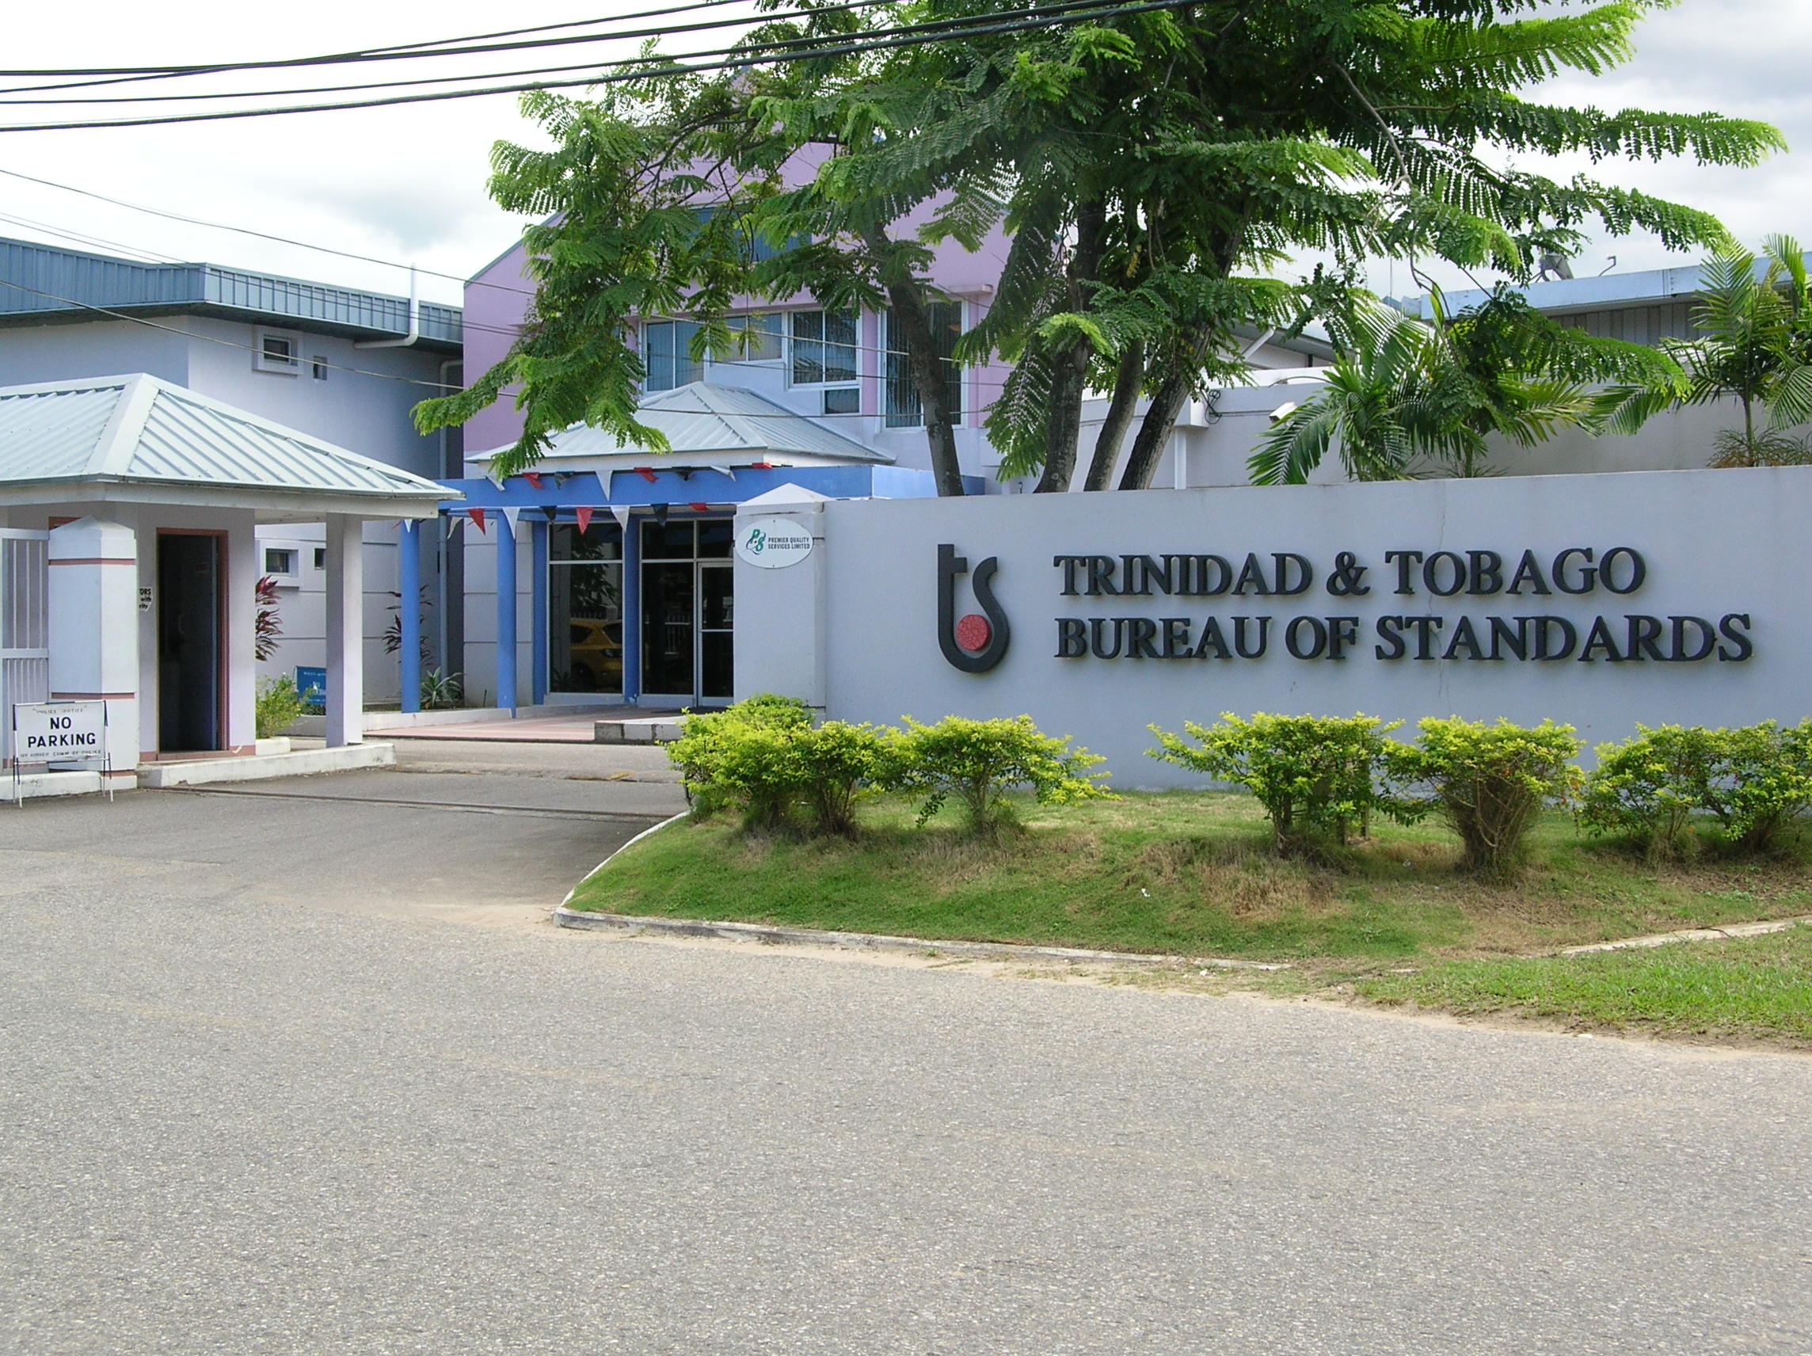
TTBS
TTBS is a corporate body established on July 8th, 1974.
Governed by the authority of the Standards Act No. 18 of 1997.
Operates under the aegis of the Ministry of Trade, Industry and Investment.
Time & Frequency Metrology Working Group - Workshop and Planning Meeting (January 27-29, 2015)
3
Notes:
Who we are
The Trinidad & Tobago Bureau of Standards (TTBS) is a corporate body established on July 8th, 1974 and now governed by the authority of the Standards Act No. 18 of 1997. TTBS operates under the aegis of the Ministry of Trade, Industry and Investment. It has a statutory responsibility for the quality of goods and services, which are subject to trade in the Republic of Trinidad & Tobago, except food, drugs, cosmetics.
What we do
The primary role of TTBS is to develop, promote and enforce standards in order to improve the quality and performance of goods produced or used in the Republic of Trinidad and Tobago. To ensure industrial efficiency and development; promote public and industrial welfare, health and safety; and protect the environment.
TTBS’ mandate includes all goods except food, drugs, cosmetics, medical devices, pesticides and agricultural produce.

Slide 4
Time & Frequency Metrology Working Group - Workshop and Planning Meeting (January 27-29, 2015)
4

Slide 5
Time & Frequency Metrology Working Group - Workshop and Planning Meeting (January 27-29, 2015)
5

Slide 6
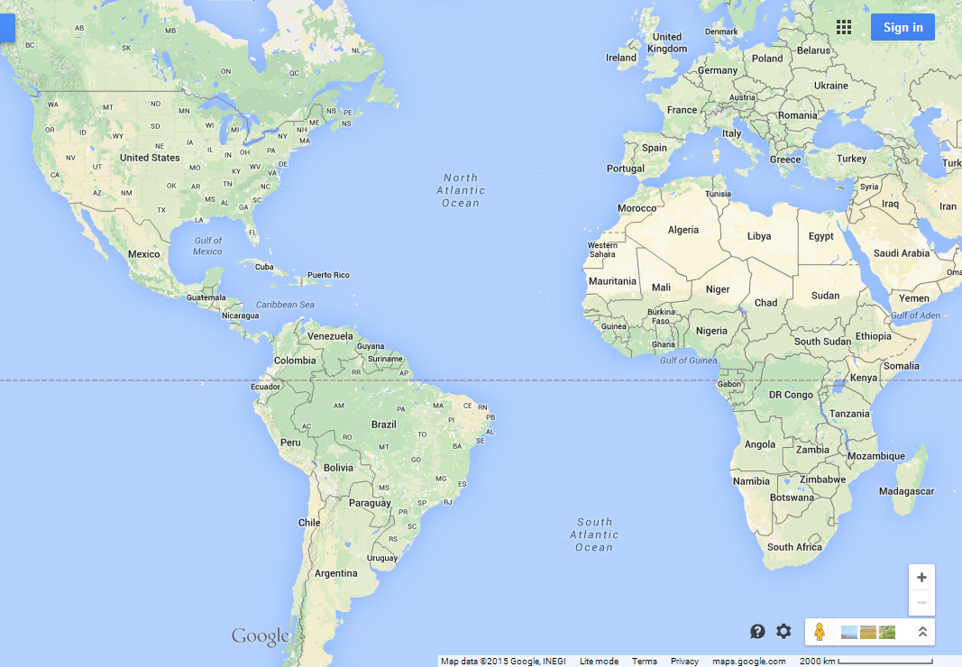
Time & Frequency Metrology Working Group - Workshop and Planning Meeting (January 27-29, 2015)
6

Slide 7
TTBS Organizational Chart (Technical Divisions/Strategic Business Units)
Metrology Division
Standardization Division
Certification Division
Laboratory Services Division
Laboratory Accreditation
Board of Directors
TTBS, Executive Director
Implementation Division
Time & Frequency Metrology Working Group - Workshop and Planning Meeting (January 27-29, 2015)
7

Slide 8
TTBS Organizational Chart (Support Units)
Standards Information Center
Board of Directors
TTBS, Executive Director
Finance
Strategic Human Resource Management
Legal
Corporate Services
Information Technology (IT)
Quality Unit
Marketing Unit
Health and Safety
Time & Frequency Metrology Working Group - Workshop and Planning Meeting (January 27-29, 2015)
8

Slide 9
Metrology Division
Metrology Division
Legal Metrology Inspectorate
Standards Laboratory Unit
Calibration Services Unit
Electrical
Time & Frequency
Mass
Dimension
Pressure
Torque
Volume
Density
Temperature
Humidity
Time & Frequency Metrology Working Group - Workshop and Planning Meeting (January 27-29, 2015)
9

Slide 10
Timeline of Events
Installation of SIM Time System
SIM Stopwatch ILC
Dissemination of Time (TTBS LAN)
Nov 2009
Dec 2010
Next Milestone
2015
2012
Time & Frequency Metrology Working Group - Workshop and Planning Meeting (January 27-29, 2015)
10

Slide 11
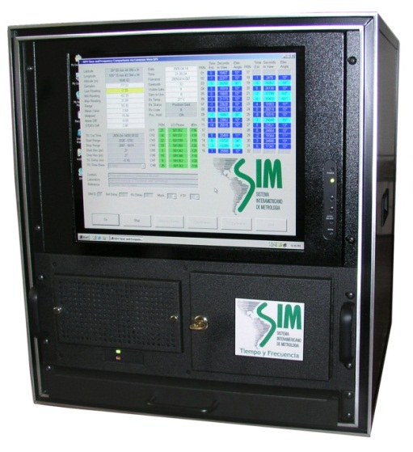
TTBS Time Measurement System
GPS Antenna
SIM Common-View System
Internet
NIST
NRC
CENAM
SIM TIME NETWORK
Time & Frequency Metrology Working Group - Workshop and Planning Meeting (January 27-29, 2015)
11
Notes:
Precision Systems GPS10RBN – GPS Disciplined Rubidium Frequency Standard
Precision Systems GPS10RBN-16 – BCD Time Output Extender (BCD Timer)
SIM Common-View Monitor
End Run Technologies Meridian Precision GPS TimeBase

Slide 12
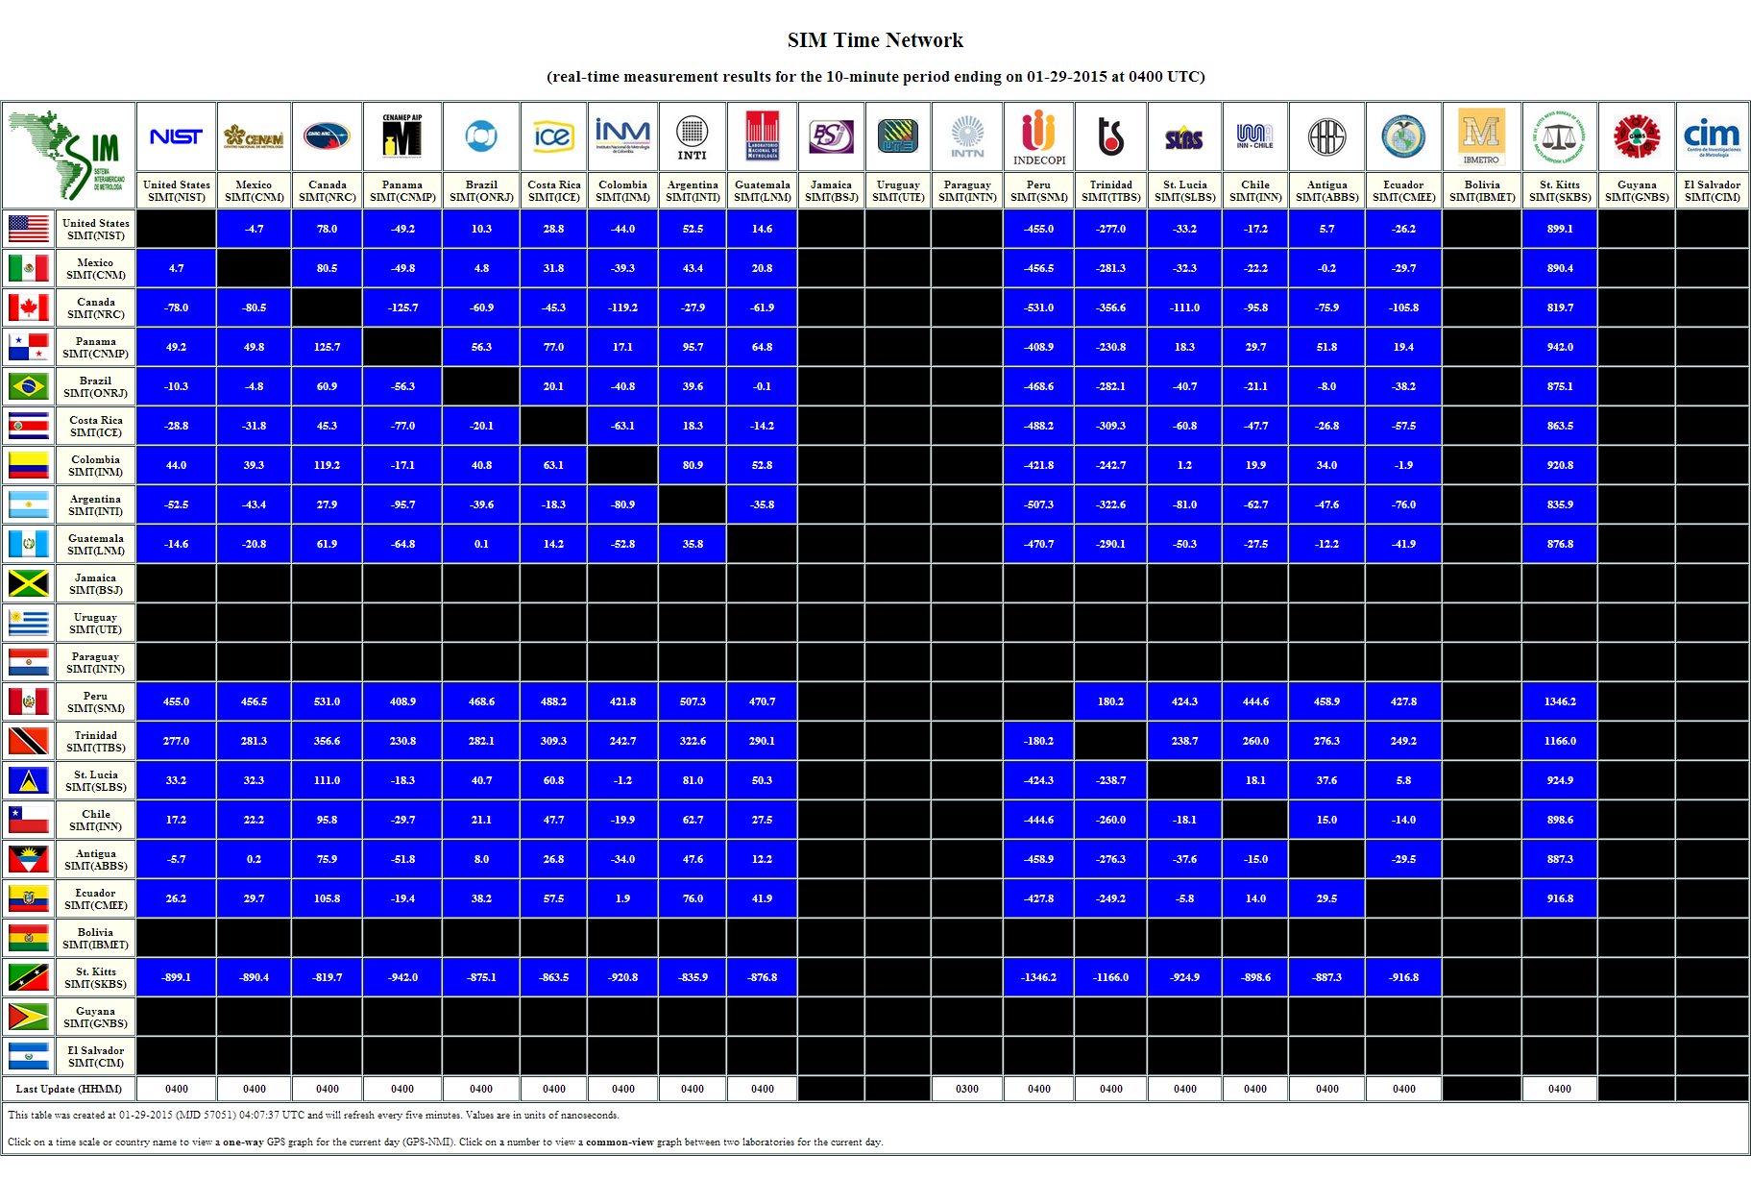
Time & Frequency Metrology Working Group - Workshop and Planning Meeting (January 27-29, 2015)
12

Slide 13
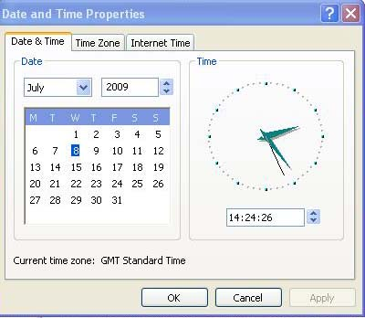
Dissemination of Time (via NTP on TTBS LAN)
Time & Frequency Metrology Working Group - Workshop and Planning Meeting (January 27-29, 2015)
13

Slide 14
Calibration of Stopwatches and Timers
Time & Frequency Metrology Working Group - Workshop and Planning Meeting (January 27-29, 2015)
14
Notes:
SIM Laboratory Inter-comparison of Stopwatches 2010/2011
Totalize Method used

Slide 15
Future Goals
Design a system with redundancy
Disseminate time to T&T public
TV Stations/Radio Stations
Financial Institutions
Telecommunication Companies
Government Institutions
General Public
Internet Time (Web Clock)
Contribute to Coordinated Universal Time (UTC)
Official/Legal Timekeeper for T&T
Time & Frequency Metrology Working Group - Workshop and Planning Meeting (January 27-29, 2015)
15

Slide 16
Challenges
Proclamation of Metrology Act
Act passed in Parliament since 2004
Procurement of Equipment Resources
Availability of funding from Government
Lengthy process
Option – Donation/External Funding
Trained and Competent Staff
Time & Frequency Metrology Working Group - Workshop and Planning Meeting (January 27-29, 2015)
16

Slide 17
Questions?
Trinidad and Tobago Bureau of Standards
1-2 Century Drive
Trincity Industrial Estate
Macoya , Tunapuna
Trinidad and Tobago , W.I
Tel: (868) 662-8827 , Fax: (868) 663-4335
Email: Siew.Durga@ttbs.org.tt
Website: www.ttbs.org.tt
Time & Frequency Metrology Working Group - Workshop and Planning Meeting (January 27-29, 2015)
17

