Slide 1

Laboratorio de Tiempo y Frecuencia
/ Time and Frequency
Laboratory
Eng. Liz Catherine Hernández Forero
lhernandez@inm.gov.co
Physicist. Nelson Bahamón Cortés
nbahamon@inm.gov.co

Slide 2

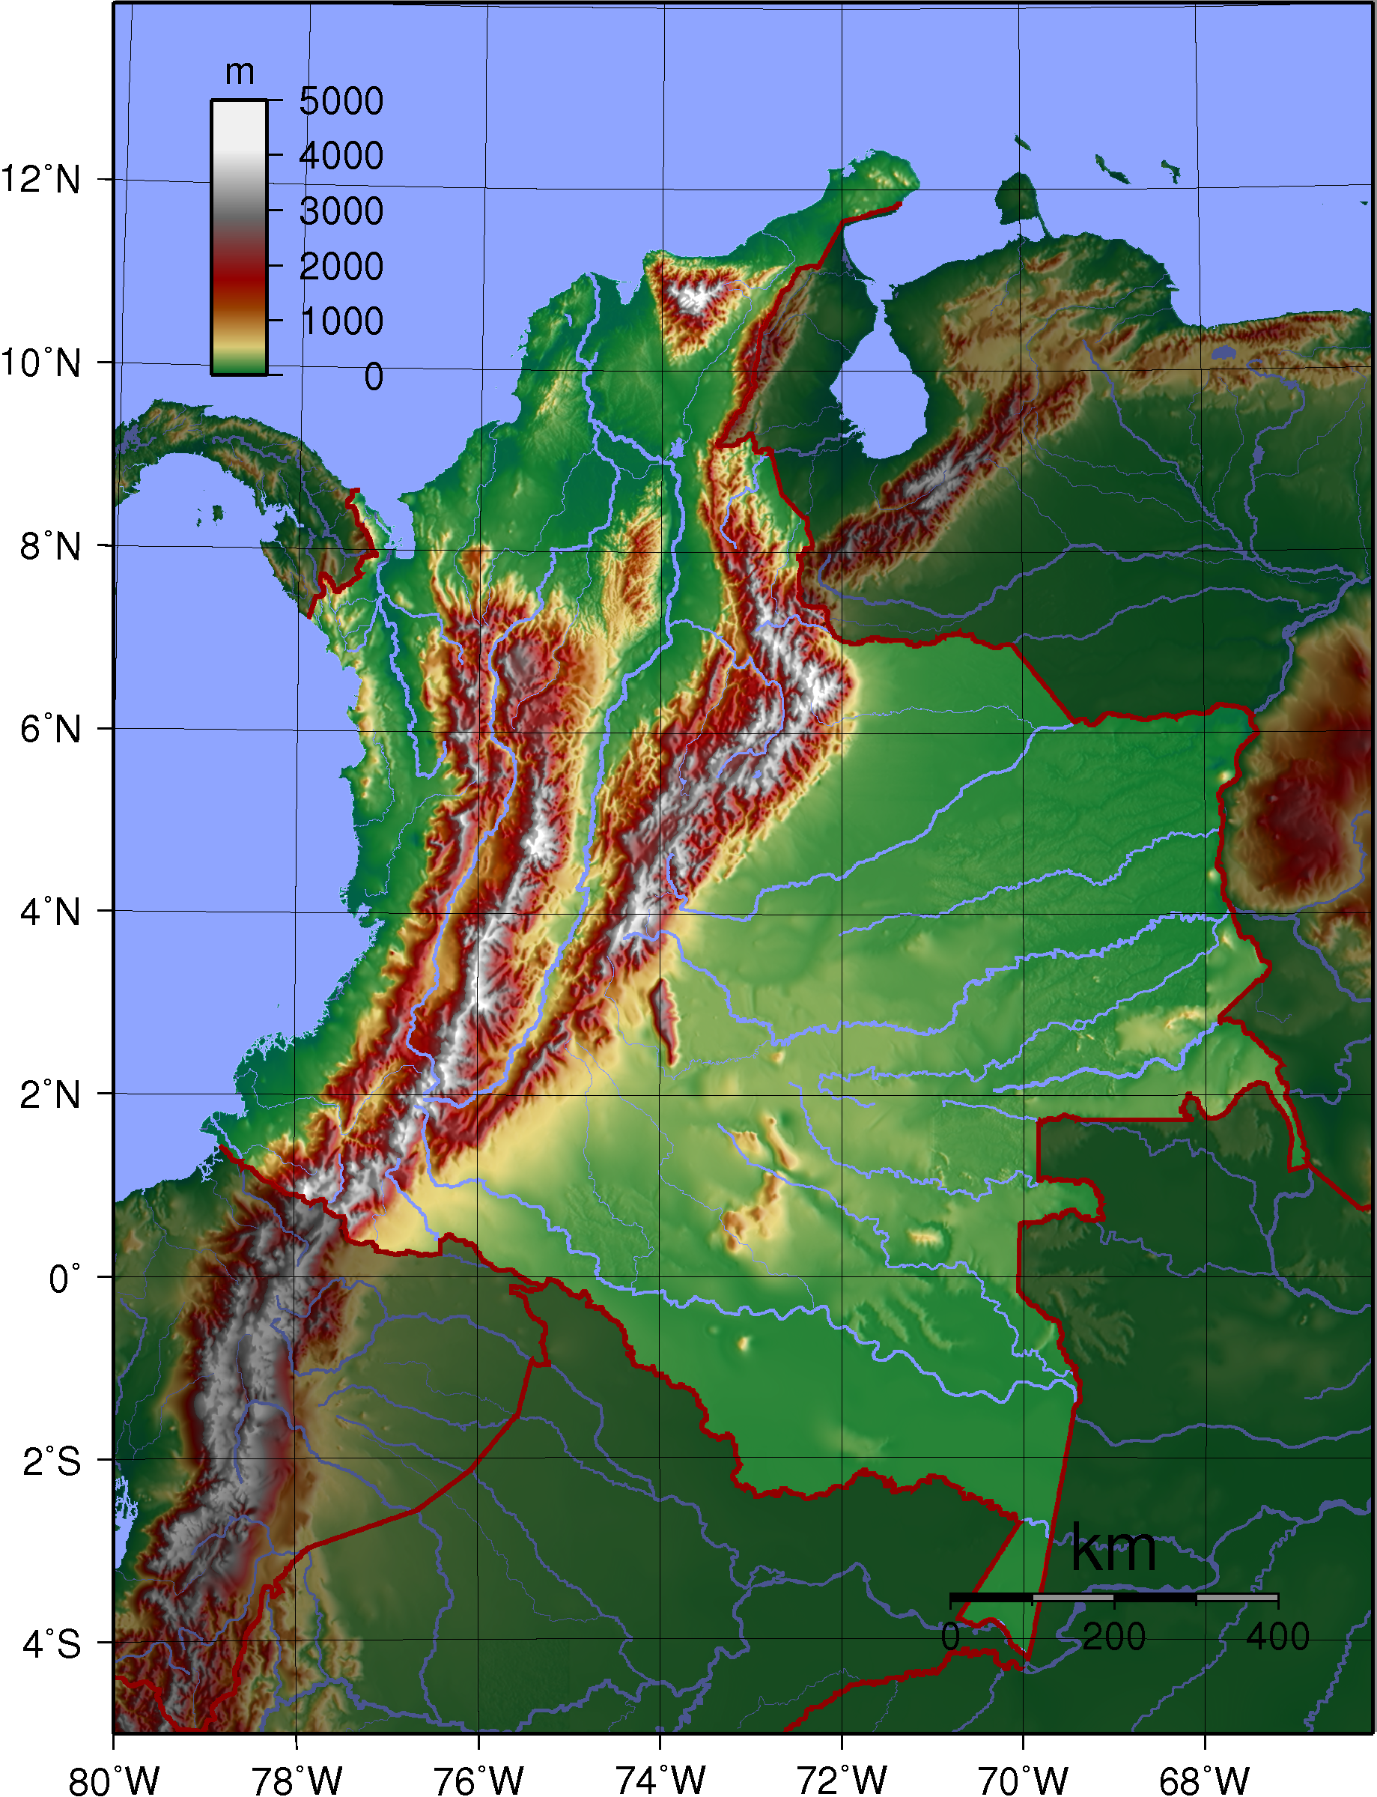
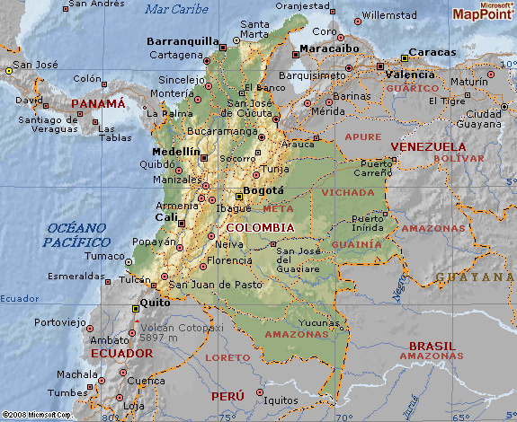

Slide 3
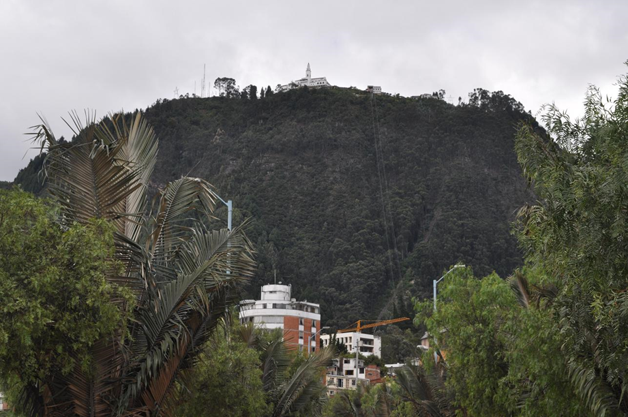

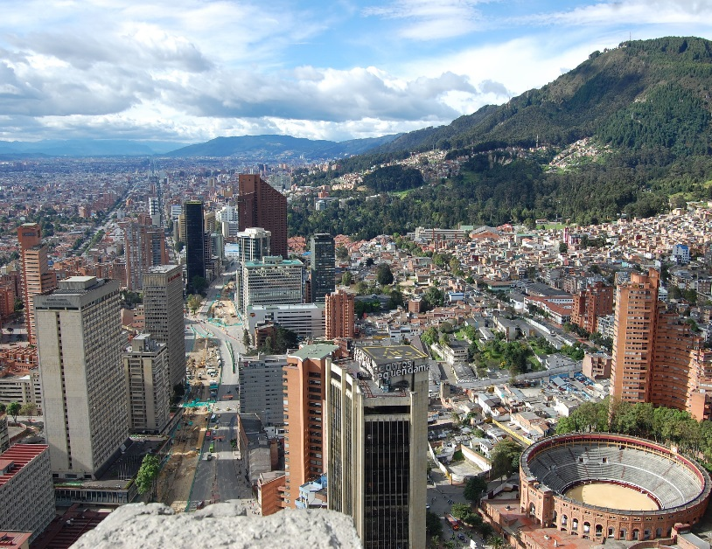

Slide 4
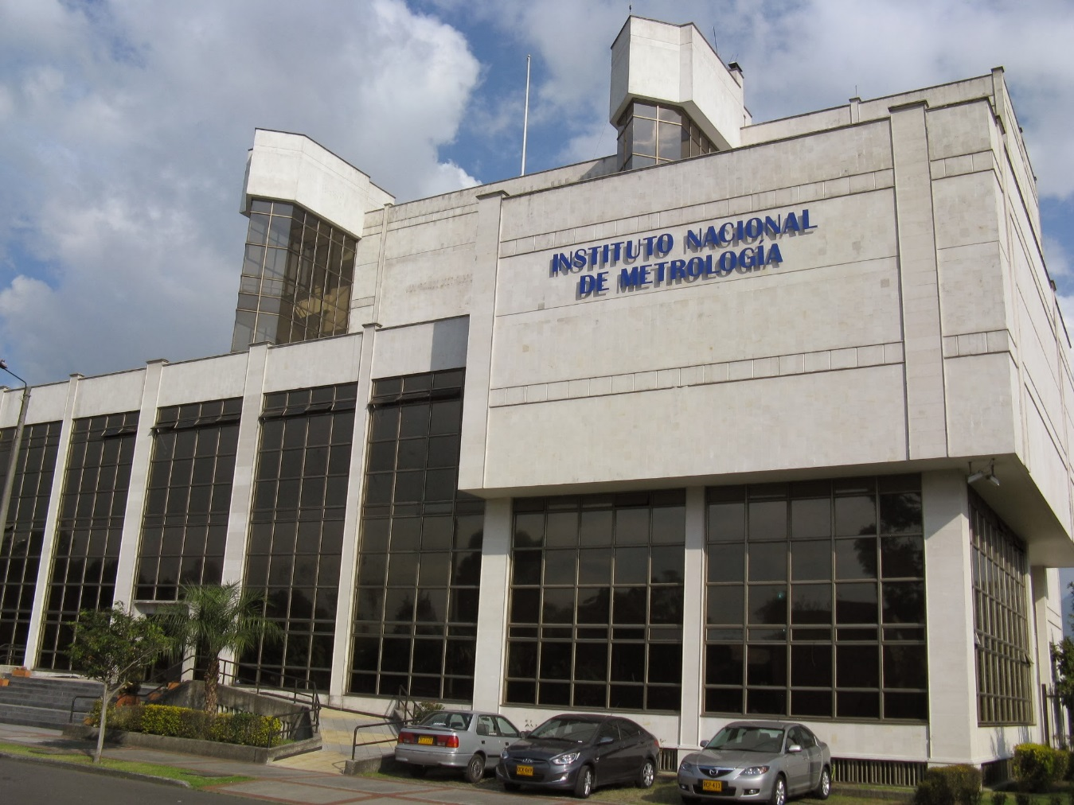

Slide 5
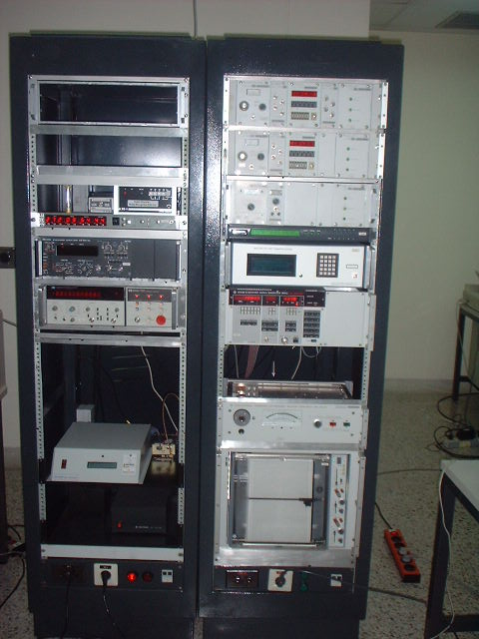
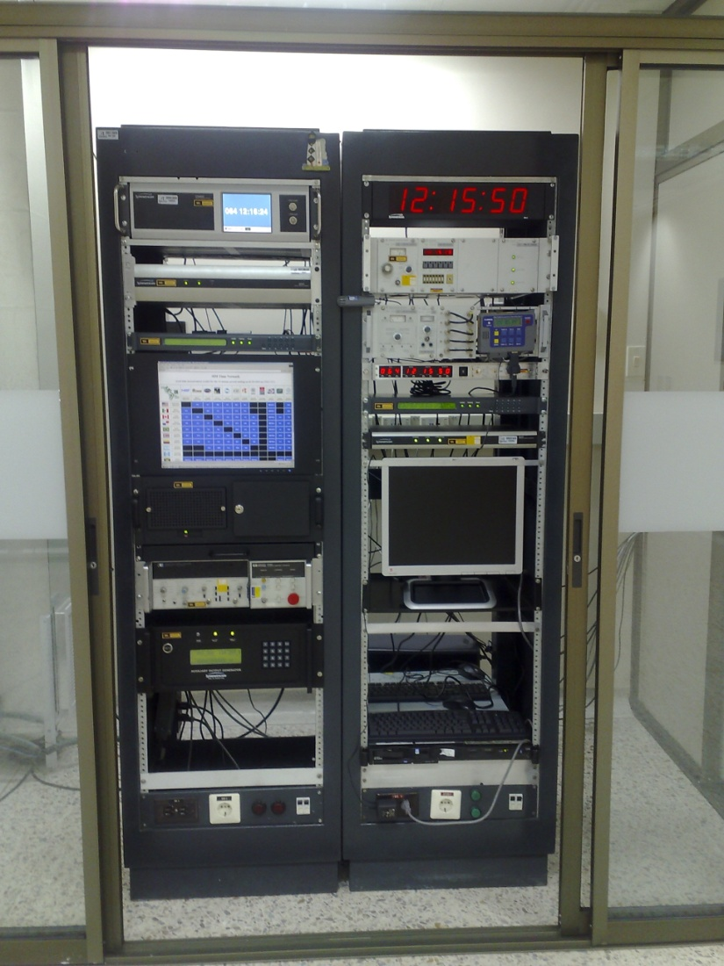
< 2008 year 2010 year

Slide 6
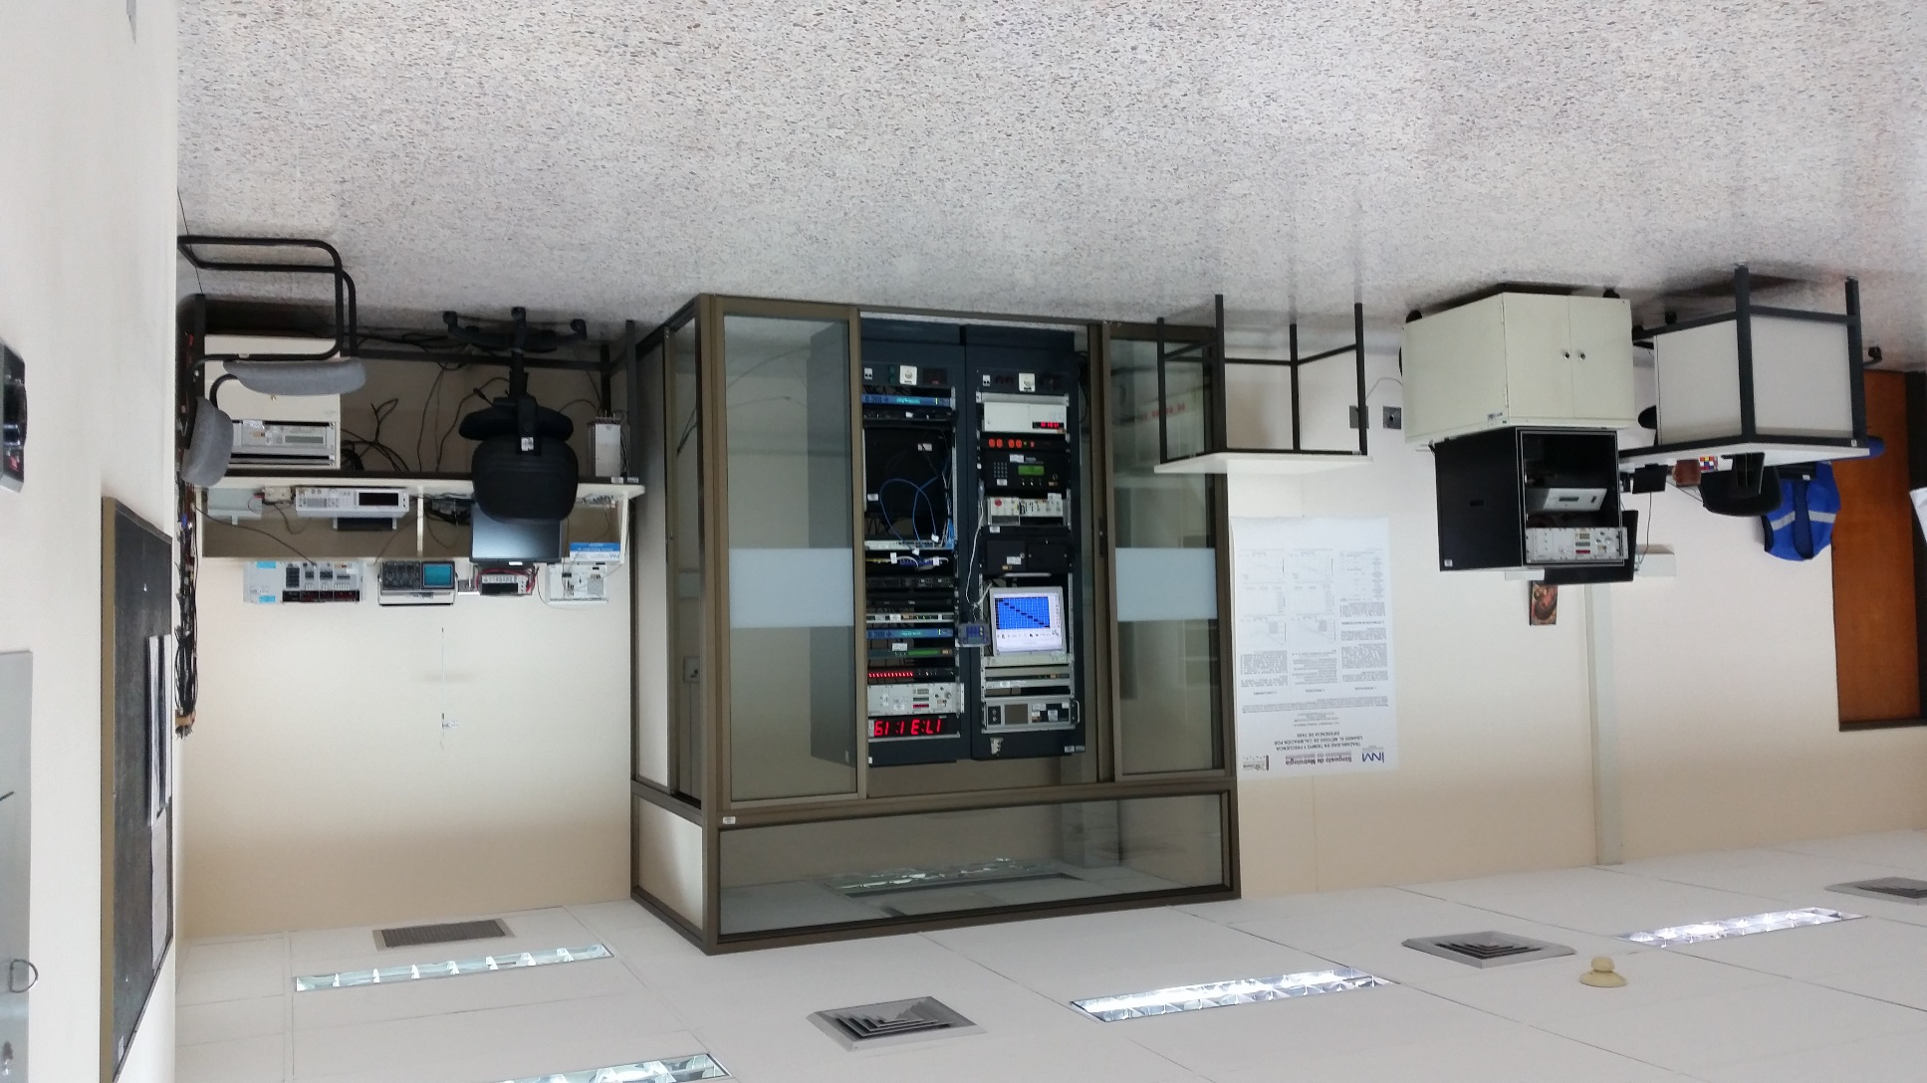
2015 year

Slide 7
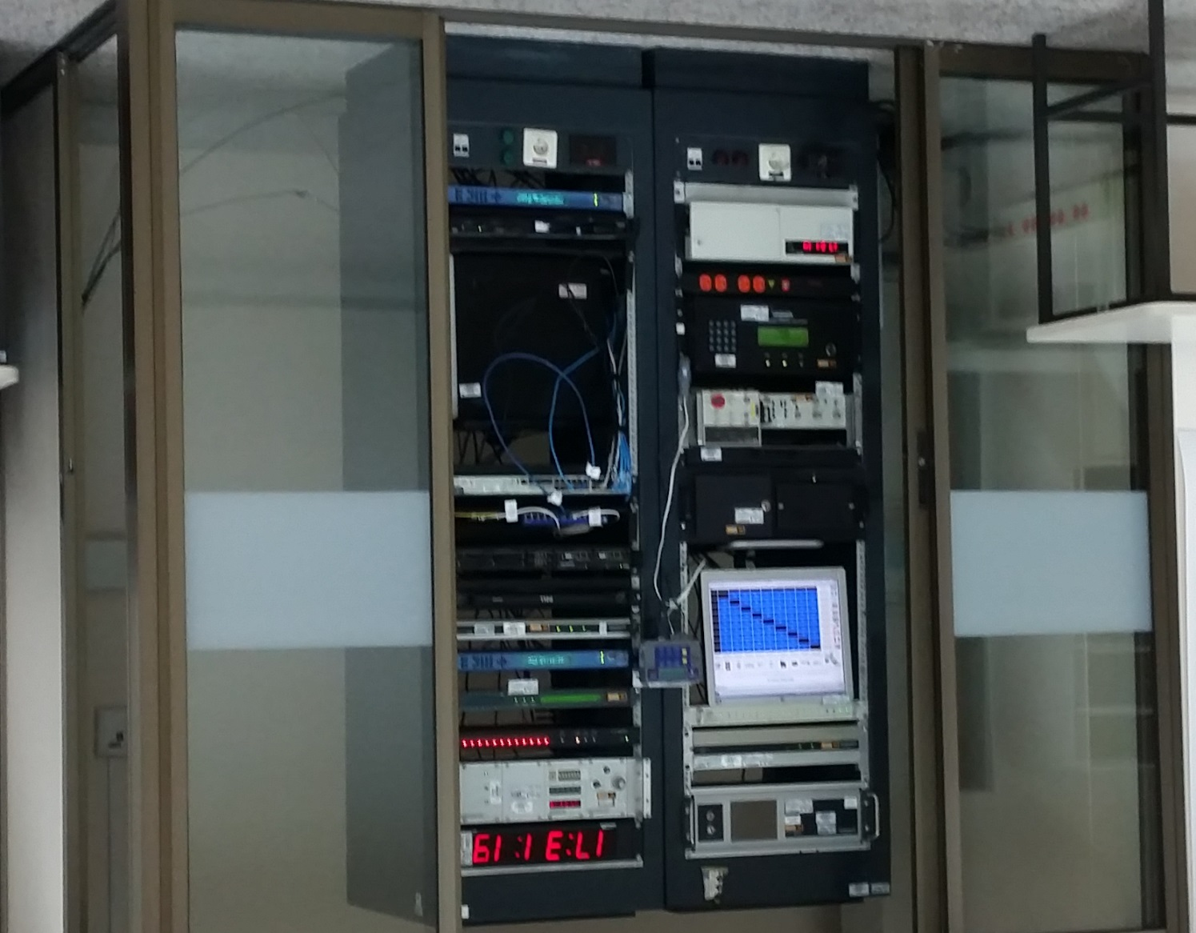
Symmetricom Atomic clocks:
CsIII 4310B
5071A
Rb 8040C
Rohde & Schwarz:
Rb XSRM
Quartz XSD 2
Generator SMS 2
Network Time Server NTP:
Symmetricom 1520R-S350
Interactive Voice Response
(IVR-DELL).
2015 year

Slide 8



DATE | OBJECTIVE PROPOSED
2011 (SIC) to 2013 (INM) 2014 (Accreditation monitoring audit) | Accreditation
2013 | The Arrangement was signed
2014 to 2015

Slide 9
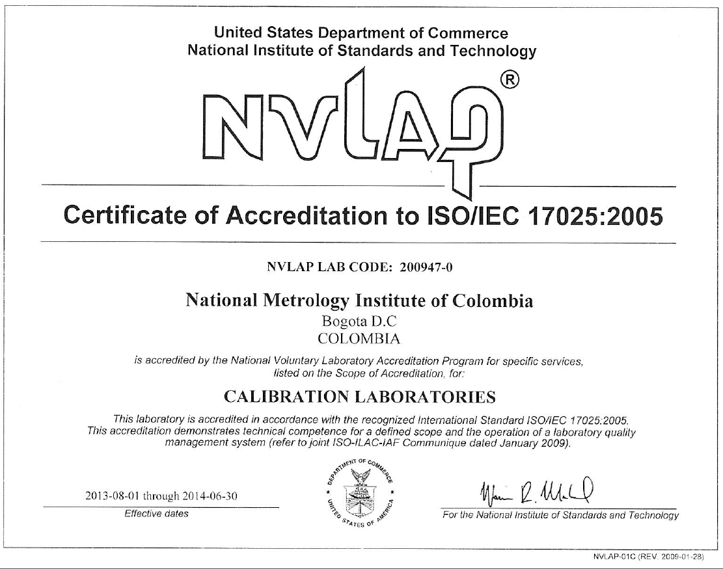
Accreditation Process
1.

Slide 10
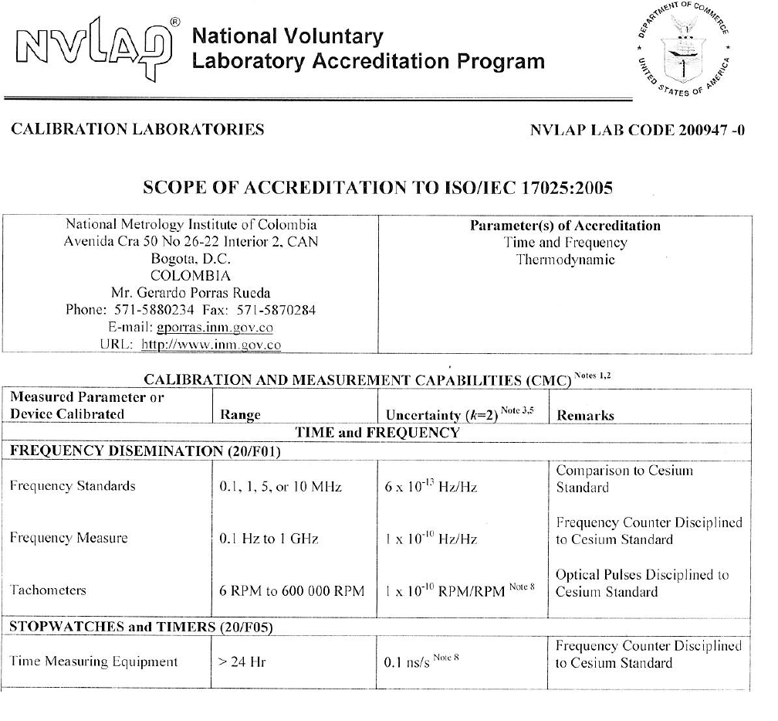
Accreditation Process

Slide 11
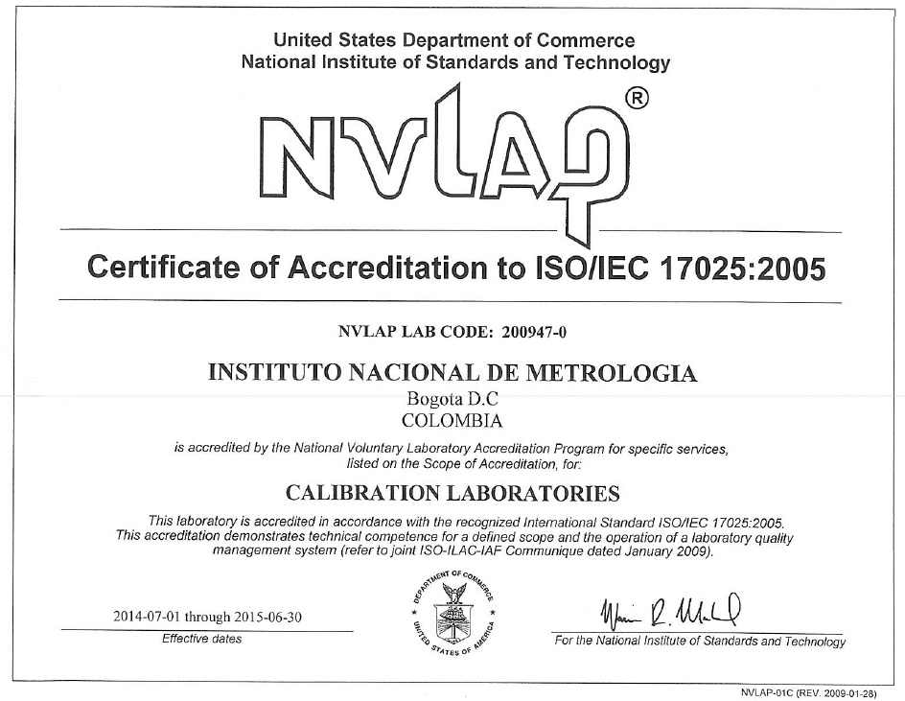
Accreditation Process
Accreditation Process
2.

Slide 12
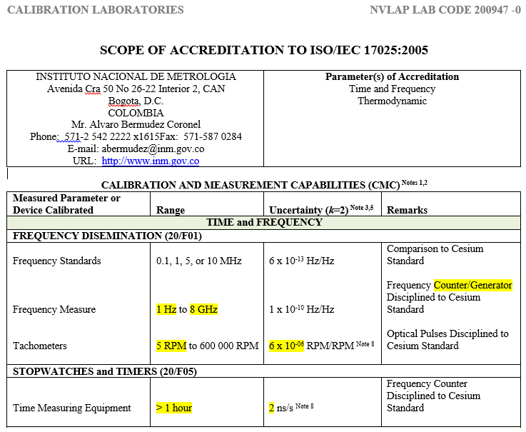
Accreditation Process

Slide 13
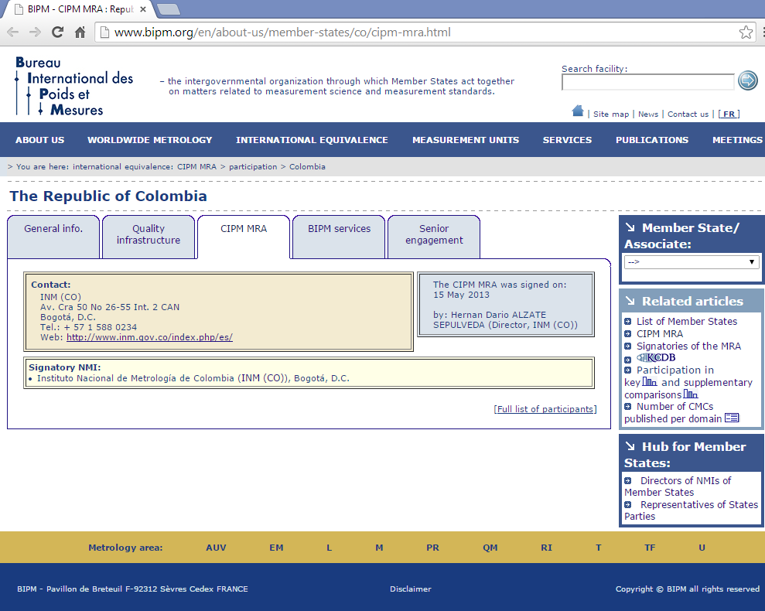
CIPM MRA (2013-05-15)

Slide 14
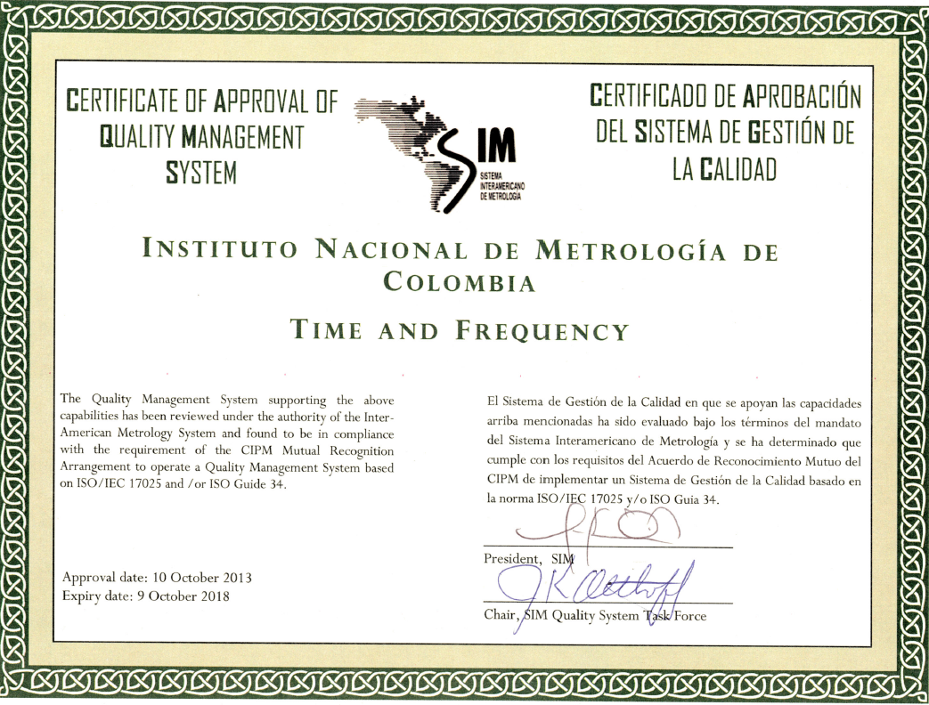
Submission of the SIM.TF.10.2014 CMC
1.

Slide 15
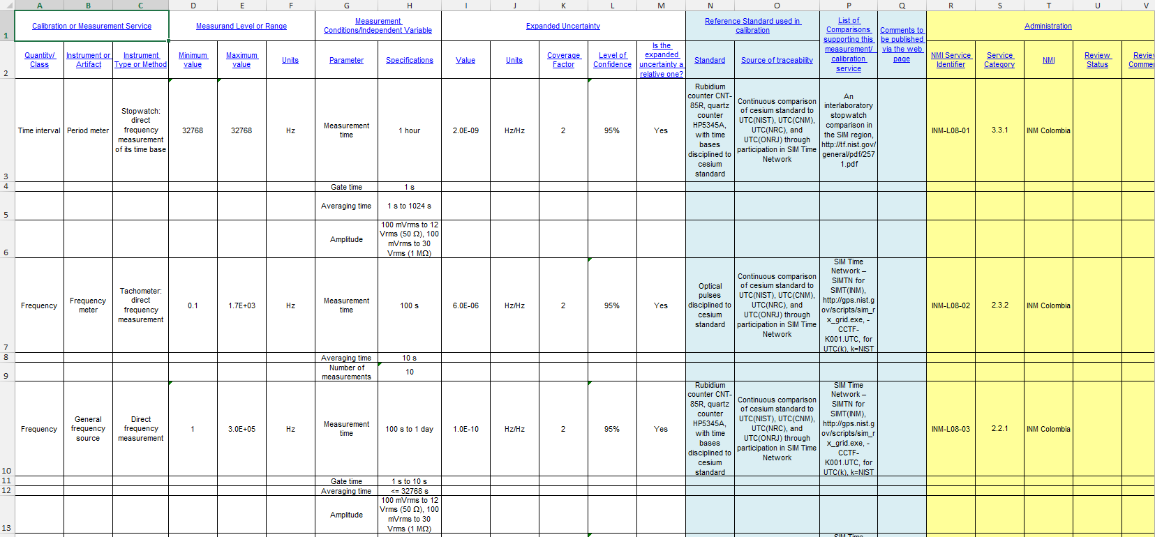
Submission of the SIM.TF.10.2014 CMC
2.

Slide 16




Submission of the SIM.TF.10.2014 CMC
3.
Date | RMO | Version number of the CMC file | Quantity of comments
2014-05-30 to 2014-08-08 |  | 01 and 02 | 6
2014-08-08 to 2015-01-21 |  | 03 | 24
2015-01-21 to 2015-02-12 |  | 04 | 2

Slide 17
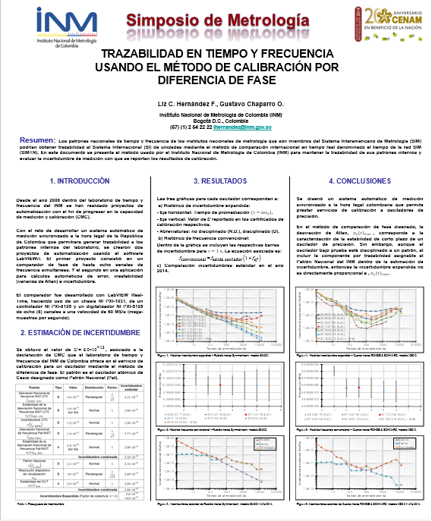
Simposium at CENAM on 2014
Traceability in time and frequency using the phase difference calibration method
➔ Analysis of reported uncertainty since 2008 to 2014

Slide 18
TRACEABILITY SCHEME
Colombian Legal Time
as a function of the INM by the
Decree 4175 of 2011

Slide 19
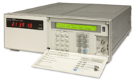
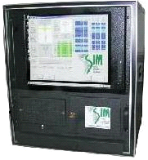


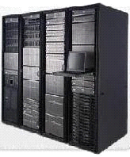
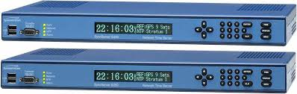
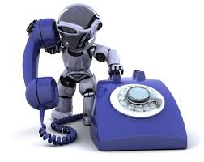
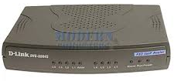
TRACEABILITY SCHEME
Common View System
SIM Time Network (SIMTN)
Cesium Primary Standard
Symmetricom 5071A
5 MHz
http://tf.nist.gov/sim/
AOG (Auxiliary Output Generator)
Microphase Stepper
Symmetricom
AOG-110
1 PPS
(pulse per second)
Distribution Switch of 1 PPS
Symmetricom 4033A
LEGAL TIME
http://horalegal.inm.gov.co
Legal Time
Servers
Time server NTP
Symmetricom 1520R-S350
Syncronization through
free software
from Symmetricom
UTC - 5 hours
Colombian Legal Time
Decree 2707 of 1982
Interactive Voice Response
(IVR-DELL).
Colombian Legal Time
as a function of the INM by the
Decree 4175 of 2011

Slide 20
TRACEABILITY SCHEME
LEGAL TIME
http://horalegal.
inm.gov.co

Slide 21
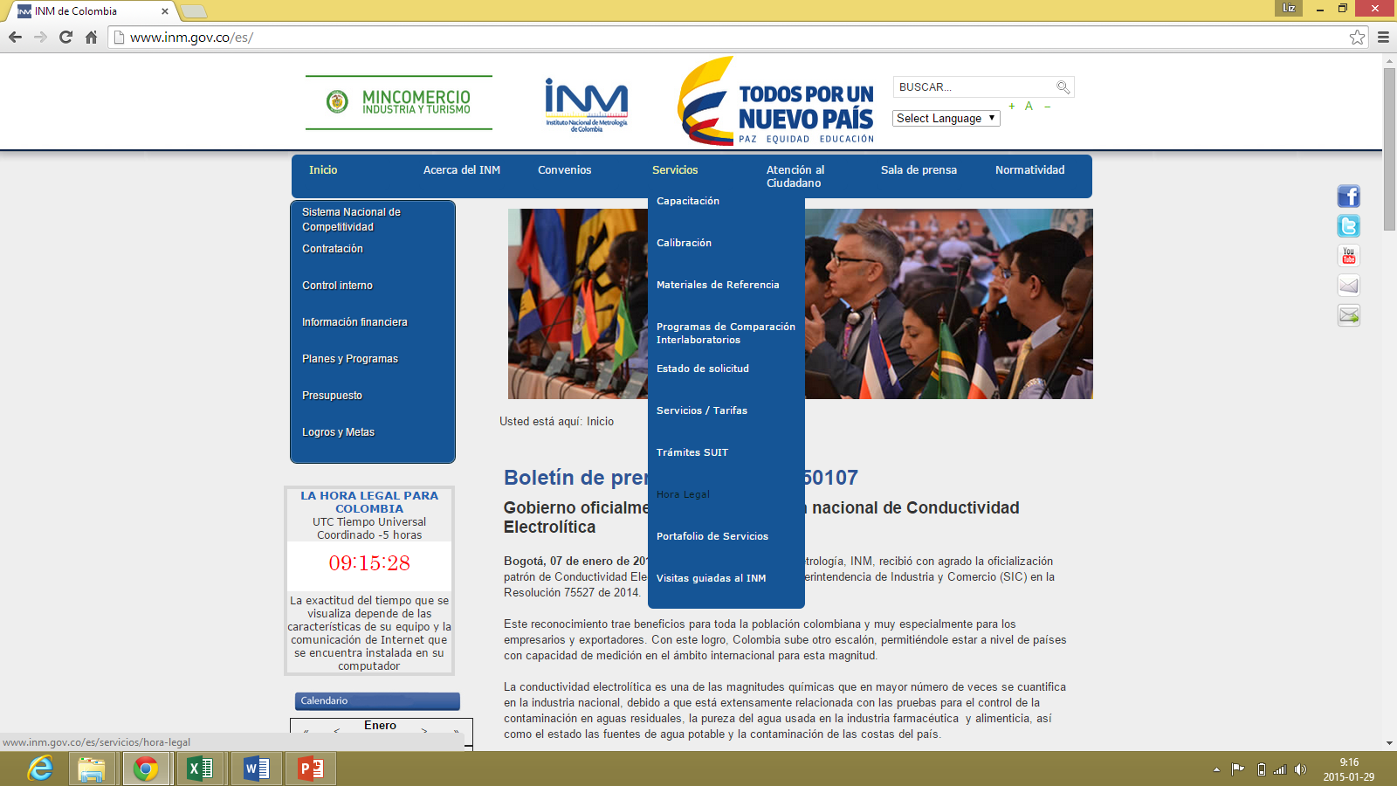
TRACEABILITY SCHEME
LEGAL TIME
http://www.inm.
gov.co

Slide 22
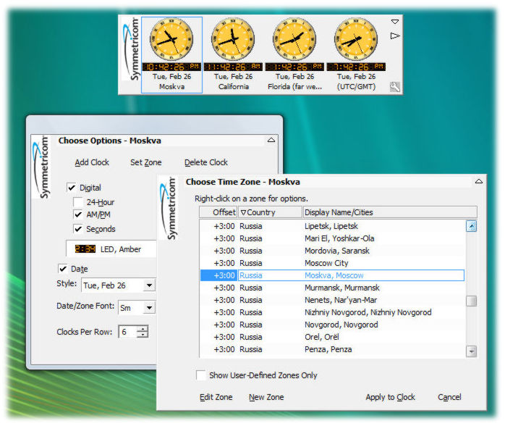

TRACEABILITY SCHEME
Syncronization through
free software
from Symmetricom

Slide 23
OBJECTIVE | ACTIVITIES
What is done right now? | Proposing a method for adjusting the output signal of the Cesium standard using the AOG-110. To increase the SIMT(INM) contribution.

Slide 24
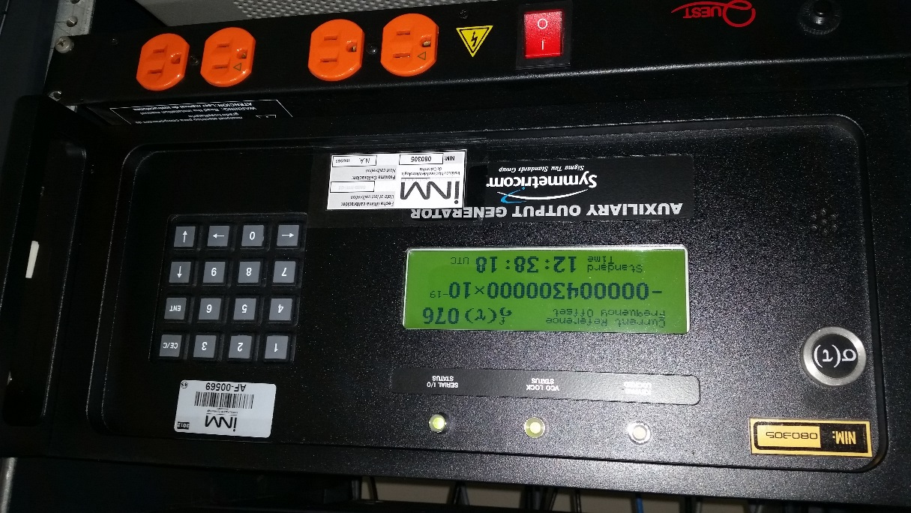
SIM TFWG 2015 CENAMEP AIP

Slide 25
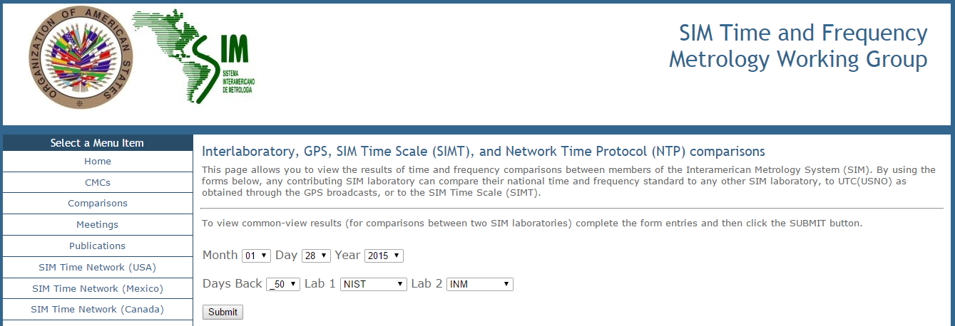

Slide 26
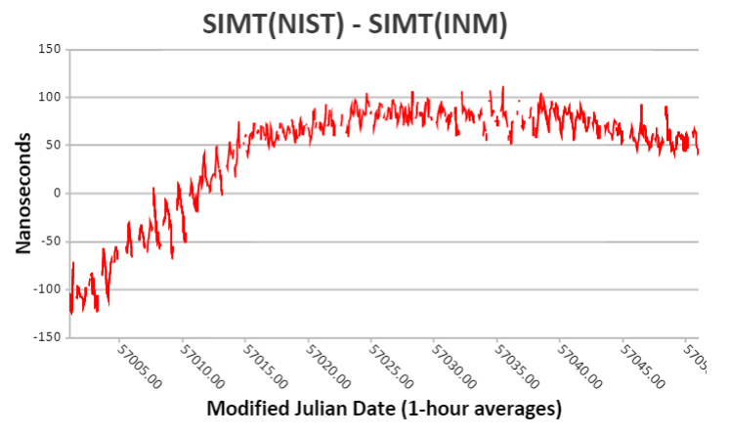

Slide 27
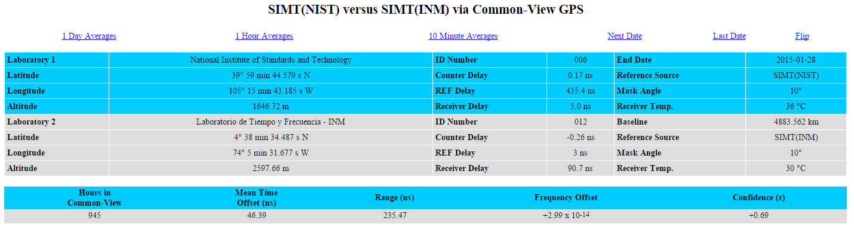
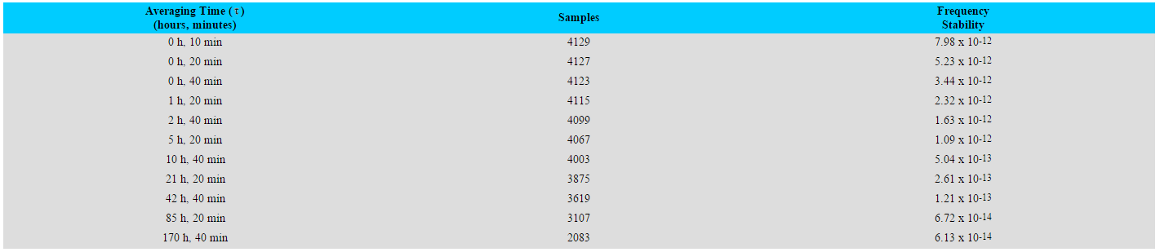

Slide 28
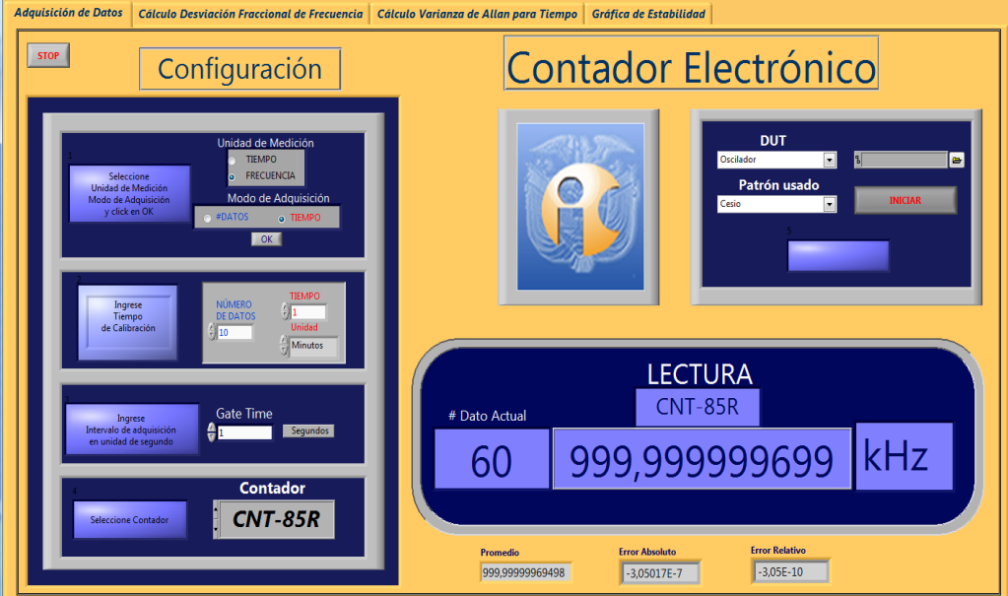
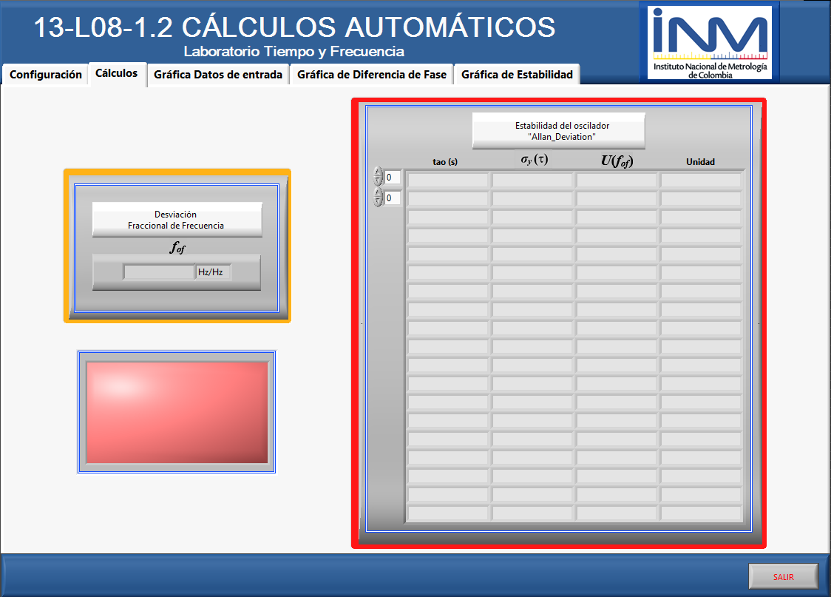
OBJECTIVE | ACTIVITIES
What is used? | Automated and validated programs.

Slide 29
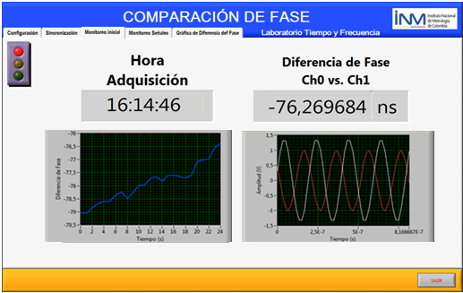
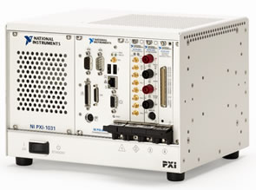
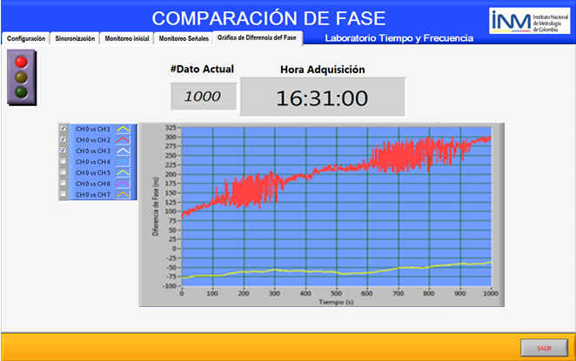

OBJECTIVE | ACTIVITIES
What is proposed to do? | Improve the automatization method with an additional validation process, related to acquisition in real time with a PXI.

Slide 30

Gracias!
Thank you!

