Slide 1
General Concepts of Time and Frequency Metrology
Michael Lombardi
NIST Time and Frequency Division
SIM Time and Frequency Metrology Working Group Workshop and Planning Meeting
Panama City, Panama
January 27-29, 2015

Slide 2
Outline
Basic Concepts and Terminology
Clocks and Oscillators
Mechanical Clocks
Atomic Clocks
Time Scales and Coordinated Universal Time (UTC)
Frequency and Time Calibrations
The Difference Between Accuracy and Stability
Statistical Tools Used to Estimate Stability

Slide 3
Basic Concepts and Terminology

Slide 4
There are three basic types of time and frequency information
Date and Time-of-Day
  The notation used to described when an event occurred.
    I was born on March 5, 1960 at 0300 UTC.
Time Interval
  The duration between two events.
  I am almost 55 years old.
Frequency
  The rate of a repetitive event.
  I have one birthday per year.

Slide 5
Two units of measurement in the International System (SI) apply to time and frequency metrology
Second (s)
    The standard unit for time interval
    One of 7 base SI units
Hertz (Hz)
    The standard unit for frequency (s⁻¹)
    Defined as events per second
    One of 21 SI units derived from base units

Slide 6
The units of time of day are defined as multiples of the SI second
1 minute = 60 second
1 hour = 60 minutes or 3600 seconds
1 day = 24 hours or 1440 minutes or 86400 seconds
1 year = 365.2422 days
Hour and minutes are based on the sexagesimal (base 60) system that is around 4000 years old. Days are based on the duodecimal (base 12) system that is at least 3500 years old.

Slide 7
The units of time interval are defined as fractional parts of the SI second
millisecond (ms), 10⁻³ s
microsecond (μs), 10⁻⁶ s
nanosecond (ns), 10⁻⁹ s
picosecond (ps), 10⁻¹² s
femtosecond (fs), 10⁻¹⁵ s
The sub-second units are all relatively new (within the last few hundred years) and all use the decimal (base 10) system.

Slide 8
The units of frequency are expressed in hertz, or in multiples of the hertz
hertz (Hz), 1 event or cycle per second
kilohertz (kHz), 10³ Hz
megahertz (MHz), 10⁶ Hz
gigahertz (GHz), 10⁹ Hz

Slide 9
The relationship between frequency and time interval
We can measure frequency to get time interval, or we can measure time interval to get frequency. This is because frequency is the reciprocal of time interval:
Where T is the period of the signal in seconds
f is the frequency in hertz
We can also express this as f = s⁻¹ (the notation used to define the hertz in the SI).

Slide 10
Period
Period is the reciprocal of frequency, expressed in units of time.

Slide 11
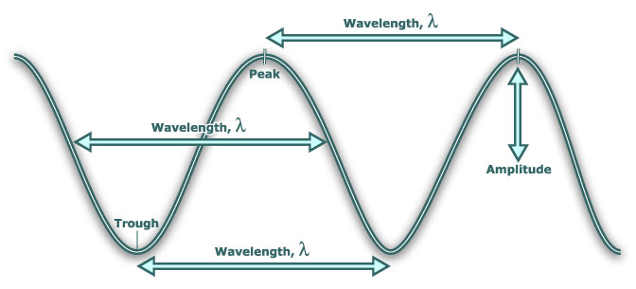
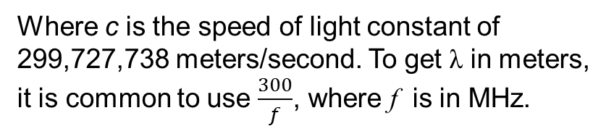
Wavelength
The wavelength is the length of one complete wave cycle, expressed in units of length.
wavelength in meters = 300 / frequency in MHz
Where c is the speed of light constant of 299,727,738 meters/second. To get λ in meters, it is common to use $\frac{300}{f}$, where f is in MHz.

Slide 12
Frequency Bands
Higher frequencies means shorter wavelengths

Slide 13
“Everyday” frequencies in time and frequency metrology

Slide 14
Clocks and Oscillators

Slide 15
Clocks and Oscillators
A clock counts cycles of a frequency and records units of time interval, such as seconds, minutes, hours, and days. A clock consists of an oscillator, a counter, and a display.
  A wristwatch is a good example of a typical clock. Most wristwatches contain a quartz oscillator that generates 32 768 cycles per second. After a watch counts 32 768 cycles, it records that one second has elapsed by updating its display.
Oscillators are the heart of all clocks. They produce a periodic event that repeats at a nearly constant rate. This rate is called the resonance frequency. The best clocks contain the best oscillators.

Slide 16
The parts of a clock
Repeating Motion + Counting Mechanism/Display
(from oscillator)
Earth Rotation
Pendulum Swing
Quartz Crystal Vibration
Cesium Atomic Vibration
Sundial
Clock Gears and Hands
Electronic Counter
Microwave Counter

Slide 17
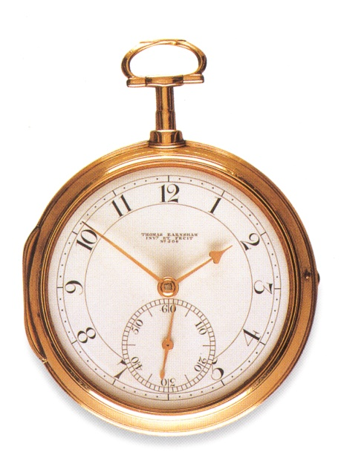
The words “clock” and “oscillator” are often used incorrectly by metrologists
To most people, a clock is a device that displays the time of day. It answers perhaps the world’s most common question: What time is it now?
Technically, an oscillator is the reference or “time base” for the ticks of a clock.
However, metrologists often refer to oscillators as clocks. Thus, you will probably hear the term “clock” in this meeting when we are referring to devices that produce frequency, but that do not always keep time or have a display.

Slide 18
Synchronization and Syntonization
Synchronization is the process of setting two or more clocks to the same time.
Syntonization is the process of setting two or more oscillators to the same frequency.

Slide 19
Relationship of
Frequency Accuracy to Time Accuracy

Slide 20
Mechanical Clocks

Slide 21
History of Mechanical Clock Performance

Slide 22
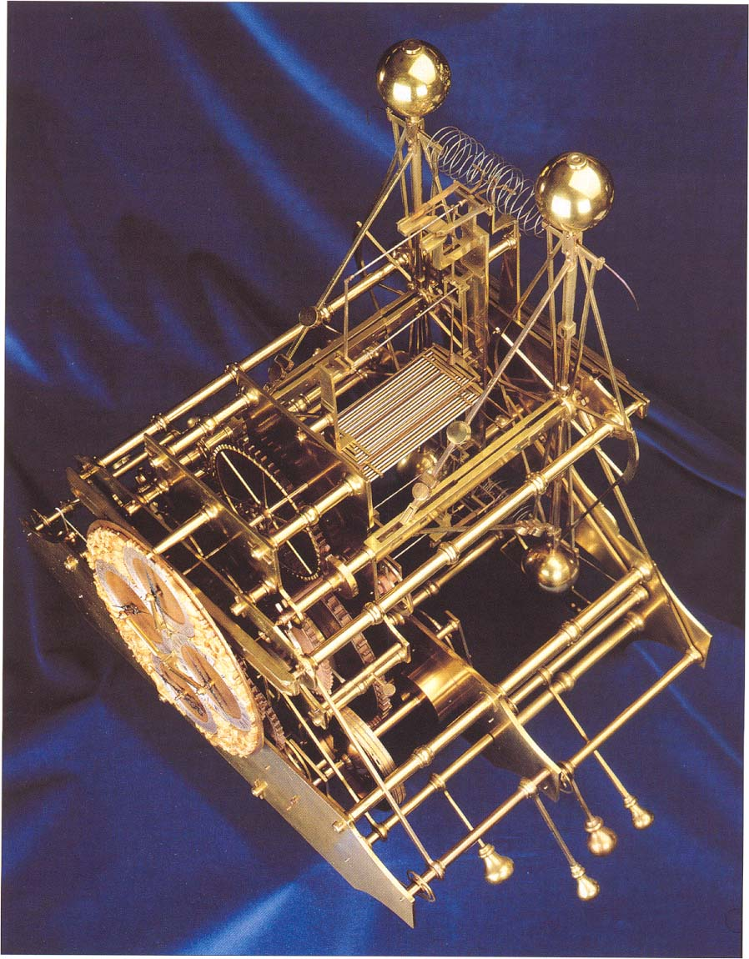
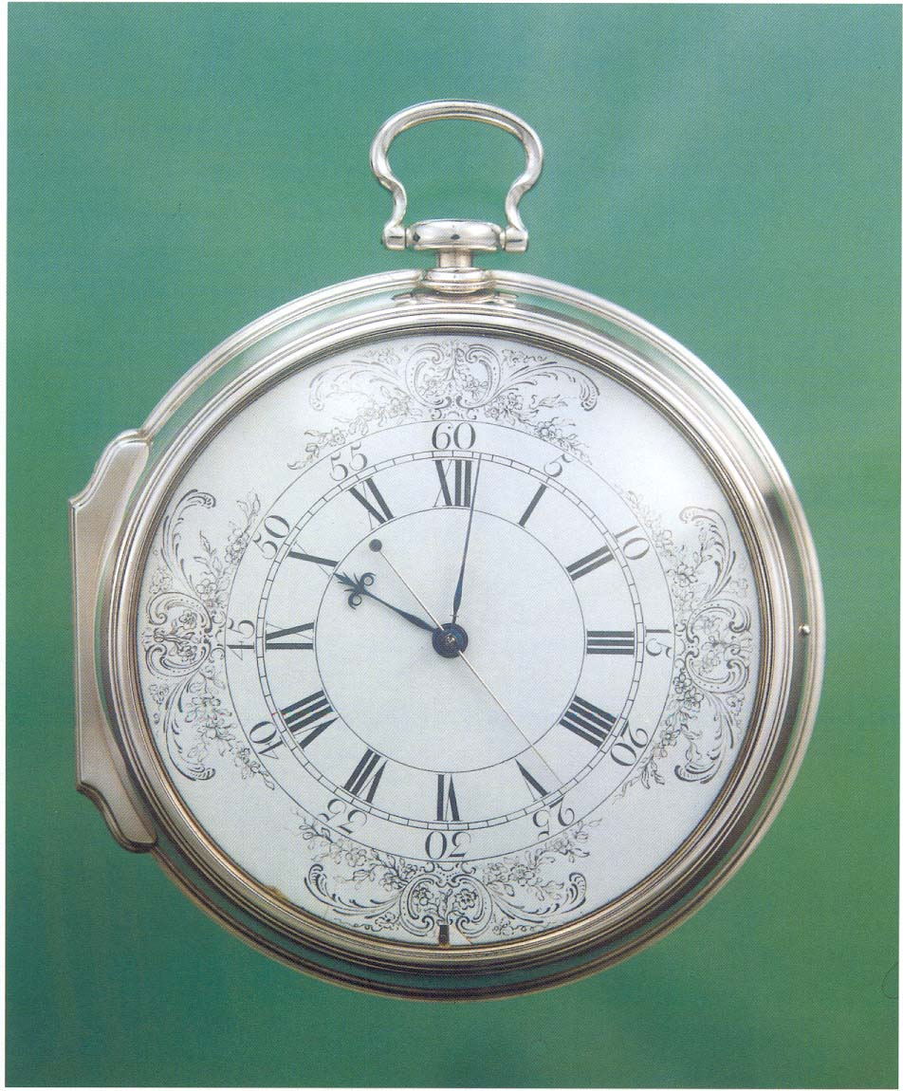

Slide 23
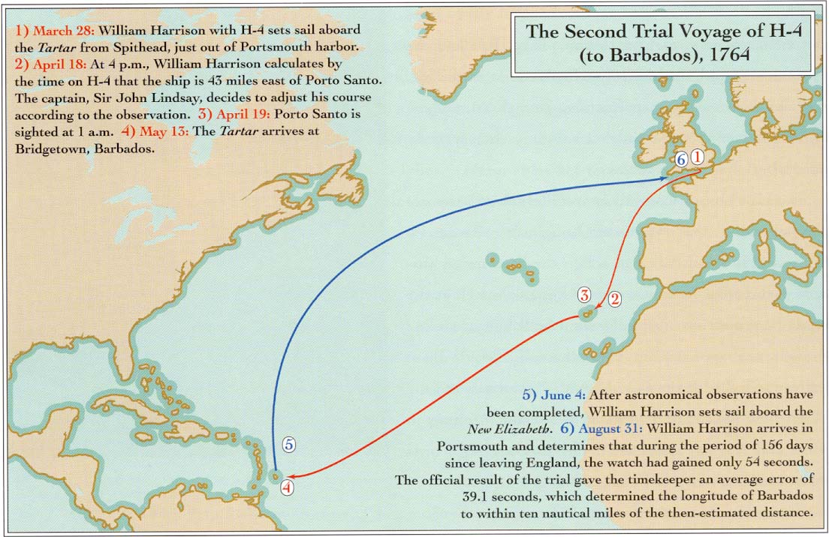

Slide 24
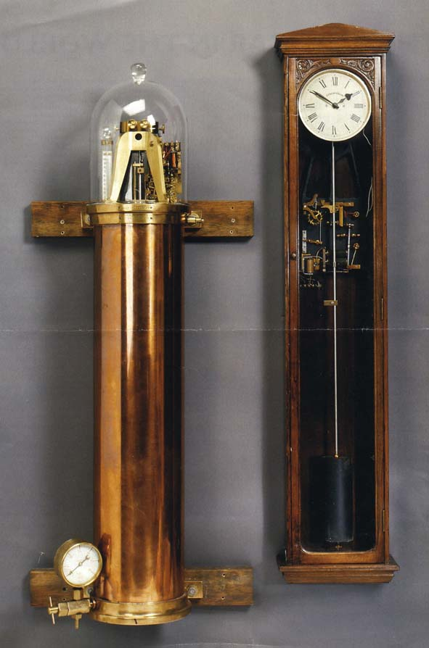
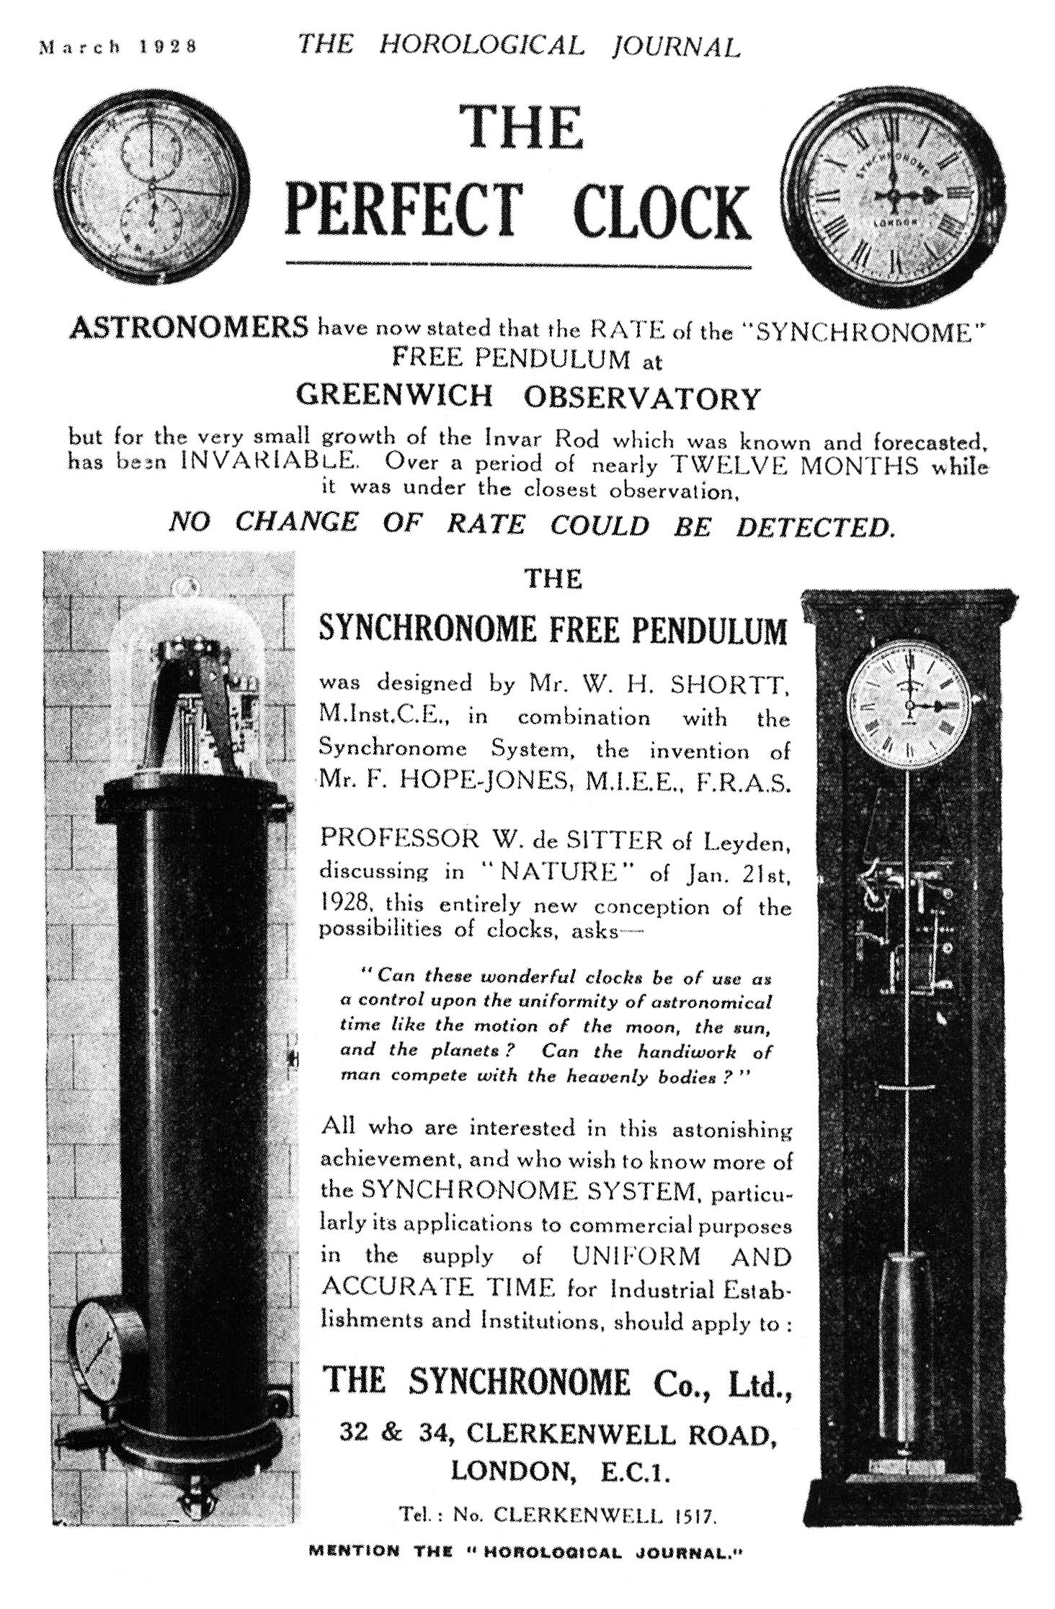

Slide 25
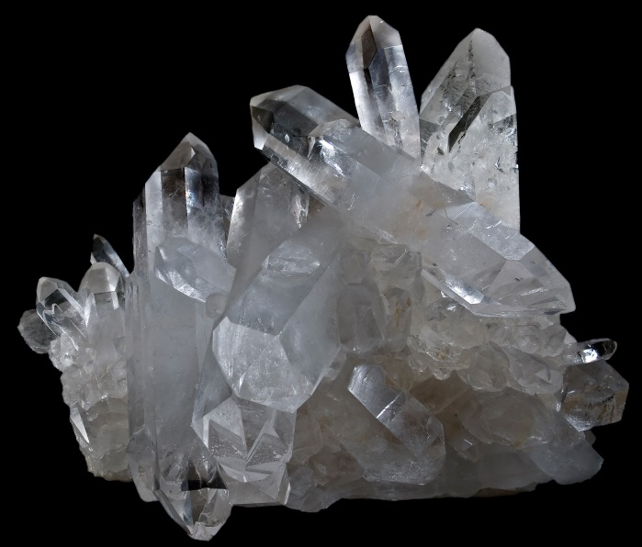
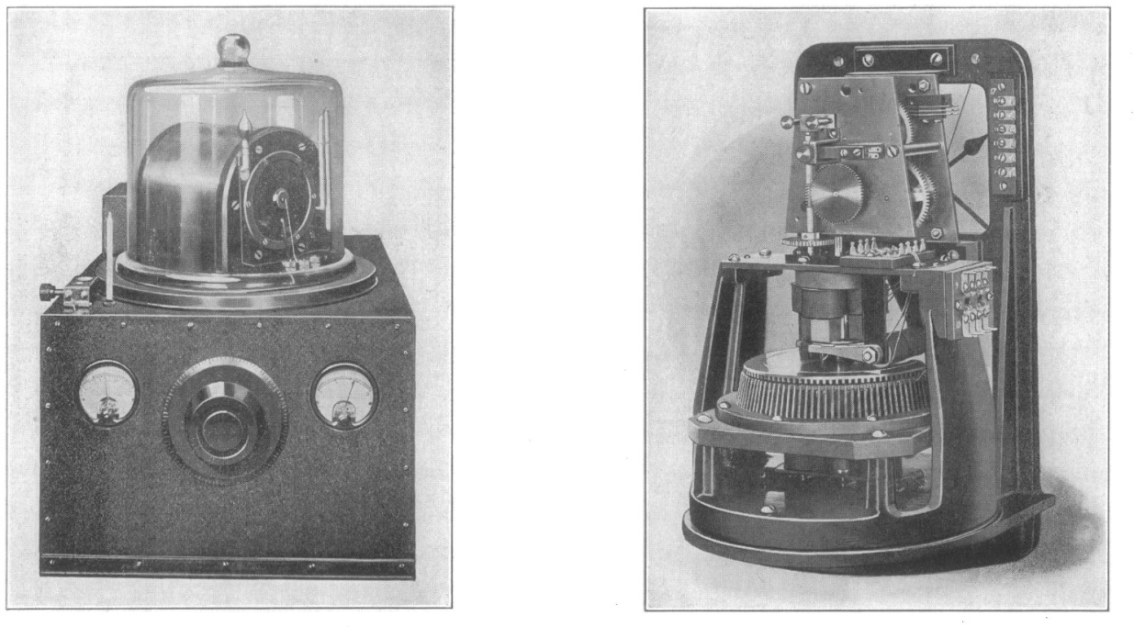
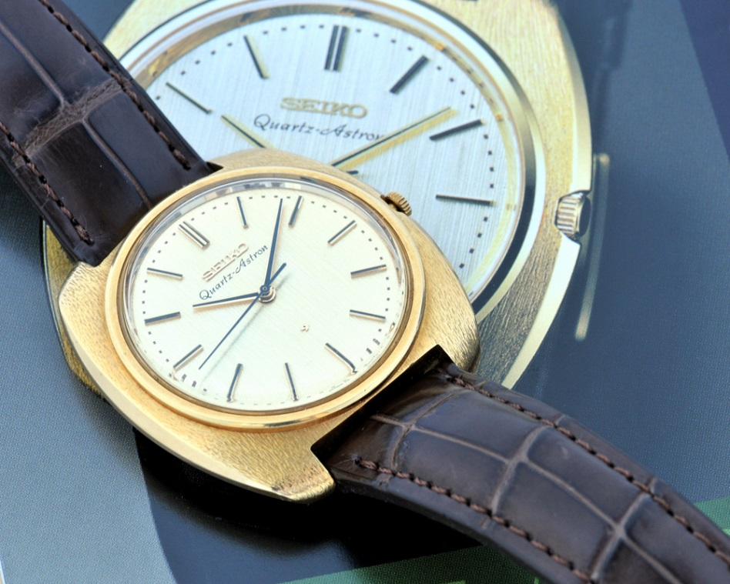
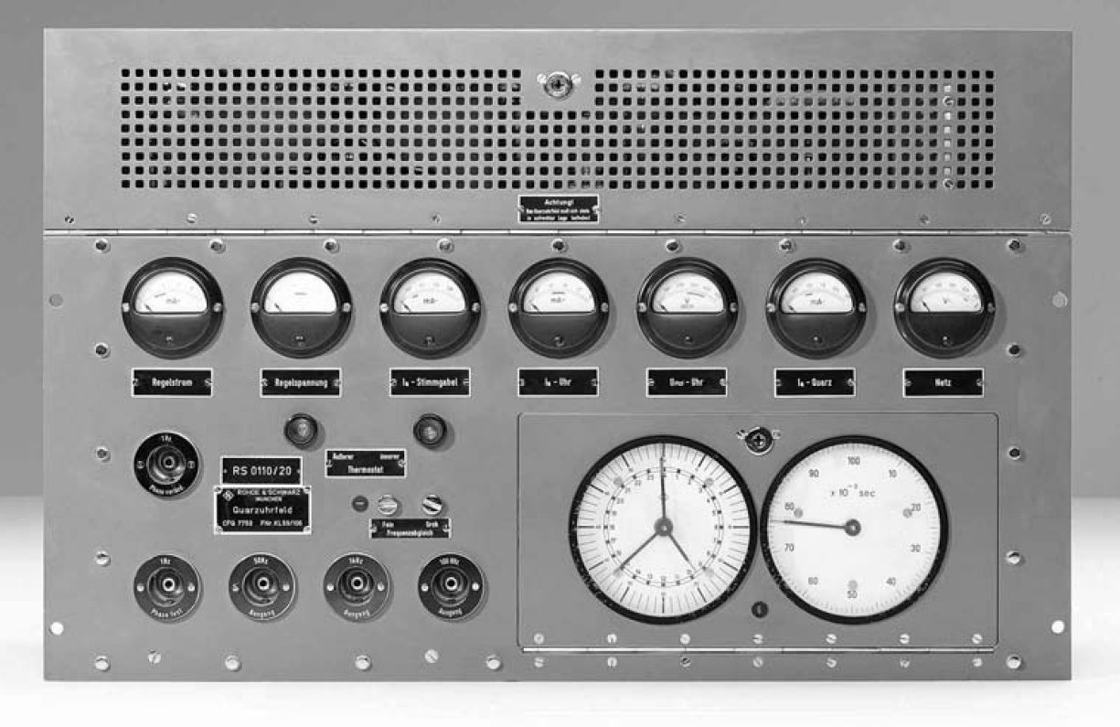

Slide 26
Atomic Clocks
(to be covered in detail by Mauricio Lopez)

Slide 27
Atomic Clock Performance

Slide 28
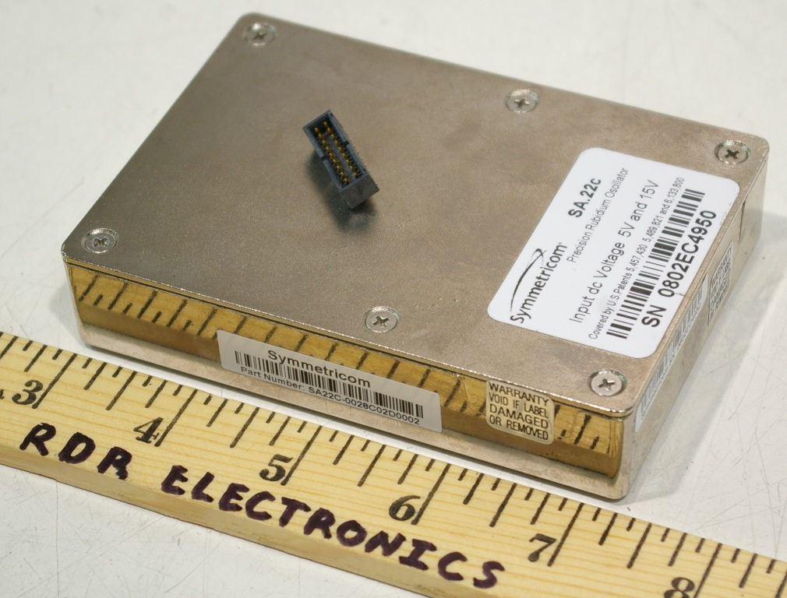
Rubidium Oscillators
  The lowest priced atomic oscillators, used by many labs in the SIM Time Network.
  They are good laboratory standards. Their long-term accuracy and stability is much better than a quartz oscillator, and they cost much less than a cesium oscillator.
  Rubidium oscillators do not always have a guaranteed accuracy specification, but most are accurate to about 5 × 10⁻¹⁰ after a short warm up. However, their frequency often changes due to aging by parts in 10¹¹ per month, so they require regular adjustments.

Slide 29
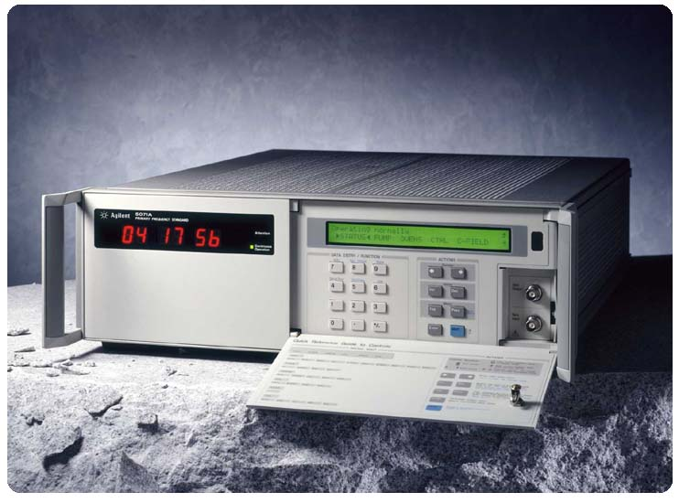
Cesium Oscillators
  Cesium oscillators are primary standards. They are the basis for atomic time around the world, because the SI second is defined by counting energy transitions of the cesium atom.
  Cesium oscillators are accurate to about 1 × 10⁻¹³ and have excellent long-term stability.
  Cesium oscillators are expensive (usually $50,000 or more USD) to buy and can be expensive to maintain. The cesium beam tube usually wears out (runs out of cesium) after about 7 to 15 years.

Slide 30
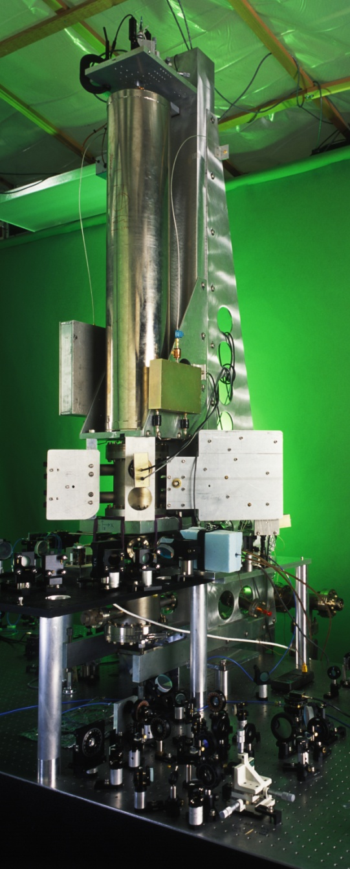
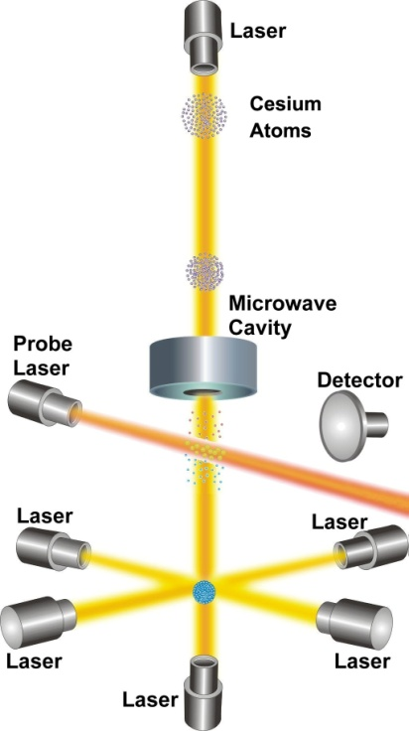
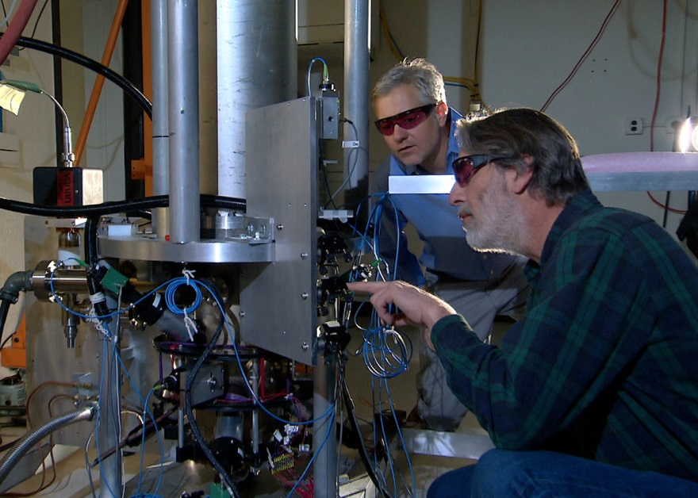
Cesium Fountain Clocks
Several NMIs now operate fountain clocks, including two at NIST (NIST-F1 and NIST-F2). The current accuracy (uncertainty) of NIST-F2 is 1 x 10^{-16.} This is equivalent to about:
10 picoseconds per day
1 second in 300 million years

Slide 31
Optical Clocks will provide further improvements in uncertainty
NBS-1
Frequency Uncertainty
NIST-F1
NIST-F2
Optical
Standards
Year

Slide 32
Clocks keep getting better!
The performance of the best clocks has improved by about 14 orders of magnitude in the past 700 years, and by about 10 orders of magnitude (a factor of ten billion) in the past century. Further gains will occur when optical clocks are used as standards.

Slide 33
Time Scales and
Coordinated Universal Time (UTC)
Time Scales to be covered by Ricardo de Carvalho and Mauricio Lopez

Slide 34
What is a Time Scale?
An agreed upon system for keeping time, based on a common definition of the second. Seconds are then counted to form longer time intervals like minutes, hours, days, and years.
Time scales serve as a reference for time-of-day, time interval, and frequency.

Slide 35
How is the SI second defined?
Pendulums or quartz oscillators were once used as national standards at NIST and elsewhere, but they were never used to define the second. The definition of the second went directly from astronomical to atomic time.
Before 1956, the second was defined based on the length of the mean solar day and was called the mean solar second.
From 1956 to 1967, the second was defined based on a fraction of the tropical year and was called the ephemeris second.
Since 1967, the second has been defined based on oscillations of the cesium atom and is called the atomic second, or cesium second.

Slide 36
SI Definition of the Second
The duration of 9,192,631,770 periods of the radiation corresponding to the transition between two hyperfine levels of the ground state of the cesium-133 atom.
=> Defined by Markowitz/Hall (USNO) & Essen/Parry (NPL), 1958.
=> Ratified by the SI in 1967.

Slide 37
Coordinated Universal Time (UTC)
UTC is an atomic time scale based on the SI definition of the second.
UTC is computed by the International Bureau of Weights and Measures (BIPM) in France. They collect data from about 400 atomic oscillators located at about 70 laboratories.
Six SIM labs currently contribute to UTC (with several more on the way):
  CENAM, CENAMEP, INTI, NIST, NRC, ONRJ
UTC is a virtual time scale, computed by the BIPM after the data is collected. Therefore, no lab can distribute or broadcast UTC.
Many laboratories maintain local, real-time versions of UTC that they distribute as a measurement reference. Most of the real-time versions of UTC are within 100 nanoseconds of the official UTC time scale.

Slide 38
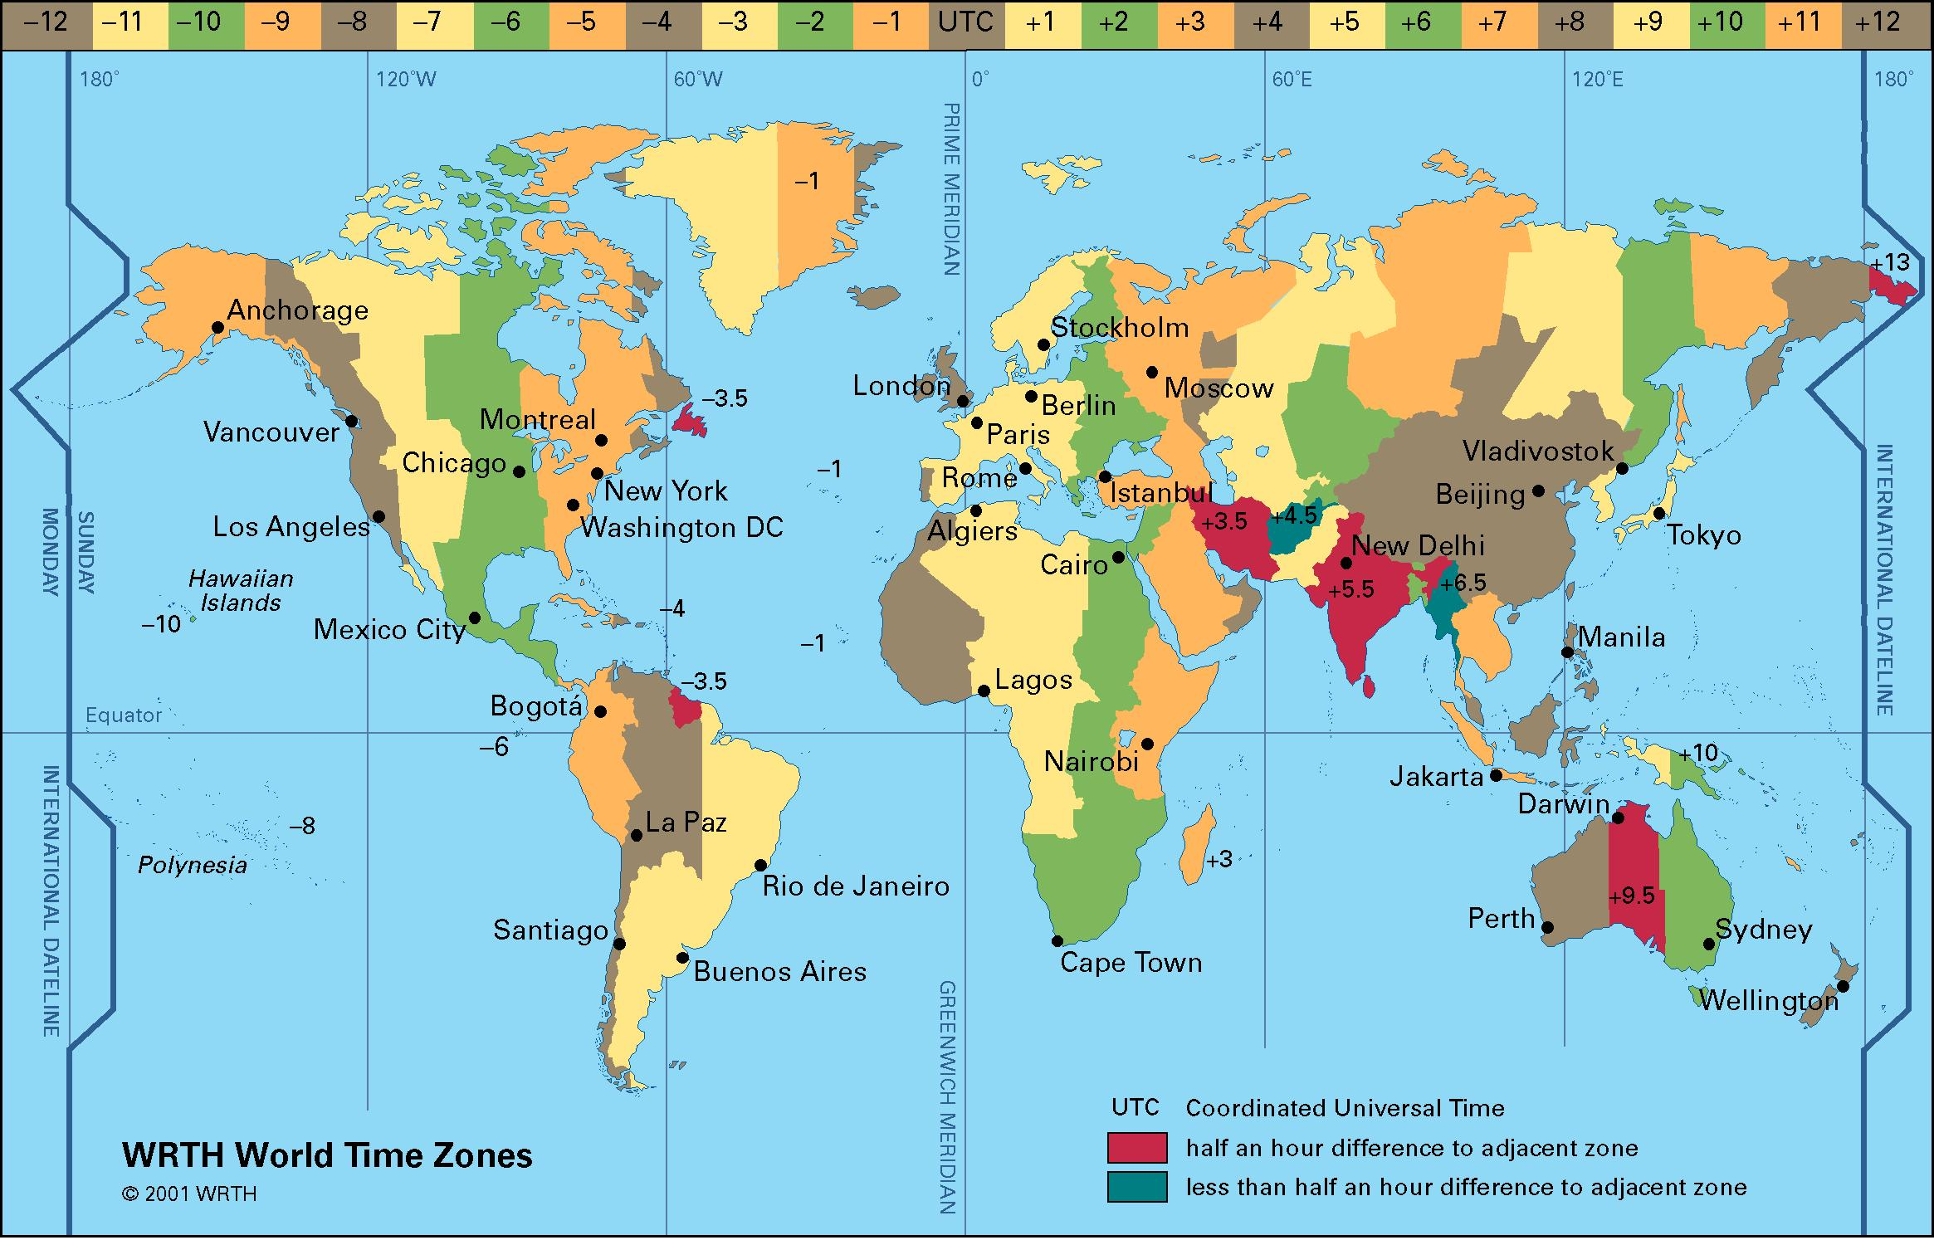
UTC is the Official Reference for Time-Of-Day
  Clocks synchronized to UTC display the same second (and normally the same minute) all over the world. However, since UTC is used internationally, it ignores local conventions like time zones and daylight saving time (DST). The UTC hour refers to the hour at the Prime Meridian which passes through Greenwich, England.

Slide 39
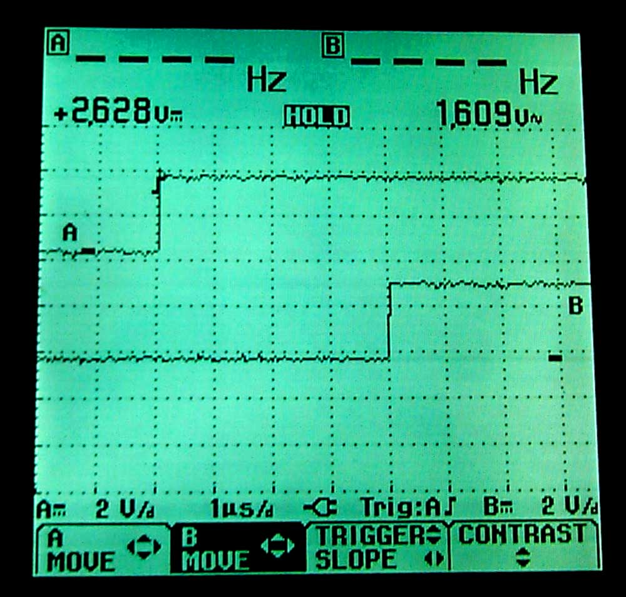
UTC is the Official Reference for Time Interval
  Time interval is the duration between two events measured in seconds or sub-seconds (milliseconds, microseconds, nanoseconds, picoseconds).
  All time interval measurements are referenced to the best realization of the SI second as computed by the BIPM when they derive UTC.
  Clocks can be synchronized to UTC by using an On-Time Marker (OTM) that coincides as closely as possible with the arrival of the UTC second.

Slide 40
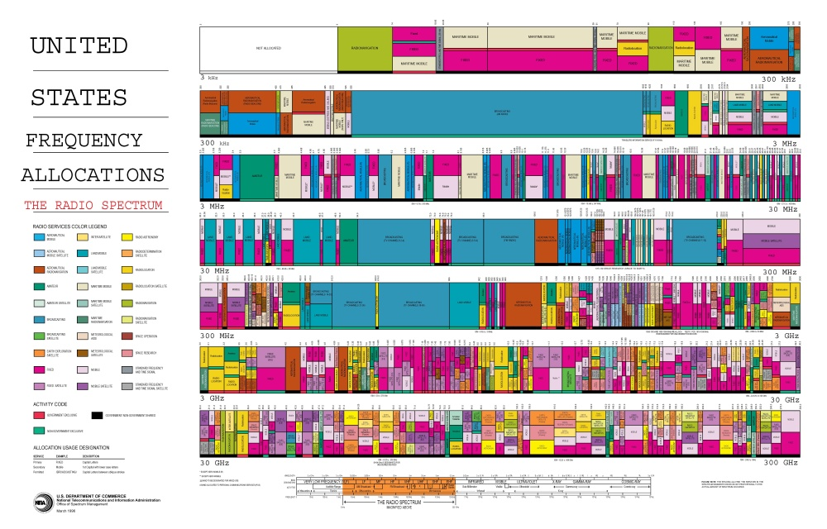
UTC is the Official Reference for Frequency
  UTC is an extremely accurate and stable frequency source. Its uncertainty is typically parts in 10¹⁵ or less. Therefore, it serves as the international reference for all frequency measurements.

Slide 41
Frequency and Time Calibrations
(to be covered in detail by Raul Solis, Luis Mojica, and Franciso Jimenez)

Slide 42
Four Parts of a Calibration
A calibration is a comparison between a reference and a device under test (DUT) that is conducted by collecting measurement data.
Device Under Test (DUT)
  Can be a tuning fork or a stopwatch or timer
  Can be a quartz, rubidium, or cesium oscillator
Reference
  Must be more accurate than the DUT
  Must be metrologically traceable to the SI
Calibration Method
  The measurement system and procedure used to collect data
Calibration Result
  The result must be accompanied by an uncertainty analysis

Slide 43
Frequency Accuracy
Accuracy is the degree of conformity of a measured value to its definition at a given point in time. Accuracy tells us how closely an oscillator produces its nominal or nameplate frequency. For example, if an oscillator is supposed to produce 5 MHz, its frequency accuracy tells us how close it actually is to 5 MHz.
In the time and frequency literature, it sometimes is called other things, including:
Frequency Offset
Frequency Error
Frequency Bias
Frequency Difference
Relative Frequency
Fractional Frequency

Slide 44
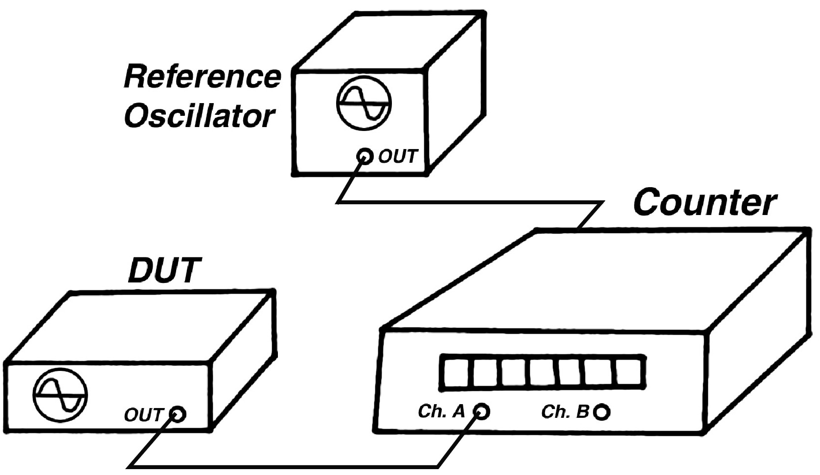
Using a Frequency Counter

Slide 45
Estimating Frequency Offset (accuracy) in the Frequency Domain (a measurement made with respect to frequency)
f_{measured} is the reading from a frequency counter or similar instrument
f_{nominal} is the nominal frequency of the oscillator

Slide 46
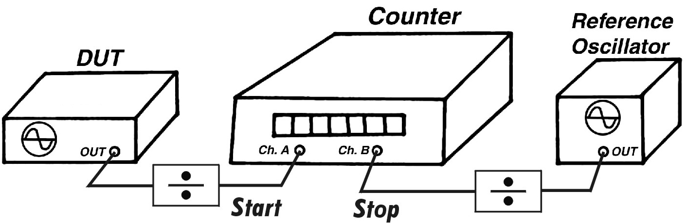
Using a Time Interval Counter

Slide 47
Estimating Frequency Offset (accuracy) in the Time Domain (a measurement made with respect to time)
The quantity Δt is the phase change expressed in time units, estimated by the difference of two readings from a time interval counter or oscilloscope. T is the duration of the measurement, also expressed in time units.

Slide 48
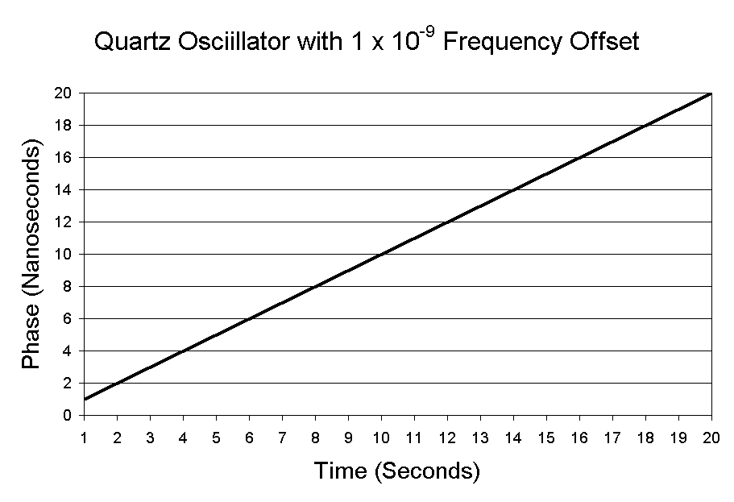
Frequency accuracy is computed from the slope of the phase

Slide 49
Two important things to remember
Frequency accuracy is normally expressed as a dimensionless number (unitless). You can convert the offset to units of frequency by multiplying the nominal frequency by the offset. For example, a 10 MHz oscillator with a frequency offset of 1 x 10⁻¹¹ has a offset of 0.0001 Hz.
(1 x 10⁷) (1 x 10⁻¹¹) = 1 x 10⁻⁴ = 0.0001 Hz
We get the same answer in either the frequency domain or the time domain:

Slide 50
The Difference Between
Accuracy and Stability

Slide 51
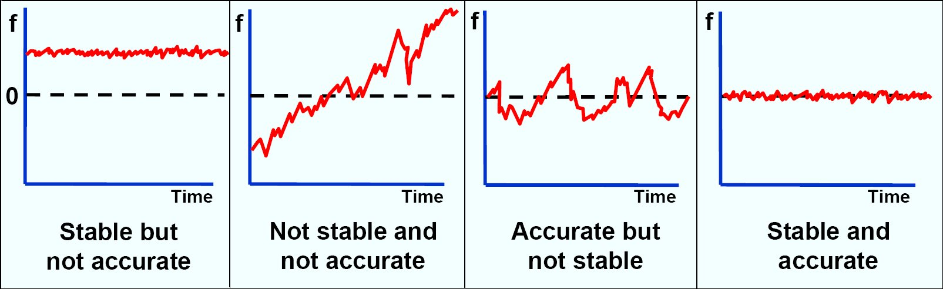
Stability
Stability indicates how well an oscillator can produce the same time and frequency offset over a given period of time. Stability doesn’t indicate whether the time or frequency is “right” or “wrong”, but only whether it stays the same.
In contrast, accuracy indicates how well an oscillator has been set on time or set on frequency.

Slide 52
A few things to remember about accuracy and stability
It is important to not confuse accuracy with stability. This is a mistake that is commonly made by people when they talk about clocks.
The accuracy over a given averaging time can never be better than the stability over that same averaging time.
In most cases, the stability will be a smaller, more impressive number than the accuracy.

Slide 53
Statistical Tools Used to Estimate Stability
(to be covered in detail by Mauricio Lopez)

Slide 54
Why standard deviation doesn’t work with clocks and oscillators
Consider this graph of the growth of a child who was 20 inches tall at birth, and 67 inches tall at age 16.
At age 8, the child’s average height was about 36 inches, and the standard deviation was about 8 inches. By age 16, the average height had increased to 46 inches, and the standard deviation was about 14 inches.
These numbers are meaningless! Taking the mean and the standard deviation from the mean is pointless if the data has a trend, or is “non-stationary”.
Clocks accumulate time errors and oscillators drift, so standard deviation is seldom used in time and frequency.

Slide 55
What is the Allan Deviation (ADEV)?
It’s a statistic used to estimate frequency stability. It was named after Dave Allan, a physicist who retired from NIST in 1993. He first published the statistic in 1966.
The mathematical notation is σ_{y}(τ). The y is frequency and ττ refers to the averaging period. The σ is the same notation we use for standard deviation. Thus, ADEV is the deviation of the frequency over a given averaging period.
ADEV is computed by taking the differences between successive pairs of data points. This differencing removes the trend or slope contributed by the frequency offset. This is necessary because data with a trend is non-stationary, and never converges to a particular mean. By removing the trend, we can make the data converge to a mean.
Because the slope contributed by the frequency offset is gone, ADEV is only useful for computing stability, and not accuracy. Keep in mind that ADEV has EVERYTHING to do with stability, and NOTHING to do with accuracy.

Slide 56
Using the Allan Deviation with time domain data
where:
x_{i} is a set of equally spaced phase measurements in time units, such as data from a time interval counter
N is the number of values in the x_{i} series
τ (tau) is the measurement or sampling interval
m is the averaging factor
ADEV is computed using an iterative method (multiple passes through a loop). Normally, ADEV is computed using the octave method, so m is doubled on each pass. For example, stability would be estimated at 1, 2, 4, 8, 16, 32 s, etc. But it is possible to increment m by 1 each time, and calculate stability for every possible averaging period. That takes longer, but reveals more information.

Slide 57
Computing ADEV from time interval measurements

Slide 58
Using time measurements to estimate stability (cont.)
2.2 x 10⁻²¹ is the sum of the first differences squared
1 second data is combined to estimate stability over longer periods

Slide 59
Noise Floor
ADEV graphs show stability estimates at averaging periods that are increasing in duration. These estimates improve until the devices reaches its noise floor. The noise floor is the point when more averaging doesn’t help, you’ll get the same answer or a worse answer if you continue to average. This is because the frequency is starting to change.
Specification sheets usually only provide stability estimates out to the point where the noise floor is reached. For example, if an oscillator’s specification sheet only shows stability estimates out to an averaging period of 10 seconds, you’ll know that the stability at longer intervals (like 1 hour or 1 day) is worse than the stability at 10 seconds. Atomic oscillators have much better long-term stability than quartz oscillators.
Quartz oscillators usually reach their noise floor in 10 s or less, sometimes in less than 1 s.
Rubidium oscillators usually reach their noise floor in less than 30 minutes.
Cesium oscillators take at least several days, and sometimes many weeks, to reach their noise floor.

Slide 60
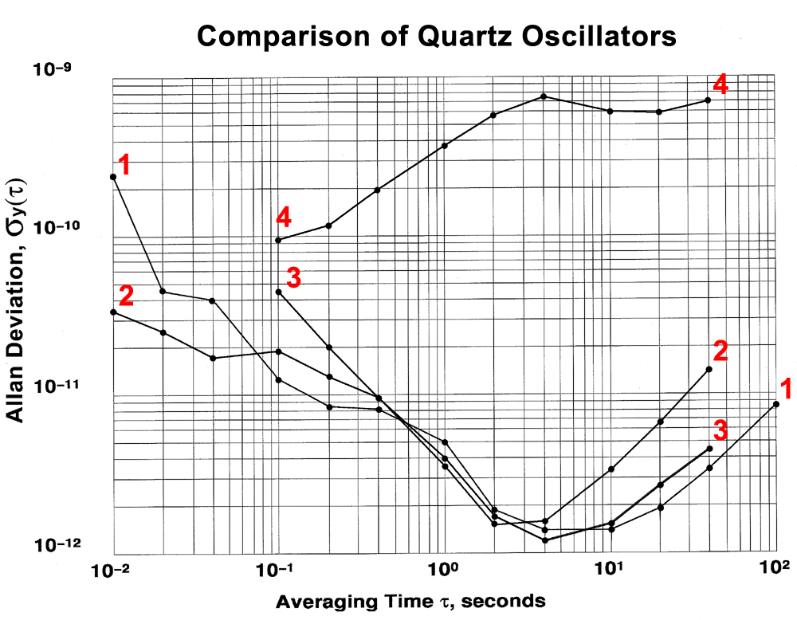

Slide 61
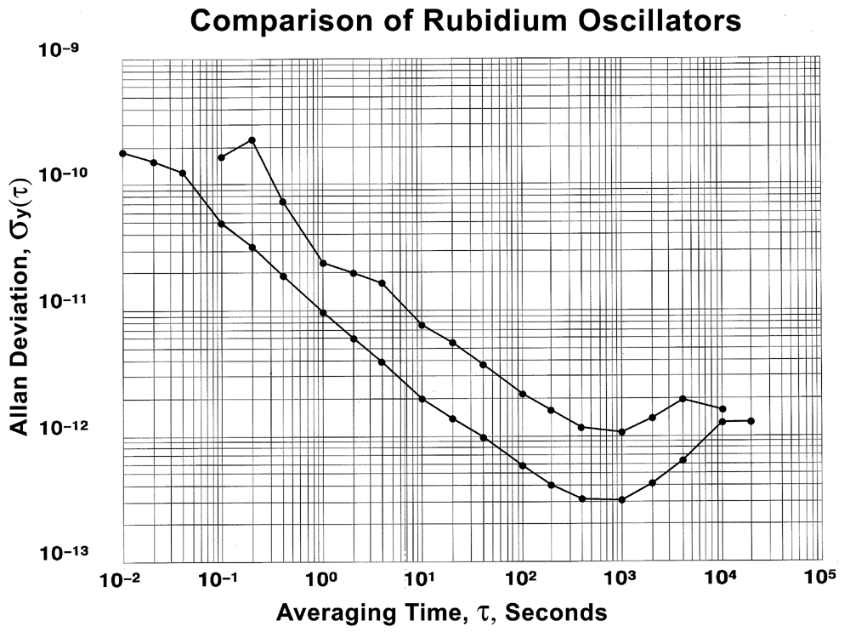

Slide 62
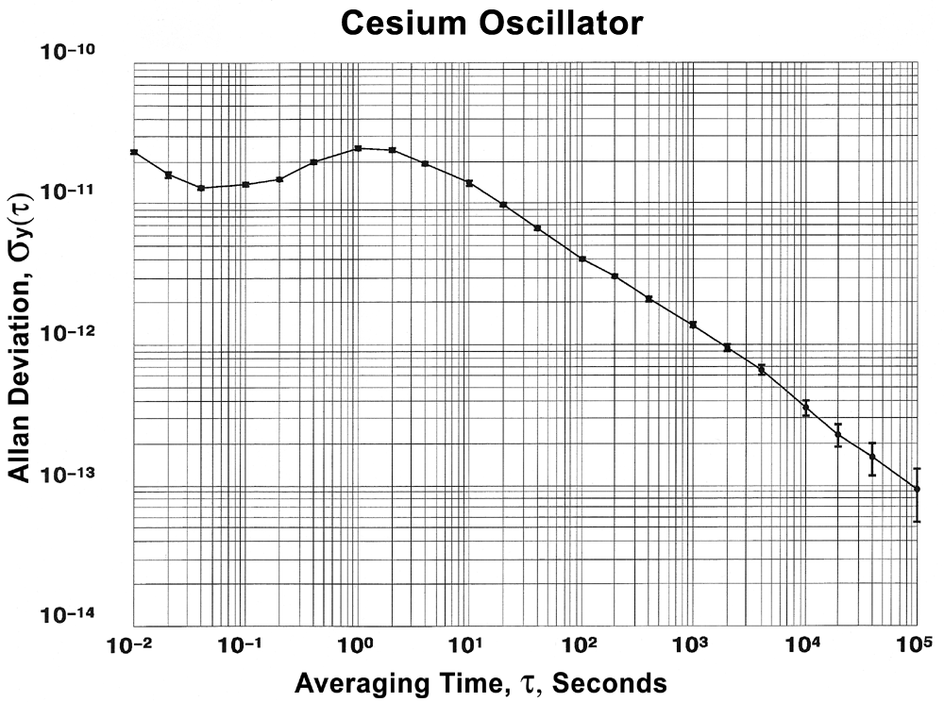

Slide 63
Summary
This introductory talk has been an overview of the topics to be covered in more detail later in this meeting. We have touched upon some key aspects of time and frequency metrology, including:
    Basic Concepts and Terminology
    Clocks and Oscillators
    Mechanical Clocks
    Atomic Clocks
    Time Scales and Coordinated Universal Time (UTC)
    Frequency and Time Calibrations
    The Difference Between Accuracy and Stability
    Statistical Tools Used to Estimate Stability

