Slide 1
The Global Positioning System (GPS) and Common-View Time Transfer
Michael Lombardi
NIST Time and Frequency Division
SIM Time and Frequency Metrology Working Group Workshop and Planning Meeting
Panama City, Panama
January 27-29, 2015

Slide 2
Outline
What is GPS?
How does GPS work?
What is the uncertainty of GPS positioning?
What is the uncertainty of GPS time?
Common-view GPS time transfer
The SIM Time Network
The uncertainty of SIMTN comparisons
Contributing to UTC by participating in the BIPM key comparisons

Slide 3
What is GPS?

Slide 4
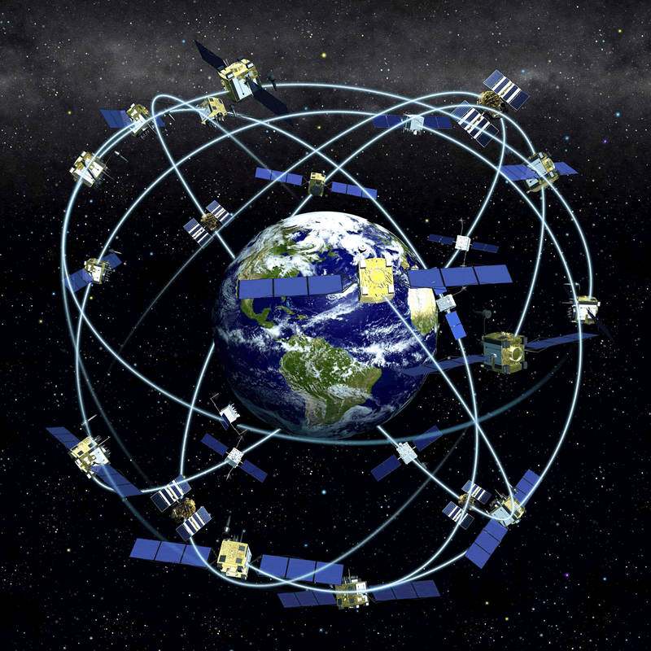
What is GPS?
The Global Positioning System (GPS) is not only a positioning and navigation system, but the main system used to distribute accurate time and frequency worldwide
The constellation includes a maximum of 32 operational satellites
  The satellites are in semi-synchronous orbit at an altitude of about 20,200 km
  The orbital period is 11 hours, 58 minutes
  At least four satellites, but typically seven or more, can always be received at a given location, so the entire Earth has continuous GPS coverage
The satellites carry either cesium or rubidium atomic clocks

Slide 5
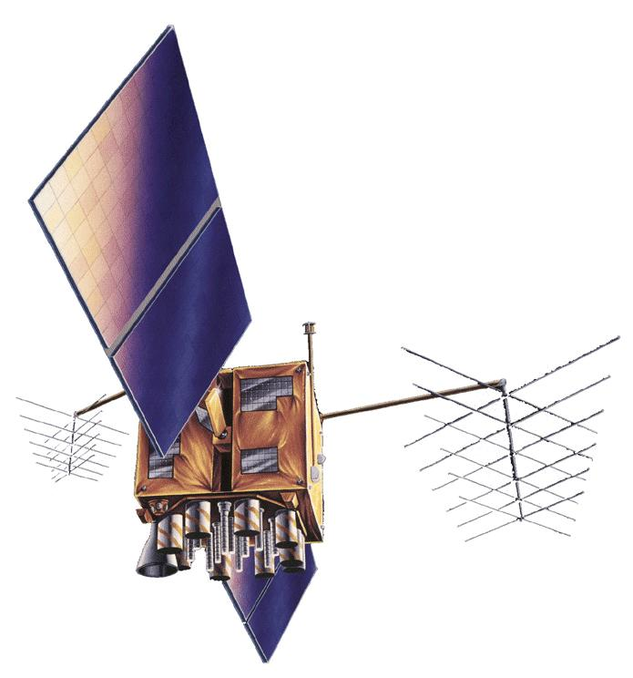
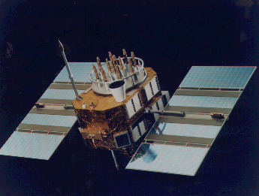
GPS Satellites
GPS Satellites
Currently (January 2015) there are 31 operational GPS satellites occupying all but one of the 32 possible “slots”
  Only two satellites (PRN 10 and PRN 24) are referenced to cesium clocks, the other 29 are referenced to rubidium clocks.
  The oldest satellite is PRN 32, launched in November 1990, this was a Block IIA satellite built by Rockwell.
  The newest satellite is PRN 03, launched on October 29, 2014, a Block IIF satellite built by Boeing.
Block IIR/IIR-M
Built by Lockheed Martin
Launched from 1997 to 2009
Block II/IIA Vehicles

Slide 6
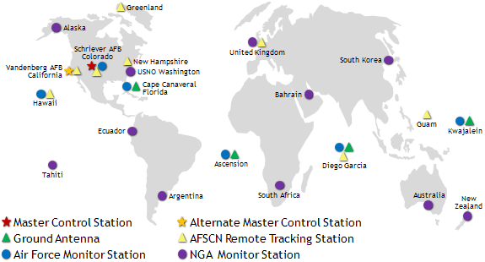
GPS Control Segment
The GPS control segment includes a master control station in Colorado, an alternate master control station in California, 12 command and control sites, and 16 monitoring sites that
  Monitor the GPS satellites for operational health
  Upload satellite almanacs, ephemeris messages, and clock corrections

Slide 7
How Does GPS Work?

Slide 8
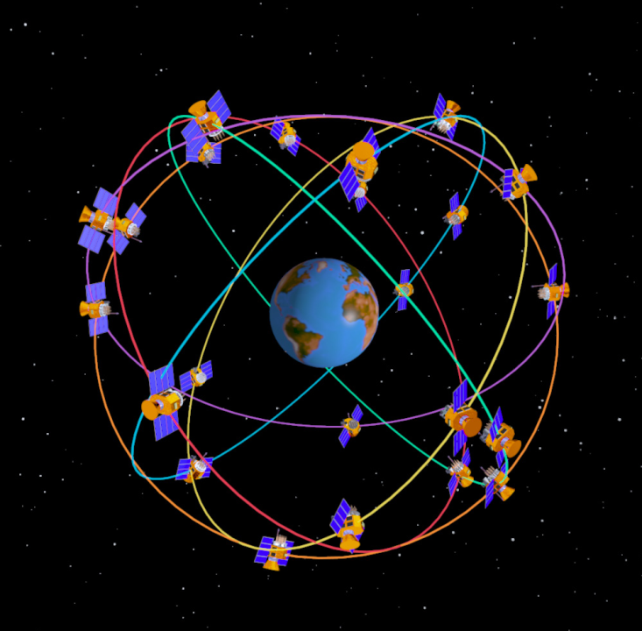
GPS Signal Structure
GPS Signal Structure
Two L-band carrier frequencies
  L₁ = 1575.42 MHz L₂ = 1227.60 MHz
Two PRN Codes
  P(Y): Military Code
    267 day repeat interval
    Encrypted – code sequence not published
    Available on L1 and L2
  C/A: Coarse Acquisition (Civilian) Code
    1 millisecond repeat interval
    Available to all users, but only on L1
Code modulated with Navigation Message Data
  Provides ephemeris data and clock corrections for the GPS satellites
  Low data rate (50 bits per second)

Slide 9
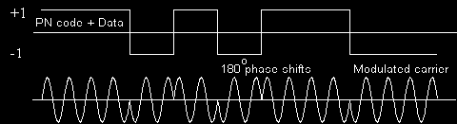
GPS Modulation
The GPS carriers are sine waves. Two binary codes are modulated onto them: the C/A (coarse/acquisition) code and the P (precise) code.
Binary biphase modulation (also known as binary phase shift keying [BPSK]) is the technique used to modulate the codes onto the carrier. There is a 180 degree carrier phase shift each time the code state changes.
GPS spreads the data over a bandwidth much wider than needed to carry the small amount of information. This allows very low power signals to be used. This “spread spectrum” technique is the same principle used by household cordless telephones and other devices.

Slide 10
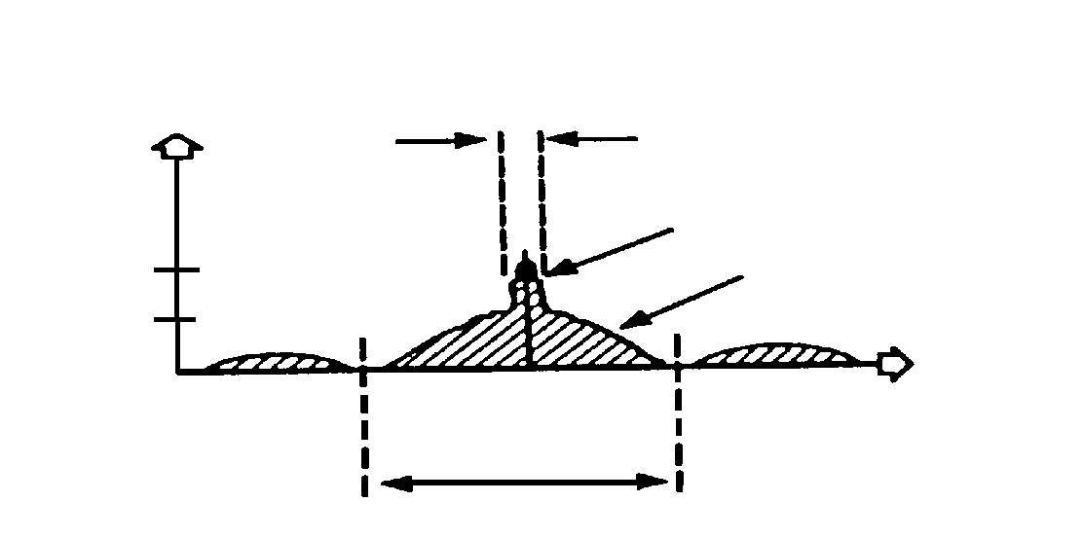
GPS Signal (L1 band, C/A Code)
P[dBW]
2.046 MHz
C/A-CODE
-160
P-CODE
-163
f [Hz]
1575.42 MHz
L1 Signal
P[dBW]
20.46 MHz
Frequency Spectrum
C/A stands for Coarse Acquisition. The C/A code, broadcast on the L1 carrier at 1575.42 MHz, is the reference for nearly all GPS consumer products, including the receivers used in the SIM Time Network.
The C/A code is freely available to anyone, worldwide, as part of the Standard Positioning Service (SPS) of GPS.

Slide 11
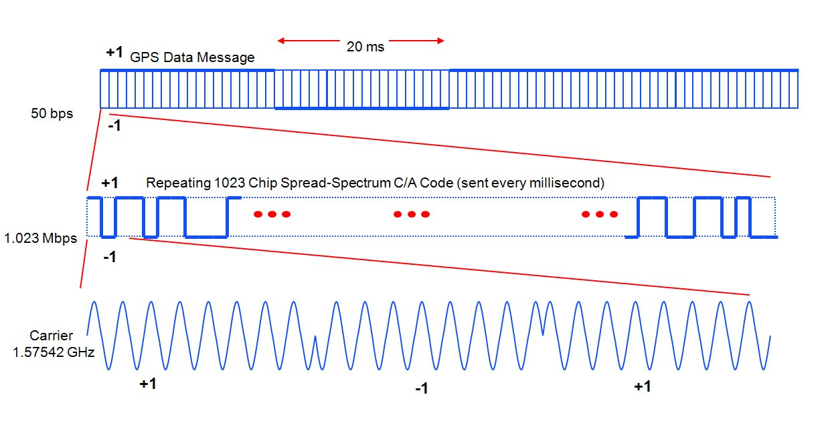
GPS L1 C/A Signal (Time-Domain)

Slide 12
GPS Positioning
GPS positioning is based on:
  The precise measurement of time
  The constancy of the speed of light
GPS positioning uses the concept of trilateration
  GPS satellite positions are known
  Receiver position is not known
  GPS-to-receiver range measurements are used to compute position

Slide 13
Positioning Example with One Transmitter
Locus of points on which the receiver can be located
Receiver
(location unknown)
Measured Range
Transmitter
(location known)

Slide 14
Positioning Example with Two Transmitters
True Receiver Location
ρ₁
ρ₂
T₁
T₂
False Receiver Location

Slide 15
Positioning Example with Three Transmitters
True Receiver Location
ρ₃
T₃
ρ₂
ρ₁
T₁
T₂

Slide 16
Solving for Receiver Position and Time
The position solution involves solving for four unknowns:
  Receiver position (x, y, z coordinates)
  Time
A positioning uncertainty of about 10 meters requires the time of the receiver clock to be known to within about 30 ns, because the speed of light is about 3 ns per meter.
The solution requires:
  Range measurements to each satellite to determine the signal propagation delay
  Reading the data message from each satellite to obtain the satellite’s location and corrections for the satellite clock

Slide 17
Pseudo-Random Noise (PRN) Codes
Each GPS satellite transmits its own unique Pseudo-Random Noise (PRN) Code. There are 32 possible codes (PRN 1 to 32), one for each satellite in the constellation.
The C/A Code repeats every millisecond.
Remember, all satellites broadcast on the same frequency (1575.42 MHz in the case of L1). The receiver can only distinguish between satellites by generating replicas of the C/A code and using code correlation to “get a lock.”

Slide 18
Locking to a Satellite by Matching the C/A Code
GPS transmitted C/A code
Receiver replicated C/A code
Finding ∆t for each GPS signal tracked is called “code correlation”. The receiver locks to the satellite by matching the code it generates to the code transmitted by the satellite.
Δt
Once the receiver has locked to a satellite, it can make a range measurement
Δt is proportional to the GPS-to-receiver range (the propagation delay).

Slide 19
Ranging Measurements
( x_{s}, y_{s}, z_{s}, t_{s} )
--- [m]
Satellite
PRN sequence
Receiver
PRN sequence
( x, y, z, t )
pr
Receiver
pseudo-range
--- [s]

Slide 20
The range measurement produces not the true geometric range, but rather the pseudorange. Errors are introduced by the satellite clock and receiver clock errors (primarily by the receiver clock), by delays as the signals pass through the ionosphere and troposphere, and by multipath and receiver/antenna noise. The pseudorange equation is
p = ρ + c ⋅ (dt − dT ) + dion + dtrop + rn
where
p is the pseudorange
c is the speed of light
ρ is the geometric range to the satellite
dt and dT are the time offsets of the satellite and receiver clocks with respect to GPS time
dion is the delay through the ionosphere (an estimate can be obtained from the GPS broadcast)
dtrop is the delay through the troposphere
rn represents the effects of receiver and antenna noise, including multipath.

Slide 21
What is the uncertainty of GPS positioning?

Slide 22
Factors that Limit the Uncertainty of GPS Positioning
Two main factors limit the uncertainty of the GPS positioning solution
  UERE (User Equivalent Range Error)
    Reflects the uncertainty of the pseudo range measurements between a particular satellite and the receiver
  DOP (Dilution of Precision)

Slide 23
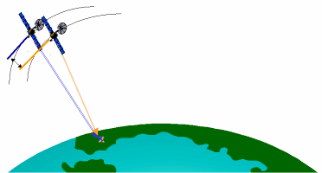
UERE accuracy exceeds published standard
N/A
N/A
N/A
N/A
N/A
7
Signal-in-Space User Range Error is the difference between a GPS satellite’s navigation data (position and clock) and the truth, projected on the line-of-sight to the user
6
2001 SPS Performance Standard
(RMS over all SPS SIS URE)
5
4
2008 SPS Performance Standard
(Worst of any SPS SIS URE)
RMS SIS URE (m)
RMS Signal-in-Space User Range Error (URE), meters
3
2
1.6
Decreasing range error
1.2
1.1
1.0
1
0.9
0
1990
1992
1994
1996
1997
2001
2004
2006
2008
2009
Selective Availability (SA)

Slide 24
Dilution of Precision (DOP)
Depends upon the geometry of satellites, as seen by the receiver.
If the satellites used in the positioning solution are spread out in the sky, the DOP is lower and the position estimate has less uncertainty.
Good (Low) DOP
Conditions:
Poor (High) DOP
Conditions:

Slide 25
GPS Positioning Accuracy Specifications
U.S. commitments to civil GPS performance are documented in the GPS Standard Positioning Service Performance Standard (2008).
  With averaging, the horizontal uncertainty (latitude and longitude) can often be reduced to less than one meter. It should be less than 10 meters with no averaging.
  The vertical uncertainty (altitude) does not improve significantly with averaging, and can be greater than 10 meters.

Slide 26
What is the uncertainty of GPS time?

Slide 27
GPS can be trusted as a reference for measuring position, distance, and time
GPS requires highly accurate timing derived from atomic clocks, or the navigation system will fail
  Assume that the maximum acceptable uncertainty contribution from the GPS clocks is 1 m:
    Light travels 3 x 10⁸ m/s, thus a 1 m error equals a 3.3 ns timing uncertainty
    The clocks must be stable enough to keep time to better than 3.3 ns for 12 hours, the approximate period between clock corrections
    This requires better than 1 x 10⁻¹³ stability (3.3 x 10⁻⁹ s / 43200 s = 0.8 x 10⁻¹³)
The atomic oscillators onboard the satellites are steered from U. S. Air Force ground stations to agree with the Coordinated Universal Time (UTC) time scale maintained by the U. S. Naval Observatory, known as UTC(USNO).

Slide 28
GPS time is a very close approximation of UTC
Coordinated Universal Time (UTC), computed monthly by the Bureau International des Poids et Mesures (BIPM), is the official world time scale.
UTC(USNO) is a real time approximation of UTC that is nearly always within 10 ns of UTC (0.01 µs).
Subframe 4 of the GPS navigation message includes a UTC(USNO) time difference correction. This correction is applied by default by GPS timing receivers (most receivers do not even allow the corrections to be turned off).
UTC(USNO) is the time scale distributed by GPS receivers.

Slide 29
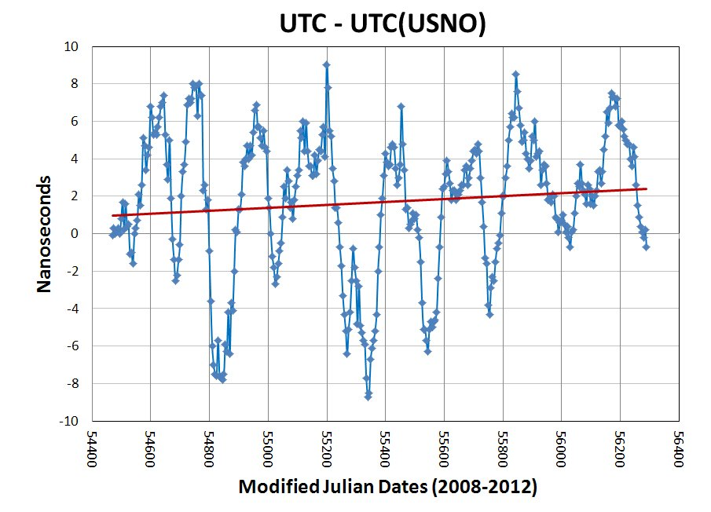
UTC – UTC(USNO), Circular-T, 2008-2012
f_{off} = 0.9 × 10⁻¹⁷

Slide 30
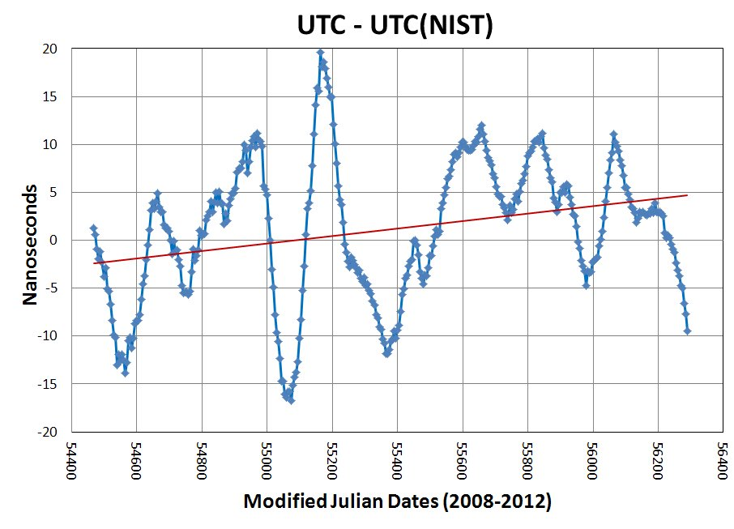
UTC – UTC(NIST), Circular-T, 2008-2012
f_{off} = 4.5 × 10⁻¹⁷

Slide 31
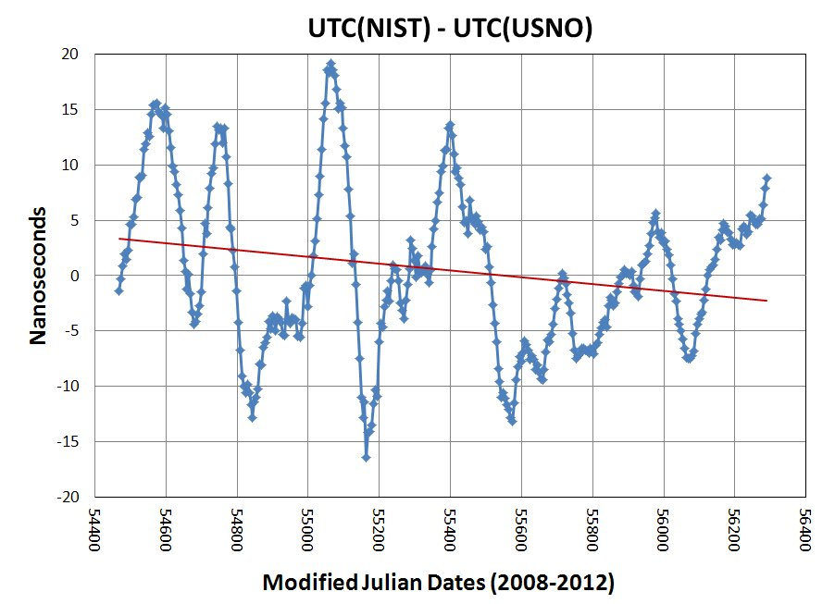
UTC(NIST) – UTC(USNO), Circular-T, 2008-2012
f_{off} = -3.6 × 10⁻¹⁷

Slide 32
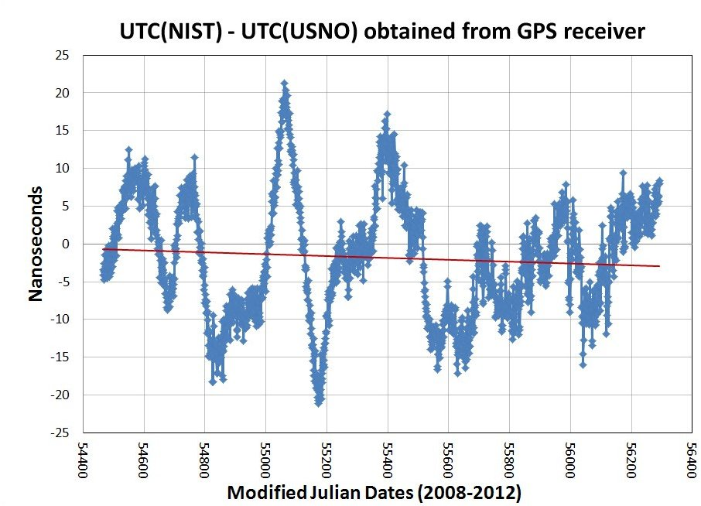
UTC(NIST) – UTC(USNO), via GPS Rx in SIM System, 2008-2012
f_{off} = -1.4 × 10⁻¹⁷

Slide 33
Common-View GPS Time Transfer

Slide 34
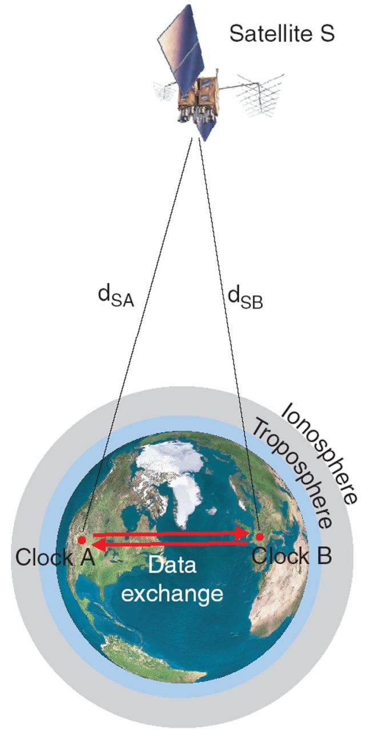
“Classic” Common-View GPS Measurements
Common-view GPS is the most practical and cost effective way to compare two clocks at remote locations.
The common-view method involves a GPS satellite (S) that can be received at each of two receiving sites (A and B). Each site has a GPS receiver, a clock, and a time interval counter.
The time interval between the local clock and GPS is measured at each site. Two data sets are recorded (one at each site):
  Clock A - S
  Clock B - S
The two data sets are then subtracted from each other to find the difference between Clocks A and B. Delays that are common to both paths (d_{SA} and d_{SB}) cancel. Delays that are not common to both paths contribute uncertainty to the measurement.
The equation for the measurement is:
(Clock A – S) – (Clock B – S) = (Clock A – Clock B) + (d_{SA} – d_{SB})

Slide 35

All-in-view GPS
Instead of requiring the same individual satellite to be received at both locations, this method takes the average of all of the satellites that can be received, and then measures the time difference between the group of satellites and the local clock.
As is the case with classic common-view, the two measurements are then subtracted from each other to obtain the difference between two clocks.
This method works over very long baselines when no satellites are in common-view. For example, it allows continuous comparisons between Brazil and Canada, or Brazil and the United States. In fact, it allows common-view systems to be located anywhere on Earth.
The performance is perhaps a little worse than classic common-view for short baselines (2500 km or less), but better than classic common-view for long baselines (5000 km or longer)
ionosphere
troposphere
A
B

Slide 36
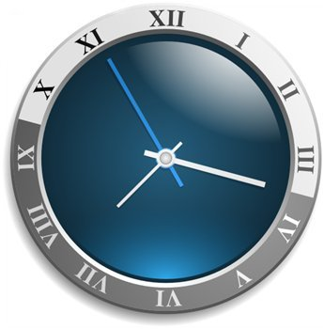
Common-view GPS data is normally post processed, but it can be processed in real time with the help of the Internet.
GPS Satellites
Clock A
Clock B
GPS Receiver
GPS Receiver
Internet Server for real-time processing
Time Interval Counter
Time Interval Counter
Clock A – Satellite(s)
Clock B – Satellite(s)
Web site showing results of Clock A – Clock B

Slide 37
A few things to know about common-view
Common-view systems need to be calibrated so that the difference in delays between two systems is as close to 0 as possible.
Anything that is different between two common-view systems will add to the measurement uncertainty. For example, if the antenna coordinates are wrong at one site, it will add uncertainty to the clock comparison.
GPS time is not the reference! Common-view is a way to compare clocks to each other, for example to compare the clock at NIST to the clock at CENAMEP. GPS is simply used as a transfer standard to compare clocks located at remote sites. Even if the GPS time were wrong, it would not affect the common-view comparison.

Slide 38
The SIM Time Network

Slide 39





Information about SIM
SIM is one of five regional metrology organizations (RMOs) recognized by the BIPM.
The BIPM expects RMOs to review the quality systems of NMIs, and their calibration and measurement capabilities (CMCs). RMOs should also organize regional comparisons to supplement the BIPM key comparisons so that more nations can establish traceability to the SI. This is the role of the SIMTN.
SIM consists of NMIs located in the 34 member nations of the Organization of American States (OAS), which extends throughout North, Central, and South America, and the Caribbean region.
SIM is the largest RMO in terms of land area, and the SIM region now has almost one billion people. About 2 out of 3 people in the SIM region live in the United States, Brazil, or Mexico.
SIM has organized metrology working groups (MWGs) in 11 different areas, including time and frequency. The SIM Time Network is operated by the T&F MWG.

Slide 40
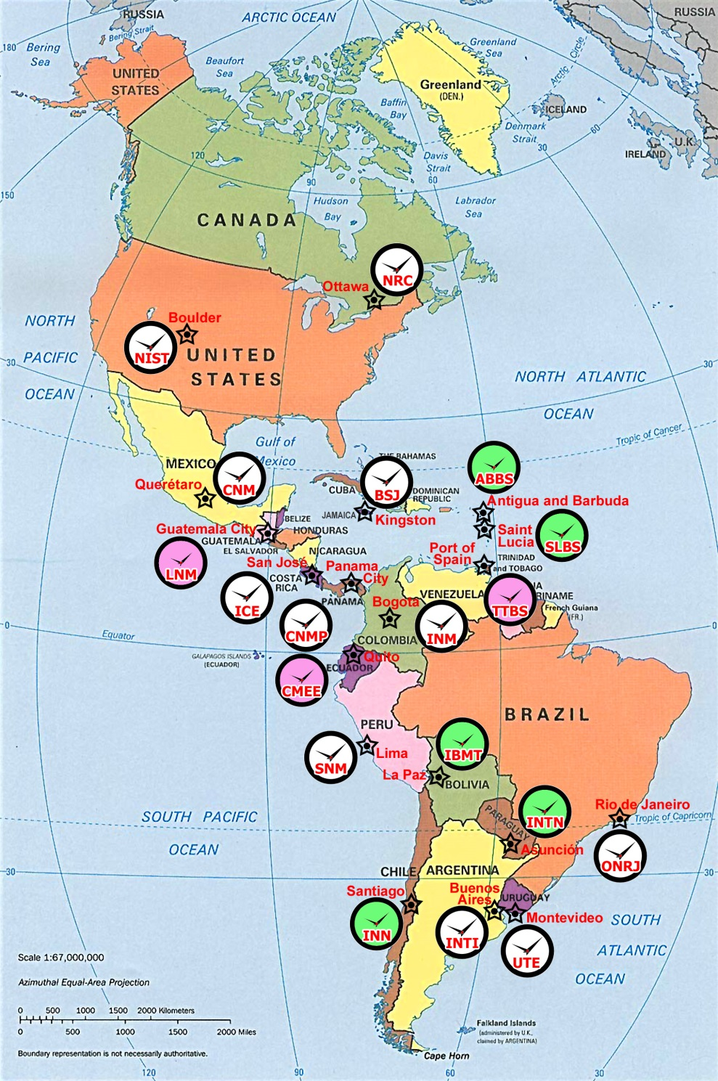
The SIM Time Network
The SIM Time Network is based on real-time common-view GPS comparisons. All participants use identical measurement equipment.
Data can be processed as common-view or all-in-view measurements.
A total of 22 laboratories now participate, with two nations currently on the waiting list as of January 2015. All of these labs continuously compare their clocks, 24 hours per day, 7 days per week.

Slide 41
Country | Organization | Year of First Participation | Time Standard (SIMT clock) | Clock Group
United States | NIST | 2005 | Ensemble time scale | 1
Mexico | CENAM | 2005 | Ensemble time scale | 1
Canada | NRC | 2005 | Ensemble time scale | 1
Panama | CENAMEP | 2005 | Cesium clock | 2
Brazil | ONRJ | 2006 | Ensemble time scale | 1
Costa Rica | ICE | 2007 | Cesium clock | 2
Colombia | INM | 2007 | Cesium clock | 2
Argentina | INTI | 2007 | Cesium clock | 2
Guatemala | LNM | 2007 | GPS disciplined clock | 3
Jamaica | BSJ | 2007 | Cesium clock | 2
Uruguay | UTE | 2008 | Cesium clock | 2
Paraguay | INTN | 2008 | SIMT disciplined rubidium clock | 4
Peru | INDECOPI | 2009 | Cesium clock | 2
Trinidad & Tobago | TTBS | 2009 | GPS disciplined clock | 3
Saint Lucia | SLBS | 2010 | SIMT disciplined rubidium clock | 4
Chile | INN | 2010 | SIMT disciplined rubidium clock | 4
Antigua and Barbuda | ABBS | 2011 | SIMT disciplined rubidium clock | 4
Ecuador | CMEE | 2012 | GPS disciplined clock | 3
Bolivia | IBMETRO | 2012 | SIMT disciplined rubidium clock | 4
St. Kitts and Nevis | SKNBS | 2014 | SIMT disciplined rubidium clock | 4
Guyana | GNBS | 2015 | SIMT disciplined rubidium clock | 4
El Salvador | CIM | 2015 | SIMT disciplined rubidium clock | 4
Dominican Republic | INDOCAL | 2015? | SIMT disciplined rubidium clock | 4
Belize | BBS | 2015? | SIMT disciplined rubidium clock | 4

Slide 42
SIM Time Network Design Goals
Our design goals were:
  To establish cooperation and communication between the SIM time and frequency labs now and in the future.
  To build a network that allowed all SIM NMIs to compare their time standards to those of the rest of the world.
  To utilize equipment that was low cost and easy to install, operate, and use, because SIM NMIs typically have small staffs and limited resources.
  To be capable of measuring the best standards in the SIM region. This meant that the measurement uncertainties had to be as small, or nearly as small, as those of the BIPM key comparisons.
  To report measurement results in near real-time, without the processing delays of the BIPM key comparisons.
  To build a democratic network that favored no single laboratory or nation, and to allow all members to view the results of all comparisons.

Slide 43
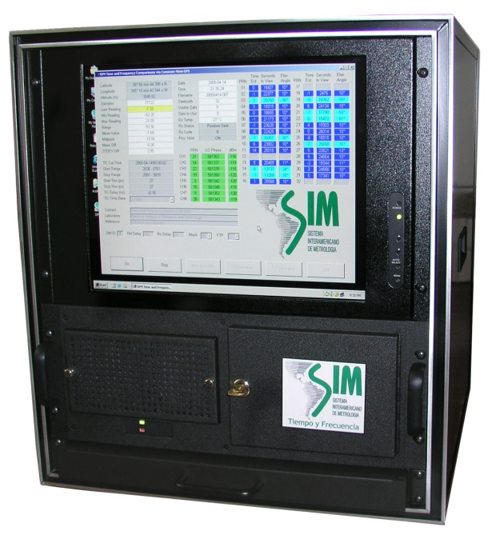
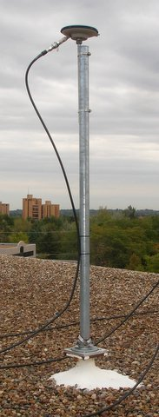
The SIM Measurement System
Simple design makes it easy and inexpensive for SIM labs to compare their clocks. It includes:
  8-channel GPS receiver (C/A code, L1 band)
  Time interval counter with 30 ps resolution
  Rack-mount PC and flat panel display
  Pinwheel type antenna
The receiver measures all visible satellites and stores 1-minute and 10-minute REFGPS averages.
All systems are connected to the Internet, and send their files to three web servers (in Canada, Mexico, and the U. S.) every 10 minutes.
The web server processes data “on the fly” in near real-time. Results can be viewed on the web in either common-view or all-in-view format.
All units are built and calibrated at NIST
Most systems are paid for by SIM and become the property of the NMI.

Slide 44

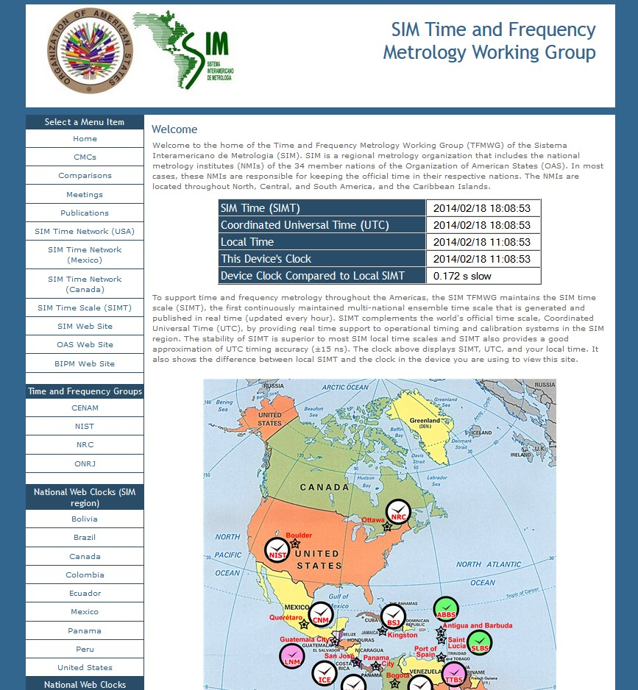

tf.nist.gov/sim

Slide 45
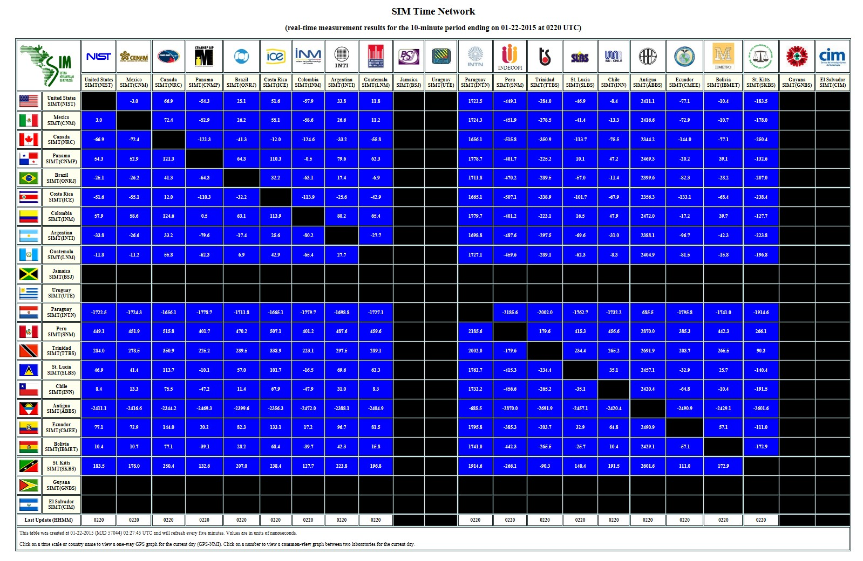

Slide 46
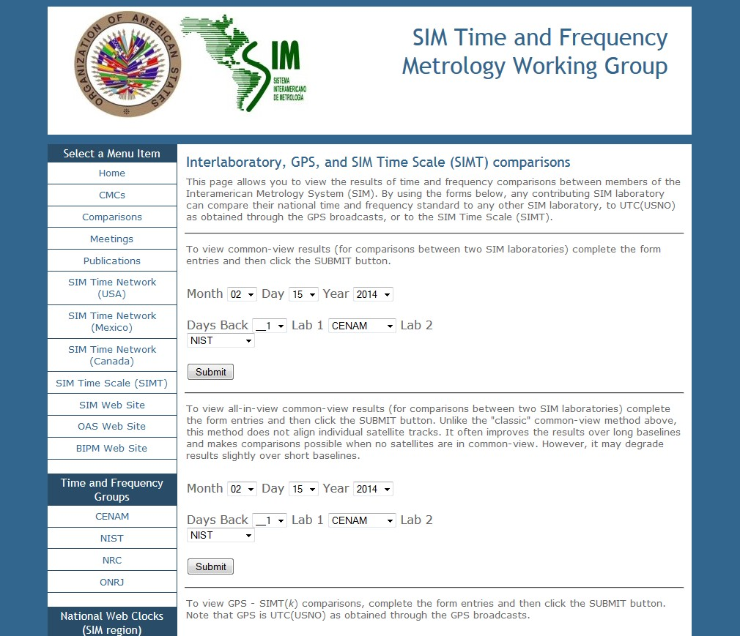

Slide 47
Viewing SIMTN Measurement Results
Measurement results can be viewed with any web device, with new data every 10 minutes. Users can
  Plot the time and frequency difference between SIM laboratories using the common-view method (data are averaged across all satellites and are also shown for each individual satellite).
  Display the Allan deviation and time deviation for all comparisons.
  Display 10 minute, 1 hour, and 1 day averages in tabular form.
  Plot up to 200 days of data at once.
  Process data using either “classic” common-view or all-in-view.

Slide 48
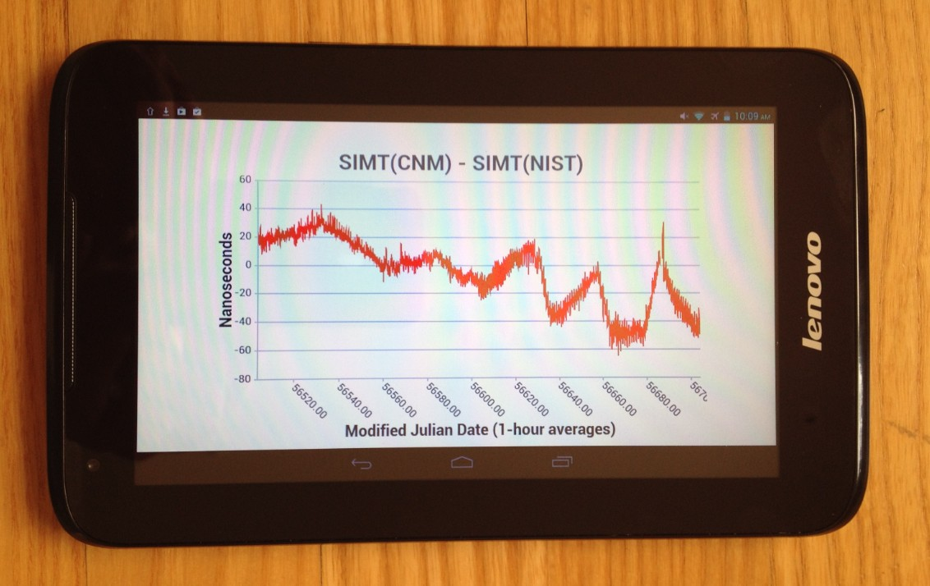
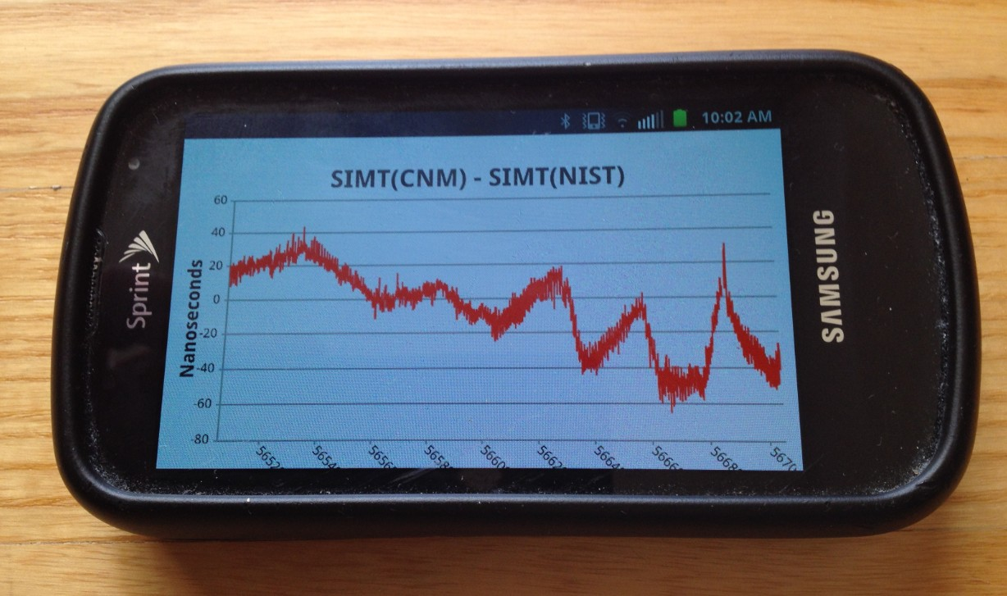
HTML5 displays work on smartphones and tablets

Slide 49
Uncertainty of SIMTN Comparisons

Slide 50
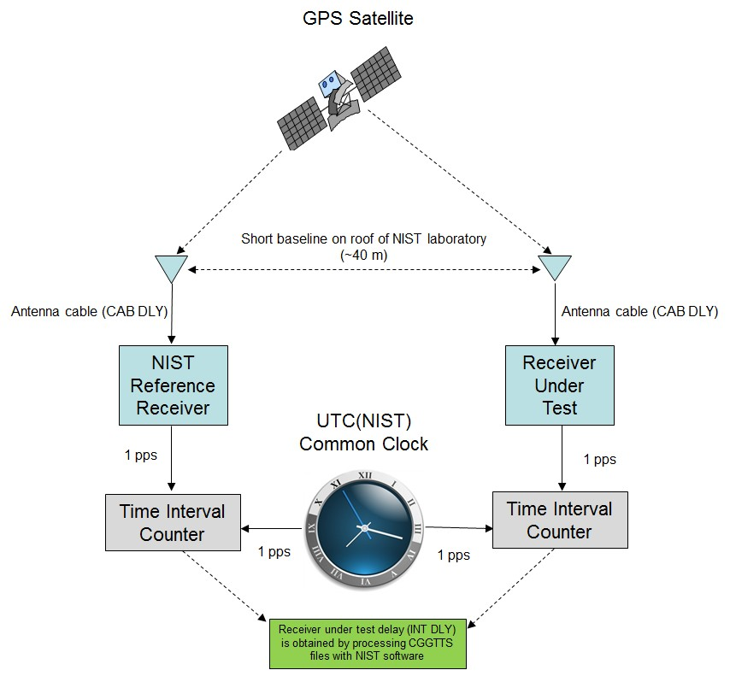
SIM Receiver Calibrations
SIM systems are calibrated at NIST prior to shipment. Calibrations are performed using the common-view, common-clock method. The SIM laboratory installs the same antenna cable and antenna that were used during the calibration.
Calibrations last for 10 days. The time deviation (Type A uncertainty) of the calibration is less than 0.2 ns after one day of averaging. The combined uncertainty is estimated at 4 ns, because a variety of factors can introduce a systematic offset.

Slide 52
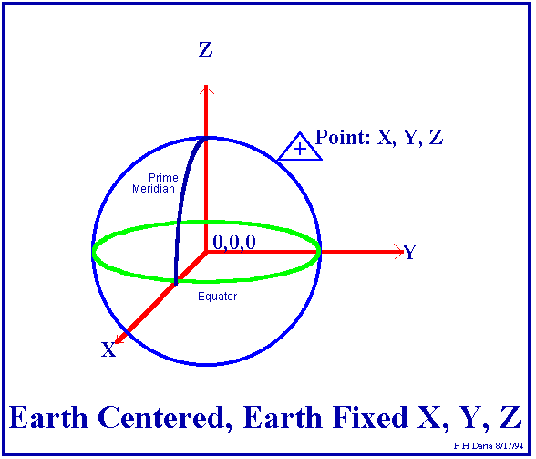
Uncertainty due to Antenna Coordinates
GPS computes dimensions in Earth-Centered, Earth-Fixed X, Y, and Z coordinates that the receiver converts to geodetic latitude, longitude, and altitude.
Coordinate errors translate to timing errors, typically about 2.2 ns per meter for a multi-channel receiver.
The SIM system has a built-in antenna survey feature that can determine horizontal position (latitude/longitude) to within < 1 meter after 24 hours of averaging.
However, the SIM system does a poor job of determining vertical position (altitude). There is nearly always a bias that can exceed 10 ns (a timing error of of 20 to 30 nanoseconds).
For best results, the altitude of the SIM GPS antenna should be independently surveyed, or checked using a dual frequency receiver.

Slide 53
Average position error of repeated survey was 5.37 m, with nearly all of this error (5.30 m) in the vertical position

Slide 54
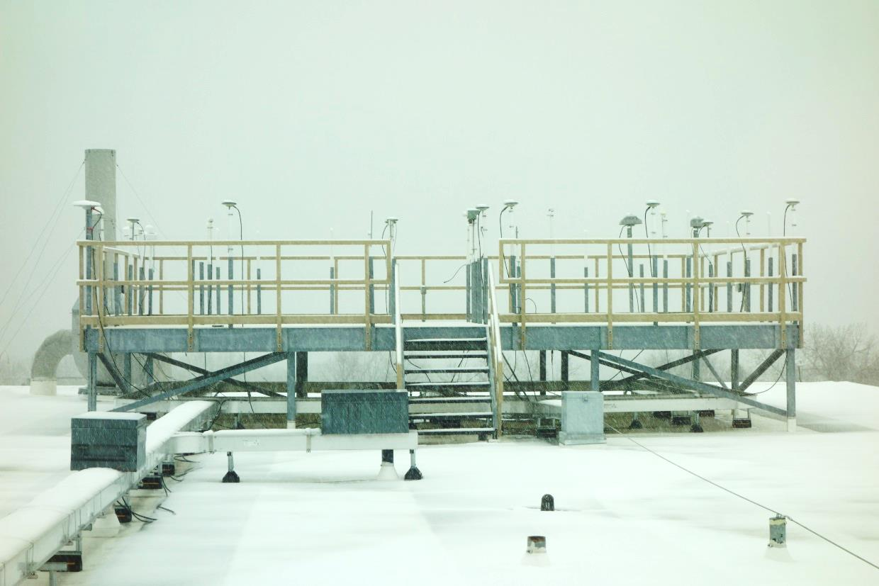
Uncertainty due to Environment
Receiver, antenna, and cable delays can change over time due to temperature, sometimes by as much as several nanoseconds.
GPS receivers are usually more sensitive to temperature than antennas or cables. The SIM receiver can experience a delay change of several nanoseconds if there is a sudden change in laboratory temperature.
The SIM system uses a high quality antenna cable (LMR-400) with a low temperature coefficient. Delay changes due to temperature are usually much smaller than 1 ns, even in places like Colorado where the temperature has a very wide range over the course of a year.

Slide 55
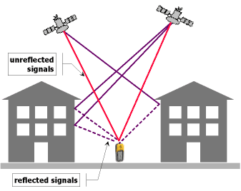
Uncertainty due to Multipath
Multipath is caused by GPS signals being reflected from surfaces near the antenna. Metal objects, such as a metal roof below the antenna, are one of the worst sources of multipath reflections. The reflected signals can then either interfere with, or be mistaken for, the signals that follow the straight line path from the satellite.
If the antenna has a clear, unobstructed view of the sky, the uncertainty due to multipath is usually very small (a few nanoseconds or less).
The pinwheel type antenna used by the SIM systems also helps keep multipath to a minimum.

Slide 56
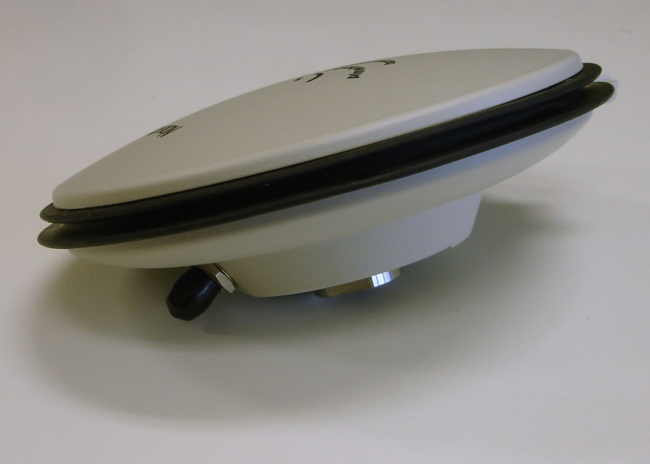
GPS Antennas

Slide 57

Uncertainty due to Ionospheric Delays
The ionosphere is the part of the atmosphere extending from about 70 to 500 km above the earth.
When signals from the satellites pass through the ionosphere their path is bent slightly, changing the delay. The delay changes are largest for the satellites at low elevation angles.
GPS broadcasts a ionospheric correction, which is automatically applied by the SIM system. This reduces the effect. These corrections are called modeled ionospheric corrections, or MDIO.
For the very best results, the ionospheric conditions are measured at a receiving location on the ground by a dual-frequency GPS receiver (one that receives both L1 and L2). These measurements are used in place of the broadcast corrections. This improves the results. These corrections are called measured ionosphere corrections, or MSIO. They are not applied by the SIM system, which uses the L1 band only and cannot measure the ionospheric delay.

Slide 58
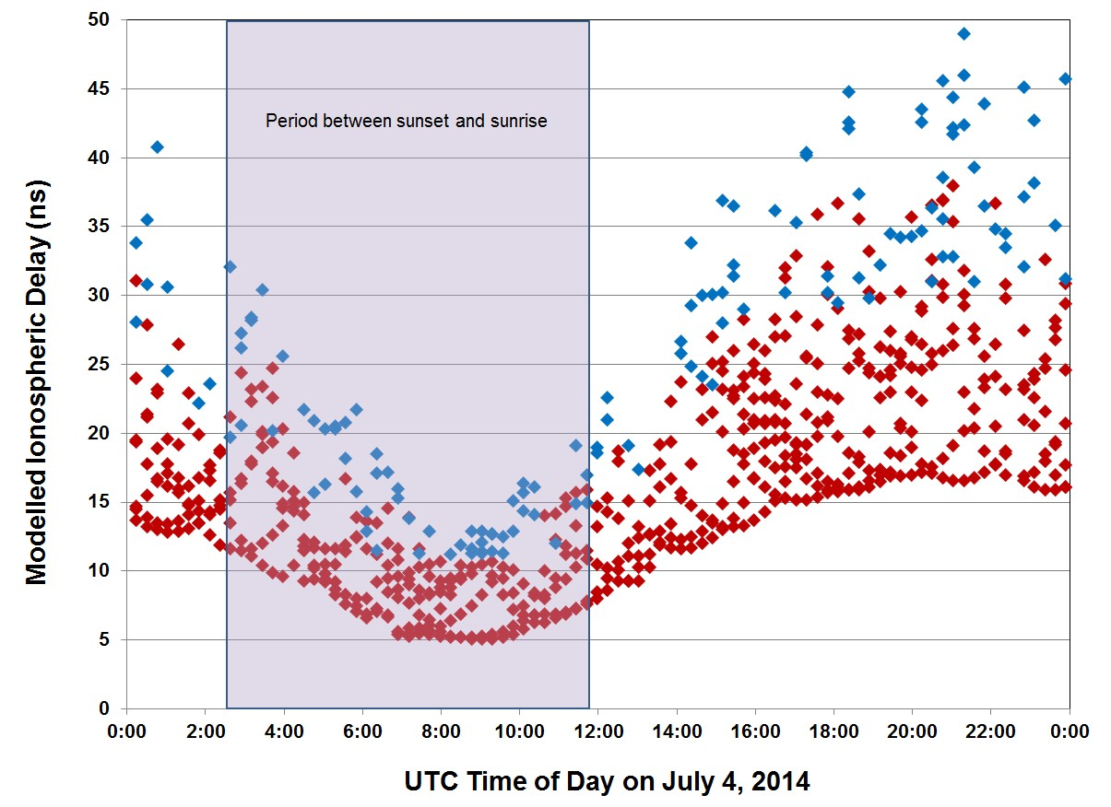
GPS Antennas

Slide 59
SIM Time Network Uncertainty Analysis
Uncertainty Component | Best Case | Worst Case | Typical
U_{A}, TDEV, τ = 1 d | 0.7 | 5 | 2
U_{B}, Calibration | 1 | 4 | 2
U_{B}, Coordinates | 1 | 25 | 3
U_{B}, Environment | 2.5 | 4 | 3
U_{B}, Multipath | 1.5 | 5 | 2
U_{B}, Ionosphere | 1 | 3.5 | 2
U_{B}, Ref. Delay | 0.5 | 2 | 1
U_{B}, Resolution | 0.05 | 0.05 | 0.05
U_{C}, k = 2 | 7.0 | 53.8 | 11.8
Uncertainties are expressed using a method complaint with the ISO GUM standard.
Combined standard uncertainty (k = 2) is usually < 15 nanoseconds for time, and usually < 1 × 10⁻¹³ for frequency after 1 day of averaging.

Slide 60
Contributing to
Coordinated Universal Time (UTC) by participating in the
BIPM Key Comparisons

Slide 61
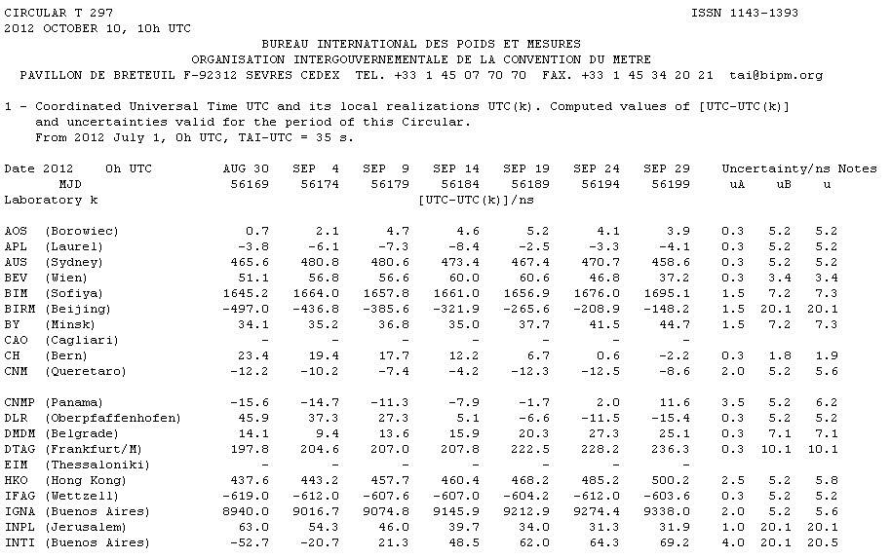
BIPM Circular T (www.bipm.org)
Published monthly, it contains the results of the BIPM key comparisons. Results are two to six weeks old at the time of publication.
PTB in Germany is the pivot laboratory for all comparisons.
About 70 laboratories now appear on the Circular T and contribute data to Coordinated Universal Time (UTC).
New “Rapid” UTC (UTCr) document is published every week.

Slide 62
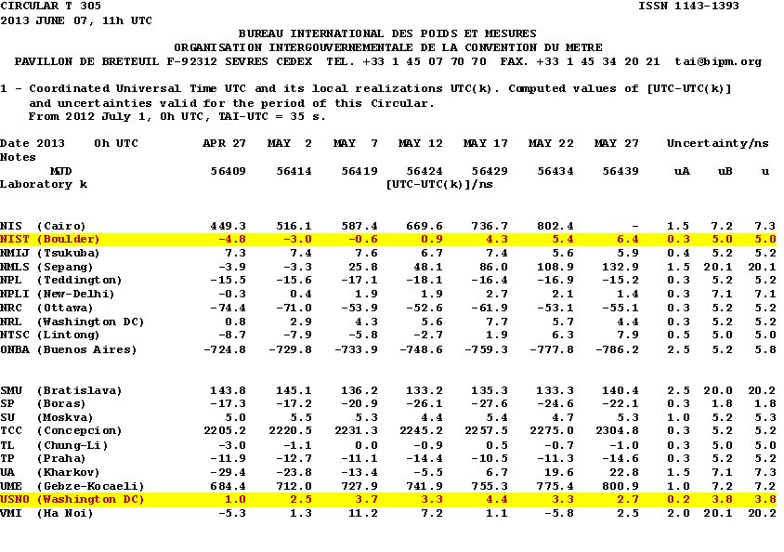

Slide 63
Steps required in order to appear on the BIPM Circular T and contribute to UTC
You must have a cesium clock
You must have a CGGTTS* compatible GPS receiver (SIM system is not compatible)
Your country must be a signatory of the CIPM MRA
You must contact the BIPM and provide information on the name/address of the laboratory, clocks (model, serial number), time transfer equipment in the laboratory, and any other relevant information. They will then assign an acronym and a code to your laboratory, and a code to each clock.
You must submit a data file once per week by FTP
* Consultative GPS and GLONASS Time Transfer Sub-committee

Slide 64
CGGTTS Data Collection Schedule
Starting at 0:00 (UTC) on the reference date (October 1, 1997), the 24 hours of a day are divided into 90 16-minute intervals.
The first 89 intervals are used for common-view. Start time of each 16-minute interval is shifted 4 minutes earlier everyday. The 90th interval is reserved for handling the 4-minute start time update.
The 13-minute common-view measurement starts 2 minutes after the beginning of the 16-minute interval.
lock up
measurement
data processing
2
13
1
90
1
2
3
4
89
1
2
t
0:00
0:16
0:32
0:48
1:04
23:28
23:44
23:56
0:12
0:28
Day 1
Day 2

Slide 65
The CGGTTS Common-view Data Format
GGTTS GPS DATA FORMAT VERSION = 01
REV DATE = 11/20/2013
RCVR = NIST TAI-1 Time Transfer Receiver
CH = 12
IMS = 99999
LAB = NIST
X = -1288331.833 m
Y = -4721664.612 m
Z = 4078681.021 m
FRAME = WGS84
COMMENTS = Lab Code - 10002, UTC Code - 0010002
COMMENTS =
INT DLY = 25.5
CAB DLY = 119.8
REF DLY = 782.4
REF = UTC(NIST)
CKSUM = 07
PRN CL MJD STTIME TRKL ELV AZTH REFSV SRSV REFGPS SRGPS DSG IOE MDTR SMDT MDIO SMDI CK
hhmmss s .1dg .1dg .1ns .1ps/s .1ns .1ps/s .1ns .1ns.1ps/s.1ns.1ps/s
02 FF 56842 001400 780 807 2428 -5049146 -47 201 -112 14 65 68 -1 137 -5 E9
04 FF 56842 001400 780 349 0500 -76293 0 113 50 31 4 116 22 195 19 81
05 FF 56842 001400 780 198 1696 3610220 -26 180 -218 23 88 198 -67 338 -67 33
06 FF 56842 001400 780 580 0460 -24402 37 132 -61 11 56 79 7 147 7 8A
10 FF 56842 001400 780 410 1160 1325608 2 279 -156 22 28 101 -8 194 -20 CF
12 FF 56842 001400 780 630 3045 -2159513 -43 157 -98 11 18 75 -4 145 -8 DE
17 FF 56842 001400 780 178 0850 1062788 45 174 42 31 95 217 59 281 27 E7
24 FF 56842 001400 780 230 2318 314713 1 101 -5 23 92 169 39 311 42 91
25 FF 56842 001400 780 256 3150 -247955 0 111 -72 23 108 153 -37 240 -30 E0
02 FF 56842 003000 780 850 3044 -5049183 -57 239 120 13 65 67 0 132 -3 C8
04 FF 56842 003000 780 281 0510 -76293 0 192 138 20 4 140 30 212 18 88

Slide 66
New Low-Cost CGGTTS Receiver is available now
A new CGGTTS is available through the SIM TFMWG:
  Designed at NIST, this low-cost receiver is a L1 band only device (12 channels). Easy to use, it has a touch screen interface.
  The part number is NIST Standard Reference Instrument 60004.
  The cost is about $10,000 USD (but is sometimes covered by SIM/OAS donations).
  It is compatible with both UTC and Rapid UTC requirements, and like the SIM system, automatically uploads data.
  The first unit is operating at INTI in Argentina. Two units have been shipped recently to Colombia and Peru. Units are expected to be shipped this year to Uruguay and Costa Rica.

Slide 67
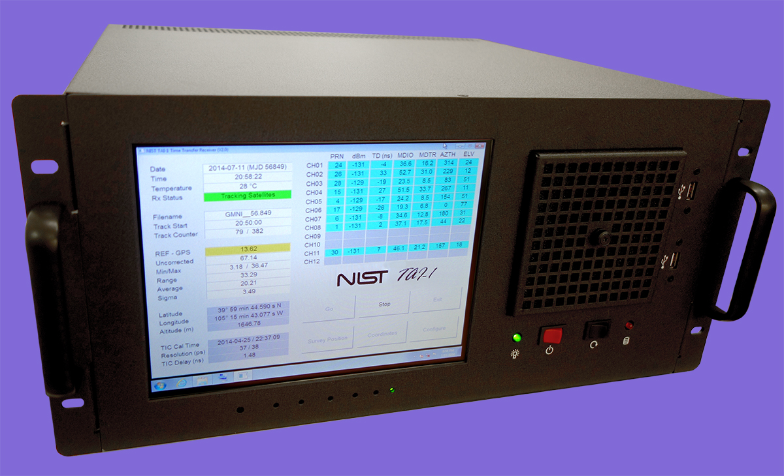

Slide 68
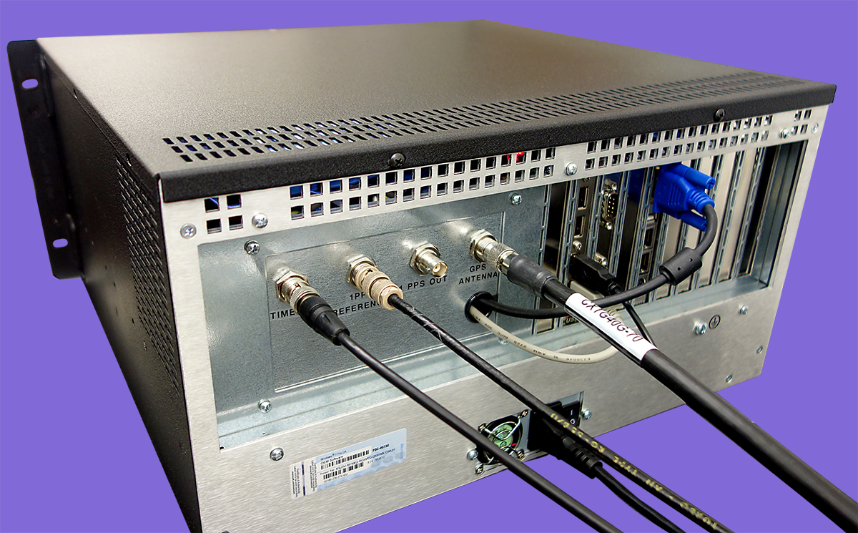

Slide 69
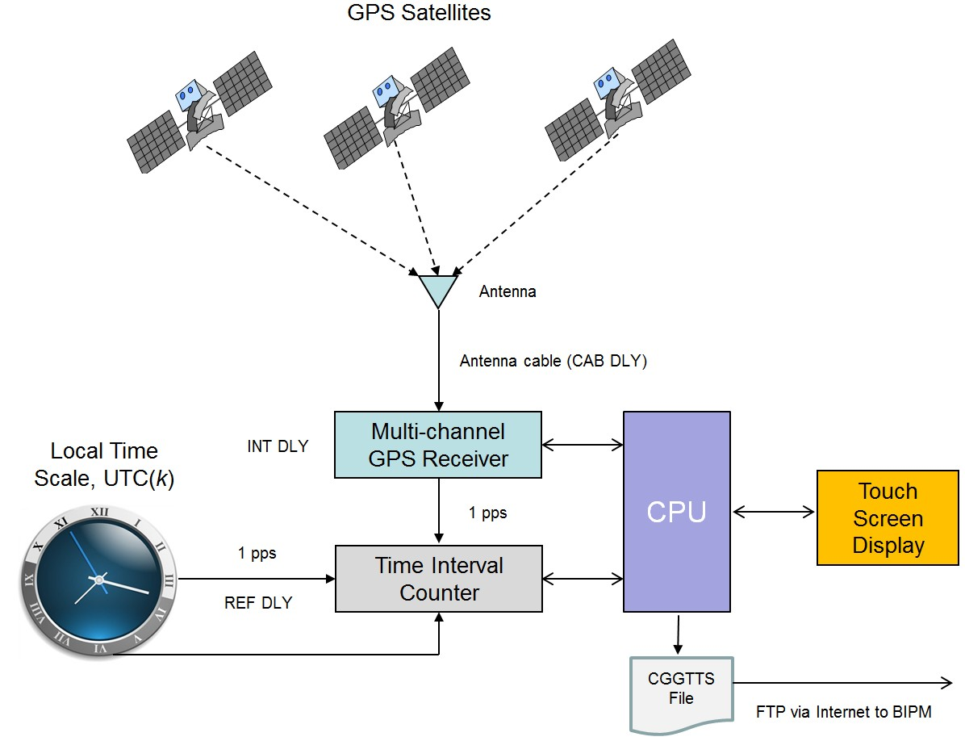

Slide 70
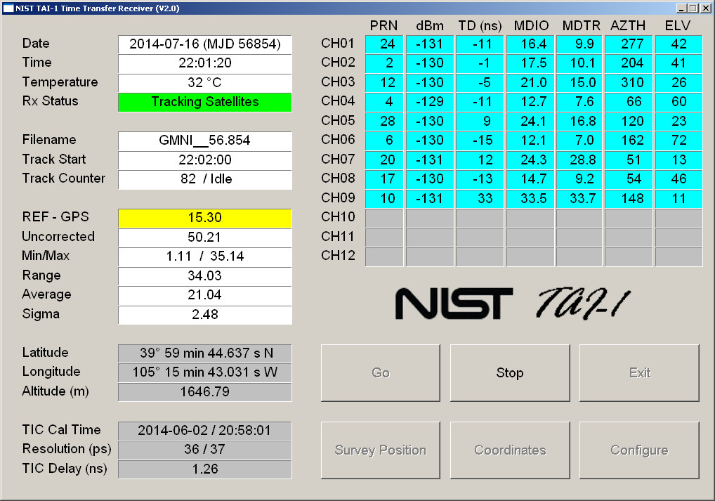

Slide 71
Other CGGTTS Time Transfer Receivers
  More sophisticated CGGTTS receivers are commercially-available, and at use at laboratories such as NRC, CENAM, and ONRJ.
  These receivers are dual frequency (GPS L1 and L2) and sometimes even receive other GNSS satellites (such as GLONASS and Galileo). They are more stable than the L1 only receivers, and have the advantage of being able to survey their antenna more accurately, and can measure the ionospheric delay. However, the cost is high, sometimes as much as $40,000 USD. Some models include:
  PIK Time TTS-4
  Dicom GTR50
  Novatel

Slide 72
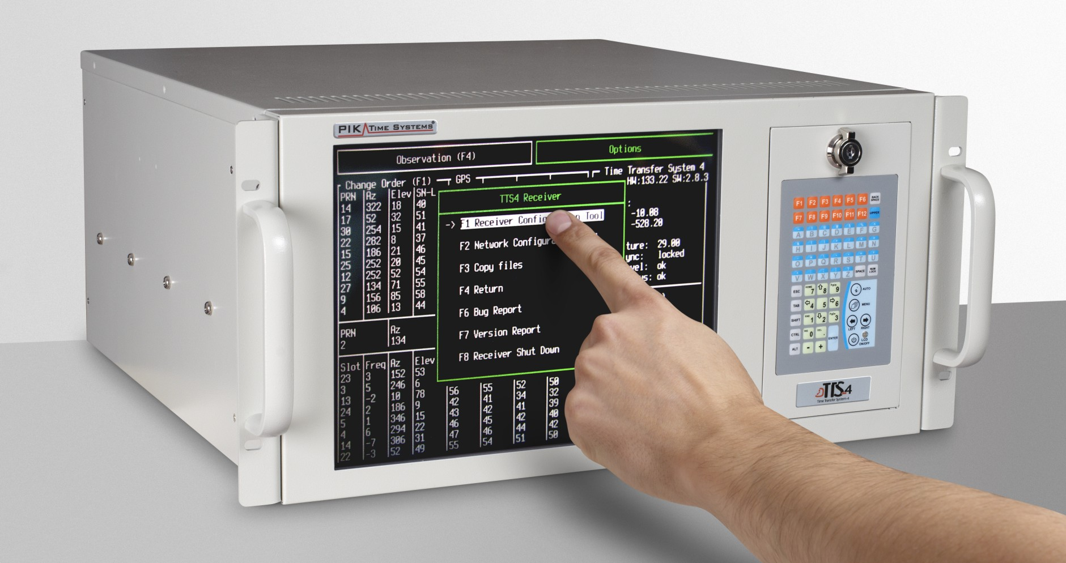

Slide 73
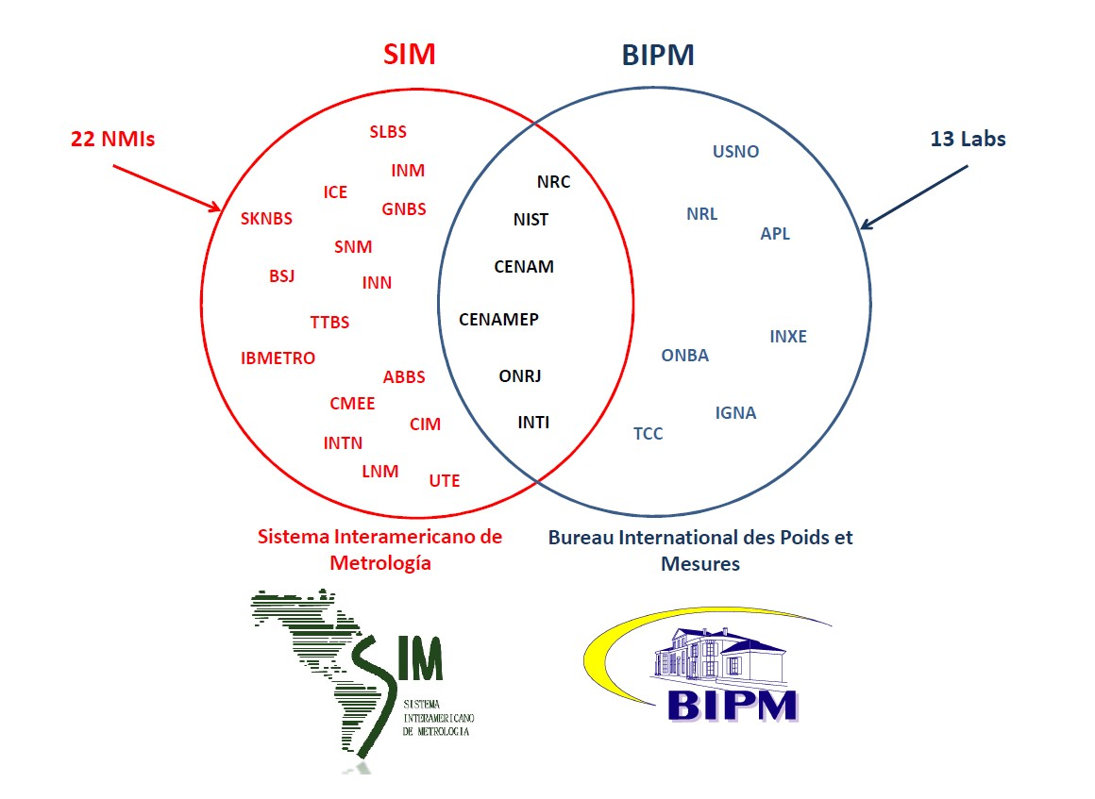

Slide 74
Labs in the Americas that Contribute to UTC
Laboratory | Country | NMI or DI | Time Scale | UTC contributor | Link to UTC | Link Calibration
INTI | Argentina | NMI | Cesium | Y | GPS | NIST
ONBA | Argentina | DI | Cesium | Y | GPS | USNO
IGNA | Argentina | --- | Cesium | Y | GPS | USNO
ONRJ | Brazil | DI | Ensemble | Y | GPS | NIST
INXE | Brazil | NMI | Cesium | Y | GPS | USNO
NRC | Canada | NMI | Ensemble | Y | GPS | NIST
TCC | Chile | --- | Cesium | Y | GPS | USNO
CENAM | Mexico | NMI | Ensemble | Y | GPS | NIST
CENAMEP | Panama | NMI | Cesium | Y | GPS | NIST
NIST | United States | NMI | Ensemble | Y | TWSTFT | ---
USNO | United States | --- | Ensemble | Y | TWSTFT | ---
NRL | United States | --- | Ensemble | Y | GPS | USNO
APL | United States | --- | Ensemble | Y | GPS | USNO
INM | Colombia | NMI | Cesium | N* | GPS* | NIST
ICE | Costa Rica | DI | Cesium | N* | GPS* | NIST
SNM | Peru | NMI | Cesium | N* | GPS* | NIST
UTE | Uruguay | NMI | Cesium | N* | GPS* | NIST
* expected to begin UTC contributions in 2015

Slide 75
Summary
Common-view GPS is a powerful tool for comparing remote clocks located anywhere on Earth.
Participation in international comparisons – comparing your national time standard to the standard in other countries – is essential for ensuring the integrity of your measurements and for establishing international traceability.
All SIM labs are encouraged to participate in the SIM Time Network for real-time verification of their clocks.
More established SIM labs are encouraged to participated in the BIPM key comparison and to contribute to UTC.

