Slide 1
Time and Frequency
Current Status
Laboratorio Metrológico de Variables Eléctricas
(LMVE)
Instituto Costarricense de Electricidad
Costa Rica
Oscar Fallas Cordero
January, 2015

Slide 2
Laboratory’s Development

Slide 3
Laboratory Staff
Oscar Fallas Cordero, Electrical Engineer since 2009. Metrologist.
The metrologist is working in the Time and Frequency Metrology Area and in the development of the Radiofrequency and Microwave Metrology Area.

Slide 4
Assessments and Training
J.M Lopez from CENAM, November 2010
F. Jiménez from CENAM, June and November 2014
R. Solís from CENAMEP, October 2014
Remote cooperation through SIMTF e-mail
SIM TN participation

Slide 5
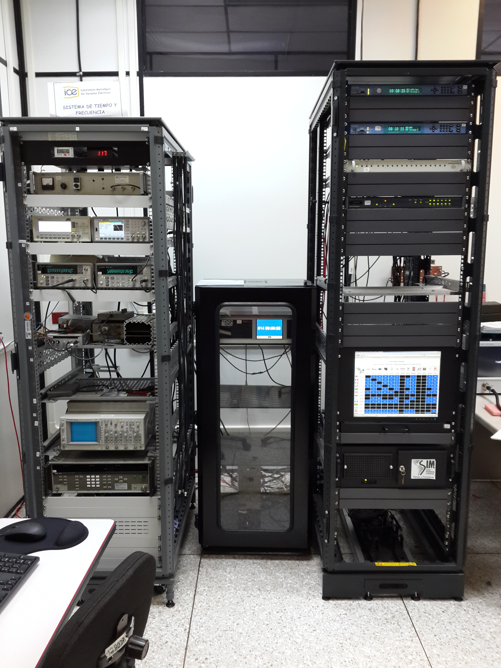
Structure
Standard
(Symmetricom CS4000)
Traceability, Distribution and Dissemination
(Comparison System, switch and distribution amplifiers, NTP servers)
Calibration Service
(frequency counters and generator, stopwatches cal system, check standars and oscilloscope)

Slide 7
CMCs

Slide 8
CMCs

Slide 9
Knowledge Transfer
National T&F training
National Stopwatches Comparison (based on SIM)
Future Activities and Services
NTP Service Improvement (equipment, alarm´s management, web clock, voice clock)
TCH Method for long and short term QS

Slide 10
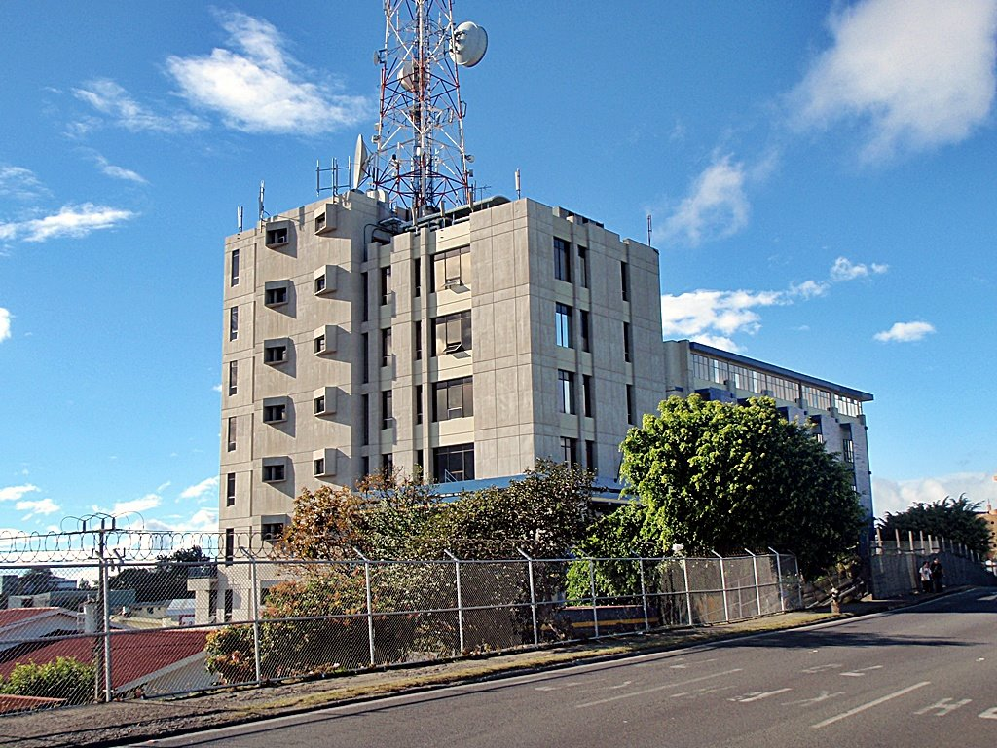
Thanks
Instituto Costarricense de Electricidad
Costa Rica

