Slide 1
NIST Time and Frequency Division Overview
Tom O’Brian
Chief, NIST Time and Frequency Division

Slide 2
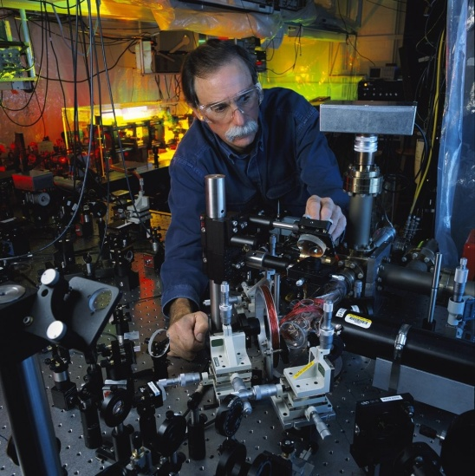
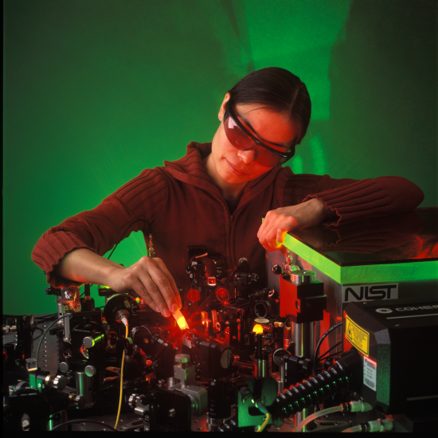
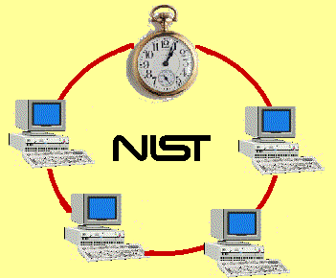
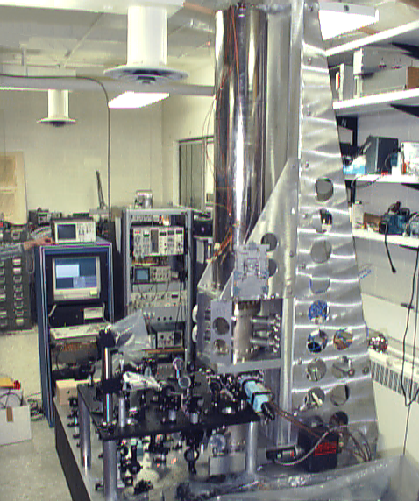
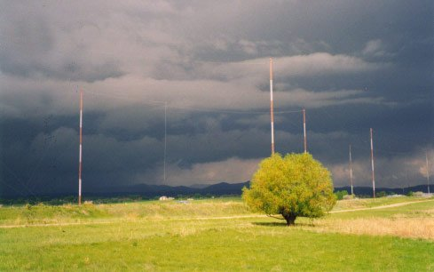
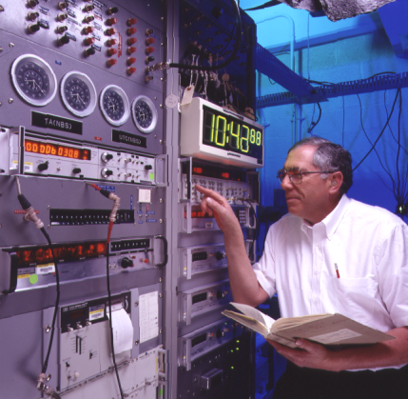
Time, Timekeeping and Time Distribution
Introduction to activities of the NIST Time and Frequency Division.

Slide 3
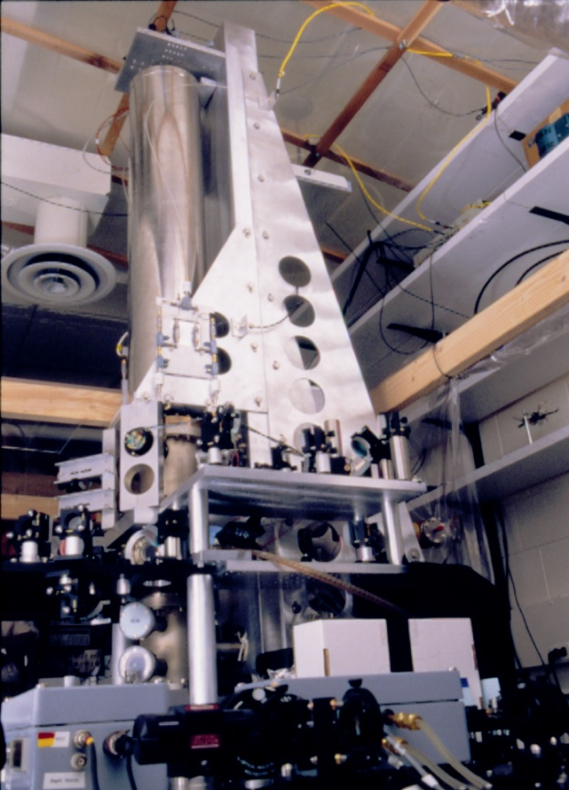
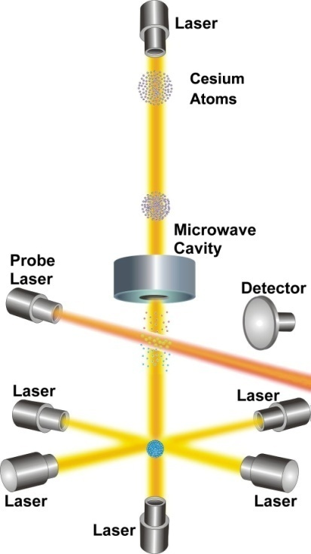
NIST-F1 Atomic Fountain Clock
Primary Frequency Standard for the United States
1 second is defined as the duration of 9,192,631,770 periods of the radiation corresponding to the transition between the two hyperfine levels of the ground state of the ¹³³Cs atom.
Current uncertainty:
Δf/f = 3 x 10⁻¹⁶.
1 second in 100 million years.
NIST-F1 laser-cooled fountain standard
“atomic clock”
Equivalent to measuring distance from earth to sun (150,000,000 km) to uncertainty of about 45 μm (less than thickness of human hair).

Slide 4


Atomic clocks
Cesium fountain standard
Cesium atoms cooled to ~0.5 μK.
Flight path (up and down) ~ 1 m (Ramsey length).
Flight time ~ 1 sec.
Δf/f = 3 x 10⁻¹⁶
1 second in 100 million years.

Slide 5
Improvements in Primary Frequency Standards
NBS-1
60 Years of Progress in Atomic Clocks
NBS-2
NBS-4
NBS-3
NBS-5
Frequency Uncertainty
NBS-6
NIST-7
NIST-F1
Initial
NIST-F1
Best
Why Improve Primary Frequency Standards?
Year

Slide 6
Improvements in Primary Frequency Standards
NBS-1
Needs as Deployed
Stratum 1 Telecomm
GNSS Current
Frequency Uncertainty
GNSS Future
VLBI/Deep Space/ Current
NIST-F1
VLBI/Deep Space/Gravimetry, etc. Future
Year

Slide 7
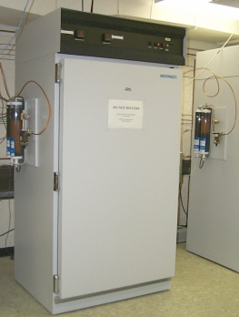
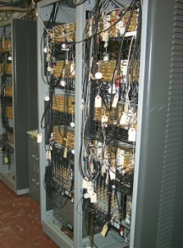

NIST Time and Frequency Standards and Distribution
Primary Frequency Standard and
NIST Time Scale
Realization of SI second
Hydrogen Maser &
Measurement system
NIST-F1

Slide 8
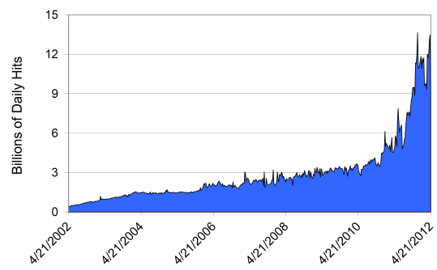
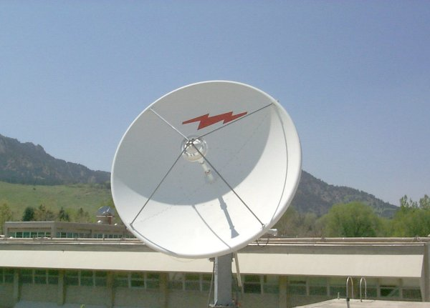
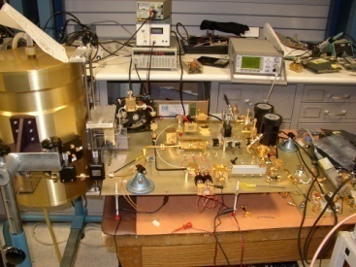
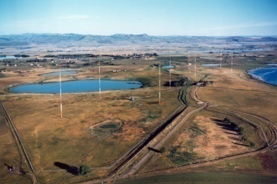
NIST Time and Frequency Standards and Distribution
Time and Frequency Distribution Services
Radio broadcasts
Networks
Satellites
Noise metrology
Primary Frequency Standard and
NIST Time Scale
Realization of SI second
Hydrogen Maser &
Measurement system
NIST-F1

Slide 9
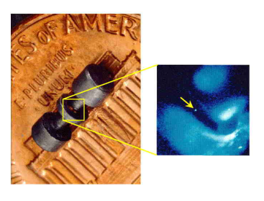
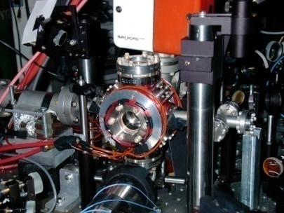
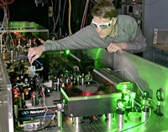
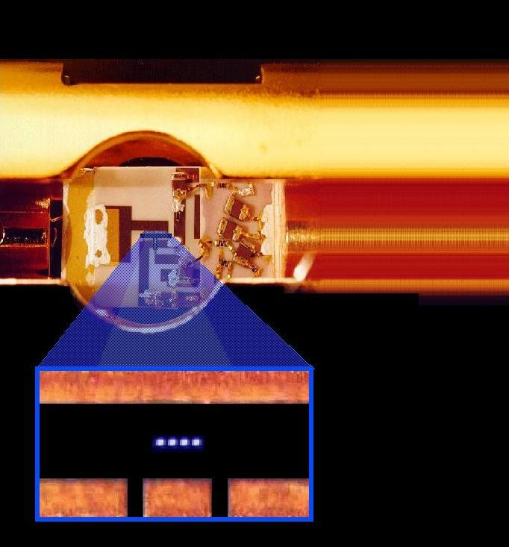
NIST Time and Frequency Standards and Distribution
Time and Frequency Distribution Services
Radio broadcasts
Networks
Satellites
Noise metrology
Primary Frequency Standard and
NIST Time Scale
Realization of SI second
Hydrogen Maser &
Measurement system
NIST-F1
Research on Future Standards and Distribution
Mercury ion clock
Neutral calcium
clock
Optical frequency
synthesis
Quantum computing

Slide 10
NIST Time and Frequency Standards and Distribution
Time and Frequency Distribution Services
Radio broadcasts
Networks
Satellites
Noise metrology
Primary Frequency Standard and
NIST Time Scale
Realization of SI second
Hydrogen Maser &
Measurement system
NIST-F1
Research on Future Standards and Distribution
Mercury ion clock
Neutral calcium
clock
Optical frequency
synthesis
Quantum computing

Slide 11
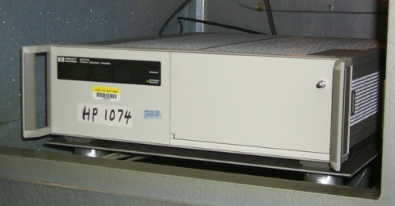


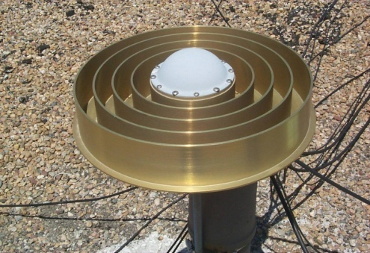
NIST Time Scale and Distribution
Two-way satellite time & frequency transfer
4 Cesium Beam standards
UTC(NIST)
6 Hydrogen Masers
GPS
Measurement System
Calibrated by NIST-F1 primary frequency standard
International coordination of time and frequency: UTC, TAI, etc.

Slide 12

NIST Time and Frequency Standards and Distribution
Time and Frequency Distribution Services
Radio broadcasts
Networks
Satellites
Noise metrology
Primary Frequency Standard and
NIST Time Scale
Realization of SI second
Hydrogen Maser &
Measurement system
NIST-F1
Research on Future Standards and Distribution
Mercury ion clock
Neutral calcium
clock
Optical frequency
synthesis
Quantum computing

Slide 13
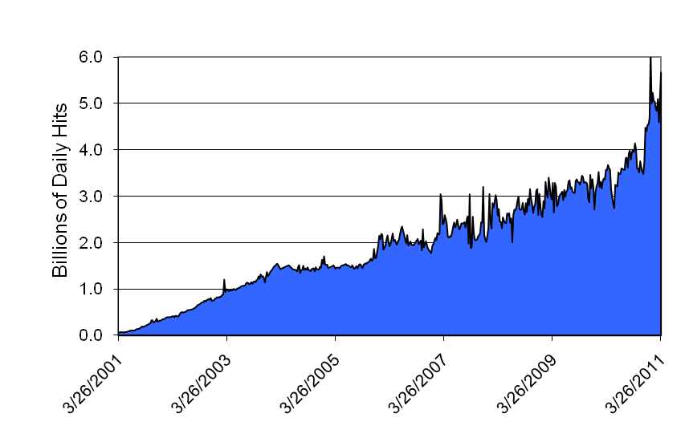
NIST Time and Frequency Standards and Distribution
Time and Frequency Distribution Services
Radio broadcasts
Networks
Satellites
Noise metrology
Primary Frequency Standard and
NIST Time Scale
Hydrogen Maser &
Measurement system
NIST-F1
Research on Future Standards and Distribution
Mercury ion clock
Neutral calcium
clock
Optical frequency
synthesis
Quantum computing

Slide 14
NIST-F1 Systematic Uncertainties
Physical Effects Bias Magnitude (×10⁻¹⁵) Type B Uncertainty (×10⁻¹⁵)
Second Order (Quadratic) Zeeman +180.60 0.013
Gravitation +179.95 0.03
AC Zeeman (Heaters) 0.05 0.05
Cavity Pulling 0.02 0.02
Rabi Pulling 0.0001 0.0001
Cavity Phase (distributed) 0.02 0.02
Fluorescent Light Shift 0.00001 0.00001
Adjacent Atomic Transitions 0.02 0.02
Microwave Spectral Purity 0.003 0.003
Adjacent Transition 0.02 0.02
Electronics 0 0.01
Spin Exchange (Collisions) -0.41 0.15
Blackbody Radiation Shift -22.98 0.28
Total Type B Uncertainty 0.34

Slide 15
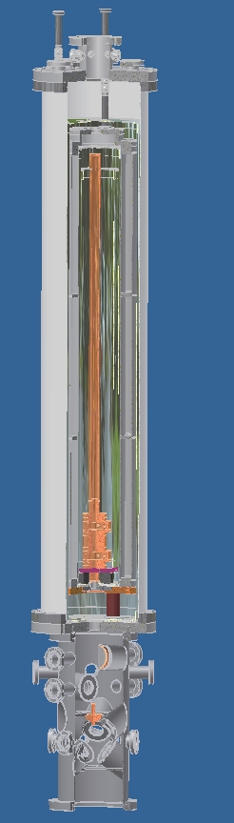
NIST-F2
Cryogenic (80K) region to reduce blackbody frequency shift
Modified laser cooling system to enable multiple atom ball tosses, reducing collisional frequency shift

Slide 16
Improvements in Primary Frequency Standards
NBS-1
Frequency Uncertainty
NIST-F1
NIST-F2
Beyond Cesium?
Year

Slide 17
Improvements in Primary Frequency Standards
More “ticks per second:” Higher clock frequencies
Cesium
10¹⁰ cycles per second
Not to scale!
Measured Quantity
Optical
10¹⁵ cycles per second
Time

Slide 18

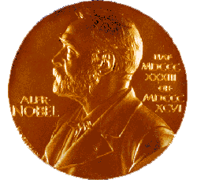
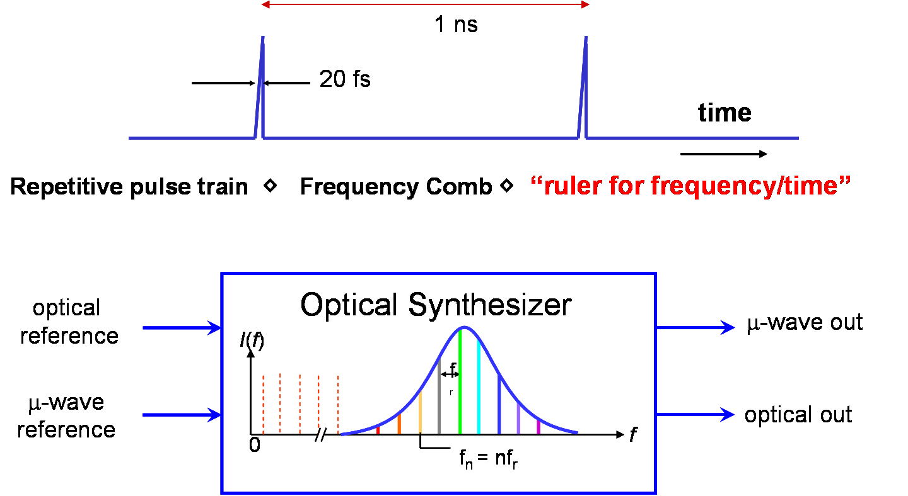
Femtosecond Laser Frequency Combs: Key to Optical Clocks
Current microwave standards at ~10¹⁰ Hz
  Direct cycle counting
  Convenient broadcast frequencies
Future optical standards at ~10¹⁵ Hz
  No technology for direct cycle counting
  Challenge to compare microwave and optical standards spanning 10⁵ Hz
  Challenge to disseminate optical standards
Solution: Femtosecond laser frequency combs.
Solution: Develop science and technology of accurate fiber-optic frequency transfer.

Slide 19
Femtosecond Laser Frequency Combs: Key to Optical Clocks
Optical ref 1
ν₁
fs laser
Optical ref 2
ν₂
Compare ν₁ vs ν₂
set ν_{n} = ν_{opt}
ν_{m} - ν_{opt2}
Optical
reference 1
Optical
reference 2
0
ν
Optical standards at NIST
Al⁺ (1124 THz), Hg⁺ (1064 THz), neutral Yb (520 THz) and
Ca (456 THz)
x 2
set f_{o}= 0
Direct comparison to Cs
(0.0092 THz)

Slide 20
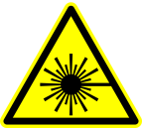
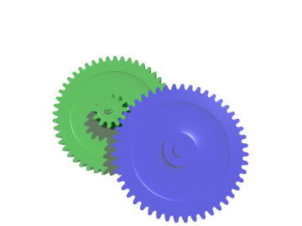
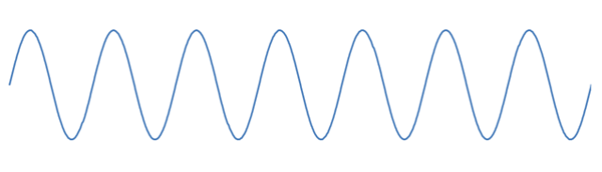
Ultrastable Microwaves From Optical Frequency Combs:
Laser Stability Translated to RF/Microwave Range
Timing corrections
OPTICAL TIMING REFERENCE
LASER
~4 fs Optical Period
Optical frequency divider
~ 100,000
30 ps
Microwave Pulses
~100 fs
Optical
Pulses

Slide 21
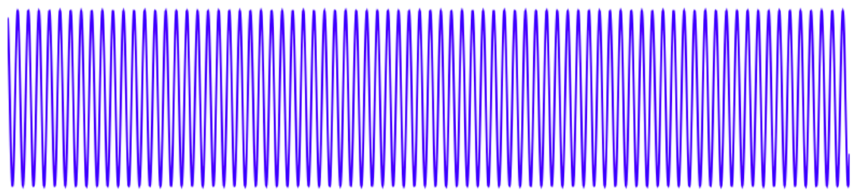
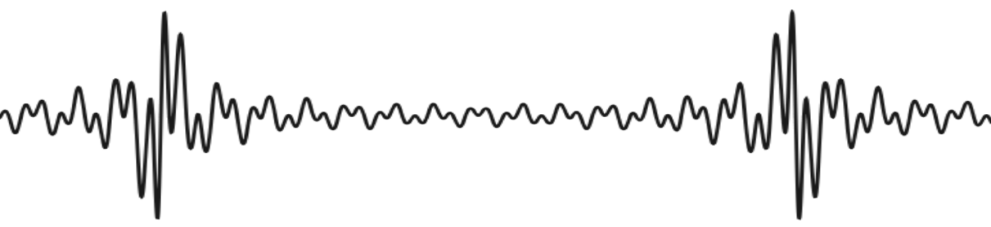
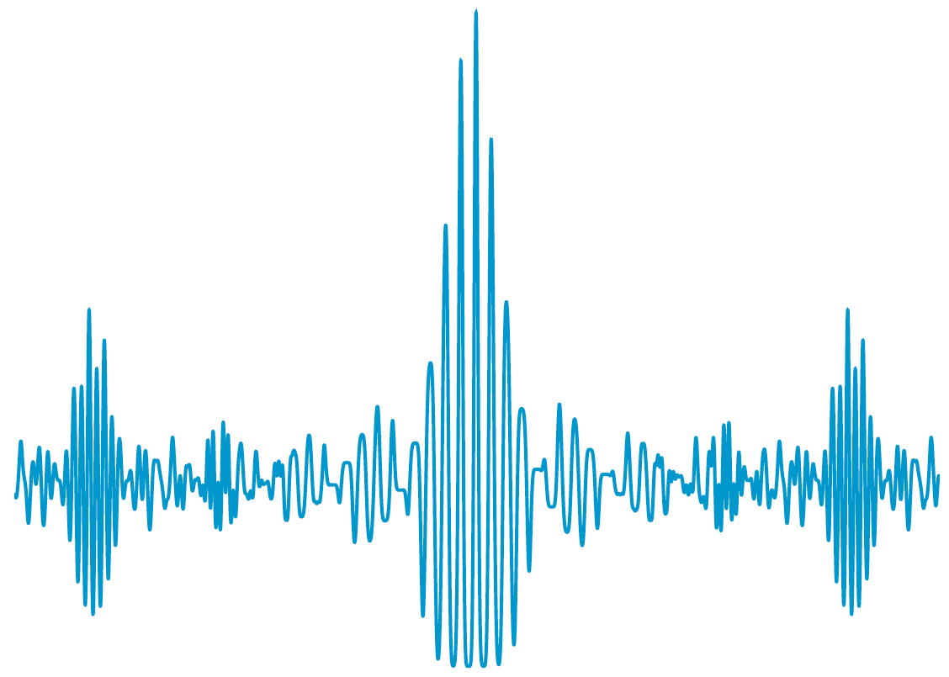
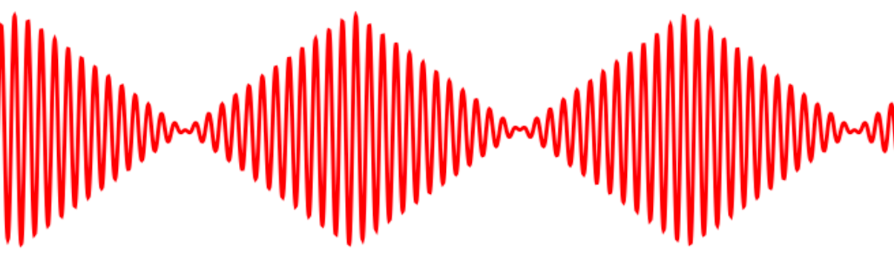
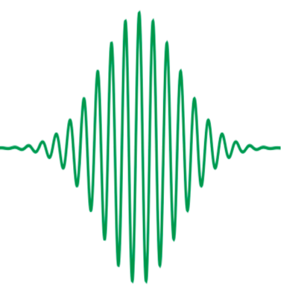
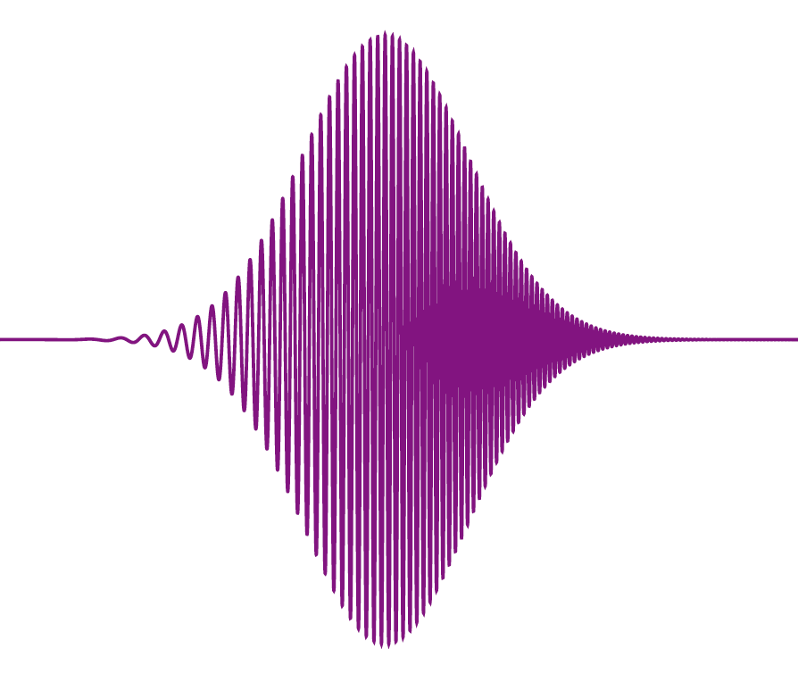
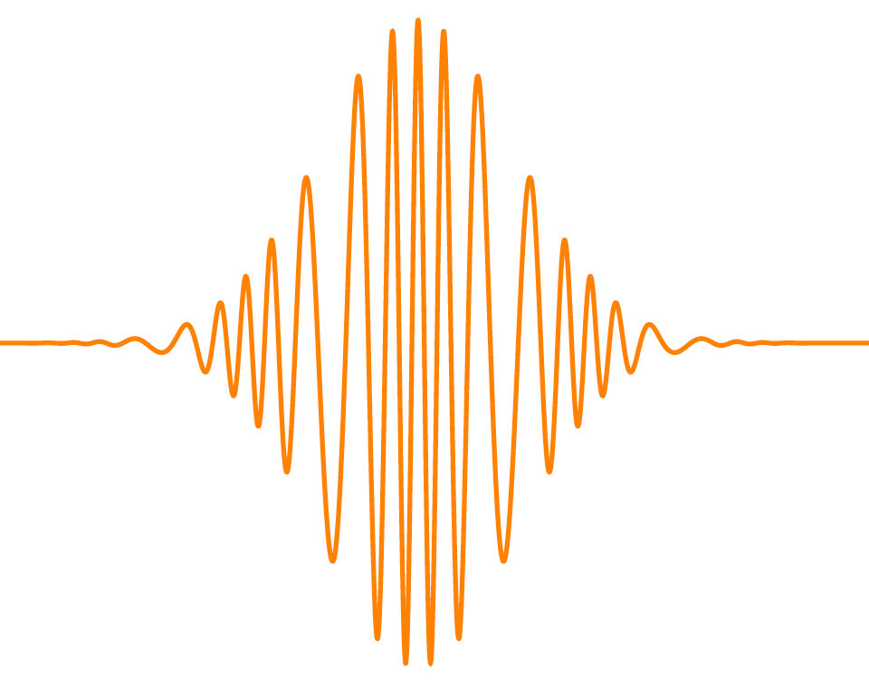
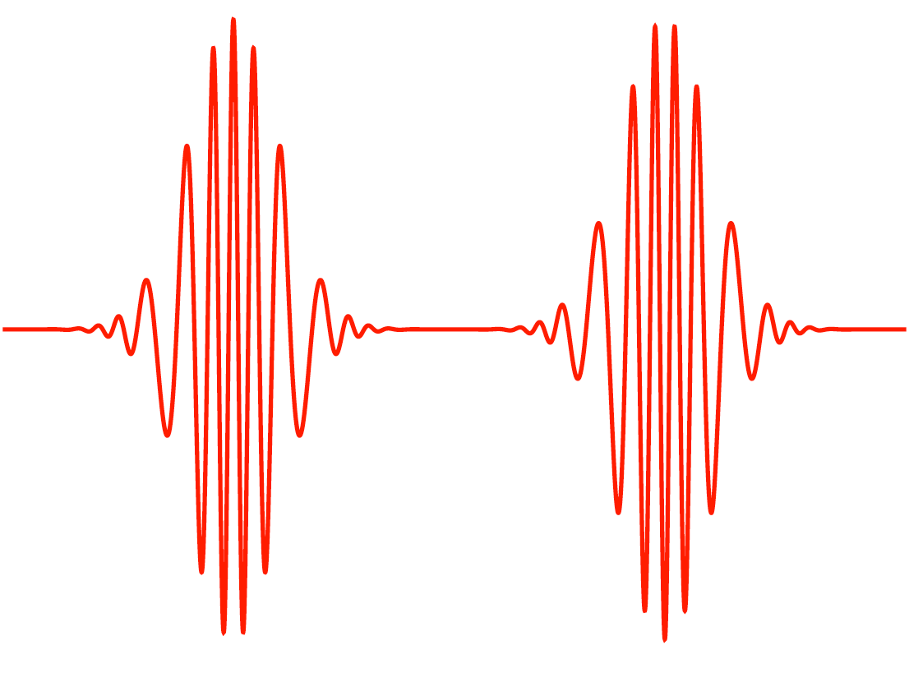
Frequency Combs: Optical Frequency Synthesis
The generation of nearly any imaginable optical waveform of arbitrary duration with femtosecond (10⁻¹⁵ s) timing precision
(Characteristic oscillation period ~ 2 fs)
Electric Field
time
In short: To carry out in the optical domain what is easily accomplished in the electronic (<1 GHz) domain
Notes:
While the atomic clock was a great breakthrough, even the best scientists in the 1940s didn’t anticipate the development of the laser, or envision that light could be used to chill atoms to temperatures just barely above absolute zero.
But these new developments of laser cooling and trapping of atoms led to the newest generation of time standards, the NIST laser-cooled atomic fountain clock. NIST scientists have been leading the world in the development of laser cooling techniques and applications.
So we’ve gone from pendulum clocks to laser-cooled atomic fountain clocks in less than 100 years. The stuff we’re doing now would have been pure science fiction in 1900 -- probably no one even imagined the ideas, let alone whether they would ever be possible.

Slide 22
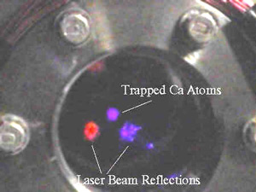
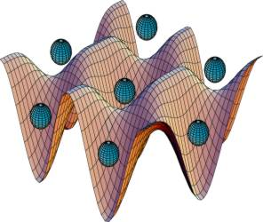

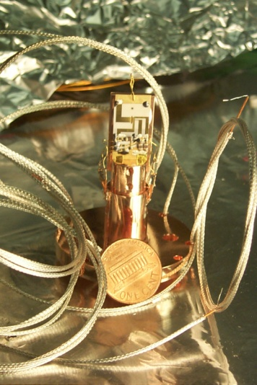
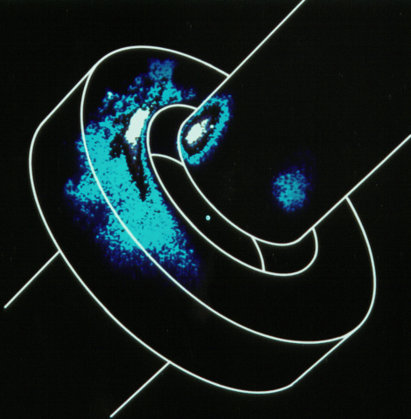
Improvements in Primary Frequency Standards: Optical Clocks
High-frequency optical clocks outperform microwave clocks.
NIST research optical clocks already performing better than 1 x 10⁻¹⁷.
Potential for accuracy at the 10⁻¹⁸ level, 100 times better than NIST-F1.
Likely to take many years to realize that potential.
Laser-cooled calcium atoms.
Ytterbium atoms in optical lattice.
#1 in world
#2 in world
Single Hg+ ion
~8 x 10⁻¹⁸
1.7 x 10⁻¹⁷
Al⁺ quantum logic optical clock.
Single mercury ion trap.

Slide 23
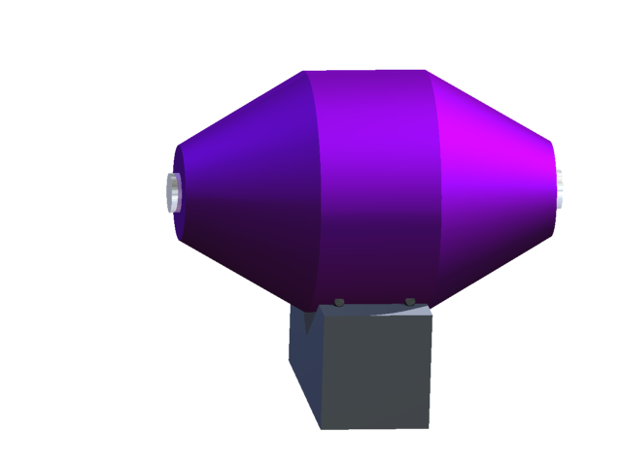
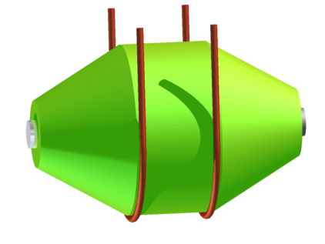
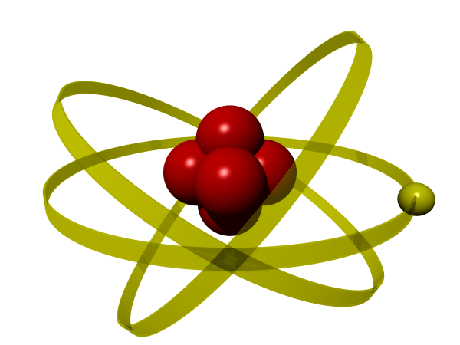

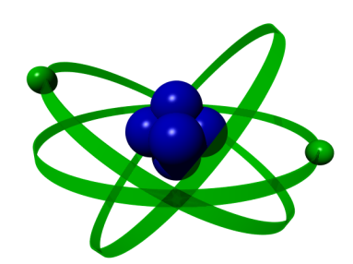
Comparison of Hg⁺ and Al⁺ Frequency Standards at NIST
1126 nm
laser
1070 nm
laser
fiber
×2
×2
fiber
×2
×2
⁹Be⁺
Hg⁺
f_{b,Al}
¹⁹⁹Hg⁺
f_{b,Hg}
²⁷Al⁺
n f_{rep}+ f_{ceo}
m f_{rep}+ f_{ceo}
1.052 871 833 148 990 438 ± 5.5 x 10⁻¹⁷

Slide 24
Improvements in Primary Frequency Standards: Optical Clocks
NBS-1
Optical
Frequency
Standards
(Research)
Frequency Uncertainty
Cesium Microwave
Primary Frequency
Standards
NIST-F1
NIST optical
clocks
Year

Slide 25
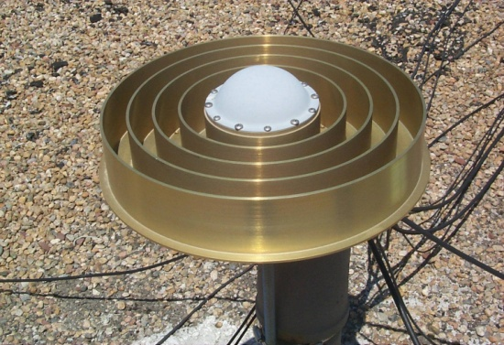
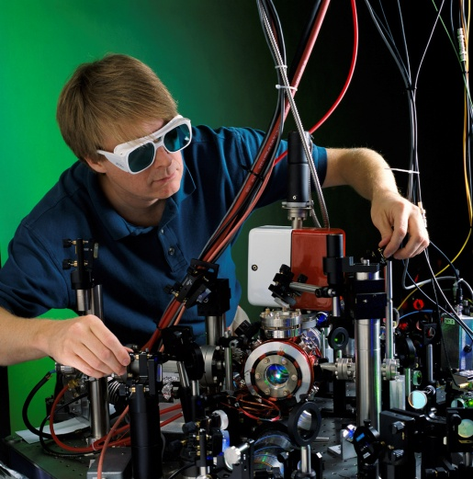
Distribution of Highest Accuracy Time and Frequency
Future microwave standards with frequency uncertainties ~10⁻¹⁶.
Future optical standards with frequency uncertainties ~10⁻¹⁸.
Most accurate current satellite time and frequency transfer:
  Frequency stability ~10⁻¹⁵ at 1 to 10 days averaging.
  Time transfer ~1 ns over 1 day.
  Microwave (not optical) frequencies.
GPS
Optical clock
~10⁻¹⁷ and better
TWSTFT
Satellite transfer ~10⁻¹⁵
??

Slide 26
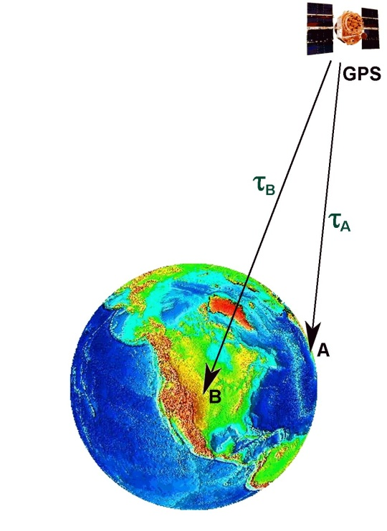
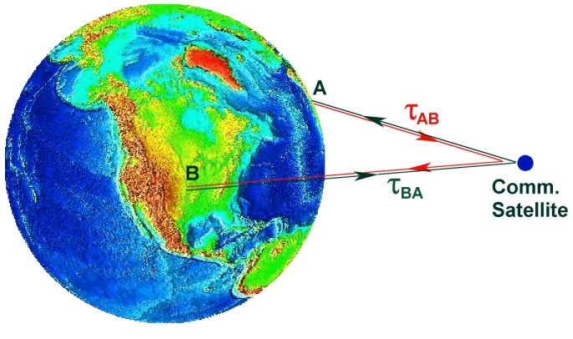
Distribution of Highest Accuracy Time and Frequency
Develop the science and technology of satellite time/frequency signal transfer to improve accuracy by a factor of 100 to 1000.
Use two independent methods to verify signal distribution performance.
  Two-way transfer.
  GPS Carrier phase.
Goal is 5 ps rms time stability at 10 days, which corresponds to ∼1x10⁻¹⁷ frequency transfer accuracy at 10 days.
GPS-CP
TWSTFT

Slide 27
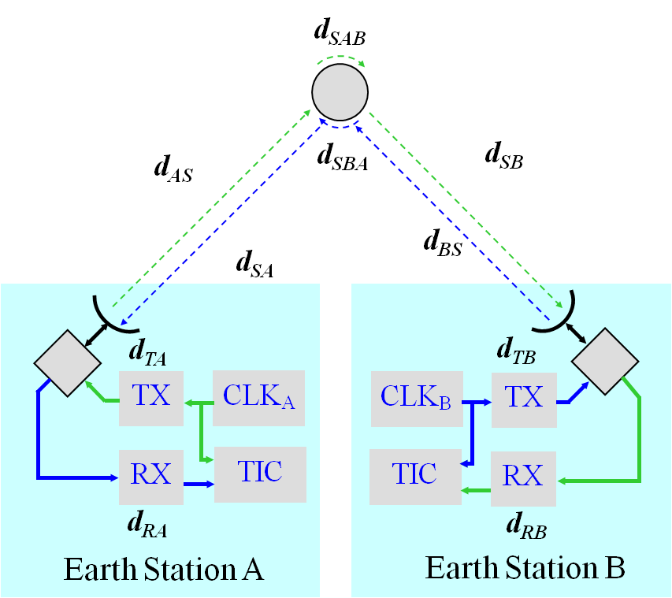
Two-Way Satellite Time and Frequency Transfer
The primary technique used by NIST to contribute to UTC.
NIST is involved in regular comparison with 12 European NMIs.
NIST earth station uses a 3.7 m dish, and K_{U} band radio equipment.

Slide 28
Distribution of Highest Accuracy Time and Frequency
Time and frequency transfer between NIST and University of Colorado (JILA).
7 km dedicated optical fiber in urban environment.
Time transfer instability 6 x 10⁻¹⁸ at 1 second.
Timing jitter (phase noise) 0.085 fs.
Heterodyne beat between independent lasers separated by 3.5 km and 163 THz yields 1 Hz linewidth.
Another recent optical fiber frequency transfer.

Slide 29

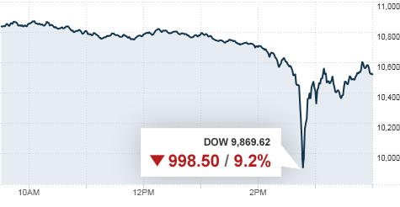
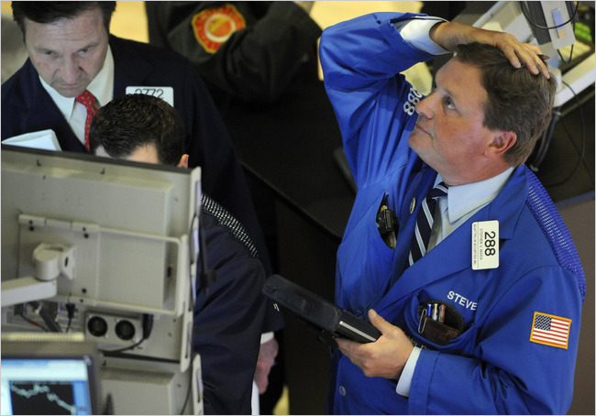
Need for Modest Accuracy Time and Frequency Metrology
NIST Internet Time Service – time codes delivered over the Internet.
12 billion requests per day.
Built into common operating systems: Windows, Mac, Linux, etc.
Servers at 25 locations across the US.
Expected significant growth in need for auditable time-stamping at ever greater timing precision.
NY Stock Exchange
Automated Trading Anomaly
May 6, 2010

Slide 30


Impacts of Accurate Timing and Synchronization
Electronic Financial Transactions
US Financial Industry Regulatory Authority (FINRA) rules for electronic financial transactions. Rules reviewed and approved by US federal government.
Rules apply to more than 800,000 businesses conducting billions of transactions daily through New York Stock Exchange, NASDAQ, and other venues.
All FINRA member electronic and mechanical time-stamping devices must remain accurate to within 1 second of NIST time.
Hundreds of billions of dollars of daily electronic financial transactions in US.
Hundreds of trillions of dollars of financial transactions per year in US.
Source: US Financial Industry Regulatory Authority

Slide 31



Remote Calibration Services
Remote calibration services satisfy the most demanding industrial timing customers, including timing laboratories, research laboratories, and the telecommunications industry.
Time Measurement and Analysis Service (TMAS)
Direct comparison to to UTC(NIST) via Common-View GPS. Based on technology of SIM Time Network.
< 15 ns uncertainty (k = 2).
Real-time measurement results available via Internet.
Frequency Measurement and Analysis Service
Full measurement system with continuous remote monitoring by NIST through telephone lines.
Frequency uncertainty w/respect to UTC(NIST) is ~2 x 10⁻¹³ after 1 day of averaging.

Slide 32





Time By Radio: WWV/WWVH

Slide 33


Time by Radio: WWV/WWVH
HF time signal stations operate in the radio spectrum from 3 to 30 MHz (often known as shortwave). WWV is the shortwave station operated by NIST from Fort Collins, Colorado. Its sister station, WWVH, is located on the island of Kauai in Hawaii.
Both stations broadcast on 2.5, 5, 10, and 15 MHz, and WWV is also available on 20 MHz.
WWV and WWVH are best known for their audio time announcements. The exact size of the radio audience is unknown. About 2000 users per day listen to the signals by telephone through the Telephone Time-of-Day Service (TTDS).

Slide 34
NIST operates two of the five remaining HF Time Signal Stations
Call Sign | Location | Frequencies (MHz) | Controlling NMI
WWV | Fort Collins, Colorado, USA | 2.5, 5, 10, 15, 20 | National Institute of Standards and Technology (NIST)
WWVH | Kauai, Hawaii, USA | 2.5, 5, 10, 15 | National Institute of Standards and Technology (NIST)
BPM | Lintong, China | 2.5, 5, 10, 15 | National Time Service Center (NTSC)
CHU | Ottawa, Canada | 3.33, 7.85, 14.67 | National Research Council (NRC)
HLA | Taejon, Korea | 5 | Korean Research Institute of Standards and Science (KRISS)

Slide 35

Time By Radio: WWVB
WWVB low frequency broadcast of time code signals (60 kHz). Began broadcasting from Fort Collins, Colorado in 1963.

Slide 36





WWVB Radio Controlled Clocks
Low frequency time signal stations operate at frequencies ranging from about 40 to 80 kHz.
WWVB broadcasts on 60 kHz with 70 kW of power from Fort Collins, Colorado.
Between 50 and 100 million WWVB radio controlled clocks are believed to be in operation.
Casio sold 2 million WWVB compatible wristwatches in 2009.

Slide 37
LF Time Signal Stations
Call Sign | Location | Frequency (kHz) | Controlling NMI
WWVB | Fort Collins, Colorado, USA | 60 | National Institute of Standards and Technology (NIST)
BPC | Lintong, China | 68.5 | National Time Service Center (NTSC)
DCF77 | Mainflingen, Germany | 77.5 | Physikalisch-Technische Bundesanstalt (PTB)
JJY | Japan | 40, 80 | National Institute of Information and Communications Technology (NICT)
MSF | Rugby, United Kingdom | 60 | National Physical Laboratory (NPL)
RBU | Moscow, Russia | 66.67 | Institute of Metrology for Time and Space (IMVP)

Slide 38




Some Nobel Prizes Related to Atomic Time and Frequency Metrology
1943 | Otto Stern | Molecular/atomic beam spectroscopy.
1944 | Isidor Rabi | Atomic beam resonance technique.
1955 | Polykarp Kusch | Magnetic moment of electron; early atomic clocks.
1964 | Charles Townes, Nicolai Basov, Alexandr Prokhorov | Quantum electronics, including maser/laser principles.
1966 | Alfred Kastler | Optical pumping methods.
1989 | Norman Ramsey, Hans Dehmelt, Wolfgang Paul | Atomic clock techniques; trapped ion spectroscopy.
1997 | Steven Chu, Claude Cohen-Tannoudji, Bill Phillips | Laser cooling of neutral atoms.
2001 | Eric Cornell, Carl Wieman, Wolfgang Ketterle | Bose-Einstein condensate.
2005 | Roy Glauber, Jan Hall, Ted Hansch | Laser spectroscopy, including laser frequency combs.
Bill Phillips, NIST
Jan Hall, NIST/JILA
Carl Wieman, CU/JILA
Eric Cornell, NIST/JILA

Slide 39



Quantum Information Processing
  Quantum Computing
  Exploit entanglement and superposition.
  32 quantum bits (qubits) store 100 million “words” simultaneously.
  300 qubits store ~ 10⁹⁰ numbers simultaneously – more than the number of elementary particles in the universe.
Why Time and Frequency and QC?
NIST work on quantum computing with ions grew out of ion clock research.
Trapped ion QC research leading to new types of clocks.
control electrodes
400 μm
rf electrode
Notes:
While the atomic clock was a great breakthrough, even the best scientists in the 1940s didn’t anticipate the development of the laser, or envision that light could be used to chill atoms to temperatures just barely above absolute zero.
But these new developments of laser cooling and trapping of atoms led to the newest generation of time standards, the NIST laser-cooled atomic fountain clock. NIST scientists have been leading the world in the development of laser cooling techniques and applications.
So we’ve gone from pendulum clocks to laser-cooled atomic fountain clocks in less than 100 years. The stuff we’re doing now would have been pure science fiction in 1900 -- probably no one even imagined the ideas, let alone whether they would ever be possible.

Slide 40


Quantum Information Processing
David Wineland of the NIST Time and Frequency Division was awarded the 2012 Nobel Prize in Physics, along with Professor Serge Haroche of the Collège de France and Ecole Normale Supérieure.
Wineland was cited by the Nobel committee "for ground-breaking experimental methods that enable measuring and manipulation of individual quantum systems.”
Notes:
While the atomic clock was a great breakthrough, even the best scientists in the 1940s didn’t anticipate the development of the laser, or envision that light could be used to chill atoms to temperatures just barely above absolute zero.
But these new developments of laser cooling and trapping of atoms led to the newest generation of time standards, the NIST laser-cooled atomic fountain clock. NIST scientists have been leading the world in the development of laser cooling techniques and applications.
So we’ve gone from pendulum clocks to laser-cooled atomic fountain clocks in less than 100 years. The stuff we’re doing now would have been pure science fiction in 1900 -- probably no one even imagined the ideas, let alone whether they would ever be possible.

Slide 41

tf.nist.gov

Slide 42


Public, searchable database of Time & Frequency Division publications.
>2,600 PDFs posted.
tf.nist.gov

