Slide 1
The Global Positioning System (GPS)
Michael Lombardi
Chair, SIM Time and Frequency Metrology Working Group
National Institute of Standards and Technology (NIST)
lombardi@nist.gov

Slide 2
Why do satellite signals work better than ground signals for time transfer?
The accuracy of any time transfer system can be no better than the uncertainty of the path delay measurement. Satellite systems have path delays that are easier to measure and calibrate than ground based systems.
The variation in path delay is small due to a clear, unobstructed path between the receiver and transmitter.
The coverage area is usually much larger.
Interference due to weather and ground based noise is usually less of a problem.

Slide 3
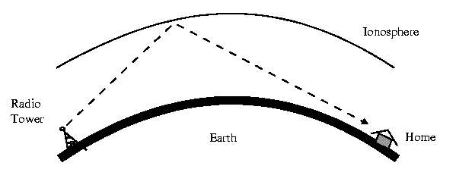
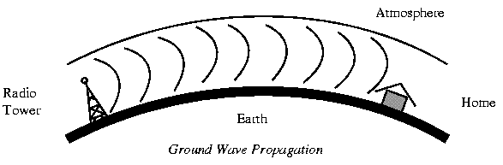
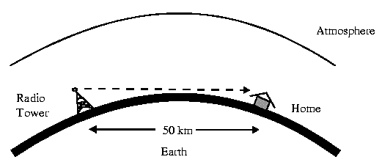
Ground-based signals
skywave
groundwave
line-of-sight

Slide 4
LF Radio
Before satellites, the most accurate time signals were sent by LF (low frequency) radio. LF is the part of the spectrum from 30 to 300 kHz, also known as longwave.
LF signals are still used to send time signals to radio controlled clocks on frequencies such as 40, 60, and 77.5 kHz using simple modulation schemes.
      NIST Radio Station WWVB (60 kHz) is one example.

Slide 5
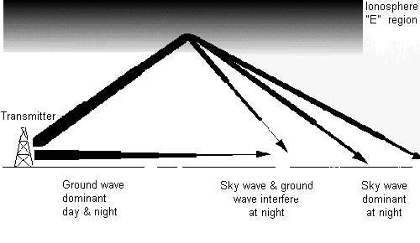
LF Radio Propagation

Slide 6
Disadvantages of LF
Limited coverage area.
Subject to diurnal phase shifts at sunrise and sunset. Over long paths, skywave can interfere with groundwave.
When receiver is unlocked, cycle slips equal to the period of the carrier (16.67 microseconds in the case of 60 kHz) are introduced in the data.
User must calibrate path delay for time transfer, and even then is limited by the cycle ambiguity.

Slide 7
Satellite Signals
The best signals for time transfer. Since the signals originate high above the Earth, there is an clear path between the transmitter and receiver.
Coverage area is worldwide with global navigation systems like GPS.
Small path delay changes occur as the signal passes through these ionosphere and troposphere, but these are measured in nanoseconds.

Slide 8
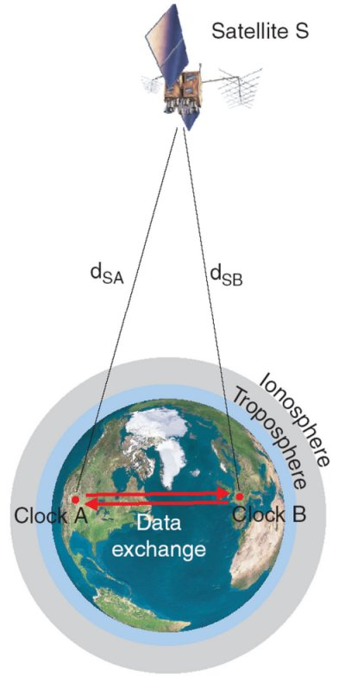
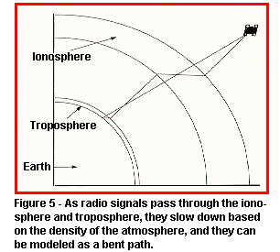
Satellite Radio Propagation

Slide 9
Comparison of Time Transfer Signals
Type of Signal | Spectrum | Coverage of single system | Stability | Reliability of Reception
Skywave | MF, HF | Good | Poor | Poor
Groundwave | VLF, LF | Good | Good | Good
Line-of-sight | VHF, UHF | Poor | Excellent | Excellent
Satellite | UHF | Excellent | Excellent | Excellent

Slide 10
What is GPS?

Slide 11
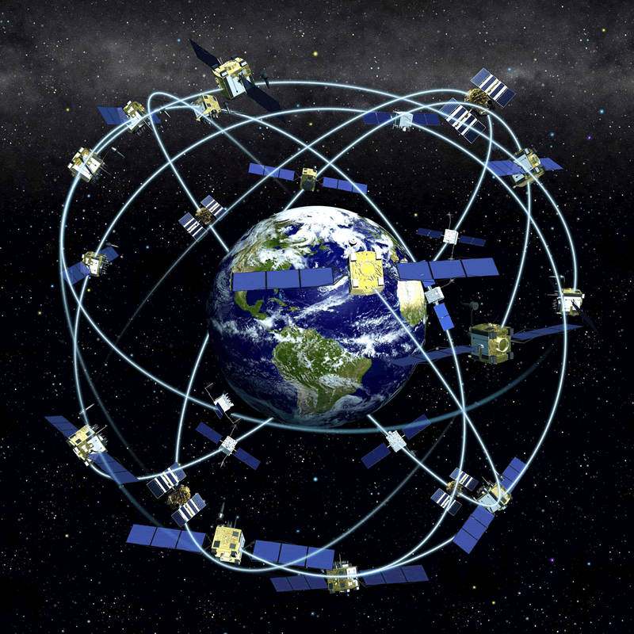
What is GPS?
The Global Positioning System (GPS) is not only a positioning and navigation system, but the main system used to distribute accurate time and frequency worldwide
The constellation includes a maximum of 32 satellites (32 satellites are in orbit as of October 2012)
  The satellites are in semi-synchronous orbit at an altitude of about 20,200 km
  The orbital period is 11 hours, 58 minutes
  At least four (typically seven or more) satellites can always be received at a given location, so the entire Earth has continuous GPS coverage
The satellites carry either cesium or rubidium atomic clocks

Slide 12
GPS History
Developed by the US Department of Defense
The first prototype GPS satellite was launched in 1978
Full Operational Capability for GPS was declared in late 1993, prior to that it was considered an experimental system. Many products became available when it was declared operational.
The accuracy of GPS improved significantly in May 2000. This was when the U. S. government removed the intentional errors that were being added to the signals sent to civil users, called Selective Availability (SA). This led to a large demand for GPS products, and the price of GPS equipment dropped dramatically.

Slide 13
Why can GPS be trusted as a reference for measuring position, distance, and time?
GPS requires highly accurate timing derived from atomic clocks, or the navigation system will fail
  Assume that the maximum acceptable uncertainty contribution from the GPS clocks is 1 m:
    Light travels 3 x 10⁸ m/s, thus a 1 m error equals a 3.3 ns timing uncertainty
    The clocks must be stable enough to keep time to better than 3.3 ns for 12 hours, the approximate period between clock corrections
    This requires better than 1 x 10⁻¹³ stability (3.3 x 10⁻⁹ s / 43200 s = 0.8 x 10⁻¹³)
The atomic oscillators onboard the satellites are steered to agree with the Coordinated Universal Time (UTC) time scale maintained by the U. S. Naval Observatory, known as UTC(USNO).
  The time difference between UTC(USNO) and UTC(NIST) is small, usually less than 10 nanoseconds
  The GPS signals contain the best estimate of Coordinated Universal Time being broadcast anywhere, and they are available free of charge to anyone, worldwide

Slide 14
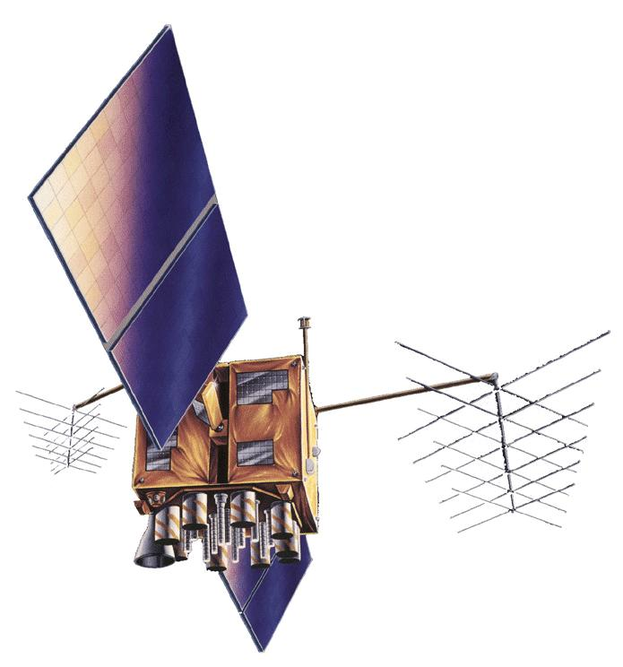
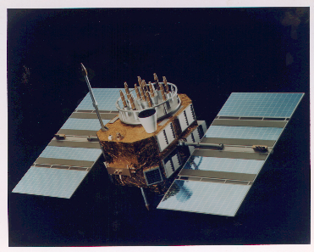
GPS Satellites
Currently (October 2012) there are 32 GPS satellites in orbit occupying all 32 possible “slots”
  5 are referenced to cesium clocks
  27 are referenced to rubidium clocks
  The oldest satellite is PRN 32, launched in November 1990, this was a Block IIA satellite built by Rockwell
  The newest satellite is PRN 24, launched on October 4, 2012, a Block IIF-3 satellite built by Boeing
Block IIR/IIR-M
Built by Lockheed Martin
Launched 1997 - 2009
Block II/IIA Vehicles

Slide 15
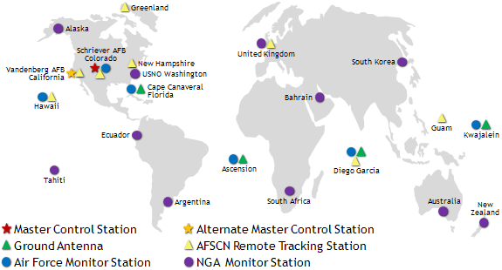
GPS Control Segment
The GPS control segment includes a master control station in Colorado, an alternate master control station in California, 12 command and control sites, and 16 monitoring sites that
  Monitor the GPS satellites for operational health
  Upload satellite almanacs, ephemeris messages, and clock corrections

Slide 16
How does GPS Work?

Slide 17
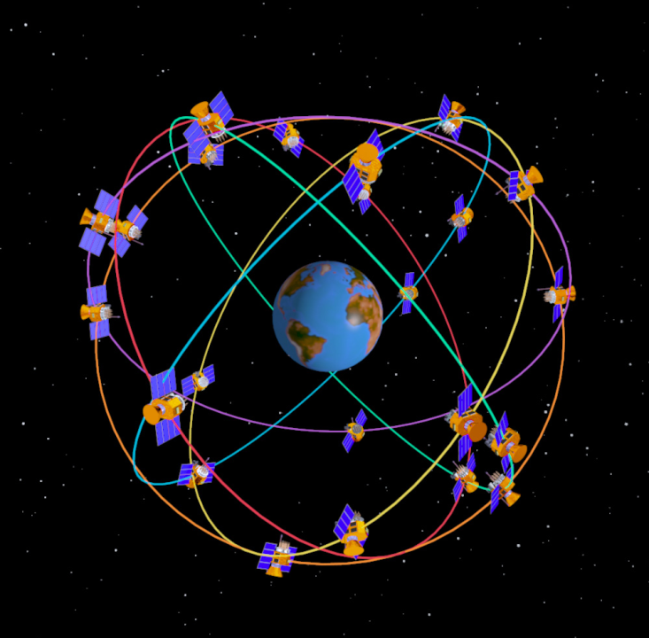
GPS Signal Structure
Two L-band carrier frequencies
  L₁ = 1575.42 MHz L₂ = 1227.60 MHz
Two PRN Codes
  P(Y): Military Code
    267 day repeat interval
    Encrypted – code sequence not published
    Available on L1 and L2
  C/A: Coarse Acquisition (Civilian) Code
    1 millisecond repeat interval
    Available to all users, but only on L1
Code modulated with Navigation Message Data
  Provides ephemeris data and clock corrections for the GPS satellites
  Low data rate (50 bps)

Slide 18
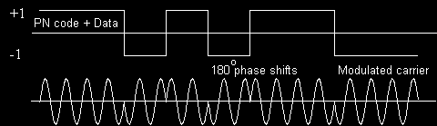
GPS Modulation
The carriers are pure sinusoids. Two binary codes are modulated onto them: the C/A (coarse/acquisition) code and the P (precise) code.
Binary biphase modulation (also known as binary phase shift keying [BPSK]) is the technique used to modulate the codes onto the carrier. There is a 180 degree carrier phase shift each time the code state changes.
The modulation requires a much wider frequency band than the minimum bandwidth required to transmit the information being sent. This is known as spread spectrum modulation. It allows very low signal levels to be used.

Slide 19
Spread Spectrum Communication
“Spreads" the power spectrum of the transmitted data over a wide frequency band at VERY LOW POWER
Same principle is used for household cordless telephones
Each satellite is assigned a unique Pseudo-Random Noise (PRN) Code. All GPS satellites transmit at the same frequency but are identified by their PRN codes.

Slide 20
Relativistic Effects in GPS
GPS is a real world application that makes use of Einstein’s theory of relativity. The oscillators onboard the GPS satellites are given a fixed frequency offset of -4.4645 x 10⁻¹⁰ to compensate for relativistic effects in the GPS satellite orbits.
  Second-order Doppler shift – a clock moving in an inertial frame runs slower than a clock at rest.
  Gravitational frequency shift – a clock at rest in a lower gravitational potential runs slower than a clock at rest in a higher gravitational potential.
Without this frequency offset, GPS satellite clocks would gain about 38 microseconds per day relative to clocks on the ground.
GPS receivers apply an additional correction of up to 23 ns (6 meters) to account for any eccentricity in the satellites orbit.

Slide 21
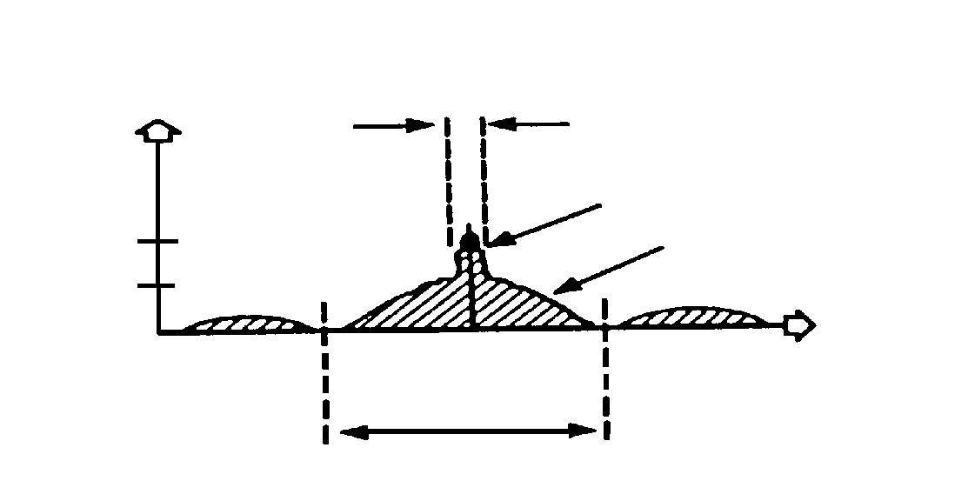
GPS Signal (L1 band, C/A Code)
P[dBW]
2.046 MHz
C/A-CODE
-160
P-CODE
-163
f [Hz]
1575.42 MHz
L1 Signal
P[dBW]
20.46 MHz
Frequency Spectrum
C/A stands for Coarse Acquisition. This code, broadcast at 1575.42 MHz, is the reference for nearly all GPS consumer products.
It is available on the L1 carrier to anyone, worldwide, as part of the Standard Positioning Service (SPS) of GPS

Slide 22
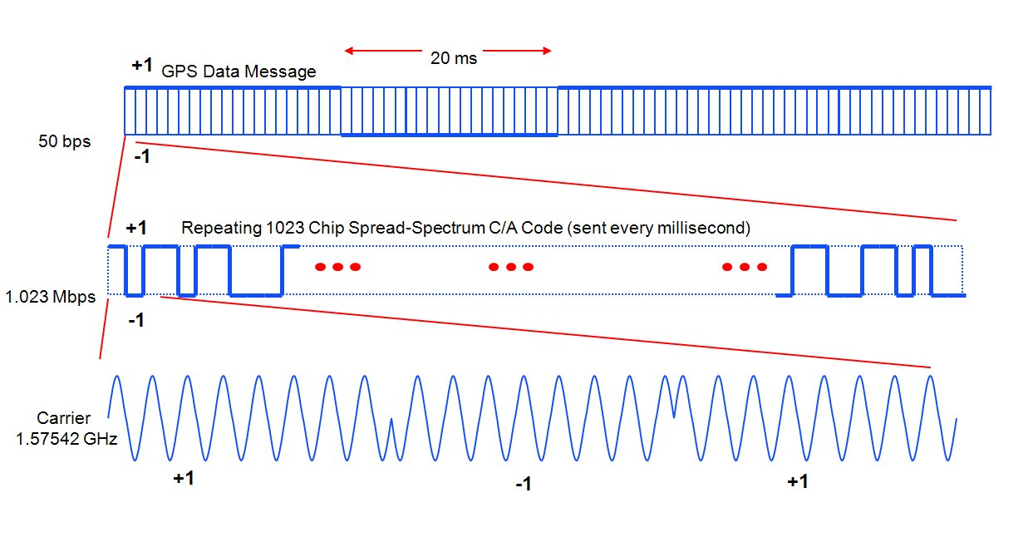
GPS L1 C/A Signal (Time-Domain)

Slide 23
GPS Positioning
GPS positioning is fundamentally based on:
  The precise measurement of time
  The constancy of the speed of light
GPS positioning uses the concept of trilateration
  GPS satellite positions are known
  Receiver position is not known
  GPS-to-receiver range measurements are used to compute position

Slide 24
Positioning Example with One Transmitter
Receiver
(location unknown)
Locus of points on which the receiver can be located
Measured Range
Transmitter
(location known)

Slide 25
Positioning Example with Two Transmitters
True Receiver Location
ρ₁
ρ₂
T₁
T₂
False Receiver Location

Slide 26
Positioning Example with Three Transmitters
True Receiver Location
ρ₃
T₃
ρ₂
ρ₁
T₁
T₂

Slide 27
GPS Positioning - II
The position solution involves solving for four unknowns:
  Receiver position (x, y, z)
  Receiver clock correction
Position accuracy of ~10 m implies knowledge of the receiver clock to within ~30 ns – the speed of light is near 3 ns per meter
Requires simultaneous measurements from four GPS satellites
  The receiver makes a range measurement to the GPS satellite by measuring the signal propagation delay
  The data message modulated on the GPS signals provides the precise location of the GPS satellite and corrections for the GPS satellite clock errors

Slide 28
Pseudo-Random Noise (PRN) Codes
Each GPS satellite transmits its own unique Pseudo-Random Noise (PRN) Code
The C/A Code repeats every millisecond
The receiver generates replicas of the C/A code and uses code correlation to distinguish between different satellites

Slide 29
Pseudorange Measurements
GPS transmitted C(A)-code
Receiver replicated C(A)-code
Finding Dt for each GPS signal tracked is called “code correlation”
Δt
Δt is proportional to the GPS-to-receiver range
Four pseudorange measurements from different satellites are needed to solve for receiver position and time

Slide 30
Ranging
( x_{s}, y_{s}, z_{s}, t_{s} )
--- [m]
Satellite
PRN sequence
Receiver
PRN sequence
( x, y, z, t )
pr
Receiver
pseudo-range
--- [s]

Slide 31
Although the primary purpose of GPS is to serve as a positioning and navigation system, the entire system relies on time measurements made with atomic clocks. After the receiver position (x, y, z) is solved for, the solution is stored.
Then, given the travel time of the signals (observed) and the exact time when the signal left the satellite (given), time from the clock on the satellite can be transferred to the receiver clock.
The measurement made by the GPS receiver reveals the difference between the satellite clock and the receiver clock by measuring the transit time of the signal:
time of signal reception,
(based on receiver clock,
can be significantly in error)
time of transmission,
encoded in signal by
GPS satellite clock
(known precisely)

Slide 32
This measurement, when multiplied by the speed of light, produces not the true geometric range but rather the pseudorange, with deviations introduced by the lack of time synchronization between the satellite clock and the receiver clock, by delays introduced by the ionosphere and troposphere, and by multipath and receiver noise. The equation for the pseudorange is
p = ρ + c ⋅ (dt − dT ) + dion + dtrop + rn
where
p is the pseudorange
c is the speed of light
ρ is the geometric range to the satellite
dt and dT are the time offsets of the satellite and receiver clocks with respect to GPS time
dion is the delay through the ionosphere (an estimate can be obtained from the GPS broadcast)
dtrop is the delay through the troposphere
rn represents the effects of receiver and antenna noise, including multipath.

Slide 33
How accurate is GPS positioning?

Slide 34
Finding Position & Time
Two main factors determine the accuracy of the position and time solution
  UERE (User Equivalent Range Error)
  DOP (Dilution of Precision)

Slide 35
User Equivalent Range Error (UERE)
The accuracy of the pseudo-range measurements between a particular satellite and a particular user
UERE is the result of several factors:
    the quality of the broadcast signal in space, which varies from satellite to satellite and time to time
    the stability of particular satellite’s clock
    the predictability of the satellite’s orbit

Slide 36
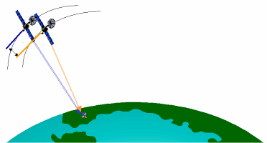
UERE accuracy exceeds published standard
N/A
N/A
N/A
N/A
N/A
7
Signal-in-Space User Range Error is the difference between a GPS satellite’s navigation data (position and clock) and the truth, projected on the line-of-sight to the user
6
2001 SPS Performance Standard
(RMS over all SPS SIS URE)
5
4
2008 SPS Performance Standard
(Worst of any SPS SIS URE)
RMS SIS URE (m)
RMS Signal-in-Space User Range Error (URE), meters
3
2
1.6
Decreasing range error
1.2
1.1
1.0
1
0.9
0
1990
1992
1994
1996
1997
2001
2004
2006
2008
2009
Selective Availability (SA)

Slide 37
Dilution of Precision (DOP)
depends on the geometry of satellites, as seen by the receiver
used in cooperation with the UERE to forecast navigation and time errors
Good (Low) DOP
Conditions:
Poor (High) DOP
Conditions:

Slide 38
GPS Positioning Accuracy Specifications
U.S. commitments to civil GPS performance are documented in the GPS Standard Positioning Service Performance Standard (2008).

Slide 39
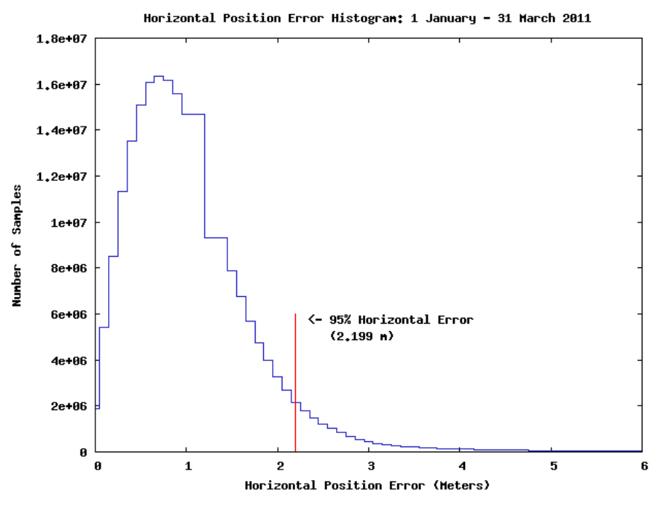
Recent Measurements of Horizontal Accuracy

Slide 40
How accurate is GPS time?

Slide 41
What is GPS Time?
GPS time is controlled by the United States Naval Observatory (USNO), but not exactly the same thing as UTC(USNO).
GPS time differs from UTC(USNO) by the number of leap seconds that have occurred since the origination of the GPS time scale (January 6, 1980); this value is equal to 16 s as of September 2012, and increases each time there is a leap second. The navigation message contains a leap second correction, however, and GPS receivers automatically correct the time-of-day solution.
GPS time also differs from UTC(USNO) by a small number of nanoseconds that continuously changes. The current difference between UTC(USNO) and GPS time is also in the navigation message, and applied by GPS receivers.
After the leap second and UTC(USNO) corrections are applied, GPS time is nearly always within 15 nanoseconds of UTC(USNO) and UTC(NIST). This is better than the specified accuracy of 40 ns.
When the corrections are applied, GPS provides the best estimate of Coordinate Universal Time available to the general public, and it is available free of change to anyone, worldwide.

Slide 42
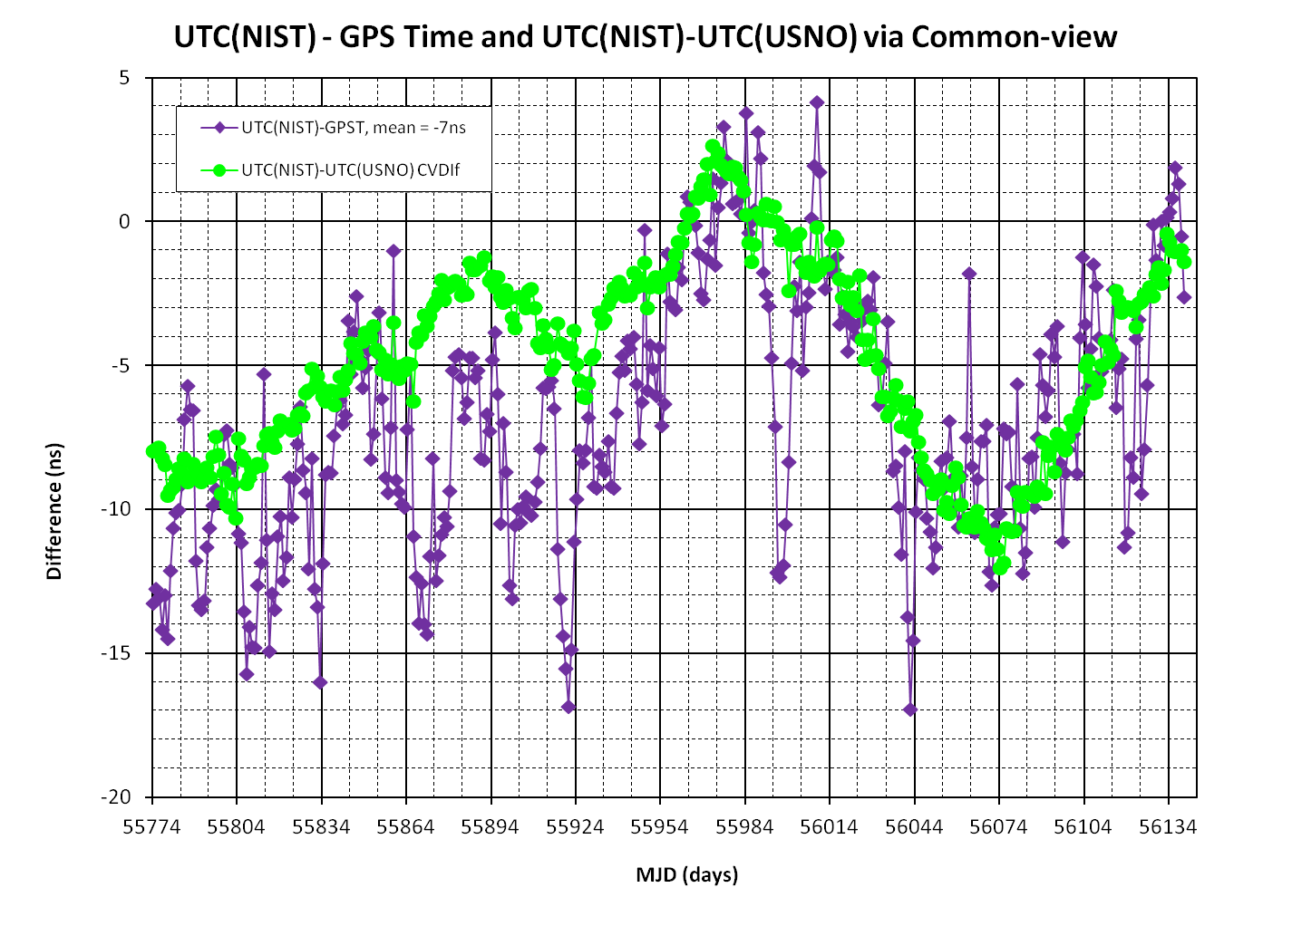

Slide 43
GPS Disciplined Oscillators

Slide 44
Disciplined Oscillators
Disciplined oscillators (DOs) have been used as time and frequency standards for more than 50 years. They use reference signals received by radio to “discipline” (steer) a local oscillator so that its frequency agrees with the incoming reference.
  Short-term stability (at intervals shorter than the steering interval is about the same as the LO.
  Long-term stability (at intervals of weeks or months) is about the same as the reference.
  Medium-term stability (longer than correction interval, but shorter than weeks or months) depends upon the design.

Slide 45
GPS Disciplined Oscillators (GPSDO)
Operated as standalone time and frequency standards
GPSDOs discipline a local oscillator (quartz or rubidium) to agree with the GPS signals.
GPSDOs are self-calibrating standards that will perform at a high level if the device and the GPS constellation are functioning normally.
Produce on-time pulses (1 pps).
Produce standard frequency outputs (such as 1, 5, and 10 MHz).

Slide 46
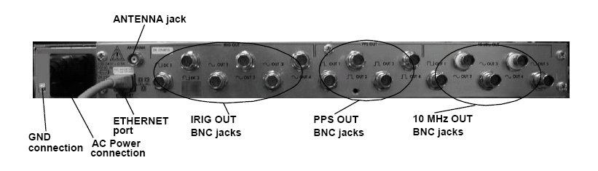
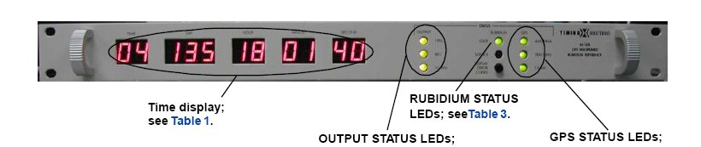

Slide 47
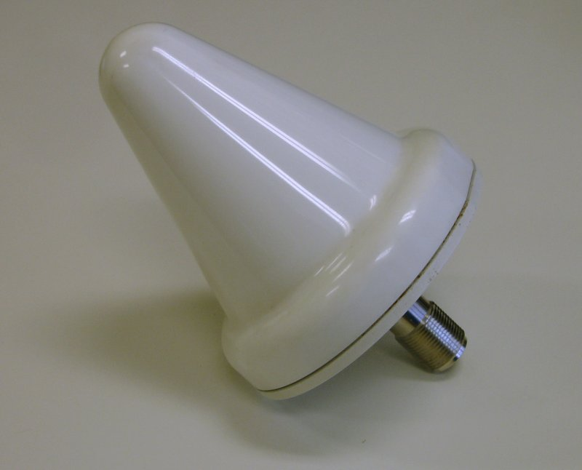
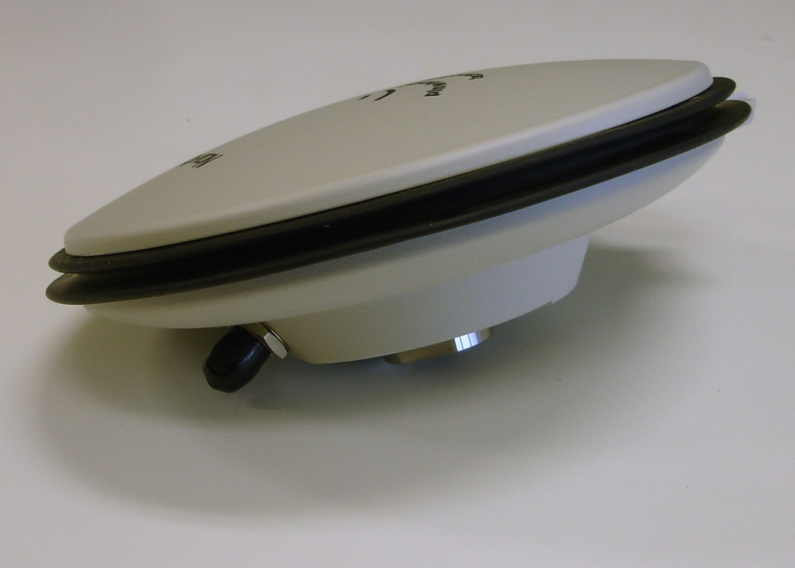
GPS Antennas
Small and inexpensive, higher gain units (> 35 dB typical) generally used for timing to drive long cables.
These antennas are normally active, with internal amplifiers powered by 5 V dc from the antenna cable.
Most bring the 1575 MHz L1 carrier straight to the receiver, without any down conversion.
Omnidirectional, need to have clear sky view on all sides for best results.

Slide 48
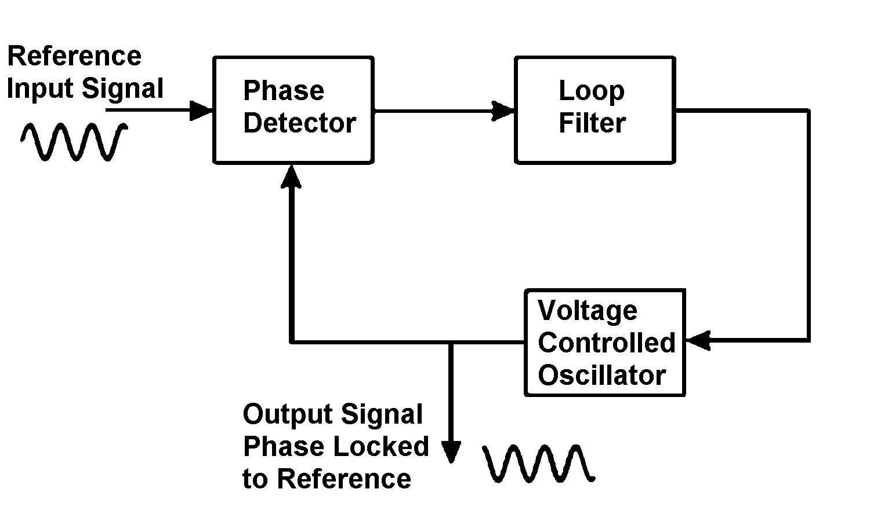
How a GPSDO Works
Most models control the local oscillator with one or more servo loops. One type of servo loop is a phase locked loop (PLL).
  A PLL compares the phase of the received GPS signal to the phase of a voltage controlled oscillator (VCO).
  The phase detector outputs the phase difference between the two input signals to a loop filter, which in turn sends a control voltage to the VCO.
  The control voltage changes the frequency of the VCO in a direction that reduces the phase difference between the VCO and the reference input. The PLL is locked when the phase of the VCO has a constant offset relative to the phase of the reference.

Slide 49
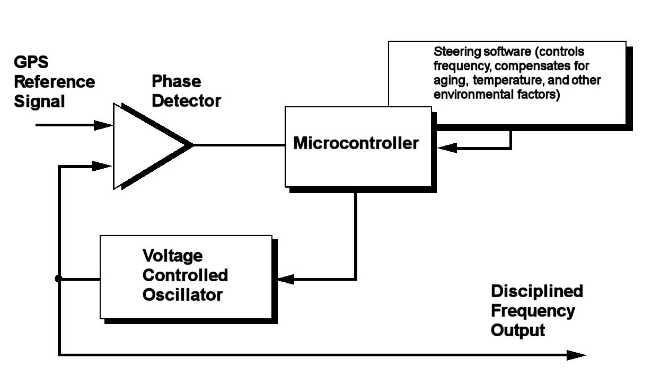
GPSDO (steered local oscillator, no synthesizer)
A phase detector measures the difference between the 1 pps signal from GPS and the signal from the local VCO.
A microcontroller reads the output of the phase detector and monitors the phase difference. When the phase difference changes, the software changes the control voltage sent to the VCO, so that the phase difference is held within a given range.

Slide 50
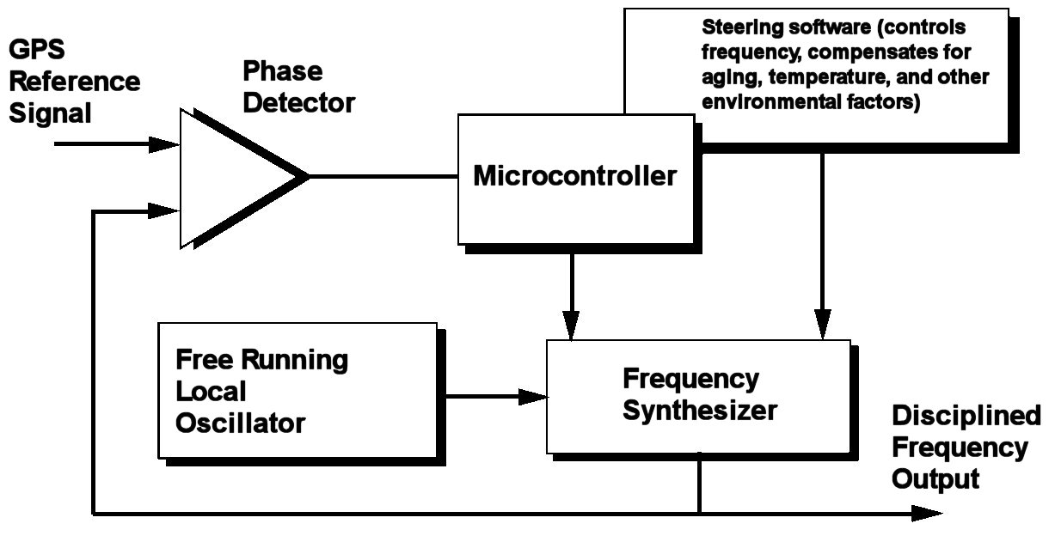
GPSDO (unsteered local oscillator, synthesizer)
The local oscillator is used as the time base for a frequency synthesizer. The phase of the synthesizer is compared to GPS. A correction is sent to the synthesizer to compensate for the frequency offset and eliminate the phase difference, but no corrections are applied to the LO
Modern direct digital synthesizers (DDS) can allow very small frequency corrections to be made (1 μHz resolution at 10 MHz allows frequency corrections of 1 × 10⁻¹³). Allowing the local oscillator to free run often results in better performance than the VCO method, where unexpected shifts in the control voltage can produce unwanted adjustments in the output frequency.

Slide 51
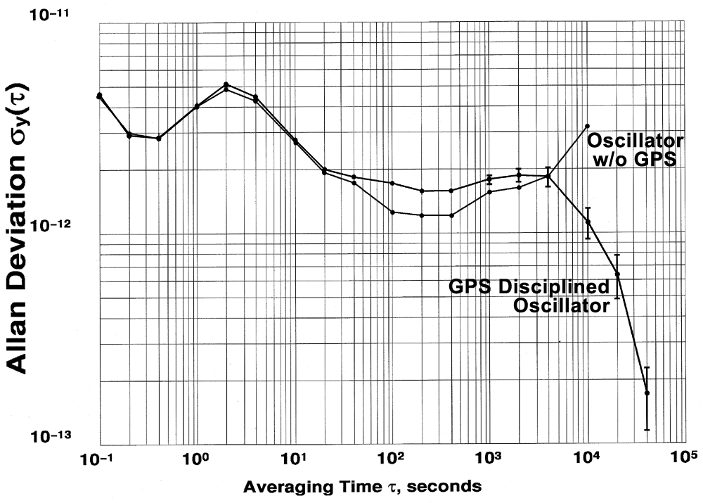
OCXO with and without GPS – crossover point

Slide 52
GPSDO Performance

Slide 53
GPSDO Performance
Different models of GPSDOs produce different results, even when operated in identical environments.
Even so, when averaging for long intervals (weeks or months) any GPSDO that is locked to the satellite signals should be inherently accurate (parts in 10¹⁴ or better) and inherently stable. This is because GPSDOs that simply “follow” the satellites will closely agree with UTC.
For calibrations, the most important specification of a GPSDO is probably frequency accuracy over a one day time period, because most frequency calibrations last for one day or less.
  The frequency accuracy can be no better than the stability
  A good metric to use when evaluating a GPSDO is its stability after one day of averaging, as estimated with the Allan deviation (ADEV).
Notes:
Now the receiver can convert each value of the time
difference between the receiver and the satellite clocks
(obtainable from C/A code PR measurement) to a value
of the time difference between the receiver clock and
GPS time.

Slide 54
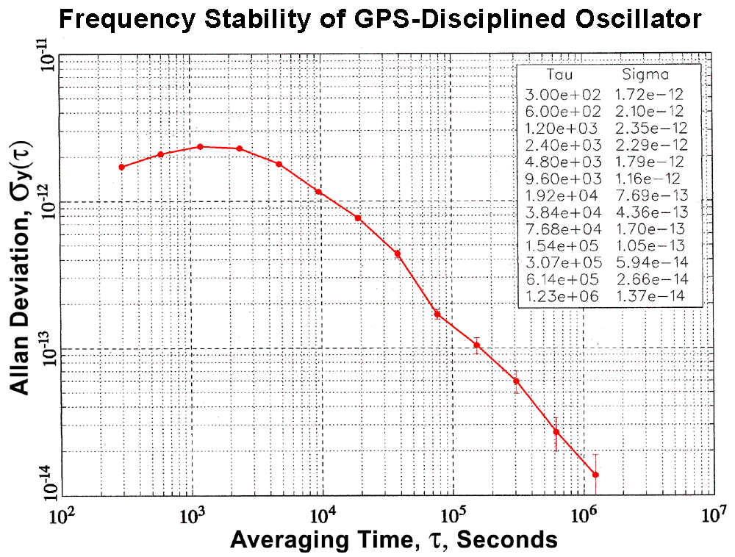
“Typical” GPSDO Performance (near 1E-13 ADEV at 1 day)

Slide 55
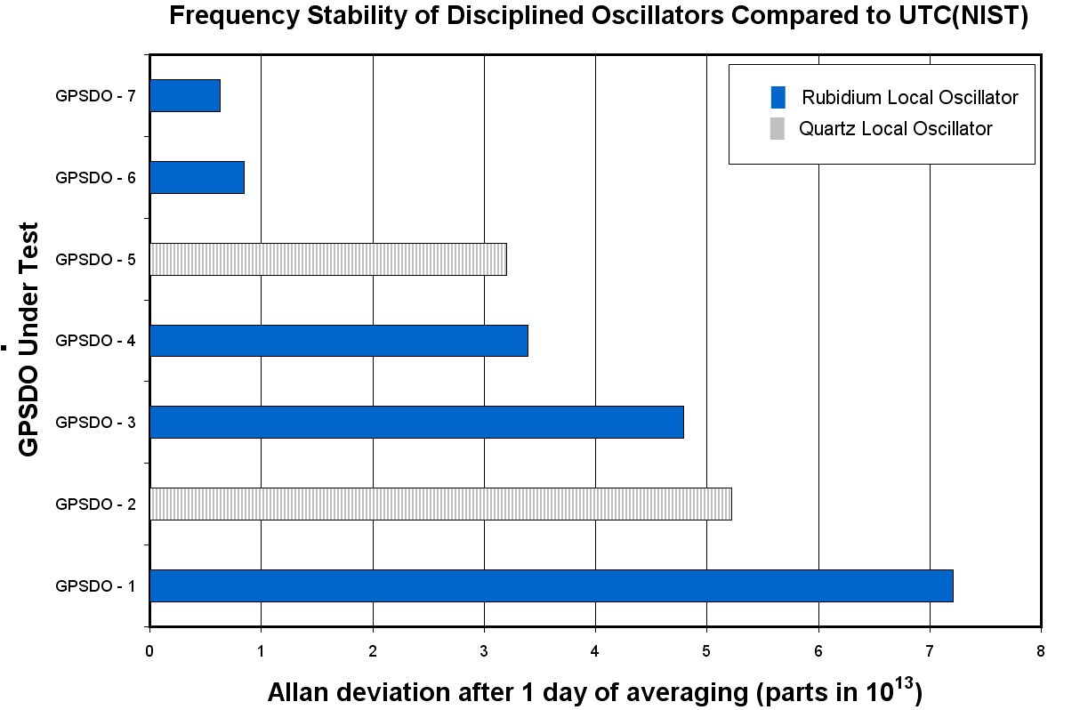

Slide 56
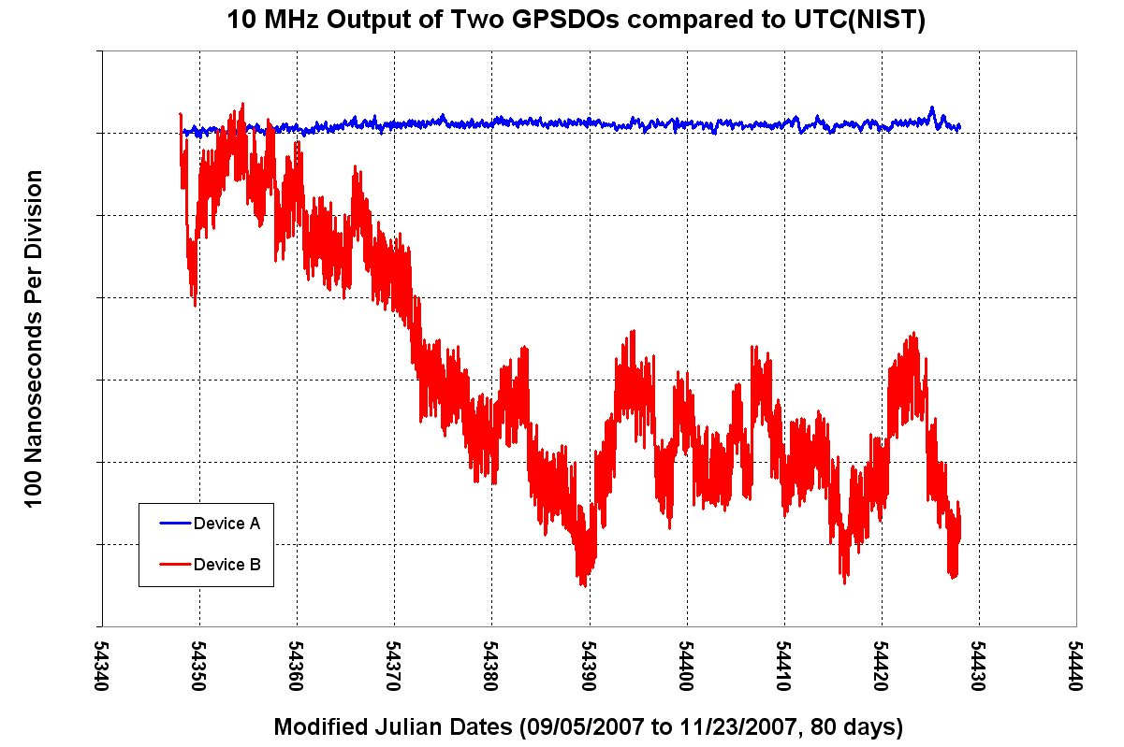

Slide 57
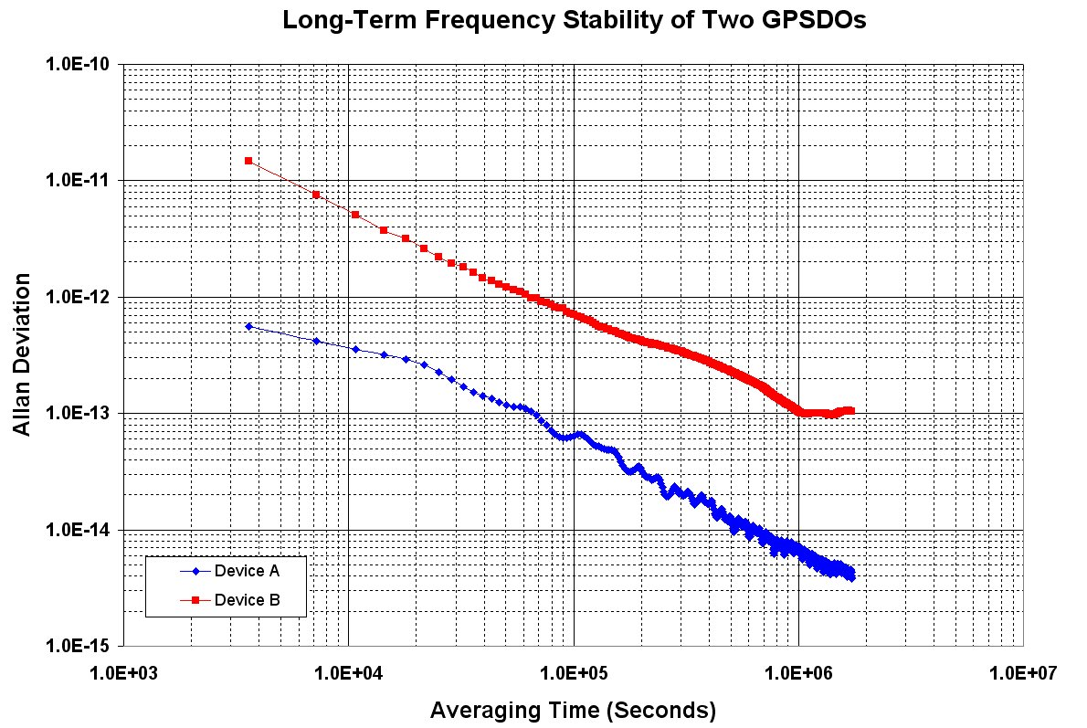

Slide 58
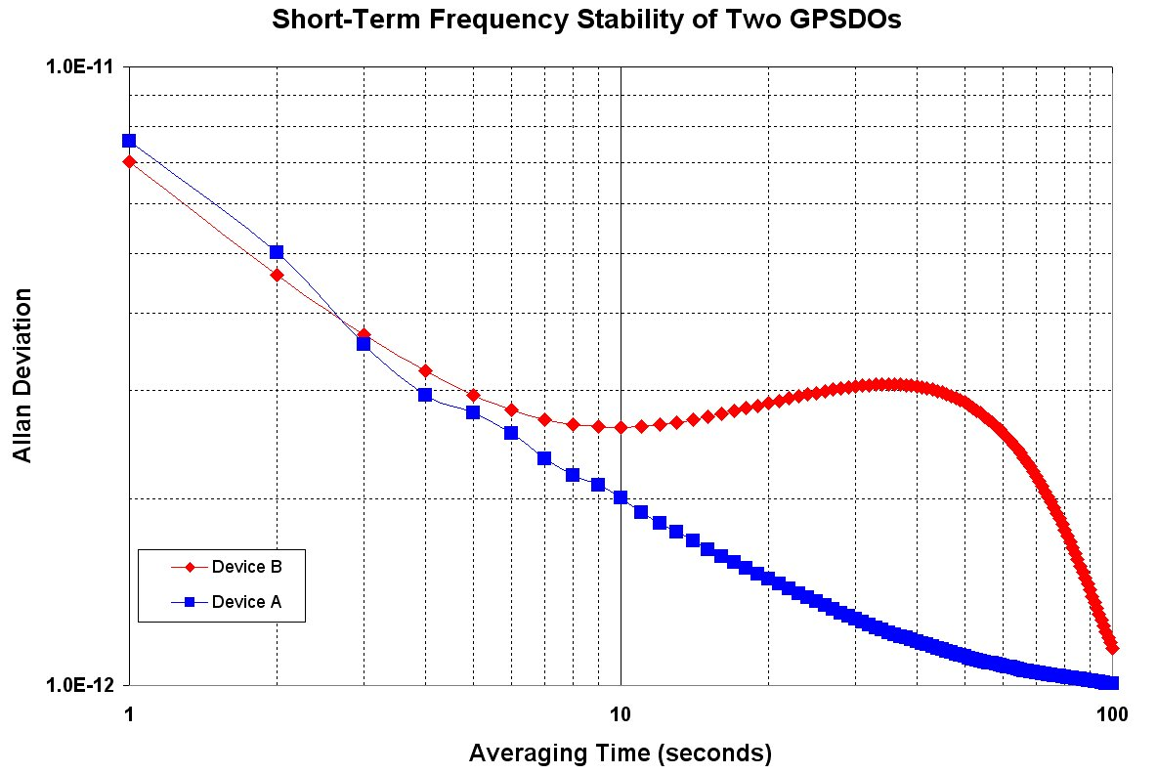

Slide 59
GPSDO vs. Cesium, Pros & Cons
PROS of using a GPSDO as a primary standard
  They cost at least 50% less, and often 90% less than a cesium oscillator.
  They cost less to maintain, because there is no cesium beam tube to replace.
  They can recover time by themselves (time-of-day and an on-time pulse synchronized to UTC).
  They never requires adjustment, because they are controlled by satellite signals.
CONS of using a GPSDO as a primary standard
  They can’t be adjusted. The operator has no control over the output.
  They generally have poorer short term stability and higher phase noise than cesium standards.
  Cesium standards are independent sources of frequency. A GPSDO only works if GPS signals are available and then locks to UTC(USNO).
  NMIs must have a cesium if they wish to contribute to Coordinated Universal Time (UTC) or to the SIM Time Scale (SIMT).
Notes:
Now the receiver can convert each value of the time
difference between the receiver and the satellite clocks
(obtainable from C/A code PR measurement) to a value
of the time difference between the receiver clock and
GPS time.

Slide 60
How reliable is GPS?

Slide 61




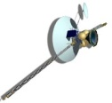
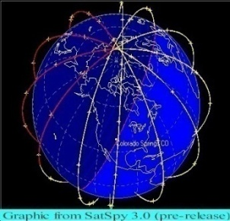



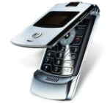
Critical Infrastructure GPS Dependencies
ATM Networks
Stock Exchanges
Energy Plants
Substations
Internet Banking
Power Grids
Banks/ Nodes
GPS Time
GPS Time
  GPS Supporting Power Grid Systems
  GPS Supporting Banking Operations
GPS
GPS Time &
Position
GPS Time &
Position
Rail Yards
Switching Towers
& Signals
Wireless
Internet
C² Centers
Comms
Networks
Air Traffic Control
Access
GIS / Map
Relay Position
To 911 Dispatch
Ship Routing
  GPS Supporting Transportation Systems
  GPS Supporting Communications Systems
Notes:
61
61
UNCLASSIFIED//FOR OFFICIAL USE ONLY
UNCLASSIFIED//FOR OFFICIAL USE ONLY
61

Slide 62
GPS Vulnerabilities
Obstructed Sky-View
  GPS is essentially a line-of-sight signal that works poorly indoors.
Local Outages
  Could be caused by human error, equipment failures, vandalism, an act of God such as a lightning strike, etc.
Government Directives
  The government reserves the right to disable GPS in the event of a national emergency.
Unintentional RF interference
  Signal power is about –160 dBW on Earth, equivalent to 10⁻¹⁶ W
  Possible sources of interferences include UHF TV signals, mobile phones, ultra-wideband communications, over the horizon radar, and even a nearby active GPS antenna.
Intentional RF interference
  Jamming – broadcast of signal near the 1575.42 MHz carrier
  Spoofing - broadcast of GPS compatible signal with false information

Slide 63
An example of unintentional interference from another GPS antenna
Antenna oscillated around 1.579GHz (about -90 dBm) at low temperatures, causing other GPS receivers in the area to fail
GPS is so vulnerable to jamming, that a GPS antenna with a cracked cable or loose connector can cause other receivers in the area to fail.

Slide 64
Low-cost, low-power GPS jammers are illegal but easy to obtain
GPS receivers are passive (receive only) devices
However, when integrated with a mobile phone, they often transmit your location, which some people (to protect their privacy), might want to block
GPS jammers, sometimes called personal privacy devices, are illegal but easy to buy on the Internet
The effective range is often around 20 meters

Slide 65

Personal privacy devices (GPS jammers)

Slide 66
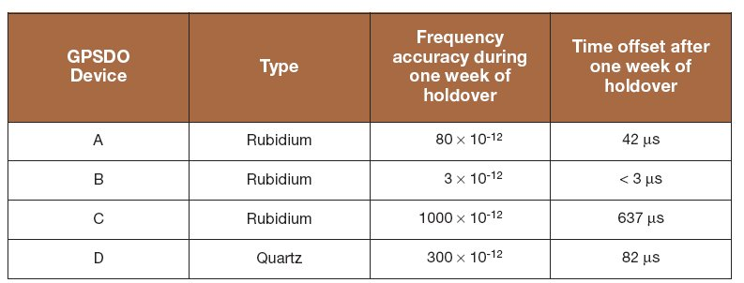
GPSDO Holdover Capability
The most likely cause of GPS failure is RF interference and jamming (either intentional or unintentional)
  GPS signals are susceptible to interference due to their low power levels. A tiny interfering signal can cause a GPSDO to lose lock.
  The minimum received GPS signal strength is –160 dBW for the L1 carrier, equivalent to 10⁻¹⁶ W.
To simulate a GPS outage, we removed the antennas from four GPSDOs that had been locked for multiple weeks. This test showed that holdover capability varies significantly from model to model.
  In theory, a GPSDO with a rubidium local oscillator should have much better holdover capability than a quartz device. However, device D outperformed device C in the test.

Slide 67
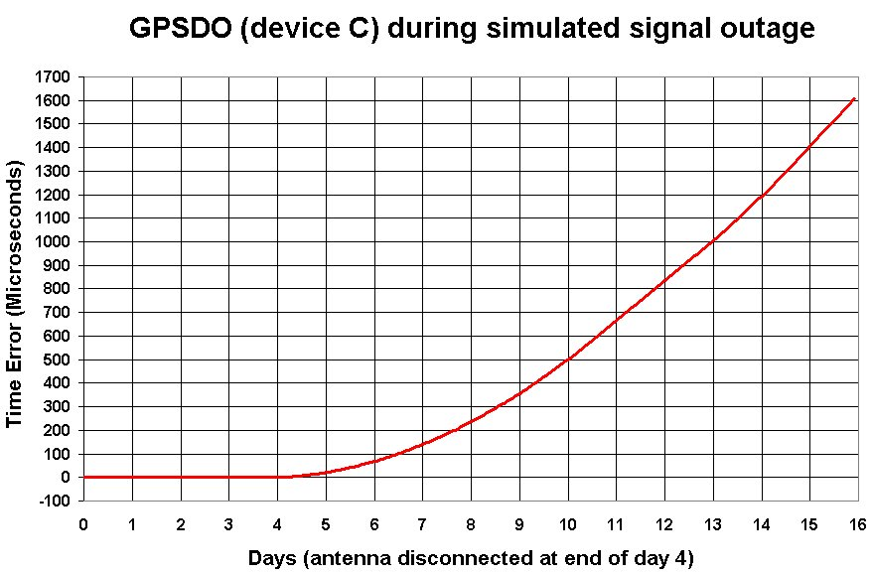
This GPSDO quickly became a free running rubidium oscillator (1 × 10⁻⁹) when GPS was lost, with no apparent holdover capability. A TCXO without holdover capability would likely be 100 to 1000 times less accurate.

Slide 68
The Future of GPS:
New products and new signals

Slide 69
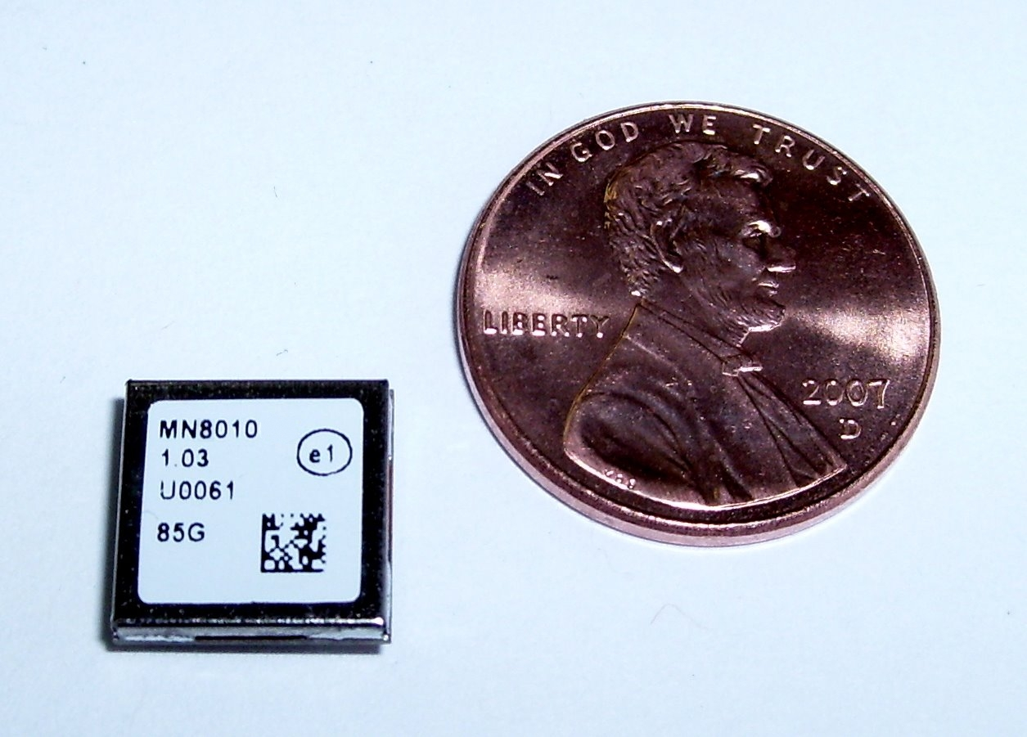

Slide 70
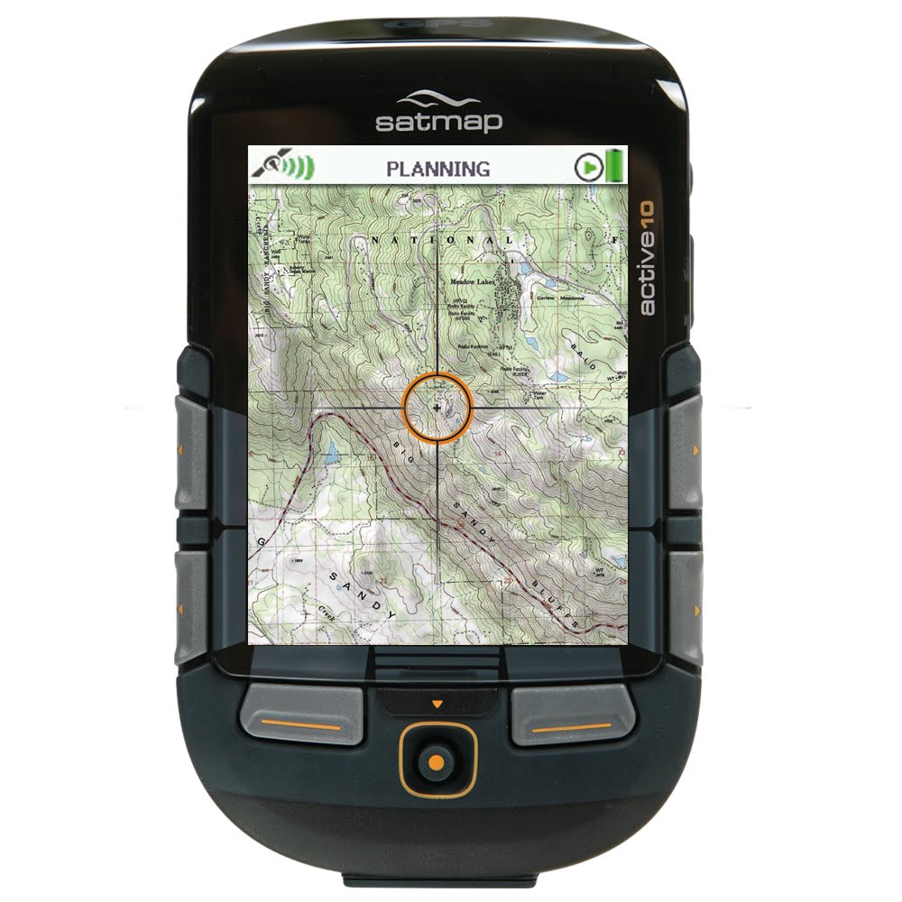
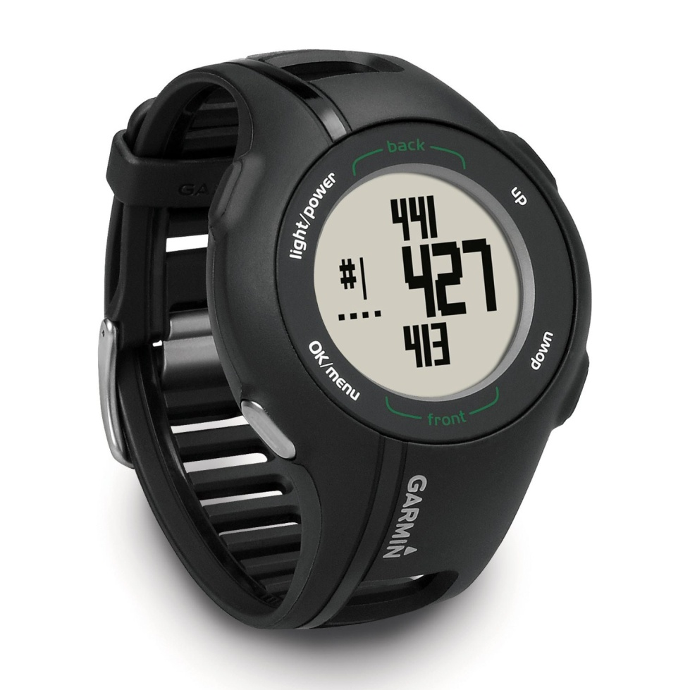

Slide 71
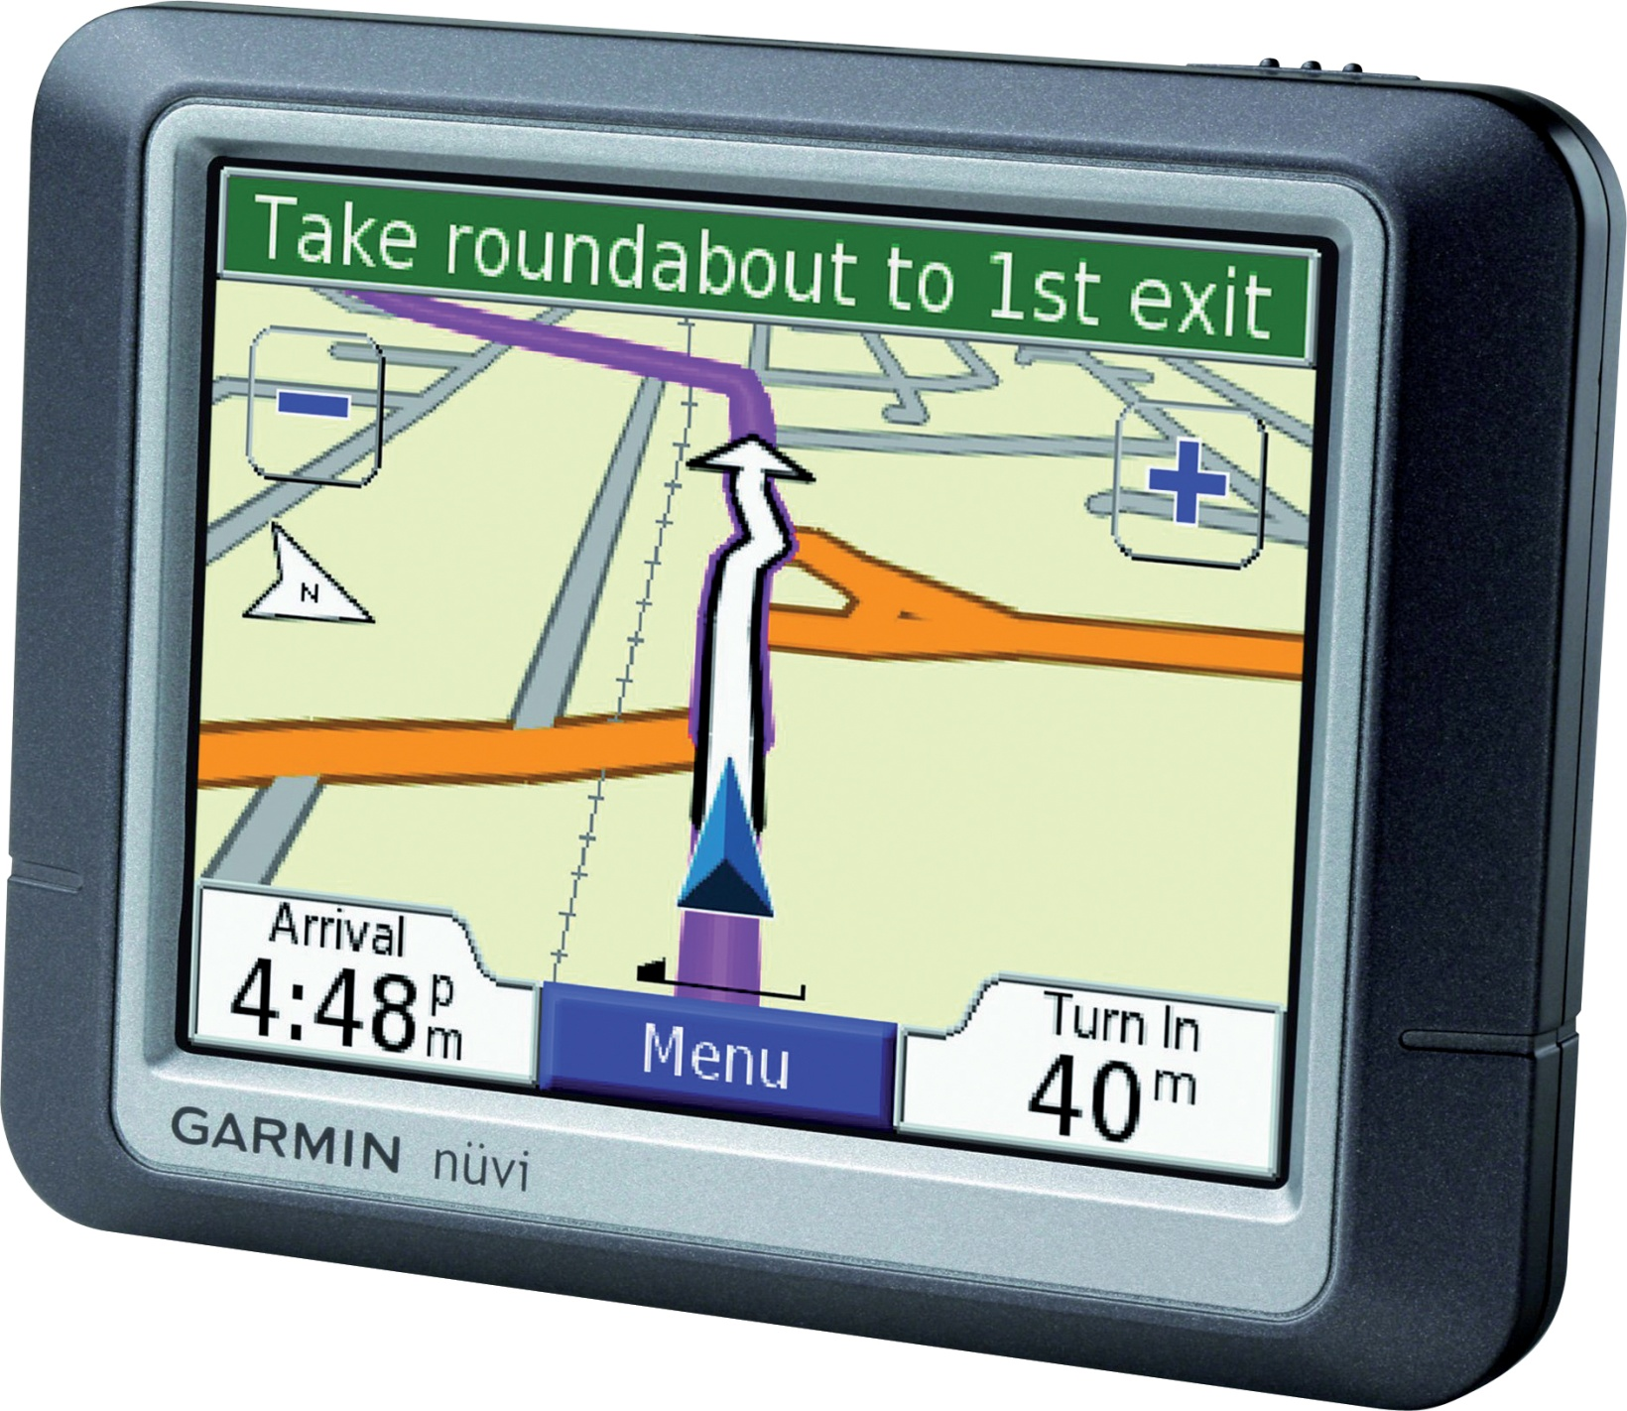

Slide 72
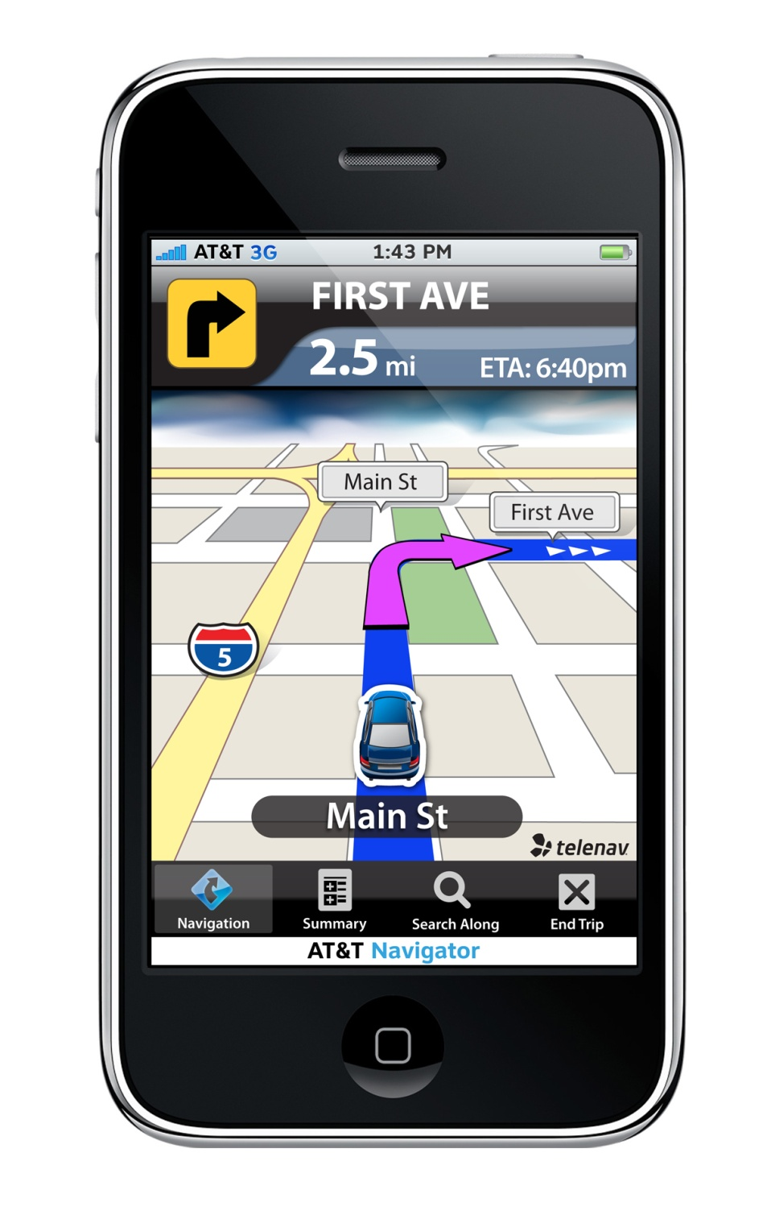

Slide 73
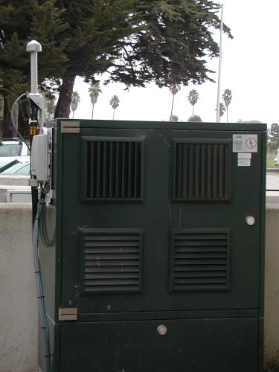
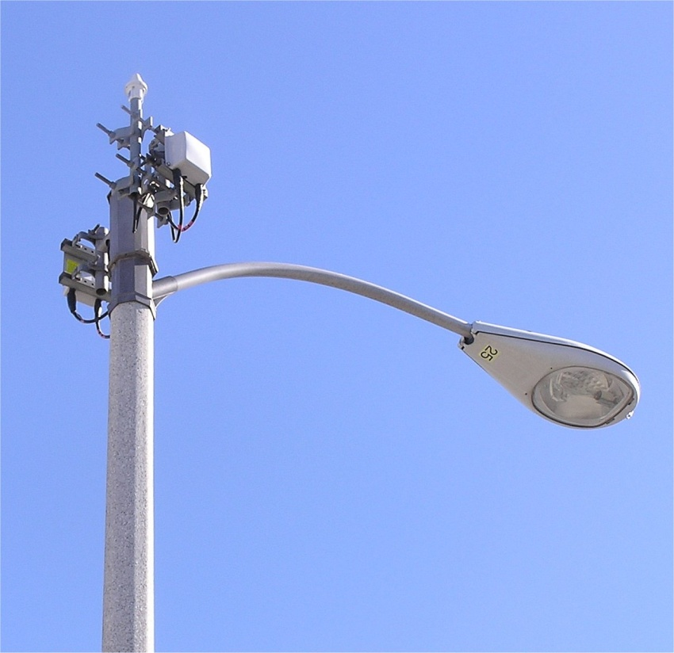
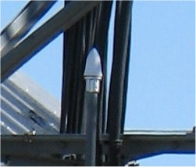
GPS antennas can be found near every location that contains mobile phone equipment

Slide 74
L2C, a new civil GPS signal
Enables higher civilian accuracy when combined with existing civil GPS signal (L1 C/A)
Overcomes some limitations of L1 C/A
  Allows receiver to measure and correct for ionospheric delay
  Designed to act as a redundant signal in case of interference, also greater code correlation (24 dB) makes the signal easier to track
  12 satellites broadcast this frequency as of October 2012

Slide 75
Third Civil Signal (L5)
New signal structure for better accuracy
Higher power than other GPS civil signals
  Doubles the power (3 dB increase)
  Wider bandwidth (1176.45 MHz +/- 10 MHz)
  Improves resistance to interference
Four satellites now have L5 capability as of October 2012

Slide 76
L1C
Begins with GPS III sats
First launch: ~ 2014
Modernized L1 civil signal
  In addition to C/A code to ensure backward compatibility
  Increased robustness and accuracy for civil users
  Designed with international partners so that it can work with other satellite navigation systems – will use same type of coding as Galileo
  First launch scheduled for 2014

