Slide 1
Common-View Measurements, the SIM Time Network (SIMTN), and Contributing to Coordinated Universal Time (UTC)
Michael Lombardi
Chair, SIM Time and Frequency Metrology Working Group
National Institute of Standards and Technology (NIST)
lombardi@nist.gov

Slide 2
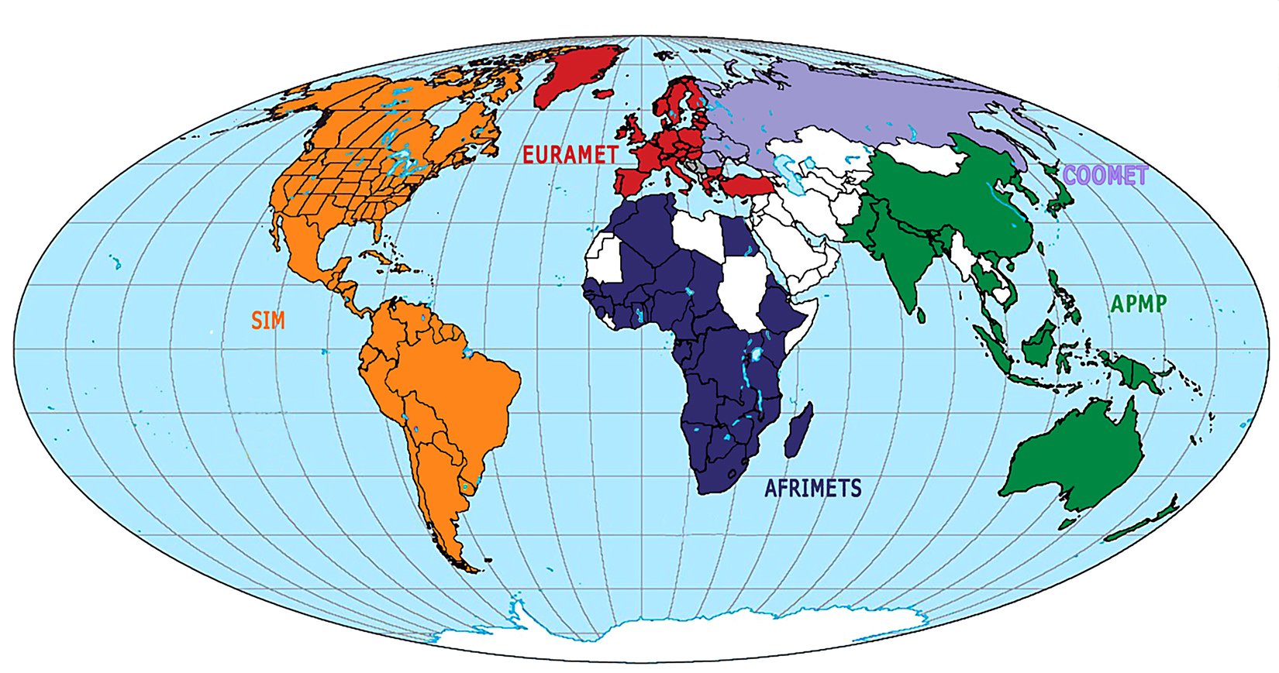
SIM is the Interamerican Metrology System, one of the world’s five major Regional Metrology Organizations (RMOs) recognized by the BIPM

Slide 3
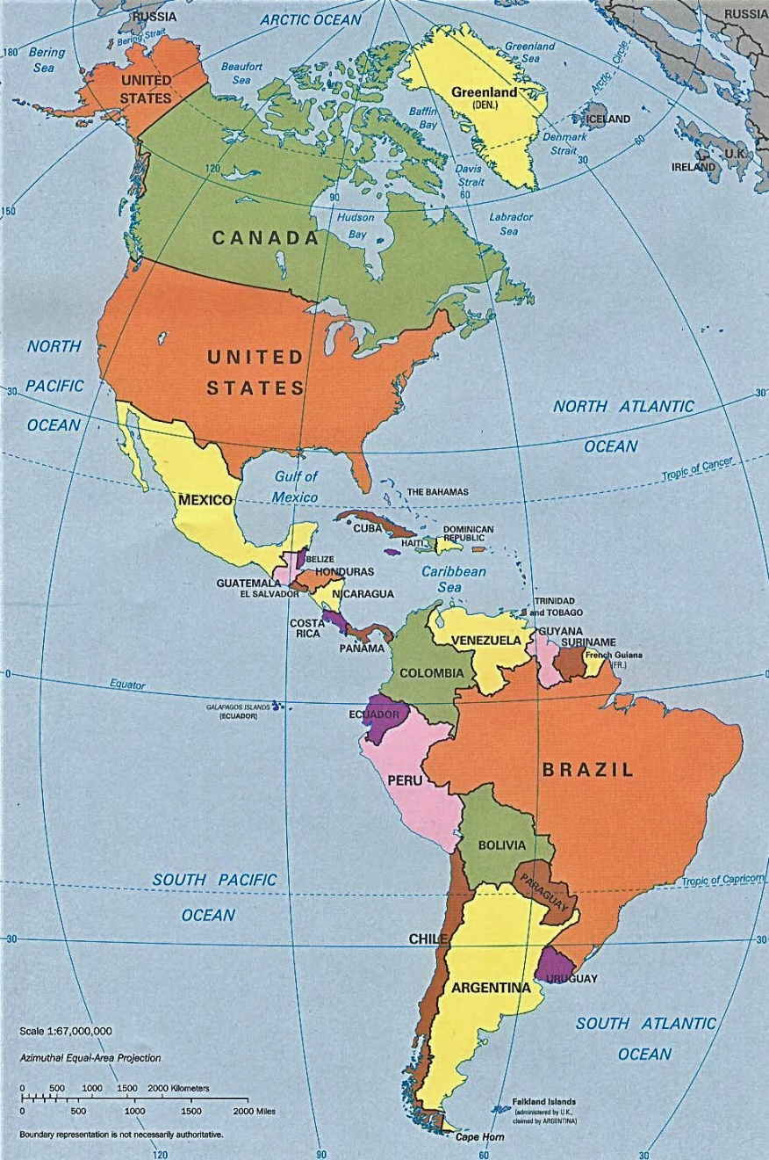
Information about SIM
SIM consists of NMIs located in the 34 member nations of the Organization of American States (OAS), which extends throughout North, Central, and South America, and the Caribbean region.
OAS accounts for roughly 13% of the world’s population (about 910 million people as of 2009), and roughly 27% of its land mass. SIM is the largest RMO in terms of land area.
About 2 out of 3 people in the SIM region live in the United States, Brazil, or Mexico (roughly 617 million people).
Eleven SIM nations (mostly islands) have less than 1 million people.
SIM has organized metrology working groups (MWGs) in 11 different areas, including time and frequency. The SIM Time Network is operated by the T&F MWG.

Slide 4





The purpose of RMOs
The International Bureau of Weights and Measures (BIPM) works to ensure the worldwide uniformity of measurements and their traceability to the International System of Units (SI). This allows the measurements made in one country to be accepted and trusted in other countries, which is important for international trade.
The BIPM expects RMOs to review the quality systems of NMIs, and their calibration and measurement capabilities (CMCs). RMOs should also:
  Organize regional comparisons to supplement the BIPM key comparisons so that more nations can establish traceability to the SI. This was the primary goal of the SIM Time and Frequency Metrology Working Group when we began work in 2005. We needed a way to compare the time and frequency standards located across a very large geographic region.

Slide 5
SIM Time Network Design Goals
Our design goals were:
  To establish cooperation and communication between the SIM time and frequency labs now and in the future.
  To build a network that allowed all SIM NMIs to compare their time standards to those of the rest of the world.
  To utilize equipment that was low cost and easy to install, operate, and use, because SIM NMIs typically have small staffs and limited resources.
  To be capable of measuring the best standards in the SIM region. This meant that the measurement uncertainties had to be as small, or nearly as small, as those of the BIPM key comparisons.
  To report measurement results in near real-time, without the processing delays of the BIPM key comparisons.
  To build a democratic network that favored no single laboratory or nation, and to allow all members to view the results of all comparisons.

Slide 6
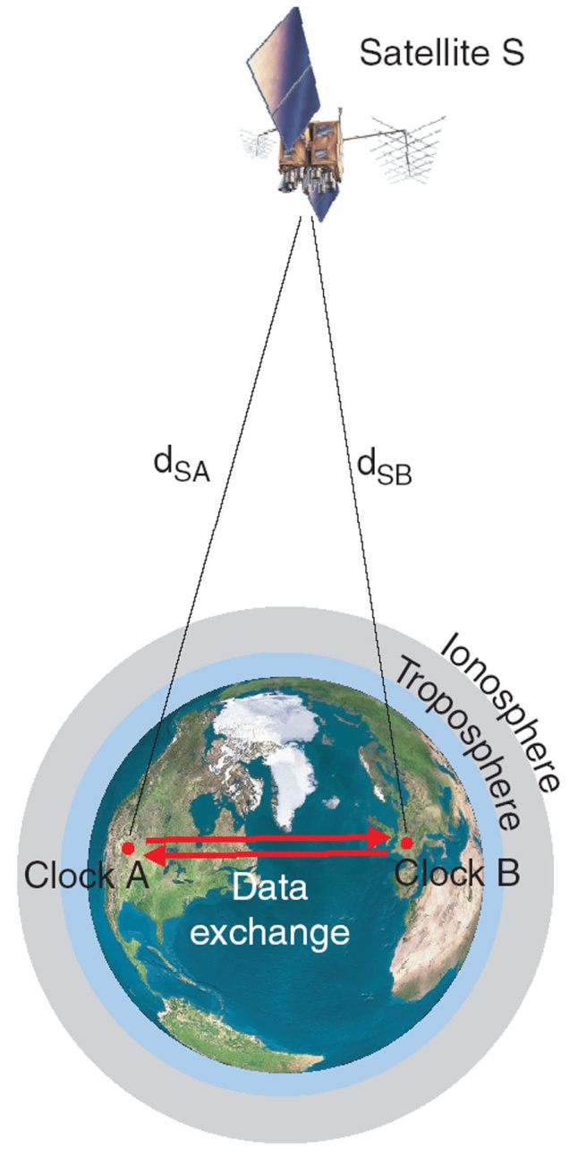
Common-View GPS Measurements
Common-view GPS is the easiest, most practical, and cost effective way to compare two clocks at remote locations.
The common-view method involves a GPS satellite (S), and two receiving sites (A and B). Each site has a GPS receiver, a local time standard, and a time interval counter.
Measurements are made at sites A and B that compare the received GPS signal to the local time standard.
Two data sets are recorded (one at each site):
  Clock A - S
  Clock B - S
The two data sets are then exchanged and subtracted from each other to find the difference between Clocks A and B. Delays that are common to both paths (d_{SA} and d_{SB}) cancel, but delays that are not common to both paths contribute uncertainty to the measurement. The equation for the measurement is:
(Clock A – S) – (Clock B – S) = (Clock A – Clock B) + (d_{SA} – d_{SB})

Slide 7

All-in-view GPS
Receivers at remote stationary locations track all the satellites in view
Each receiver makes the all-in-view measurements, (REF_{station_i} – GPS): time difference between a local reference clock and the received composite timing signal from all the satellites being tracked
The all-in-view measurements from two receivers are differenced to obtain the time and frequency difference of two remote clocks
Works when no satellites are in common-view
Performance is about the same as common-view for short baselines (2500 km or less), better than common-view for long baselines (5000 km or longer)
ionosphere
troposphere
A
B

Slide 8
A few “common-sense” things to know about GPS common-view
All systems involved in the comparison have to follow the same rules. Collect data at the same time, store data in the same format, and so on.
The measurements made at each site have to be subtracted from each other. Therefore, data transfer is always part of common-view so the data files can be brought to the same location. In order to do common-view in real-time, we need real-time data transfer.
GPS is not the reference! The reference is the other lab in the comparison. GPS is simply a transfer standard used to transfer time from one location to another.

Slide 9
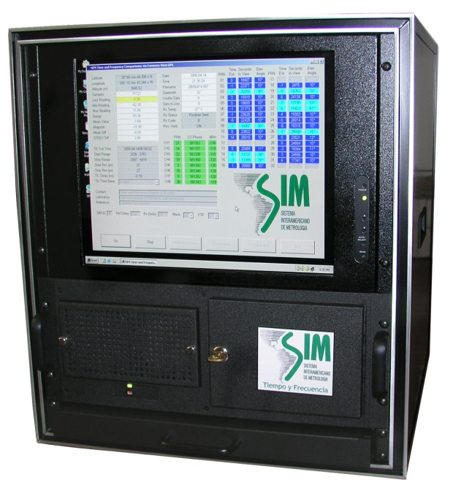
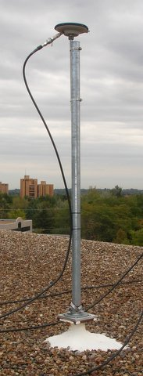
The SIM Measurement System
Simple design makes it easy and inexpensive for SIM labs to compare their standards. It includes:
  8-channel GPS receiver (C/A code, L1 band)
  Time interval counter with 30 ps resolution
  Rack-mount PC and flat panel display
  Pinwheel type antenna
  Applies broadcast ionospheric (MDIO) corrections
The receiver measures all visible satellites and stores 1-minute and 10-minute REFGPS averages.
All systems are connected to the Internet, and send their files to a web server every 10 minutes.
The web server processes data “on the fly” in near real-time. Results can be viewed on the web in either common-view or all-in-view format.
All units are built and calibrated at NIST
Systems are paid for by either OAS or the participating NMI and become the property of the NMI.

Slide 10
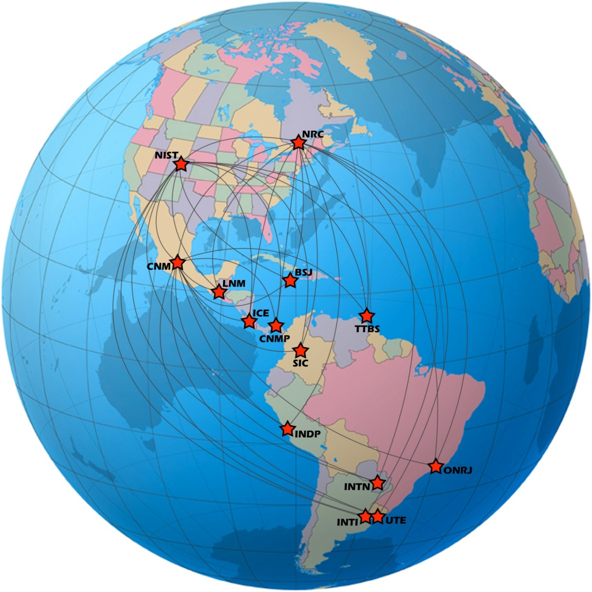
The SIM Time Network
The SIM Time Network is based on common-view GPS comparisons. All participants use identical measurement equipment.
Data can be processed as common-view or all-in-view measurements.
A total of 19 NMIs now participate. At least one more NMI is expected to join the network in 2013. All of these labs continuously compare their time and frequency standards, 24 hours per day, 7 days per week.

Slide 11
Country | Date equipment was shipped | BIPM MRA Signatory? | T&F Standard | Contributes to UTC?
United States | 2005 | Yes | Ensemble Time Scale | Yes
Mexico | 04/2005 | Yes | Ensemble Time Scale | Yes
Canada | 05/2005 | Yes | Ensemble Time Scale | Yes
Panama | 10/2005 | Yes | Two cesiums | Yes
Brazil | 09/2006 | Yes | Ensemble Time Scale | Yes
Costa Rica | 01/2007 | Yes | Cesium | No
Colombia | 02/2007 | No | Two cesiums | No
Argentina | 07/2007 | Yes | Cesium | Yes
Guatemala | 08/2007 | No | GPSDO | No
Jamaica | 12/2007 | Yes | Two cesiums | No
Uruguay | 11/2008 | Yes | Rubidium (cesium on order) | No
Paraguay | 11/2008 | Yes | Rubidium | No
Peru | 06/2009 | Yes | Cesium | No
Trinidad / Tobago | 08/2009 | Yes | GPSDO | No
Saint Lucia | 05/2010 | Yes | Rubidium | No
Chile | 12/2010 | Yes | Rubidium | NMI does not, but geodetic observatory does
Antigua and Barbuda | 08/2011 | Yes | Rubidium | No
Ecuador | 06/2012 | Yes | Rubidium | No
Bolivia | 07/2012 | Yes | Rubidium | No
St. Kitts and Nevis | 2013 | Yes | Rubidium | No

Slide 12
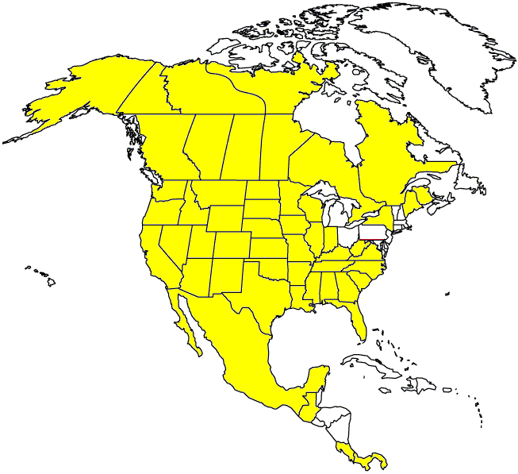
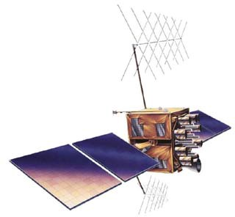

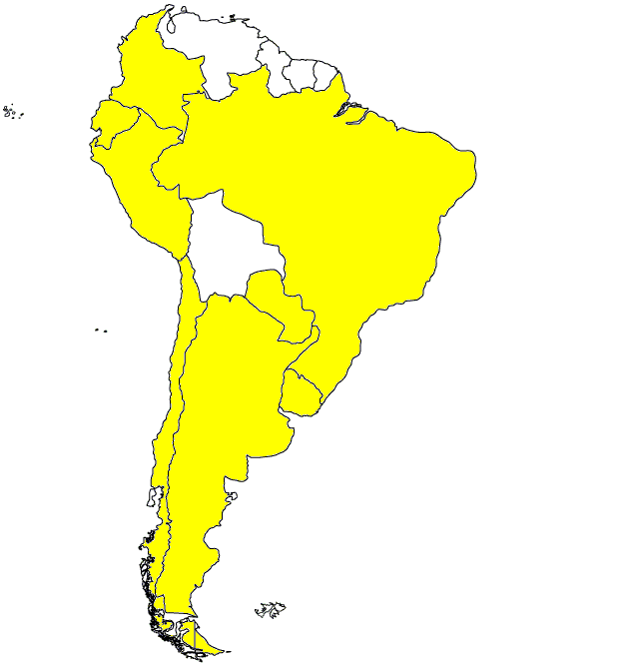
SIM Time Network
Clock A
GPS satellite
Measuring system A
GPS –Clock A
Measuring system B
GPS – clock B
Clock B
time
time

Slide 13
SIM Time Network Server Locations
SIMTN servers
Clock A
NRC
NIST
Measuring system A
CENAM
ONRJ
GPS –Clock A
Measuring system B
GPS – clock B
Clock B
time
time

Slide 14
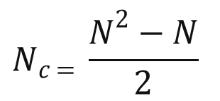
Links in the SIMTN
CENAM
LNM
$$N_{c = }\frac{N^{2}−N}{2}$$
ICE
NIST
CENAMEP
N_{C} number of bilateral comparisons
NRC
N number of laboratories in the network
SIC
For
N=19
there are
N_{C} = 171
bilateral comparisons
SLBS
ONRJ
BSJ
INDP
INTI
INTN
UTE

Slide 15
Reporting results to participating SIM laboratories
Measurement results can be viewed using any Java-enabled web browser. Our web-based software does the following:
  Plots the one-way GPS data (average of all satellites and tracks for each individual satellite) as recorded at each site relative to the local standard.
  Plots the time and frequency difference between NMIs using the common-view method (common-view data are averaged across all satellites and are also shown for each individual satellite).
  Calculates the Allan deviation and time deviation.
  Makes 10 minute, 1 hour, and 1 day averages available in tabular form.
  Up to 200 days of data can be retrieved at once. All old data remains available, nothing is ever deleted.
  The time difference between any two laboratories can be viewed by all laboratories in the network. New results are available every 10 minutes.
  Results can be processed as “classic” common-view or all-in-view.

Slide 16

tf.nist.gov/sim

Slide 17
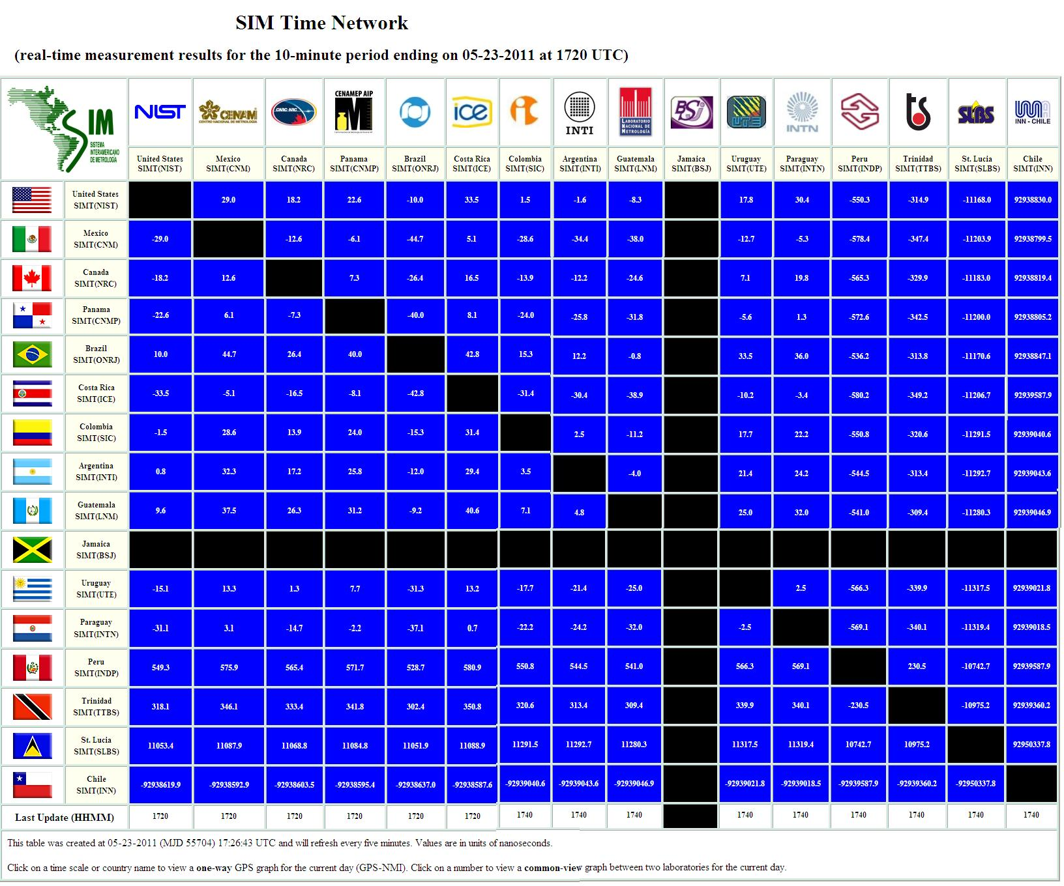
http://www.tf.nist.gov/sim

Slide 18
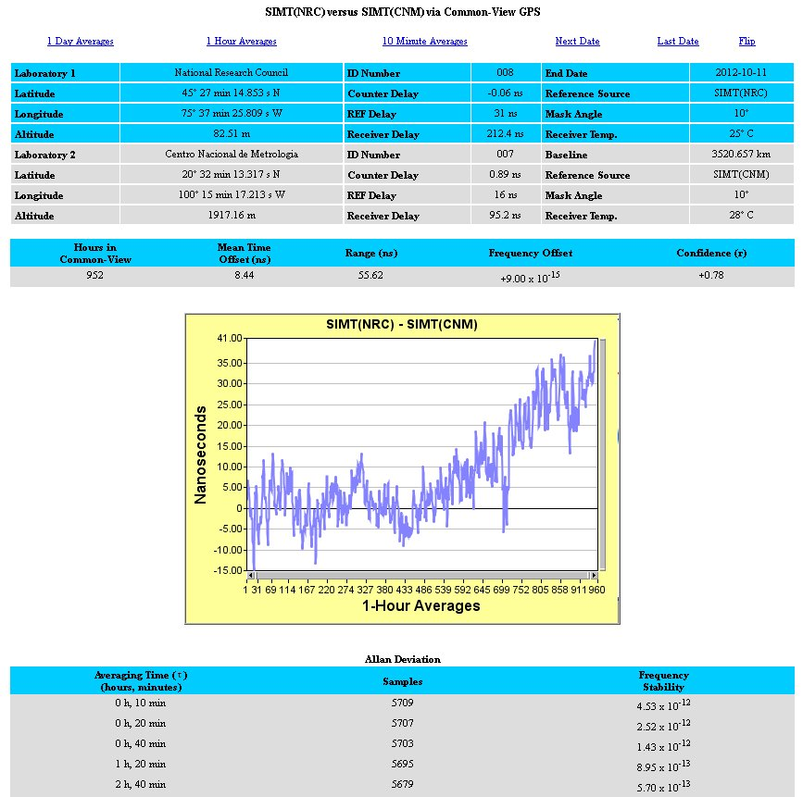

Slide 19
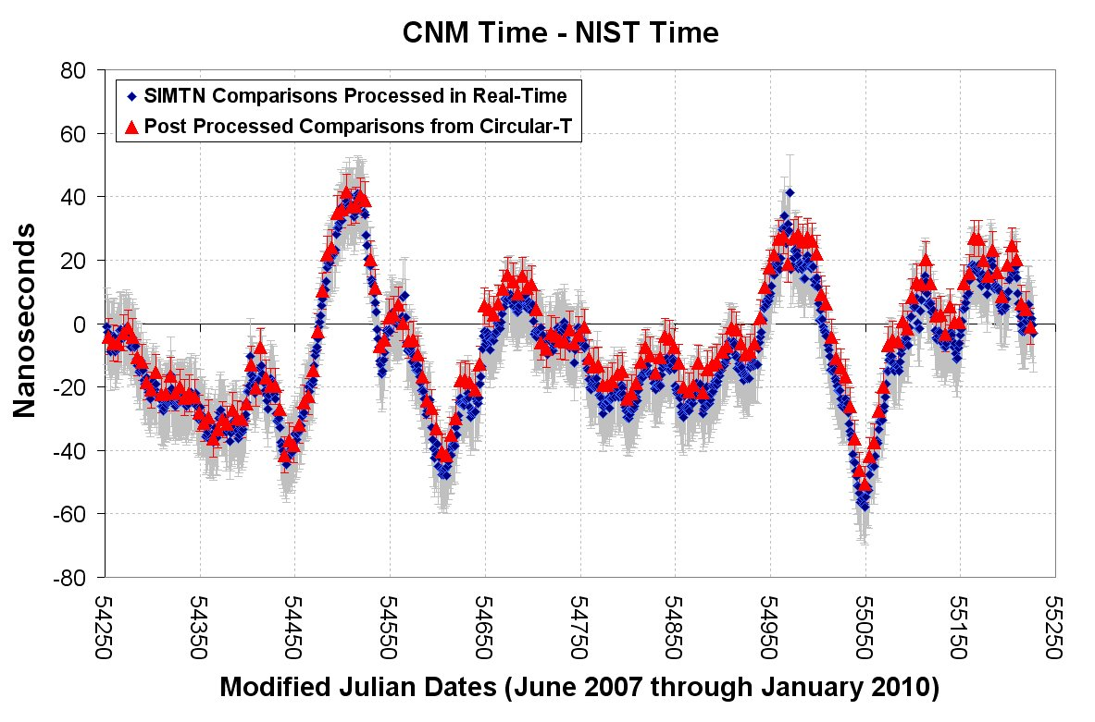

Slide 20
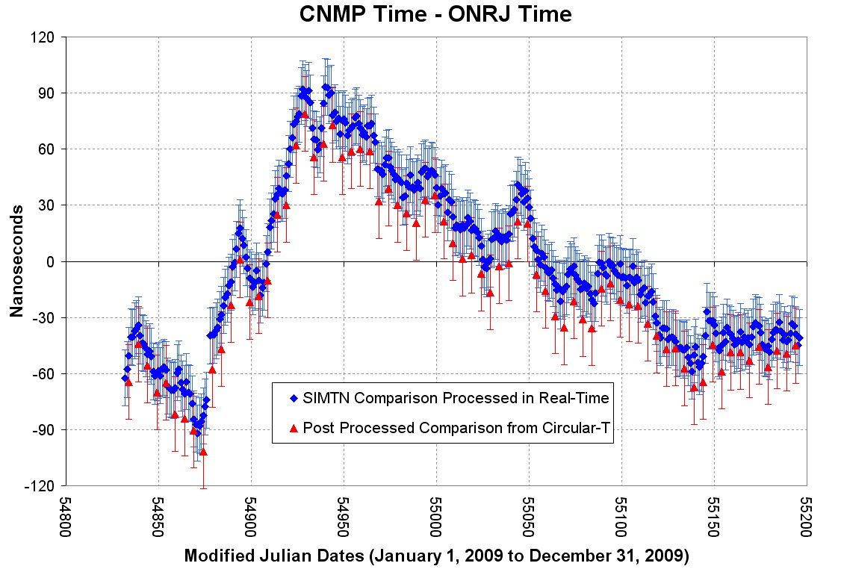

Slide 21
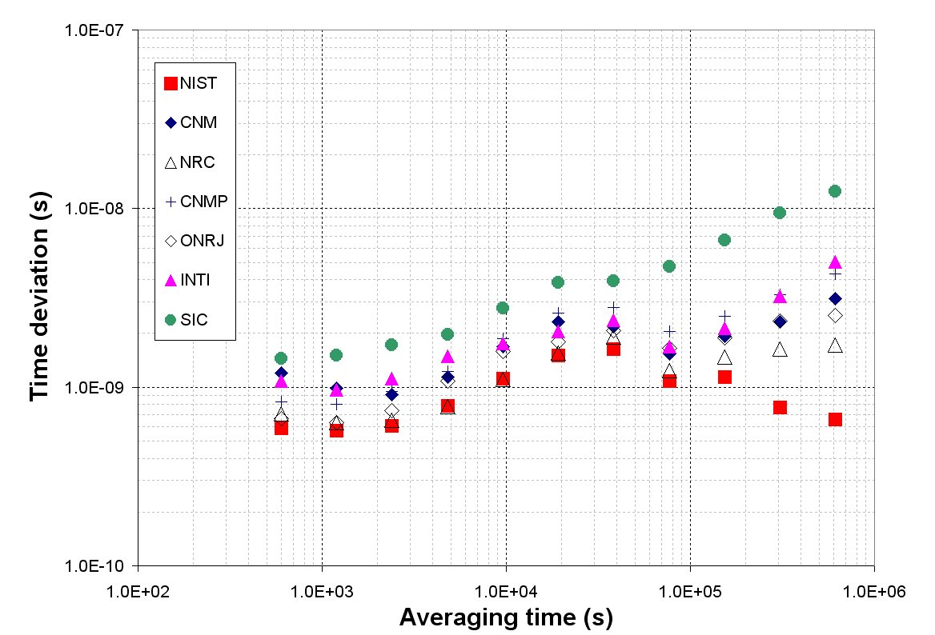
Time stability of SIM labs relative to GPS Time

Slide 22
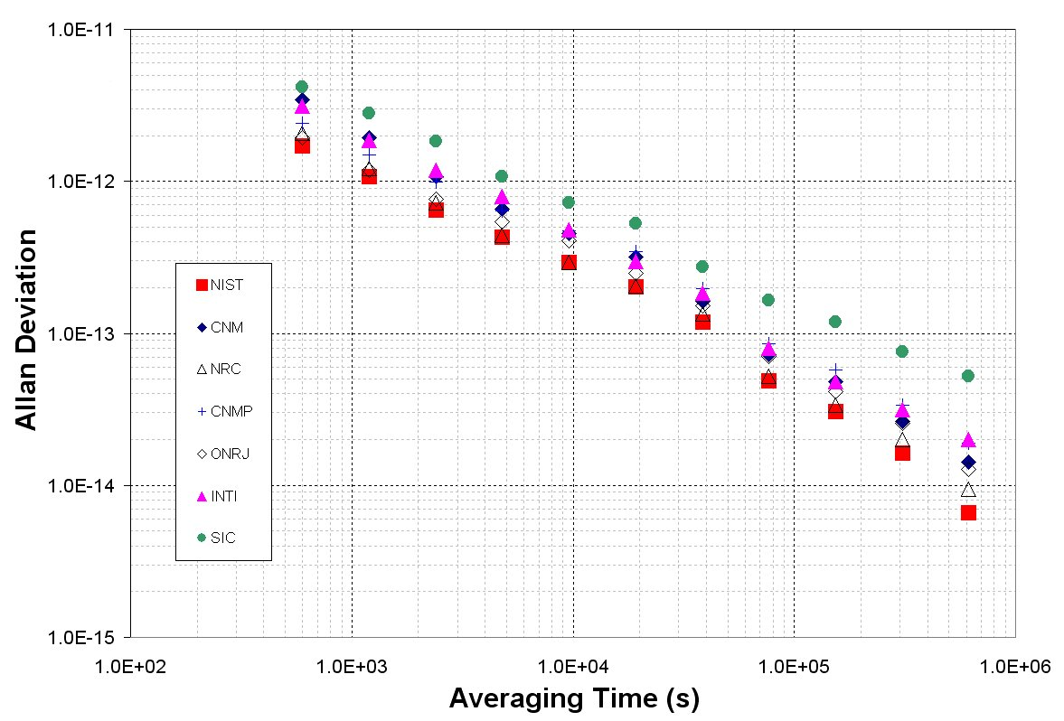
Frequency stability of SIM labs relative to GPS Time

Slide 23
Maximum Time Difference May to September 2012 (5 months) | NIST | CNM | NRC | CNMP | ONRJ | SIC | INTI
NIST |  | 31 | -96 | -48 | 51 | -137 | 82
CENAM | -31 |  | -97 | 72 | 49 | 134 | 74
NRC | 96 | 97 |  | 132 | 110 | 204 | 142
CENAMEP | 48 | -72 | -132 |  | 88 | 132 | 116
ONRJ | -51 | -49 | -110 | -88 |  | -142 | 78
SIC | 137 | -134 | -204 | -132 | 142 |  | 134
INTI | -82 | -74 | -142 | -116 | -78 | -134

Slide 24
Average Time Difference May to September 2012 (5 months) | NIST | CNM | NRC | CNMP | ONRJ | SIC | INTI
NIST |  | -6 | -49 | -21 | 3 | -26 | 16
CENAM | 6 |  | -43 | -14 | 10 | -18 | 26
NRC | 49 | 43 |  | 28 | 46 | 22 | 64
CENAMEP | 21 | 14 | -28 |  | 23 | -3 | 36
ONRJ | -3 | -10 | -46 | -23 |  | -24 | 13
SIC | 26 | 18 | -22 | 3 | 24 |  | 37
INTI | -16 | -26 | -64 | -36 | -13 | -37

Slide 25
Average Frequency Difference (× 10¹⁵) May to September 2012 (5 months) | NIST | CNM | NRC | CNMP | ONRJ | SIC | INTI
NIST |  | <1 | -8 | -3 | <1 | -16 | -2
CENAM | <1 |  | 8 | -3 | <1 | -16 | -2
NRC | -8 | -8 |  | -10 | -8 | -24 | -10
CENAMEP | 3 | 3 | 10 |  | 3 | -13 | <1
ONRJ | <1 | <1 | 8 | -3 |  | -16 | -2
SIC | 16 | 16 | 24 | 13 | 16 |  | 14
INTI | 2 | 2 | 10 | <1 | 2 | -14

Slide 26
Sources of Common-View Measurement Uncertainty

Slide 27
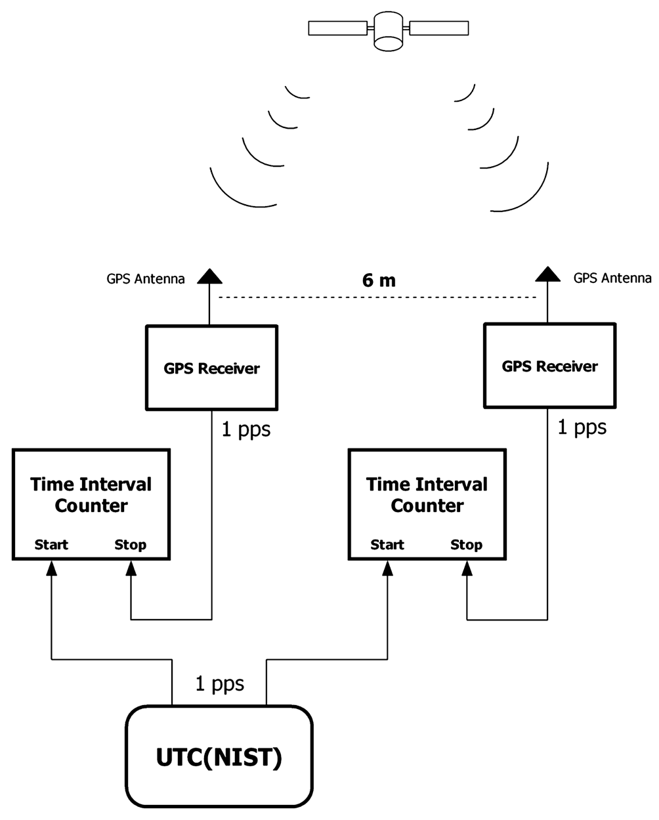
SIM Receiver Calibrations
SIM systems are calibrated at NIST prior to shipment. Calibrations are performed using the common-view, common-clock method. The SIM laboratory installs the same antenna cable and antenna that were used during the calibration.
Calibrations last for 10 days. The time deviation (Type A uncertainty) of the calibration is less than 0.2 ns after one day of averaging. The combined uncertainty is estimated at 4 ns, because a variety of factors can introduce a systematic offset.

Slide 29
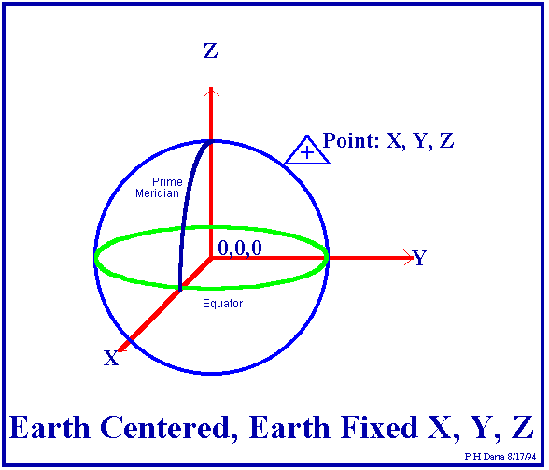
Uncertainty due to Antenna Coordinates
GPS computes dimensions in Earth-Centered, Earth-Fixed X, Y, and Z coordinates that the receiver converts to geodetic latitude, longitude, and elevation.
Coordinate errors translate to timing errors, typically about 2.2 nanoseconds per meter for a multi-channel receiver.
GPS does a good job of determining horizontal position (latitude/longitude)
  Most receivers can quickly survey latitude/longitude to within < 1 meter after several hours of averaging.
GPS does a poor job of determining vertical position (elevation)
  GPS provides distance from the center of the earth and then by using the radius of a model of the Earth’s surface, provides elevation. There is nearly always a bias in the elevation.
  A 10 meter altitude error (timing error of more than 20 nanoseconds) is not uncommon, even if the receiver averages position fixes for 24 hours

Slide 30
Average position error of repeated survey was 5.37 m, with nearly all of this error (5.30 m) in the vertical position

Slide 31
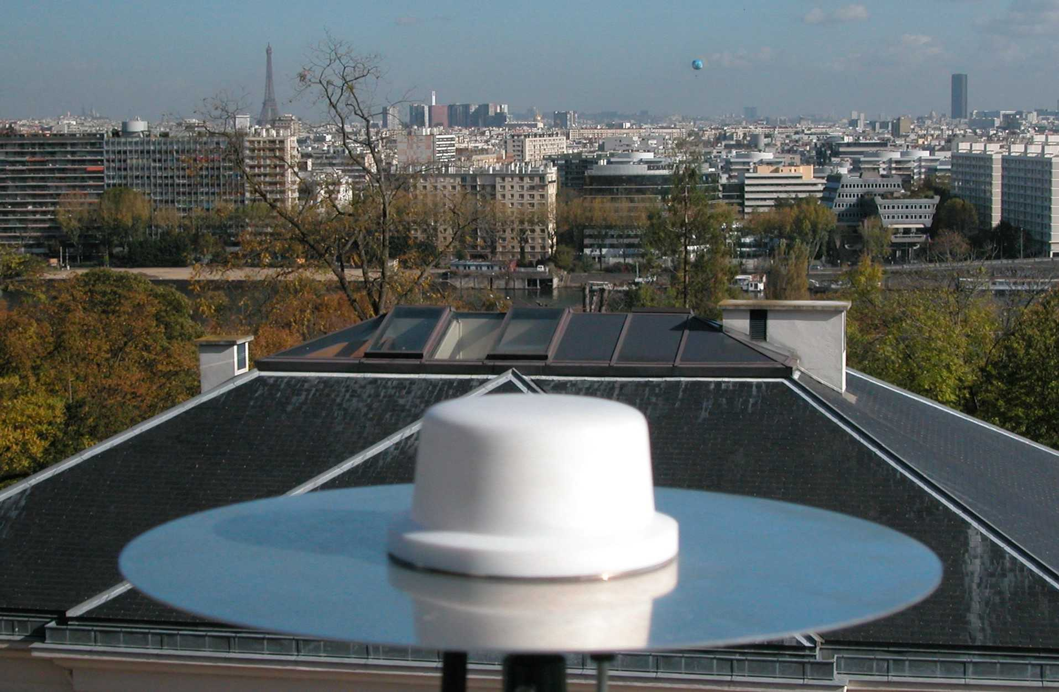
Uncertainty due to Environment
Receiver, antenna, and cable delays can change over the course of time, sometimes by as much as several nanoseconds. This is usually due to temperature.
Receivers often have the most sensitivity to temperature. The SIM receiver can move by several nanoseconds if there is a sudden change in laboratory temperature.
The SIM system uses a high quality antenna cable with a low temperature coefficient and delay changes due to temperature are much smaller than 1 ns, even in places like Boulder, Colorado where the temperature has a very wide range over the course of a year.

Slide 32
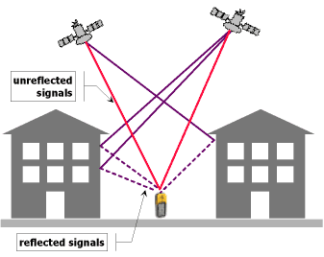
Uncertainty due to Multipath
Multipath is caused by GPS signals being reflected from surfaces near the antenna. These signals can then either interfere with, or be mistaken for, the signals that follow the straight line path from the satellite.
If the antenna has a clear, unobstructed view of the sky, the uncertainty due to multipath is usually very small (a few nanoseconds or less), but some uncertainty due to multipath is nearly impossible to avoid and detect.

Slide 33
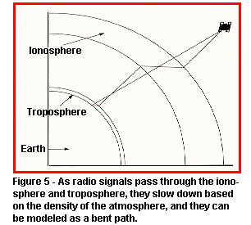
Uncertainty due to ionospheric conditions
The ionosphere is the part of the atmosphere extending from about 70 to 500 km above the earth.
When radio signals from the satellites pass through the ionosphere their path is bent slightly, changing the delay. The delay changes are largest for the satellites at low elevation angles.
GPS broadcasts a ionospheric correction, which is automatically applied by the SIM system. This reduces the effect by about 50%.
  These corrections are called modeled ionospheric corrections, or MDIO
For the very best results, the ionospheric conditions are measured at a receiving location on the ground by a dual-frequency GPS receiver (one that receives both L1 and L2). These measurements are used in place of the broadcast corrections. This improves the results.
  These corrections are called measured ionosphere corrections, or MSIO. They are not applied by the SIM system.

Slide 34
SIM Time Network Uncertainty Analysis
Uncertainty Component | Best Case | Worst Case | Typical
U_{A}, TDEV, τ = 1 d | 0.7 | 5 | 2
U_{B}, Calibration | 1 | 4 | 2
U_{B}, Coordinates | 1 | 25 | 3
U_{B}, Environment | 2.5 | 4 | 3
U_{B}, Multipath | 1.5 | 5 | 2
U_{B}, Ionosphere | 1 | 3.5 | 2
U_{B}, Ref. Delay | 0.5 | 2 | 1
U_{B}, Resolution | 0.05 | 0.05 | 0.05
U_{C}, k = 2 | 7.0 | 53.8 | 11.8
Uncertainties are expressed using a method complaint with the ISO GUM standard.
Combined standard uncertainty (k = 2) is usually < 15 nanoseconds for time, and usually < 1 × 10⁻¹³ for frequency after 1 day of averaging.

Slide 35
Joining the BIPM key comparisons and contributing to Coordinated Universal Time (UTC)

Slide 36
Steps required in order to appear on the BIPM Circular-T and contribute to UTC
You must have a cesium oscillator
You must have a CGGTTS compatible GPS receiver (SIM system is not compatible)
Your country must be a signatory of the CIPM MRA
You must contact the BIPM and provide information on the name/address of the laboratory, clocks (model, serial number), time transfer equipment in the laboratory, and any other relevant information. They will then assign an acronym and a code to your laboratory, and a code to each clock.
You must submit a data file once per week by FTP

Slide 37
Key Comparisons
Most NMIs contribute to the computation of International Atomic Time (TAI) and Coordinated Universal Time (UTC) using the all-in-view GPS method and the CGGTTS format*
Results are published monthly in the Circular-T document
PTB in Germany is the pivot laboratory
Coordinated by the BIPM (Bureau International des Poids et Mesures located near Paris, France)
About 70 laboratories participate
* Consultative GPS and GLONASS Time Transfer Sub-committee

Slide 38
Multi-channel Common-view Track Schedule
Starting at 0:00 (UTC) on the reference date (October 1, 1997), the 24 hours of a day are divided into 90 16-minute intervals.
The first 89 intervals are used for common-view. Start time of each 16-minute interval is shifted 4 minutes earlier everyday. The 90th interval is reserved for handling the 4-minute start time update.
The 13-minute common-view measurement starts 2 minutes after the beginning of the 16-minute interval.
The multi-channel common-view track schedule contains the single channel common-view track schedule as a subset.
lock up
measurement
data processing
2
13
1
90
1
2
3
4
89
1
2
t
0:00
0:16
0:32
0:48
1:04
23:28
23:44
23:56
0:12
0:28
Day 1
Day 2

Slide 39
The CGGTTS Common-view Data Format
GPS RCVR: NBS10
V9809
MJD= 51658 YR=00 MONTH=04 DAY=24 HMS=14:47:20 (UT)
GGTTS GPS DATA FORMAT VERSION = 01
REV DATE = 2000-04-03
RCVR = NBS10....................
CH = 01
IMS = 99999
LAB = NIST
X = -1288398.27 m
Y = -4721698.10 m
Z = +4078625.68 m
FRAME = ITRF....
COMMENTS = NO COMMENTS..............
INT DLY = 53.0 ns
CAB DLY = 0199.9 ns
REF DLY = 0066.7 ns
REF = UTCNIST
CKSUM = 74
PRN CL MJD STTIME TRKL ELV AZTH REFSV SRSV REFGPS SRGPS DSG IOE MDTR SMDT MDIO SMDI CK
hhmmss s .1dg .1dg .1ns .1ps/s .1ns .1ps/s .1ns .1ns.1ps/s.1ns.1ps/s
3 08 51655 105800 780 380 760 -1058301 -1131 -571 -1098 415 163 107 +2 76 +0 02
8 32 51655 111400 780 319 2933 -7071115 -3061 -246 -3082 290 074 125 -20 85 -9 34
13 28 51655 113000 780 415 3083 +6965884 -30 -94 -241 625 019 100 -12 71 -7 FB
3 74 51655 114600 780 296 530 -1058331 +929 -503 +962 470 163 133 +19 92 +24 17
31 08 51655 121800 780 498 706 -7572 -400 -197 -390 470 180 87 +4 99 +14 DD
13 32 51655 123400 780 569 2693 +6966345 +171 -440 -40 424 011 79 +0 90 +9 F0
18 68 51655 125000 780 279 1829 -341335 +18 -132 +22 698 182 141 +35 152 +44 16
31 74 51655 132200 780 283 472 -7436 +2669 -73 +2678 441 206 139 +29 190 +36 24

Slide 40
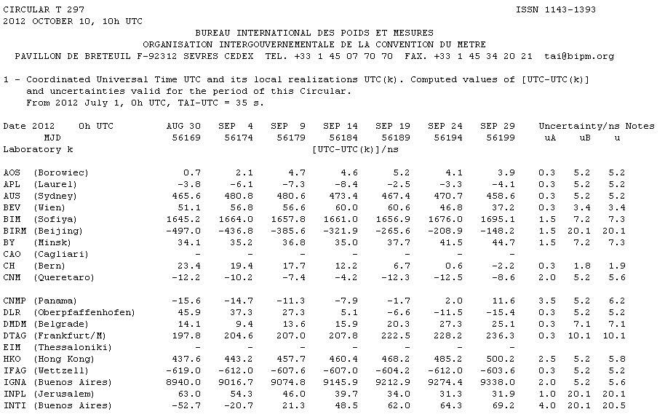
BIPM Circular T (www.bipm.org)
Published monthly, it contains the results of the BIPM key comparisons
Six labs in the SIM network have their standards listed on the Circular-T (Argentina, Brazil, Canada, Mexico, Panama, United States).
The Circular-T numbers are post processed and published two to seven weeks after the measurements.
New “Rapid” UTC (UTCr) document is published every week.

Slide 41
BIPM-Compatible Time Transfer Receivers
  There are a few dual frequency (GPS L1 and L2) receivers that you can buy. They have less noise than the L1 only receivers like the one found in the SIM system. However, the cost is high, usually between $15,000 and $40,000 USD.
  AOS TTS-3 and TTS-4 (dual frequency)
  Dicom GTR50 (dual frequency)
  Novatel (dual frequency)
  PolaRx2eTR (dual frequency)

Slide 42
New Low-Cost CGGTTS Receiver will be available through SIM TFMWG
A new CGGTTS receiver will be made available through the SIM TFMWG.
  The currently available receivers cost between $15,000 and $40,000 USD, but are dual frequency.
  This low-cost receiver is a L1 band only device (12 channels)
  It will cost about $10,000 USD (and perhaps be covered by OAS donations).
  It is compatible with both UTC and Rapid UTC requirements, and like the SIM system, automatically uploads data.
  A beta unit is now operating well at INTI in Argentina.

Slide 43
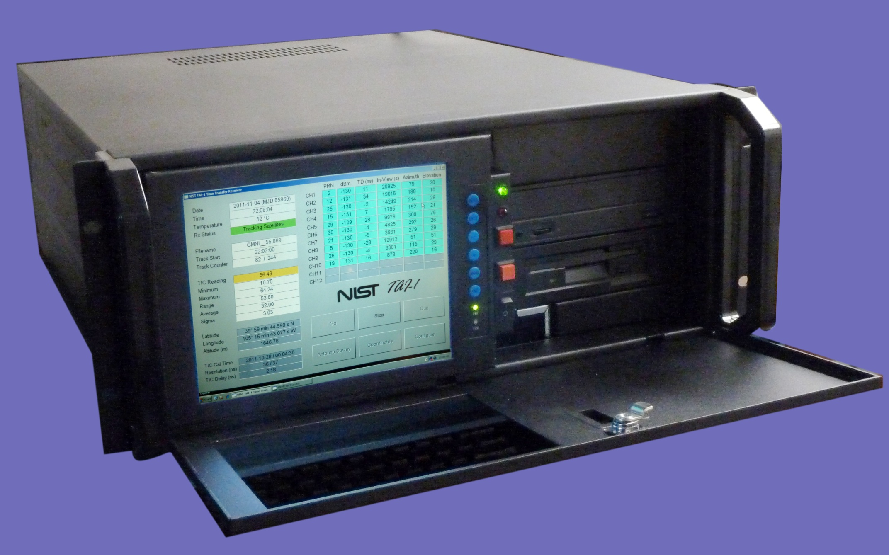

Slide 44
Category | Parameter | Specification
GPS receiver | Receiver frequency | 1575.42 MHz (L1 band)
 | Number of channels | 12
 | Receiver board | i-Lotus M12M Timing Oncore or Navsync CW12-TIM
 | Receiver interface | RS-232, 9600 baud
 | Timing output | 1 pulse per second
 | Antenna | Novatel GPS-701-GG
 | Antenna cable | Times Microwave LMR-400
GPS Software | Control software | NIST TAI-1 software
 | File Format | CGGTTS multi-channel GPS
 | Tropospheric model | NATO STANAG 4294
 | Ionospheric model | Klobuchar
Time Interval Counter | Manufacturer | NIST or Brilliant Instruments
 | Time base | External, 5 or 10 MHz
 | Single shot resolution | < 50 ps
Computer | Microprocessor | Intel Pentium III or Intel Atom
 | Operating System | Microsoft Windows XP Pro or Windows 7
 | Architecture | Single Board computer, passive backplane, ISA and PCI slots
Chassis | Manufacturer | Synergy Global or Trimap
 | Display size | 8.4” or 10” LCD
 | Display resolution | 1024 × 768

