Slide 1
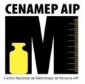
CMCs and the BIPM Key Comparison Database
Raul Fernando Solís Betancur
rsolis@cenamep.org.pa
2012

Slide 2
Convention of the Metre
Signed on 20 May of 1875 (every May 20th we celebrate World Metrology Day).
Creation of a reference system based in physical phenomena.
Actually this reference system is based in 7 base units and nearly 30 derived units.

Slide 3
Convention of the Metre
Diplomatic Treaty
The Metre Convention
General Conference on Weights and Measures CGPM
Member States and Associate States
Consultative Committees
CCAUV: Consultative Committee for Acoustics, Ultrasound and Vibration CCEM: Consultative Committee for Electricity and Magnetism CCL: Consultative Committee for Length CCM: Consultative Committee for Mass and Related Quantities CCPR: Consultative Committee for Photometry and Radiometry CCQM: Consultative Committee for Amount of Substance - Metrology in Chemistry CCRI: Consultative Committee for Ionizing Radiation CCT: Consultative Committee for Thermometry CCTF: Consultative Committee for Time and Frequency CCU: Consultative Committee for Units
International Committee for Weights and Measures
CIPM
MRA
National Metrology Institutes
International Bureau of Weights and Measures
BIPM

Slide 4
Bureau International des Poids et Mesures
Bureau International des Poids et Mesures
International organization that resides in Paris.
Keeps and coordinate the international metrology activities (like comparisons, the units, the measurement capabilities, etc.) in the world.
The Time Department that coordinates UTC is an example of this.

Slide 5
KCDB
The BIPM key comparison database.
Containing Appendices A, B, C and D of the CIPM MRA.
Appendix A: Participants in the CIPM MRA.
Appendix B: Key and supplementary comparisons.
Appendix C: Calibration and Measurement Capabilities – CMCs.
Appendix D: List of key comparisons.

Slide 6
Comparison
They are the best way to show the traceability and the level of your measurement skill.
You need to participate in at least one comparison to validate your capability.
When you participate in a registered comparison, the result are published in the Appendix B.
The comparison can be key, regional or bilateral.

Slide 7
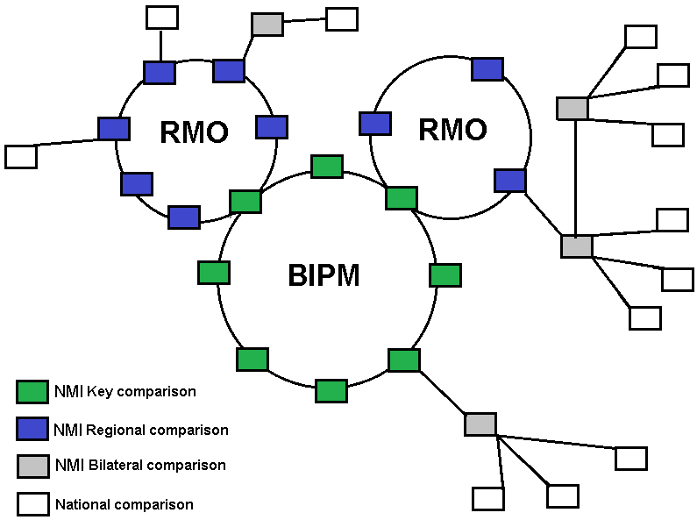
Comparison

Slide 8
Comparison
Key comparison: Comparison between NMIs with the highest level of skills in the measurement or the unit realization.
Regional comparison: Comparison between NMIs in a RMO when one or more of the participants is in a key comparison.
Bilateral comparison: comparison between a NMI with a Key or regional comparison and another NMI.

Slide 9
Comparison
In the T&F area, the key comparison is running since 1977. Is the UTC (coded CCTF-K001.UTC).
Only laboratories with T&F standards like Cesium (commercial or primary), Hydrogen maser, or another laboratory prototype can contribute.
The results are published monthly in the Circular T.

Slide 10
Calibration and Measurement Capability
The BIPM has a list of measurement and calibration capabilities for 9 metrology areas.
Every NMI that has signed the MRA and can provide enough evidence of their measurement skills in these areas can register their capabilities in the Appendix C.

Slide 11
Calibration and Measurement Capability
The CMC expires every five years. After that, an NMI needs to perform the same exercises to maintain the CMC.
If you had a CMC, you can update his values to better or worse. All of this depends upon what has recently happened in your laboratory (for example if your only standard is broken, you can’t support your uncertainties and your traceability, but if you acquire a better one you can improve your calibration uncertainties).

Slide 12
Calibration and Measurement Capability
For the declaration of your CMC you need:
To be a part of an MRA
A peer review in the service that you want to publish (it is better if the peer review is from another NMI with a CMC or a good reputation in the metrology area)
Fulfill the quality assessment under ISO 17025.

Slide 13
Calibration and Measurement Capability
For the declaration of your CMC you need:
The approval of your Quality System (QS) from SIM.
The approval of your capabilities from all other RMOs.
Incorporation in the Appendix C.

Slide 14
Classification of services in Time and Frequency
In the T&F metrology area, the measurement capabilities are divided in three branch (version 1.0 of December 2002):
Time scale difference: synchronization with UTC or UTC(k).
Frequency: frequency difference.
Time interval: duration of events.

Slide 15
Branch: 1 Time scale difference
1.1. Local clock
1.1.1. Local clock vs. UTC(NMI)
1.1.2. Local clock vs. UTC
1.2. Remote clocks
1.2.1. Remote clock vs. UTC(NMI)
1.2.2. Remote clock vs. UTC

Slide 16
Branch: 2 Frequency
2.1. Standard frequency source
2.1.1. Local frequency standard
2.1.2. Remote frequency standard
2.2. General frequency source
2.2.1. General frequency source
2.3. Frequency meter
2.3.1. Frequency counter
2.3.2. Frequency meter

Slide 17
Branch: 3 Time interval
3.1. Period source
3.1.1. Period source
3.2 Time Interval source
3.2.1. Rise/fall time source
3.2.2. Pulse width source
3.2.3. Time difference source
3.2.4. Delay source

Slide 18
Branch: 3 Time interval
3.3. Period meter
3.3.1. Period meter
3.4 Time Interval meter
3.4.1. Rise/fall time meter
3.4.2. Pulse width meter
3.4.3. Time difference meter
3.4.4. Delay meter

Slide 19
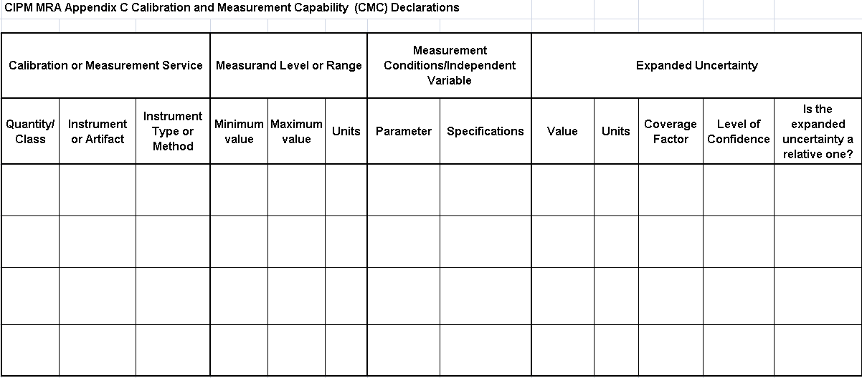
CMC sheet

Slide 20
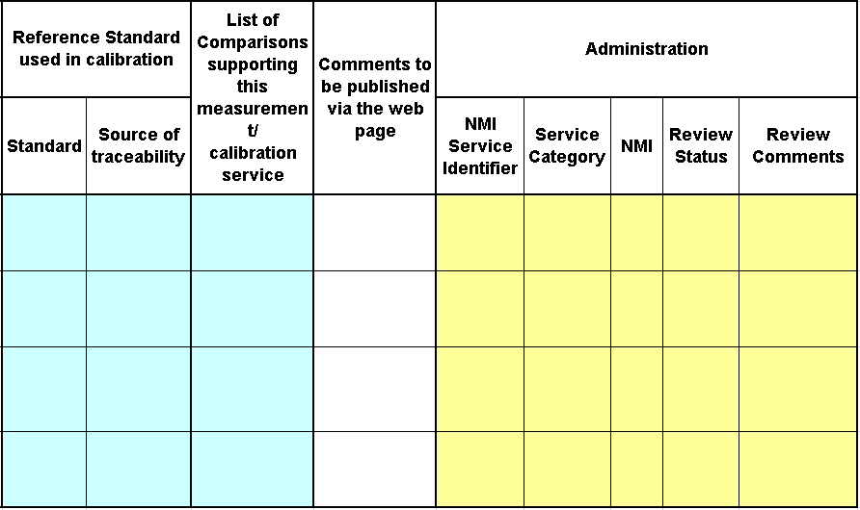
CMC sheet

Slide 21
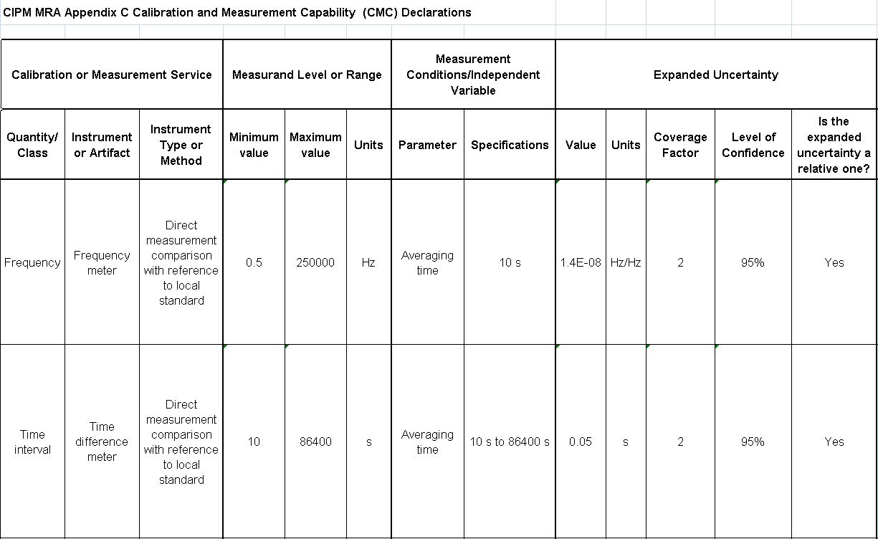
CMC sheet

Slide 22
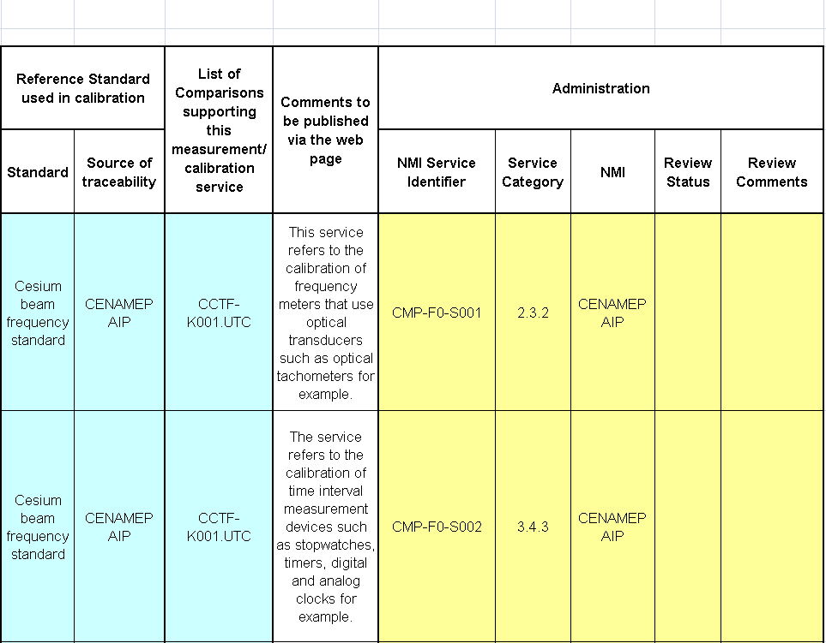
CMC sheet

Slide 23
The road to the CMC
Develop the calibration service and estimate his uncertainty (and gain a lot of experience, you will need it!).
Fulfill the implementation of the ISO 17025 in your calibration service (not only your laboratory, the Quality System and the Administration department of your NMI, too).
Fill out the CMC sheet and report the process from your traceability chain to the calibration result (with stated uncertainties). This report may contain the list of equipment and the calculations used to reach your level of uncertainty.

Slide 24
The road to the CMC
Perform a Peer Review with a another NMI. Their findings are valuable information of how you can improve your skills.
You need to fix all the nonconformities or other types of findings. You need to present enough evidence so you do this in front of the Quality System Task Force (QSTF).

Slide 25
The road to the CMC
Update the CMC sheet and the report with the new information.
Present the evaluation results to the QSTF of the SIM and wait to see if your NMI and laboratory quality system are approved for publication in the CMCs.

Slide 26
The road to the KCDB-CMC
The chairman of the T&F area will summit the CMC for review to the other members of the SIM. When that review is complete, the CMC is submitted to the other RMOs.
You will probably receive questions from other laboratories in other RMOs. You must answer their questions as clearly as possible to clear their doubts. If you can’t clear their doubts, you maybe need to update your CMC sheet with new values.
When all of the other RMOs grant their approval, the document is sent to the BIPM.

Slide 27
The road to the KCDB-CMC
The BIPM verifies that your quality system and the technical document are approved.
Congratulations! You had your CMC registered in the appendix C. You now need to update your CMC every 5 years (quantity of calibrations, improvement, changes in your lab, etc.).
You need to remember that you can spend nearly 2 years to complete the new CMC process!

Slide 28
Discussion
In the SIM region only 5 laboratories had CMC registered in the KCDB. The SIM need more.
You can start with a low level capability calibration services (U_{95%}= 0.05 s or 1E-08 Hz/Hz) like stopwatches, frequency meters or optical tachometers (a rubidium oscillator is enough for this).

Slide 29
Discussion
The SIMTFN must be used to create a SIM registered comparison like the Circular T.
What is the individual need of the NMI to register his CMC in the KCDB?.
In a small NMI, having a CMC can increase the national and international confidence in the laboratory.

Slide 30
Discussion
This is another way to show the importance of participate in projects like the SIMTFN and participate in meetings like the T&F workshop.
When you increase your metrological status this will allow you to obtain funds from your government, the private sector, or other organizations.

Slide 31
Thanks!

