Slide 1
Time and Frequency Laboratory current status
INTN - Paraguay
Ing. Raúl Aristides González Paredes
rgonzalez@intn.gov.py
Queretaro, 2012.

Slide 2
Organization Chart
Director INTN
ONM
Termoeléctrica
Masa
Mecanica
- Electricidad
- Temperatura
- T y F

Slide 3
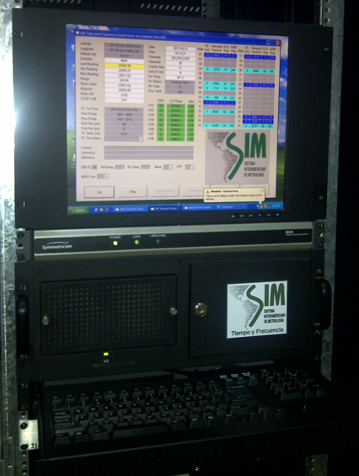
TIME AND FREQUENCY LABORATORY EQUIPMENT

Slide 4
Development of T y F Laboratory
2008
Rubidium Clock Donation from the SIM
2009
Start up operate Rubidium’s clock automatically discipline to agree with SIM
2010 - 2011
Stop-watches Comparision with Panamá, Brazil, Uruguay, Paraguay, Peru, Argentina y Colombia
2012
Time dissemination service (Web-clock)

Slide 5
Services
Basic Functions
Mantain and disseminate the legal time in Paraguay
Support other metrology areas of INTN
Calibrations for meassurement instruments of time. (Stop-watches)

Slide 6
Laboratory Staff
Raúl González. Electronic Engineer. Since September 2012
Ricardo Ramirez. Electromecanic Engeneer. Since Julio 2012
Cesar Agüero. Technical. Since 2008

Slide 7
Thank you!
Gracias!
Aguijé!

