Slide 1
INSTITUTO BOLIVIANO DE METROLOGÍA
2012 SIM TFWG Workshop Meeting
QUERETARO – MÉXICO
Franklin David Espejo Alcázar
October - 2012
Notes:
Presentación realizada el 7 de julio de 2010, sala de reuniones DMIC - IBMETRO

Slide 2
Scientific and Industry Metrology
Legal Metrology
Accreditation

Slide 3
Laboratories
Mass
Temperature and Humidity
Flow
Pressure
Force
Volume and Density
Length
Time and Frequency (new)
Acoustic (sound level meter) (new)
Electricity (new)
Chemistry
pH
Gas chromatography

Slide 4
Time and Frecuency Laboratory
This is a new project
We had received the Time and Frequency's SIM system around August.
We are working in the building to put on the system.

Slide 5
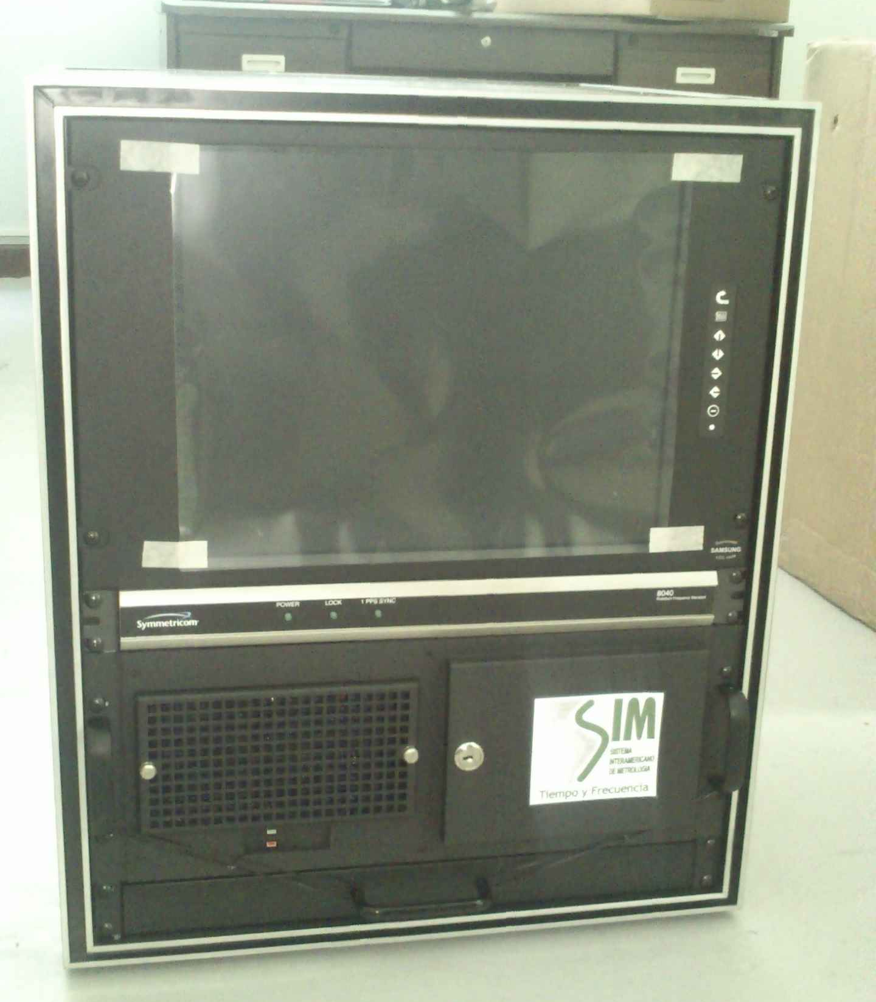
Time and Frecuency Laboratory

Slide 6
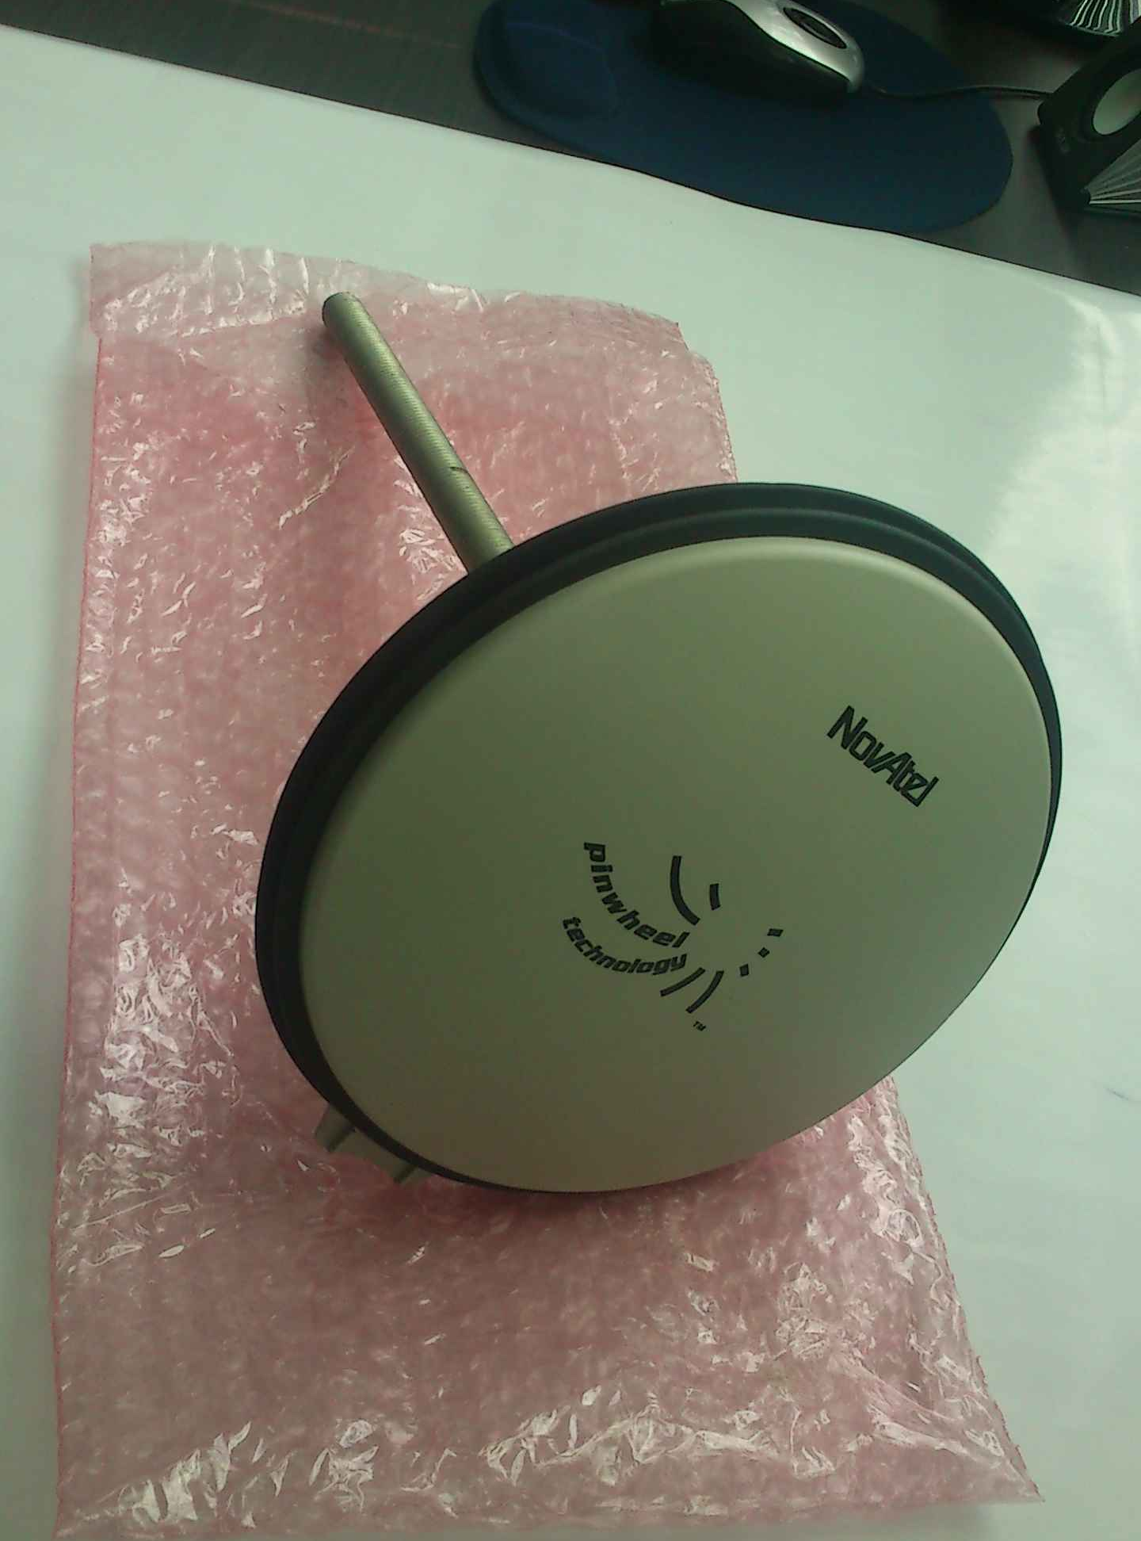
Time and Frecuency Laboratory

Slide 7
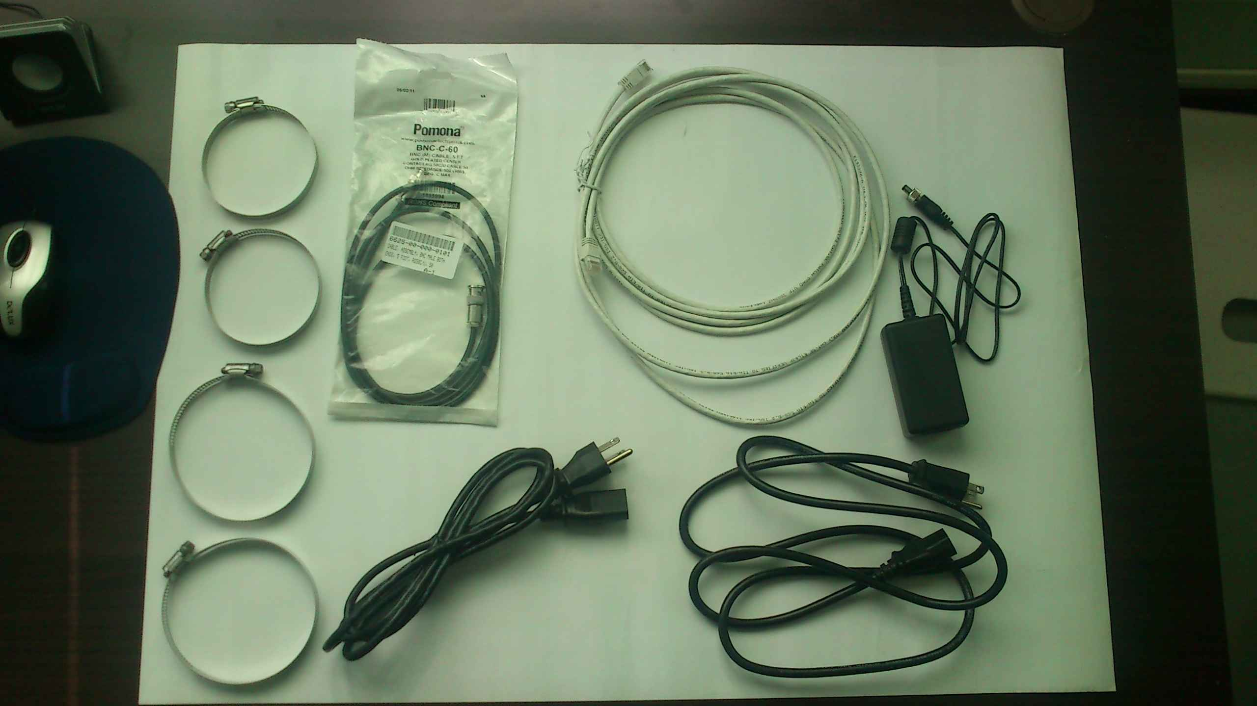
Time and Frecuency Laboratory

Slide 8
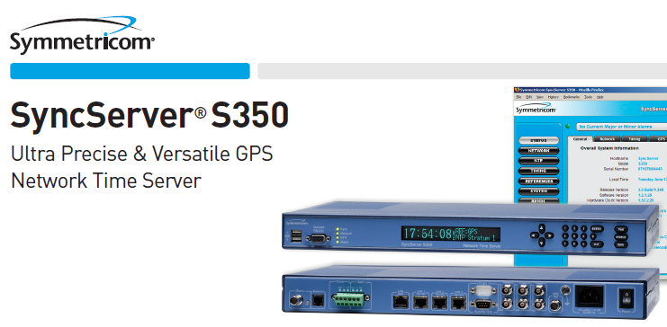
Time and Frecuency Laboratory

Slide 9
Time and Frecuency Laboratory
I will work with the Time and Frequency CENAM’s team, in a internship for about one month
We would want to turn on the system on December
At the first time we will disseminate the time by our web page, after that we want to disseminate with a NTP server.
We are thinking to buy the S250 or S350 SYMMETRICON NTP Server.

Slide 10
THANK YOU
FRANKLIN ESPEJO ALCAZAR
IBMETRO
fespejo@ibmetro.gob.bo
La Paz - Bolivia

