Slide 1
CENAMEP AIP: Time and Frequency Laboratory current status
Raul Fernando Solis Betancur
rsolis@cenameporg.pa
Queretaro, 2012.

Slide 2
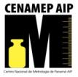
Development of the Laboratory
2002 - April: Acquisition of the two Cesium clocks.
2003 - October: Starting of the report to the BIPM and the beginning of the UTC(CNMP).
2005 - December: Incorporation to the common view system started by NORAMED.
2006 - August: First CMC included in the BIPM database.

Slide 3
Development of the Laboratory
From 2007 to 2009: Time dissemination services (Voice, Web Clock and NTP).
2009 - February: Declaration of the Time and Frequency National Standards based in the atomics clocks of the CENAMEP.
2009 - December: Implementation of the phase measurement system for the local comparison.
2010 - February: Beginning of the monthly report to the BIPM about local comparison.

Slide 4
Development of the Laboratory
2010 - June: Declaration of the UTC(CNMP) as the Official Time of the governmental institutions.
2011 - March: New UTC(CNMP) based in the master clock and the Phase and Frequency Offset Generator.
2011 - October: New CMC included in the BIPM database.
2012 - January: Participation in the pilot project called rapid UTC, the UTCr.

Slide 5
Laboratory Staff
Raul F. Solis B. Electronic Engineer. Since May 2006.
Luis M. Mojica O. Electronic Engineer. Since May 2008.
Actually two metrologists are working in the Time and Frequency Metrology and the Radiofrequency and Microwave Metrology.

Slide 6
Quality assessments conducted
Michael Lombardi – NIST (July 2005 and July 2011).
Dr. Jean Simon Boulanger – NRC (September 2005).
Dr. José Mauricio López – CENAM (October 2007 and November 2008).
Dr. Ricardo José de Carvalho – ONRJ (August 2010).

Slide 7
Time and Frequency Laboratory
Actually is separated in three laboratories (only his quality system) meanwhile the new building is constructed (2014):
Primary Laboratory.
Secondary Laboratory.
Dissemination Laboratory.

Slide 8
Primary Laboratory
Objectives:
Maintenance of the National Time and Frequency Standards.
Provide traceability through UTC(CNMP).
Development of new methods or system to improve the UTC(CNMP).
Provision of the T&F metrology.
Support other metrology areas of CENAMEP.

Slide 9
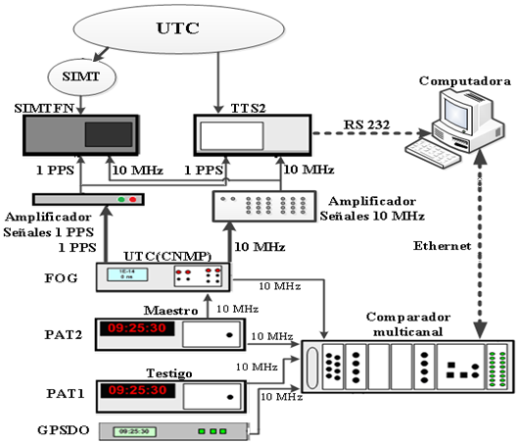
Structure

Slide 10
Reference system
Two low performance Cesium clocks.
DC batteries, UPS and power generator (backup for 3 days)
TTS-2 and SIMTFN System.
Phase and Frequency Offset Generator with the master clock for UTC and SIMT local realization.

Slide 11
Comparison and traceability
UTC (Circular T CCTF-K001.UTC since October 2003). World key comparison.
SIMTFN (and the SIMT) since December 2005. Regional comparison.
Phase measurement system since December 2009. Local comparison.

Slide 12
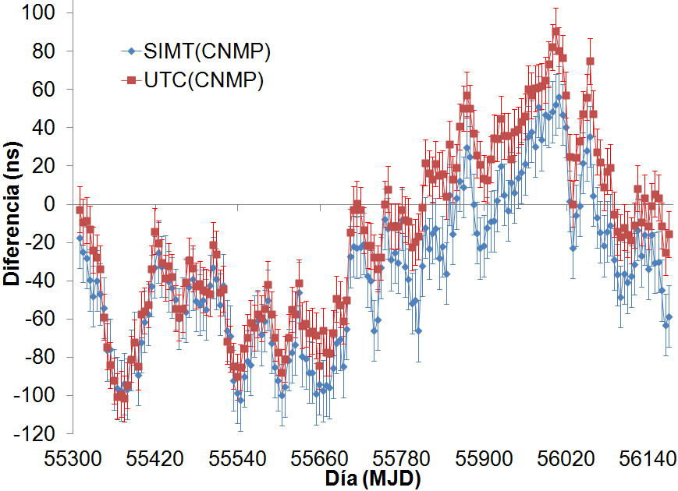
UTC(CNMP) and SIMT(CNMP)
Data since 2010/04/23 to 2012/07/31.

Slide 13
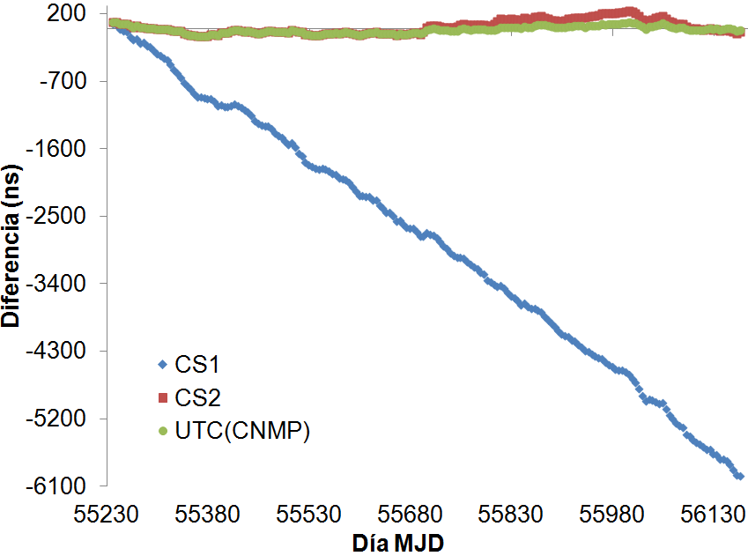
Local comparison
Data since 2010/02/3 to 2012/08/30.

Slide 14
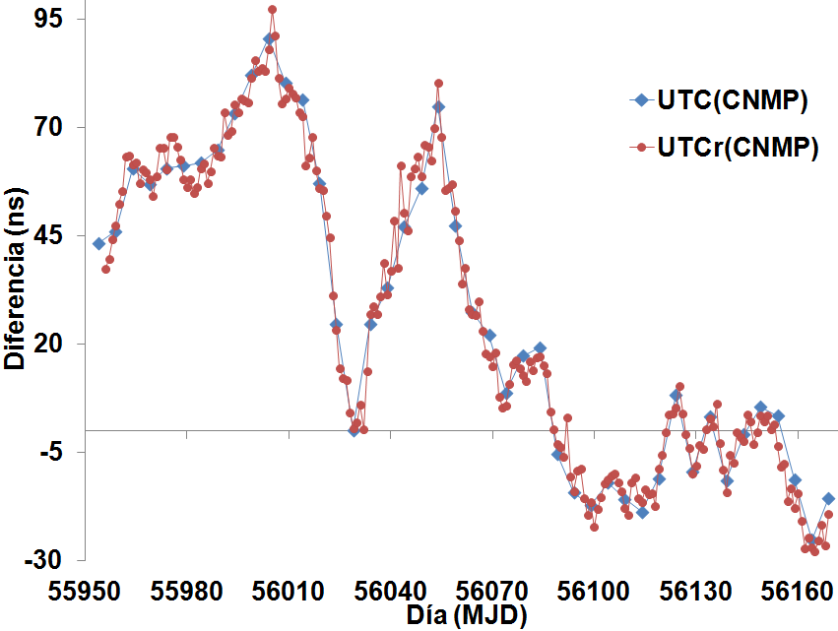
UTC(CNMP) and UTCr(CNMP)
Data since 2012/01/30 to 2012/08/30.

Slide 15
Secondary Laboratory
Objectives:
Provide calibration in T&F services with traceability under the ISO 17025.
Development of new calibration method (seeking to low the calibration costs)
Training and knowledge calibration transfer.
Increase the income of the laboratory.

Slide 16
Equipment
Two universal counters.
Time and Frequency Processing Card.
Two optical tachometer.
Two signal generators.
One oscilloscope.
Auxiliary equipment (environmental sensors, signal mixers and LP filters).
PC with software for the process automation.

Slide 17
Calibration services acknowledge
Included CMC in the Time and Frequency area:
MIT: Time interval meters (2006).
MFAO: Optical coupling frequency meters (2006).
OSC: Oscillators (2011).
SSF: Signal Frequency Synthesizer (2011).
CF: Frequency counters (2011).
In 2011, the original first CMC were evaluated for his vitality.

Slide 18
Calibration services acknowledge
Services accredited in 2007:
MIT: Time interval meters.
MFAO: Optical coupling frequency meters.
MFAM: Mechanical coupling frequency meters
GFR: rotation frequency generators.
Funding cuts and bureaucratic problems caused the suspension of the evaluation in 2012. For this reason we lost the accreditation.

Slide 19
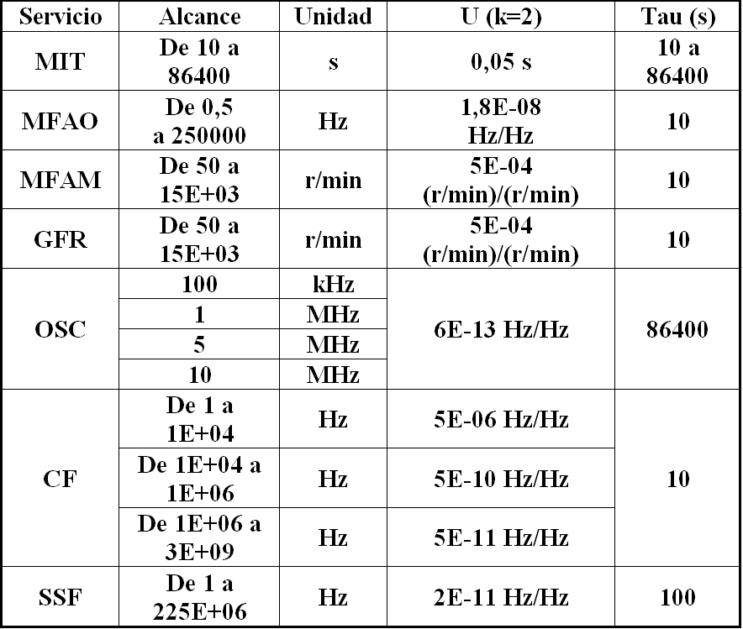
Measurement capabilities

Slide 20
Knowledge transfer
The laboratory transfer his knowledge with courses and trainings:
Clinical centrifuges, optical and mechanical tachometers calibrations.
Introduction to the time and frequency metrology.
Introduction to the measurement uncertainty estimation (GUM).

Slide 21
Dissemination Laboratory
Objectives:
Dissemination of the UTC(CNMP) in the time magnitude.
Development
Increase the income of the laboratory.

Slide 22
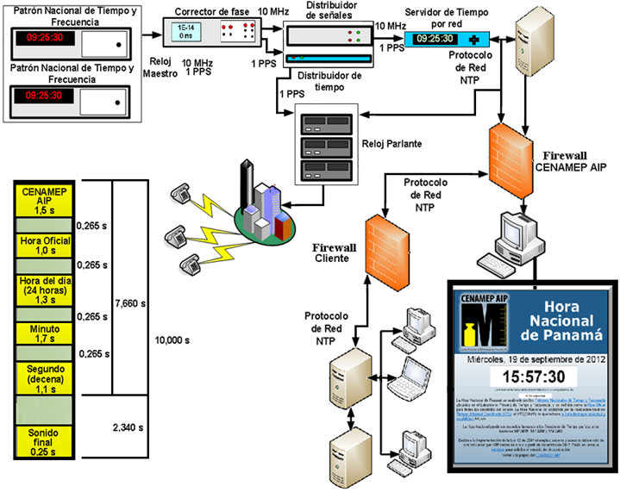
Structure

Slide 23
Equipment
Two NTP server synchronized to the 1 PPS with a 10 MHz signal for backup.
One Web server synchronized with the NTP server.
Three time server by voice synchronized with the NTP server and the 1 PPS from the UTC(CNMP).

Slide 24
Web Clock
http://horaexacta.cenamep.org.pa/
Near of 640 000 visits since 2007 to December 2011.
18,5% of the user not use Java.
5713 visits were from smart phones.
The countries with more visits (in order of visits): Colombia, Canada, United States, Spain, Venezuela and Mexico.

Slide 25
Time by Voice
Analog access calling: (+507) 517-3201, 517-3202 and 517-3203.
Three systems were developed by the CENAM based in a own project.
The system is a desktop pc, a software program that control the sound files and the time, a NTP client program and the 1PPS signal to keep running the hour
Near of 5400 callings since March 2009 to December 2011.

Slide 26
Network synchronization
NTP synchronization.
35 (government and private) institutions use the service.
Near of 7,4 millions of synchronization request each 5 minutes (since 2009 to December 2011).
Financial companies, governmental organism and logistic companies generated the major of the request.

Slide 27
Laboratory weakness
Only 2 cesium clocks (10 years).
TTS-2 had 10 years of continued working. The TTS-2 is discontinued.
Physical space and electrical capabilities are limited.
The accreditations of the past review services were loss.
Only 2 people to 5 laboratories limit the time for investigation and development of new methods, standards and improvements.

Slide 28
Future works
Fully automation of the report process to the BIPM (monthly and weekly files).
With the new cesium clock (maybe the arrival is in December or January) we need to update the software to ensure the comparison of the three clocks and their traceability.
The CENAMEP Time Scale.
Remote calibration of clocks and oscillators.

Slide 29
Future works
New time and frequency dissemination services to the electrical and telecommunication companies.
A new national law about the Official Time for Panama (the actual law only cover the government institutions).

Slide 30
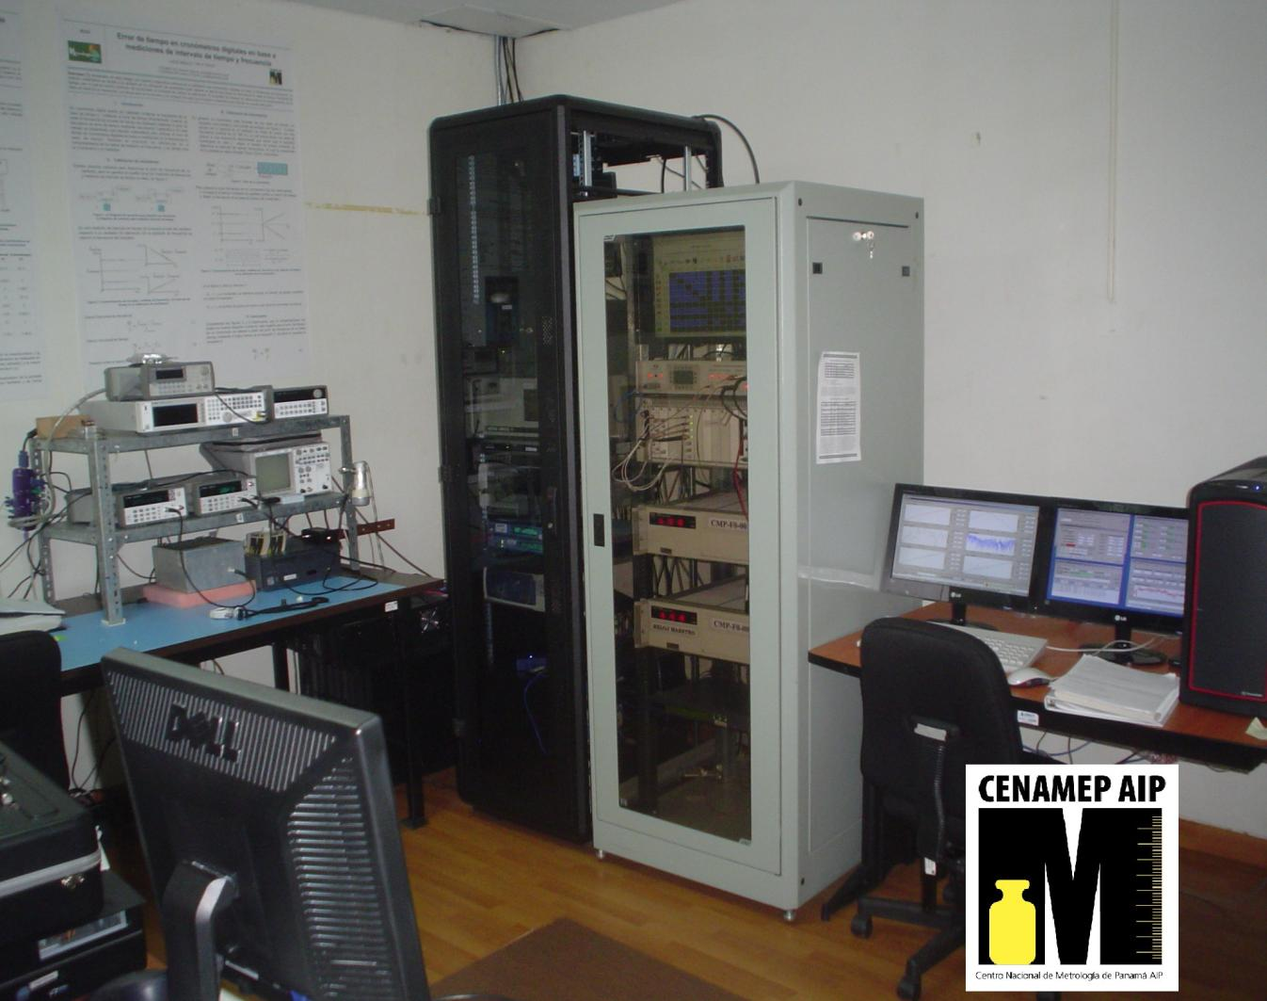
¡Thanks!

