Slide 1
ANTIGUA & BARBUDA sim REPORT
TFWG Workshop & Planning Meeting, Querétaro, Mexico, October 15 – 17, 2012
by
Alan Michael
Standardization Officer
Antigua and Barbuda Bureau of Standards

Slide 2
contents
Antigua & Barbuda – Basic Info
Antigua & Barbuda Bureau of Standards
A & B Time & Frequency Metrology Status

Slide 3
ANTIGUA & Barbuda – Basic info
Antigua & Barbuda

Slide 4
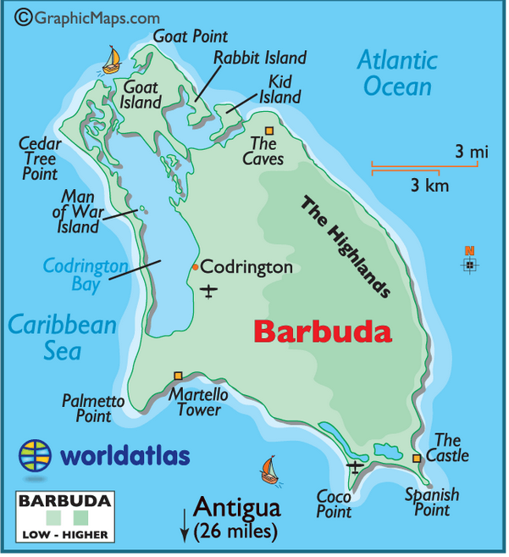
ANTIGUA & Barbuda – Basic info
279.72 sq km (108 sq miles)
160.58 sq km (62 sq miles)

Slide 5
Antigua & barbuda – basic info
Population – 86,295 (2011 census)
Official Language – English
Exports –
petroleum products 48%,
manufactures 23%,
machinery and transport equipment 17%,
food and live animals 4%,
other 8%
Industries – Tourism, Construction, Alcohol, others
GDP – EC$ 1.187 Billion (US$ 0.44 Billion)

Slide 6
365 beaches to choose from

Slide 7
365 beaches to choose from

Slide 8
365 beaches to choose from

Slide 9
A & b bureau of standards
Antigua and Barbuda Bureau of Standards (ABBS) :
Established – Standards Act (1987) Cap. 411
Purpose –
To prepare and promulgate standards in relation to goods, services, processes and practices.
Provide a broad base of technical, advisory and monitoring services for retailers, manufactures and service providers.
National Metrology Institute

Slide 10
A & b bureau of standards
Membership in –
Caribbean Regional Organisation for Standards and Quality (CROSQ)
Codex Alimentarius (WHO/FAO)Commission
Inter-American Metrology System (SIM)
Subscriber Member of the International Organization for Standardization (ISO)
Affiliate Member of the International Electrotechnical Commission (IEC).
National Inquiry Point for WTO TBT Agreement

Slide 11
A & b bureau of standards
Metrology
Metrology Act – 2007 (passed 2008)
Regulations pending
Equipment available (mainly for Legal Metrology) but no Labs
2 x staff (Bureau 9 total)
Participating in SIM Time & Frequency Network January 12, 2012
Metrication Programme re-launched October 2011

Slide 12
Antigua & barbuda – T & F metrology status
Equipment donated by SIM – September, 2011
Installed January, 2012
Antigua Computer Technologies Internet Co-location Centre (due pending re-location of ABBS) – Computer/Telecomms/Internet Provider
Administered remotely via Microsoft Remote Desktop & Teamviewer Software
No Services offered currently

Slide 13
Antigua & barbuda – T & F metrology status
Issues/Problems: 1 to date
No Measurement uploads to SIM Servers June 02 – 15, 2012 (advised by NIST)
Uploads manually restarted (via remote control). Unsure of cause.
Milestones
Installation of Software to steer Rubidium Standard to SIMT automatically by NIST (July 13, 2012)
Manual steering no longer required & working well

Slide 14
Antigua & barbuda – T & F metrology status
Challenges–
Awareness – Business / Industry / Government / Public
Finance to develop services
Human Resource availability and competence
Future Plans –
Training, Develop Awareness Programmes, Establish and Distribute National Time, Develop & Offer T & F Calibration & other services.

Slide 15
Thank you for your attention!

